Slide 1
Helping Non-Project Managers to Deliver Success
Rhian Davies • Nikki Stuart
Notes:
<Rhian>
Thanks for coming along to our presentation this morning on helping non project managers to deliver success
We’ll try to leave time for questions at then end but we’re more than happy to stay around afterwards to share experiences
Before we get started let us introduce ourselves

Slide 2
Rhian Davies
Deputy Head of Project Services
Portfolio Manager
Delivering projects and business change for 15+ years
rhian.davies@ed.ac.uk
Notes:
<Rhian>
I am the Deputy Head of Project Services at the University of Edinburgh.
I am also a portfolio manager, responsible for delivery of IT change projects for our Corporate Services Group.
I have been involved in project delivery for over 15 years, firstly with State Street Bank and then with the University for the last 11 years.

Slide 3
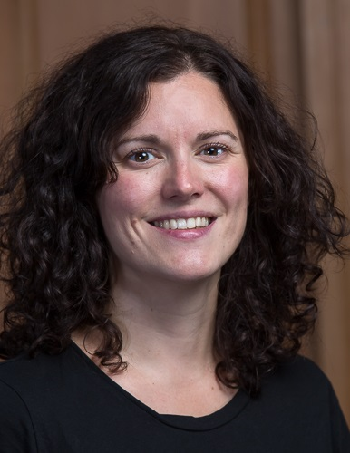
Nikki Stuart
Senior Project and Programme Manager
Delivering projects and business change for 10+ years
nikki.stuart@ed.ac.uk
Notes:
<Nikki>
I am a Senior Project and Programme Manager within Project Services, also at the University of Edinburgh
I am a programme manager with responsible for delivery of IT change projects for our Payroll & Pensions and Procurement departments
I have over 10 years experience working with projects, 8 of those at the University and prior to that I worked in project support and business change roles with the Scottish land registry.

Slide 4
35,000+ students
22 Schools
3 Colleges
13,000+ staff
$450M research
Influencing the world since 1583
Notes:
<Rhian>
We would to like share a brief overview of our University with you.
We are based in Edinburgh, in Scotland in the UK.
Edinburgh is beautiful city and we are lucky to have some beautiful buildings at the University
This is Old College at the heart of the University.
The University was founded in 1583 and is the sixth oldest University in the English speaking world.
We are consistently ranked in the top 50 universities in the world.
We have more than 35,000 students, about two thirds are undergraduate.
We have 22 schools split across 3 colleges.
We have over 13,000 staff – includes academic, administration, research
Research is very important to the University with in the region of $450M funding each year

Slide 5
Who are Project Services?
25 people
Business analysts
Project/programme/portfolio managers
Part of Information Services
5 people spend some of their time supporting non project managers – equivalent to 1-2 FTE
Notes:
<Rhian>
Nikki and I are part of Project Services, which is a project management office within the Information Services Group
We have 25 people involved in project delivery in a variety of roles
5 of us spend some of our time supporting non project managers – it is equivalent to 1 or 2 people doing it full time, depending on demand.

Slide 6
EDUCAUSE 2014 Poster Session
Notes:
<Rhian>
We shared some of things we have done to support non Project Managers at EDUCAUSE last year in a poster and we had some great discussions with people who stopped by our stand.
There was some real enthusiasm for the topic so we thought it would be good to do a conference session this year.
We have brought some copies of our poster which are on some of the seats and also down the front if you would like a copy.

Slide 7
Who are our non Project Managers?
Researcher
Student
Administration
IT
Academic
Notes:
<Rhian>
You might be wondering by now what we mean by non project manager!
Most projects in the University do not have the luxury of having a dedicated project manager, and are frequently not even considered projects.
This includes research, studies, changes to processes, systems, office moves
We have identified 5 particular groups pictured here
Researchers
Students – who can use project management techniques to help them deliver class projects and their thesis. Some of our University courses include classes on project management and the students enjoy hearing about theory is put in to practice.
Administration – here covers all staff who support the research and academic business of the university, including course administrators, business functions like HR and finance and student record administration.
IT – we have a large IT community out with our PMOs remit who deliver change in key areas, such as leaning technology and infrastructure.
Academics – which for us are often involved in research

Slide 8
How have we helped non Project Managers Deliver Success?
Training
Tools
Support
Notes:
<Rhian>
This is a really diverse group of people, who have different needs and don’t even necessarily recognise that they are working on projects.
We felt that we could use our project management knowledge and experience to develop resources which could help them focus on their areas of expertise.
We wanted to find ways to do this but we knew that we couldn’t find a one size fits all approach which would suit all our non project managers.
We looked at three key areas;
Firstly training, Nikki will talk about how we have created and delivered a range of training options.
I will then talk about our tools. We developed a simple methodology and a projects website to aid collaboration on projects.
Nikki will then cover some of the typical support activities we undertake.
As we go through we will share stories from people that we have helped and some of the lessons that we have learned.

Slide 9
Training
Training
Notes:
<Nikki>
As Rhian said, the first theme we would like to discuss is training

Slide 10
Our starting point in 2010
No project management training available within the University
Had to attend external courses
High cost
Travel time/cost
No University context
Certification not needed or wanted!
Could see a demand that wasn’t being met
Notes:
<Nikki>
Back in 2010 we recognised that there were a wide range of projects taking place within the University on an ongoing basis with many of the participants having little or no formal training or experience.
Where training was undertaken, it had to take place externally with suppliers who were unlikely to have knowledge of the University environment and the particular challenges this can bring.
Often the external training was lengthy and certified, such as Prince2, and for our non project managers this was mostly not needed or wanted.
We could see an opportunity for us to share our knowledge and experiences and reduce the cost of training to the University.

Slide 11
What did we do?
Established advisory group
Agreed requirements for course
Worked with an experienced trainer to develop materials
Started with one trainer, one session per semester
Now have five trainers and at least seven sessions per semester
1000+ trained
Notes:
<Nikki>
So what did we do;
We did a little bit of research to see what demand there would be for an in house developed training course. We had a group of staff indicate interest in attending training and many of those also volunteered to assist with the development of the course and associated materials.
This support was really invaluable and this advisory group helped to make sure that we developed a course which met the needs of our non project managers.
One of the volunteers was an experienced trainer. They helped us to create effective training materials and sat in on the pilot courses to provide feedback.
In 2010 the PMO had one trainer delivering one full day workshop per semester. Quickly demand increased for our training and it became clear that we needed to expand and adapt. We now have 5 trainers and deliver at least 7 full day workshops each semester along with our on request training that I’ll go on to cover.
In 2015 we reached a significant milestone of training over 1000 people!

Slide 12
What do we do?
Workshops
Bitesize
Seminars
Student lectures
Notes:
<Nikki>
Our aim is to deliver practical training – we want attendees with different levels of needs to be able to take something away at the end of the day. As Rhian says we realised that one size doesn’t fit all so we offer a range of training……
Our core and most popular offering are our full day Workshops. These are instructor led with interactive group exercises. Our initial courses were open to any member of University staff but we were soon approached by our Researcher Development programme and the Institute responsible for running career development for PhD students. They asked us to run separate courses for these groups. At the time they both outsourced project management training delivered at a high cost by an external trainer. Whilst we were very passionate about helping the University community, we did not have the capacity to meet this additional demand so they agreed to cover our costs.
In addition to the workshops we also run seminars on demand for individual departments. These courses make use of the standard training materials and we can tailor them to meet a particular need. Sometimes it can include hands-on use of the Projects website where a team is using it to collaborate on projects. We’ll talk more on this tool shortly.
Continuing to adapt to different needs we offer Bitesize sessions which focus on each of the key areas from the full day workshop. These are 4 x 1 hour sessions that are held over the lunch period. We've found that these are particularly helpful to those that find it hard to commit to a full day or those that simply want a refresher for a specific topic.
We deliver lectures to different groups of undergraduate students. For one lecture we aim to put theory into practice for students who have studied project management and for another we cover the principles to help them with their course project.
So that’s what we do….

Slide 13
How has it helped?
Because I can now demonstrate a good understanding of project management I feel confident that I will secure funding for my research project
Researcher
Notes:
<Nikki>
I’d now like to share a few stories with you, the first relates to a Senior Research Fellow who attended the full day course for research staff.
She was an experienced researcher who had been involved in research projects for a number of years. However, she had failed to secure a research grant when she had been unable to articulate her project management controls during a conference call in the late stages of the bidding process.
Discussions with other researchers on the day really emphasised the importance that funding bodies are placing on project management as an indicator for likely project success and to identify sound investments.
Feedback from her following the course was that she now felt comfortable that, given the same situation, she would be able to provide the funders with the confidence that she had appropriate project management controls in place.

Slide 14
How has it helped?
I used the basic project management techniques to successfully plan my thesis
Student
Notes:
<Nikki>
Our next training story is about an undergraduate student who attended a lecture on basic project management principles to help with a class project.
We later heard some lovely feedback from his lecturer that he had transferred his learning and applied the techniques that we had discussed in the lecture to plan and complete his thesis.
Feedback from other student sessions has highlighted that they’ve enjoyed hearing about how theory is put in to practice.

Slide 15
How has it helped?
I’m now seeing IT staff confident enough to report risks and take ownership
IT
Notes:
<Nikki>
Our final training story relates to a risk seminar that we provided for a team of software developers. Their team manager was managing a number of projects and felt that doing some risk training would help identify potential issues earlier in projects.
The IT manager has fed back that he now feels more in control of his projects and that the team now feel empowered to identify and raise risks to projects and most importantly take ownership of actions and monitor risks.

Slide 16
Why the PMO?
We understand the University context
We are available for post course support
We promote a standard approach
We encourage use of University tools
We share experiences as practising PMs
Raises the profile of PMO
Notes:
<Nikki>
Whilst lots of people might agree that there is a need for project management training, we feel there are a number of benefits from the PMO providing this ;
We understand the University context​ and the challenges that projects in such a large disparate institution can encounter.
External trainers are costly and are unlikely to be available for post training support. We encourage attendees to contact the PMO for any project related advice whether a quick question or more in-depth support.
Rhian will come on to cover our simple methodology in a few minutes, but using this as the basis for our training promotes a standard approach which can be particularly beneficial where staff are involved in multiple projects across different areas.
During the training we make use of our projects website to demonstrate project documents and logs in practice. We often find people are unaware of what tools are available to staff and students across the University which could benefit the work they do so this is a great opportunity to communicate what collaborative or project tools are available.
We share experiences as practicing Project Managers​ and we can respond to the many questions we are asked during the training with how best to apply the techniques rather than simply covering the theory.
Delivery of the training has allowed the PMO to reach a much wider group on Non-Project Managers than we would have been able to through provision of our tools and support alone. This has raised the profile of the PMO across the University and enabled us to influence the wider community.
On a personal note - delivering the training has widened my own professional network and has given me the opportunity to come and do things like this.

Slide 17
Lessons Learned: Training
Ask people what they want
Keep it as simple - avoid jargon
Get advice on creating & delivering training
Different people, different needs
Make sure you can commit
Notes:
<Nikki>
Moving on to some lessons learned;
We wanted to be credible source of support for the university and didn’t want to be seen as just an IT group telling people what to do. Asking people what they wanted at the beginning meant that we got buy-in from our non project managers and started with a pool of eager attendees.
Keep it simple and remember that not every one has the same background. We work on the principle that we need to cover the basics first and explain terminology so that it doesn’t get dismissed as jargon. To begin with we used IT examples, as we are IT project managers, but over time we’ve really scaled this back and found examples more suitable for the different audiences and which they are more likely to relate to.
As mentioned previously we are project managers not trainers. We were confident in the content that needed to be covered but advice on creating and delivering the training from an experienced trained was really beneficial in making sure the pace of the course and the materials were pitched correctly.
Our experienced trainer who helped us gave us lots of practical advice and told us that not everyone has the skills to be a trainer. On that basis we have gradually built up a pool of trainers who provide a good mix of project management knowledge and experience and who also have the qualities needed to train. For example we are really passionate about what we do and find this really helps engage attendees particularly on some of the drier areas of project management.
If we had only offered one training option we would not have trained a 1000 people. By understanding the different needs we’ve been able to create a range of training varying in length, complexity and audience, for example our one day workshop v’s the bitesize sessions.
Probably our most important lessons is don’t underestimate the demand and effort required to maintain a training programme. In the early days we aimed to do more than we could and in the short term had to scale back. Over time we’ve been able to expand our training team as areas that were previously paying for more costly external training cover our costs. Our advice would be to start small and once the training is established consider if you can expand. As with projects you don’t want to be setting expectations you cant meet.

Slide 18
Tools
Notes:
<Rhian>
We have two tools we would like to share with you today.

Slide 19
What tools do we provide?
Simple Methodology
Projects Website
Notes:
<Rhian>
Our simple methodology and our projects website.
Back when we started to develop training for our non project managers we realised that out tools were very focussed on IT projects, primarily software development and infrastructure change.
This was quite intimidating for someone looking for an easy way to manage their projects.

Slide 20
Simple methodology
Monitoring and Control
Risks Issues Communication
Initiate
Plan
Execute
Close
Benefits
Objectives
Scope
Stakeholders
Tasks
Milestones
Do it
Check it
Release it
Benefit Realisation
Lessons Learned
Notes:
<Rhian>
We created a simple methodology on the basis that all projects go through the same lifecycle.
We created a project brief to capture key info such as why the project was taking place and when it needs to be done by.
We create a completion report to reflect on whether benefits can be realised and to encourage lessons learned.
We created logs to manage risk and issues.
People can create their own documents or use our projects website.

Slide 21
Projects Website
One location for projects
Create space for your project online
Easy on-line editing
Simple methodology
Standard language
Not just for the project manager
Content can be shared across the world
Notes:
<Rhian>
As we became more engaged with out non project manager community we realised the they could benefit from access to a collaborative project tool.
We were redesigning our projects website at the time and took their needs in to consideration.
We made sure that it was easy to edit online, without the need for training or specialist tools.
We based it on the simple method and gave users the ability to customise.
We wanted the site to be easy to use to promote wider involvement with projects, encouraging project teams to use the site to collaborate within and outside the university.

Slide 22
Why did we build our own tool?
We wanted a tool which could be used by any member of staff or student
Didn’t want licence costs/restrictions!
There was nothing in the market which met our requirements
We wanted to use our approach, not one dictated by the tool
Notes:
<Rhian>
We thought about whether we should build the website or if there was a suitable product in the market that would meet our needs.
There are many project management software tools available but we felt that these were more focused on aspects such as resource and time management and less focused on providing a collaborative space.
They also had significant costs and we didn’t want ongoing cost to become a barrier for either us or our non project managers.
We also had an established project approach and none of the tools available at the time were able to provide the functionality that we needed.

Slide 23
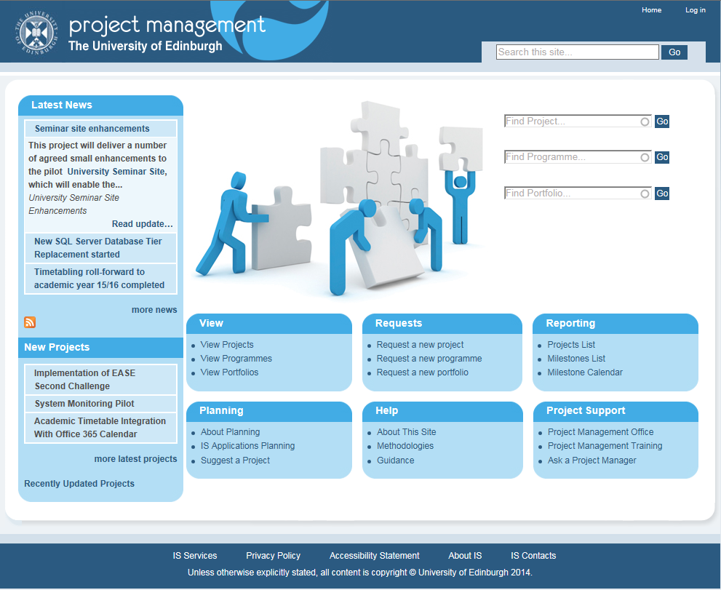
Projects Website – www.projects.ed.ac.uk
Notes:
<Rhian>
This is the front page – it has project news and links to new projects for people who are interested in what’s happening.
You can easily find projects, programmes and portfolios.

Slide 24
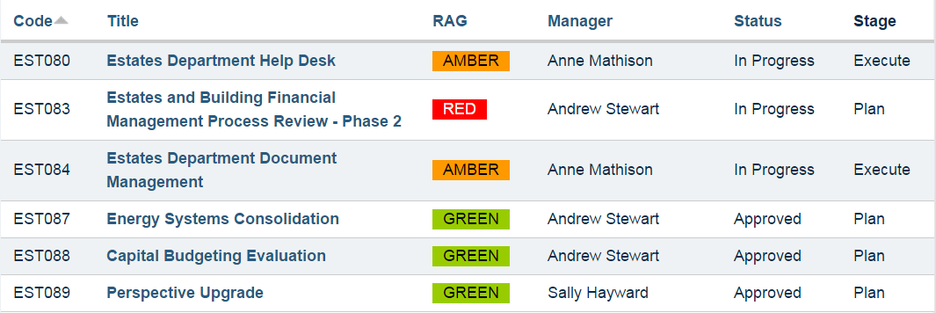
Collaborating using the Projects Website
Notes:
<Rhian>
The programme feature is really good for collaborating.
You can set up collections of projects as programmes
This screen shows a programme of projects for Estates and Buildings.
It provides one place to view summary information on the project and see it’s red, amber or green status.
If you want more information you can drill down on any project.
This has proved popular with areas working together on projects.

Slide 25
How has it helped?
Using the Projects Website has given me visibility of all the projects within my research unit
Researcher
Notes:
<Rhian>
A cancer researcher came along to one of our project management training courses and saw us using the Projects Website.
She had been looking for a way of tracking all the projects in the unit as they were having problems sharing information which was leading to having duplicate information in different places.
After attending our training she thought the Projects Website might just be the solution!
She asked us to come along and present to the research team and we showed them how they could easily share information using the projects website with an agreed group of people.
We showed them how they could use the site to get visibility and track projects.
We helped them get started and two years later they are still successfully using the website.

Slide 26
How has it helped?
Using the Projects Website within our division has kept us on track, ensuring that project work gets the focus it needs
IT
Notes:
<Rhian>
We were approached by a group of learning technologists who were managing projects and finding it difficult to make progress.
They didn’t feel they had any visibility of what anyone was doing.
They struggled to know what information they needed to capture.
We gave them an introduction to the Projects Website and they created project spaces for each of their projects and grouped them together as a programme.
They created project briefs.
They were then able to properly update progress and give their management team the visibility they needed.
This immediately gave them structure, and a common approach.

Slide 27
Lessons Learned: Tools
Ask the community what they need
Keep tools simple – content and access
Make self help easy to find…and helpful
Different projects have different needs
Make sure you can commit
Notes:
<Rhian>
Ask the community what they need
We asked people what they would want from a projects website
They said it should be easy to edit, easy to see the status of projects and easy to view recent updates
We incorporated each of these key points when developing the website.
Keep tools simple – content and access
We got engagement from our non project manager community by creating templates which focus on what's needed
We felt it was better that less experienced projects managers did something rather than nothing
Make self help easy to find…and helpful
From experience we knew that if people cant understand how to use something they can give up
We have tried to make the projects website easy to navigate without needing to ask, but if required online self help is provided.
Different projects have different needs
As mentioned, we have lots of different projects so we have developed tools which can be used for any project
The simple methodology can be the basis for managing a small or a large complex project
And the projects website allows for either the basic initiation and closure documentation to be used or more technical documentation to be added if required.
Make sure you can commit
There is an ongoing theme around commitment
Make sure that you have considered the number of non project managers that may use your tools and whether you can commit to supporting use of the tools

Slide 28
Support
Notes:
<Nikki>
Our final theme is support

Slide 29
What do we do?
Advice
Recruitment
Online Help
Governance
Career Guidance
Review
Mentoring
Tools
Co-locate
Notes:
<Nikki>
I’m sure many of you are familiar with the support that PMOs offer and for the most part much of the support we offer our non project managers is not different. We offer a broad range of support to our non project managers and I’d like to pick up on just a few areas today;
Rhian’s already touched on our project tools and online help, but to expand, on the projects website we have guidance for the techniques that support the simple methodology, such as estimation, risk management and stakeholder engagement. We also have guidance in each of our templates so that users who are not as familiar with the documentation can help themselves.
We have a range of activities that we offer to support recruitment of project related roles in other departments, we have assisted with creation of job descriptions, been members of recruitment panel or reviewed job adverts and job specifications
We’ve helped individuals across the university better understand how they either start or progress a career in a project related role. Our 25 PMs have come from varied backgrounds, many of us have been the accidental PM!
Individual requests for career advice have also led to members of our team taking on mentoring roles.
Governance, we’ve supported departments in establishing their own governance and programme or portfolio structures
The final point I want to talk about is that we have now had 3 of our team collocate on a part time basis to directly support departments establishing their own project processes and structures. This has provided us with an excellent opportunity to have sight of and influence business rather than IT projects.

Slide 30
How has it helped?
A dedicated support role has been beneficial to our project delivery and has given us the foundations to build on
Administration
Notes:
<Nikki>
Our first support story relates to a co-location scenario…..
One of our team collocated within human resources on a 0.5FTE basis. Although we work with HR to deliver their IT projects they were in the process of an ambitious programme of change that was out with our normal remit.
They were experiencing challenges with projects either not completing or not being implemented due to lack of available resources.
In addition their stakeholders across the university had different understandings of what each project would deliver.
We provided general project management training to the key HR staff with project related roles and introduced them to the projects website. They now use the projects website, simple methodology and templates to engage with stakeholders to minimise assumptions and encourage collaboration.
In addition we supported them through establishing a prioritisation process and helped them understand their available resources to allow them to create an achievable forward plan for the year.

Slide 31
How has it helped?
We now have the skills and basic set up to allocate and manage resource across multiple clinical trial project
Researcher
Notes:
<Nikki>
Our second support story is about a….
School administrator for an area responsible for multiple clinical trials.
She came to us with a problem where many required the same people and the only way to see the position of multiple trials was to open multiple plans and she had no way of knowing the impact if the timescales for one changed.
As their plans were already in MS project we were able to suggest functionality to link the plans that would provide the oversight needed. We worked with the area to provide the basic set up for the linked plans and the skills required to maintain these. They are now able to manage resources across multiple projects and identify where conflicts may arise.

Slide 32
Why ask the PMO?
Sharing best practice
Consistent advice
Notes:
<Nikki>
Support could be seen as the bread and butter of a PMO, so many of you will be familiar with how the PMO adds value to this area.
When extending the support to non project managers the benefit of the PMO providing straightforward and consistent advice is even more important.
By using the same approach through the training, tools and on to support our non project managers are not left with confusing messages that impedes the success of their projects.
In addition, where our non project managers are also involved as team members of own IT projects consistent advice only makes things easier for us.

Slide 33
Lessons Learned: Support
Make sure you can commit
Keep it simple and consistent
Make self help easy to find…and helpful
Diverse community has diverse needs
Notes:
<Nikki>
Make sure you can commit
When we first started the training we also initiated project management clinics. The clinics were a networking and support group for the large community of non project managers across the University. Although a valuable group we just couldn't maintain the momentum required for this and the training with just two people organising both. Now we have a larger group to assist, we've been slowly reinstating the clinics over the last year and see these as a really valuable support mechanism for our non project managers.
Keep it simple and consistent
As I've just mentioned, using the same project approach through our training, tools and support has provided us with the basis to ensure consistent advice to non project managers no matter who of the 25 people within project services they contact.
Make self help easy to find…
Make self help easy to find and useful as not everyone wants to be talked to. Our projects website and the supporting templates for our methodology all include basic guidance for non projects managers. Where additional information is needed for one of our own IT projects this is covered by our own divisional procedures and not documented in the publicly available guidance.
Diverse community has diverse needs
When supporting such a large and diverse group as all your non project managers across the University remember that not one size fits all. Requests for support can be varied, be approachable and be prepared for anything!

Slide 34
Conclusions
Notes:
<Rhian>
So what have we learned from our experiences?

Slide 35
There are many more non Project Mangers than you can imagine…
Notes:
<Rhian>
We were really surprised by the numbers of non projects managers we have come across
We knew there was a need for project management training but we had no idea that the demand would be so high that the training would regularly be 100% oversubscribed.
Non project managers are all over the institution, in the last few weeks alone we have spent time with our international office, our students unions, our department for social responsibility and our researchers.
We have more than 150 projects spaces on the website that are not from within the PMO.
Demand continues to increase.

Slide 36
Consider how you can meet the demand
Notes:
<Rhian>
One of the most important lessons we learned for the work we have done on training, tools and support was around how can we meet the demand.
We had to scale back training initially as we could not sustain the amount of training required with just the original trainer team.
We took at least a year longer than planned to deliver the projects website – it had to take second place to project delivery!
We had to suspend our project clinics as we did not have the time to prepare and run the training at the same time as the clinics.
We were generally allowing our enthusiasm and desire to help to outweigh our common sense!
We are now careful to manage expectations.

Slide 37
One size does not fit all
Notes:
<Rhian>
This is one of our key messages for today.
It is difficult to meet the needs of a very diverse community if you cannot be flexible.
Nikki talked about the different methods for delivering training – both in terms of content and in terms of delivery options.
We would not have trained 1000 people if we had not been flexible in both the length and complexity of our courses.
Being prepared to tailor session for particular groups can be helpful as they can share experiences.
We have also scaled our tools and support activities.

Slide 38
A shared project space helps collaboration and communication
Notes:
<Rhian>
We have shared some stories with you today which have demonstrated how a shared project space can aid collaboration.
We had a cancer researcher start using the projects website so that her unit could share project information.
Similarly, we had learning technologists using the website to help the team to capture and share the right information.
The projects website is a great tool for staff and students in the University to make projects more visible.
Maintaining project documentation should not just be for the project manager!

Slide 39
Keep it simple
Notes:
<Rhian>
Project management can be seen as bureaucratic and all about paperwork.
We decided it was important not to put people off and we would rather people used some project management principles rather than none.
In training we encourage people to take one key message away and implement it, then another and so on, rather than trying to do it all at once, becoming overwhelmed and
We limit jargon and IT examples.
Our simple methodology helps to keep things simple!
We try to make self help easy to find - for users that don’t want to ask for help and to free up our time.

Slide 40
Offer don’t insist
Notes:
<Rhian>
We have had more interaction and influence across the university than we would have perhaps expected for an IT department.
We believe that our approach has helped to widen our reach.
We offer training, tools and support and our non project managers decide what they want to make use of.

Slide 41
You can start to build a project culture
Notes:
<Rhian>
We have spoken today about how we have used training, tools, and support to enable researchers, students, administrators, IT, and academics to successfully deliver their projects.
To do this, we have worked directly with over 1000 people and indirectly with many more, across many areas of the University.
There is a growing awareness of project management and the value it provides, and together we are steadily building a project culture!

Slide 42
Questions
rhian.davies@ed.ac.uk
nikki.stuart@ed.ac.uk
pmo@ed.ac.uk
Follow us on twitter @UoE_PMO
Notes:
<Rhian>
Thanks very much for coming along to hear us today, we would be pleased to take any questions you may have.

Slide 43
Help Us Improve and Grow
Thank you for participating
in today’s session.
We’re very interested in your feedback. Please take
a minute to fill out the session evaluation found within
the conference mobile app, or the online agenda.

