Slide 1
The Challenges of Adaptive Content: The Perspective of two Universities
Amanda Buckley (Bay Path University) • Tom Cavanagh (University of Central Florida) Frank Claffey (RealizeIT) • David Demers (SUNY Buffalo State)
#AdaptiveMap || askus@realizeitlearning.com

Slide 2
Session Outline
Welcome
Theory of Adaptive Learning
Adaptive Learning Examples
University of Central Florida
Bay Path University
Knowledge Map Activity
Adaptive Learning Results
Challenges Deploying Adaptive Learning Solutions
Q&A
#EDU15 #AdaptiveMap
@RealizeitLearn
askus@realizeitlearning.com
Subject: #EDU15 #AdaptiveMap

Slide 3
Our Vision
Provide an individualized learning experience
Deliver learning at an appropriate time
Deliver appropriate learning material
Learn about the learner – deep, real-time measurement
Manage and adapt to change: abilities, metrics, behavior etc.
Identify weaknesses and try to remedy
Help a learner to realize their potential
Simulate or emulate a good teacher
Remain subject and content independent
www.realizeitlearning.com
Booths: 643/645

Slide 4
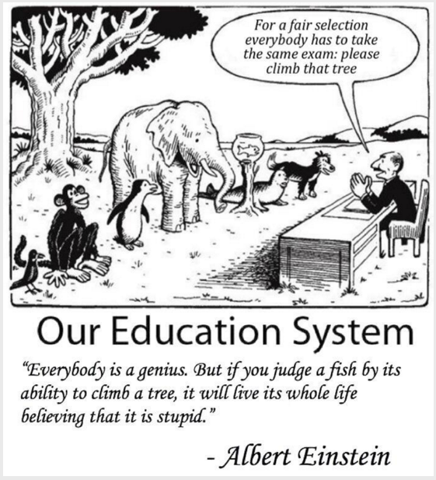

Slide 5
Find out what you already know
Work where you are most ready
Understand your current mastery
Learn using effective content
Learning Paths
Target Knowledge
(Curriculum)
Determine
Knowledge
Profiling
Intelligence Engine Adapt to Learner
Content
Ability
Metrics

Slide 6
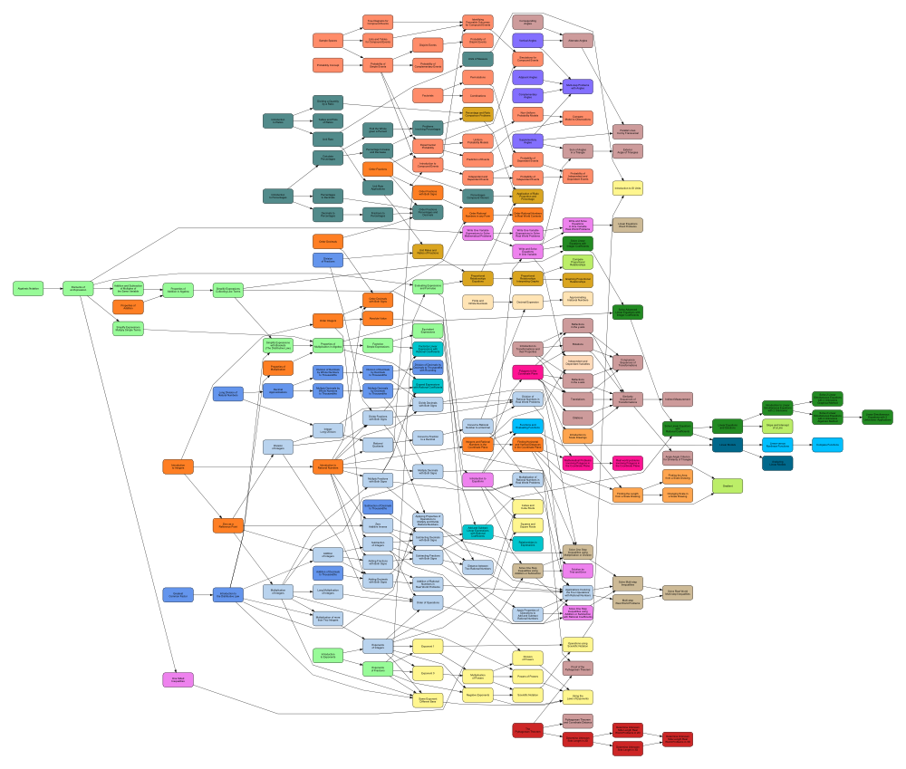

Slide 7
www.realizeitlearning.com
Booths: 643/645

Slide 8
University of Central Florida Student View
University of Central Florida
Tom Cavanagh
Associate Vice President, Distributed Learning

Slide 10
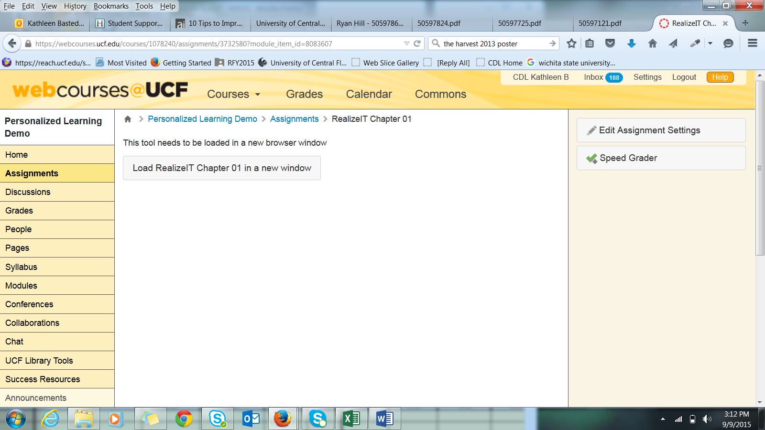

Slide 11
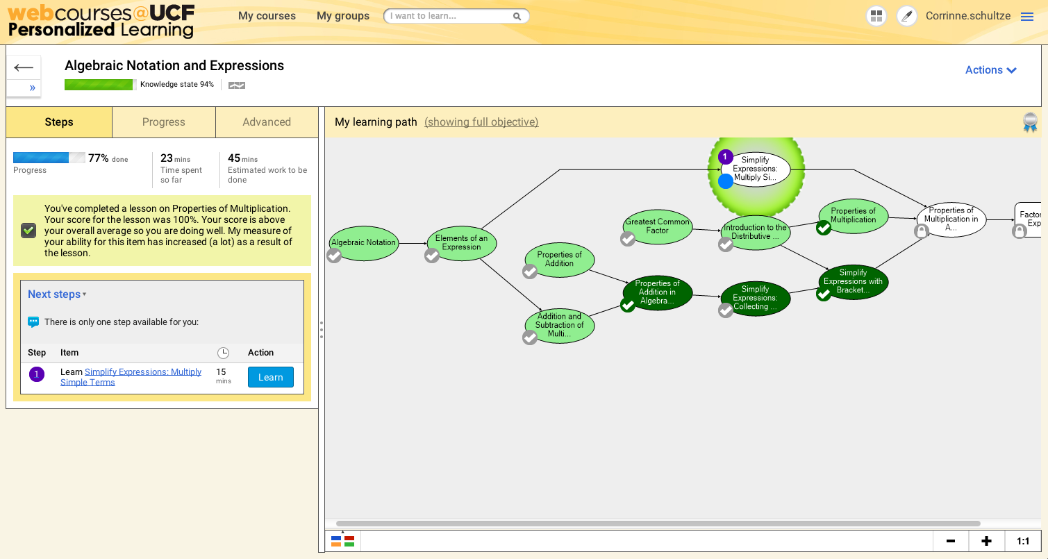

Slide 12
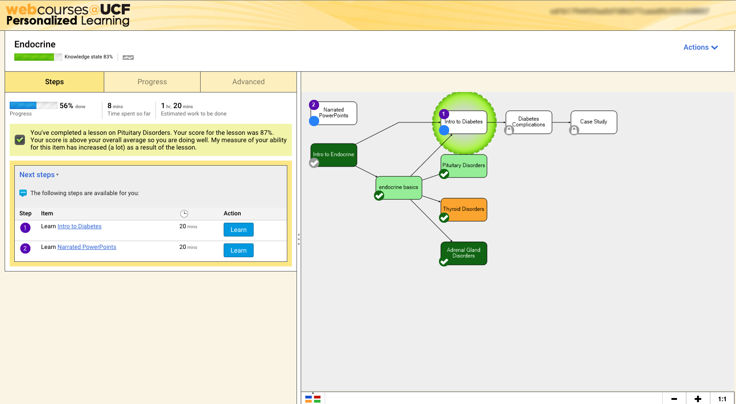

Slide 14
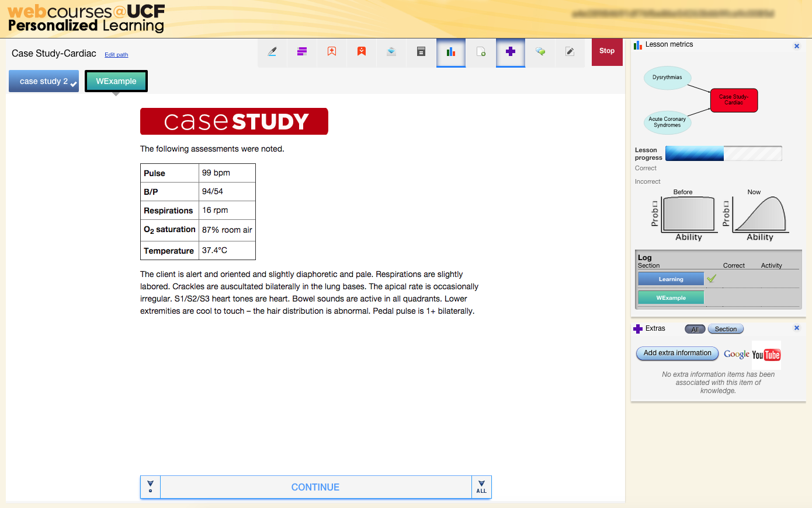

Slide 15
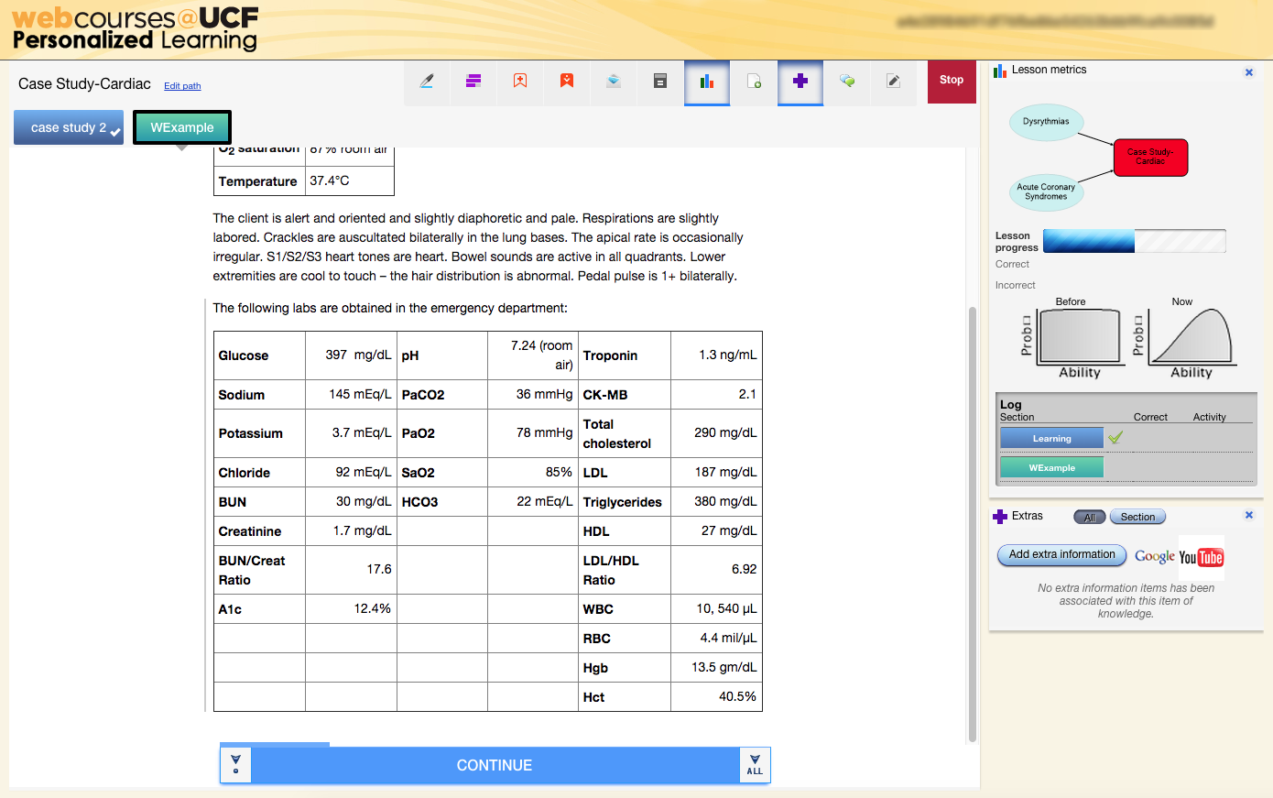

Slide 16
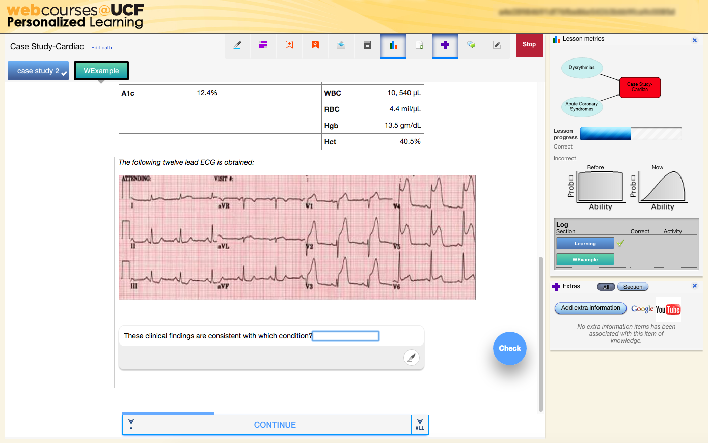

Slide 17
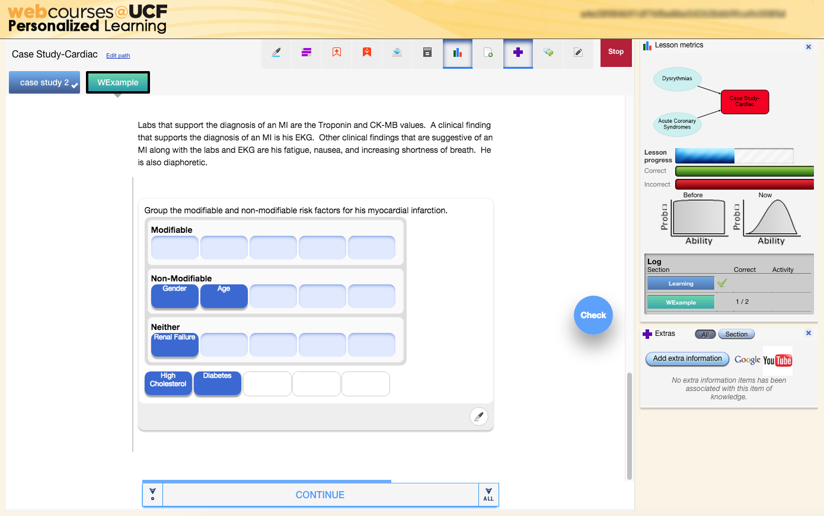

Slide 18
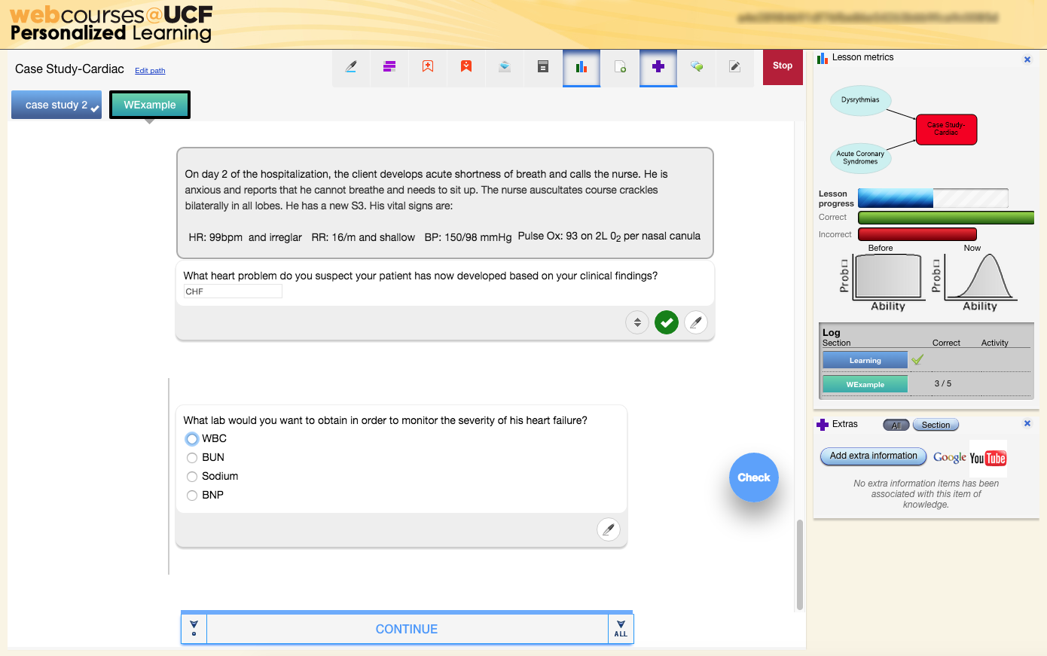

Slide 19
University of Central Florida Faculty View
University of Central Florida

Slide 20
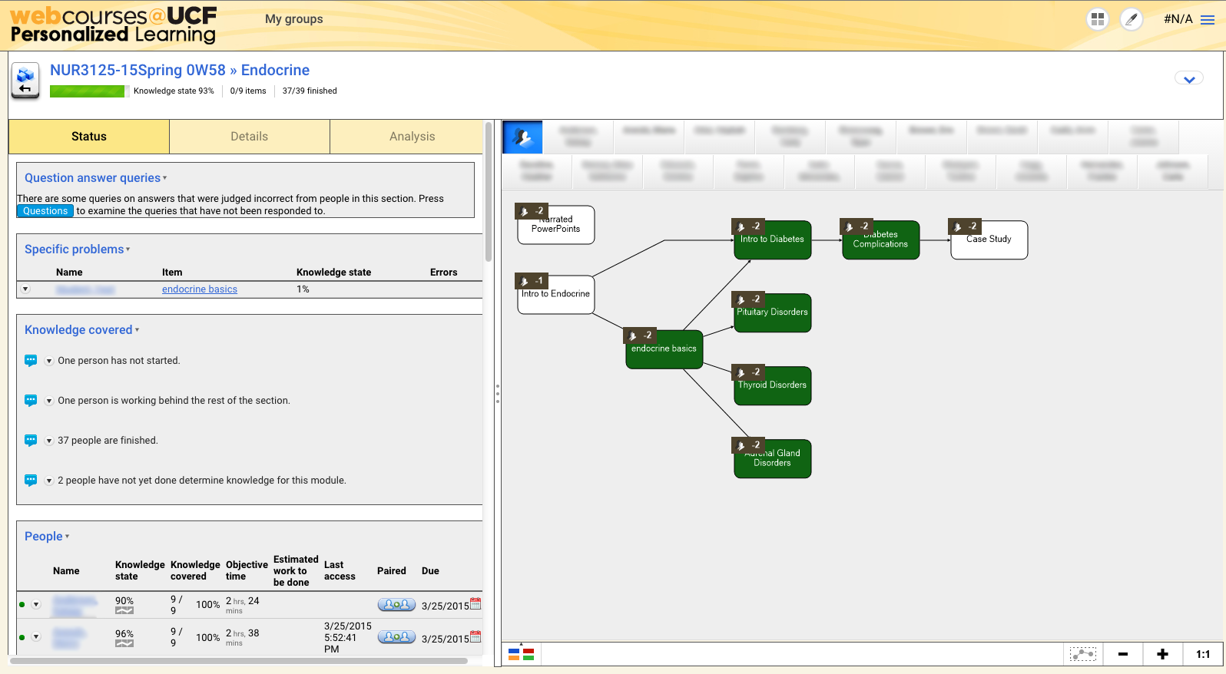
University of Central Florida

Slide 21
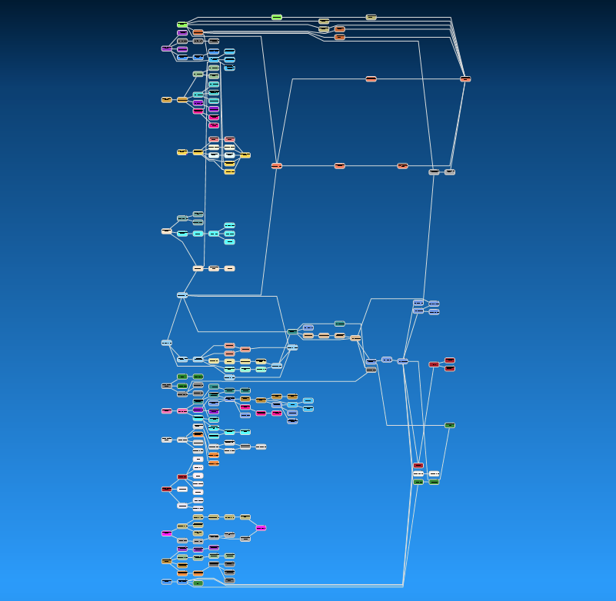
University of Central Florida

Slide 22
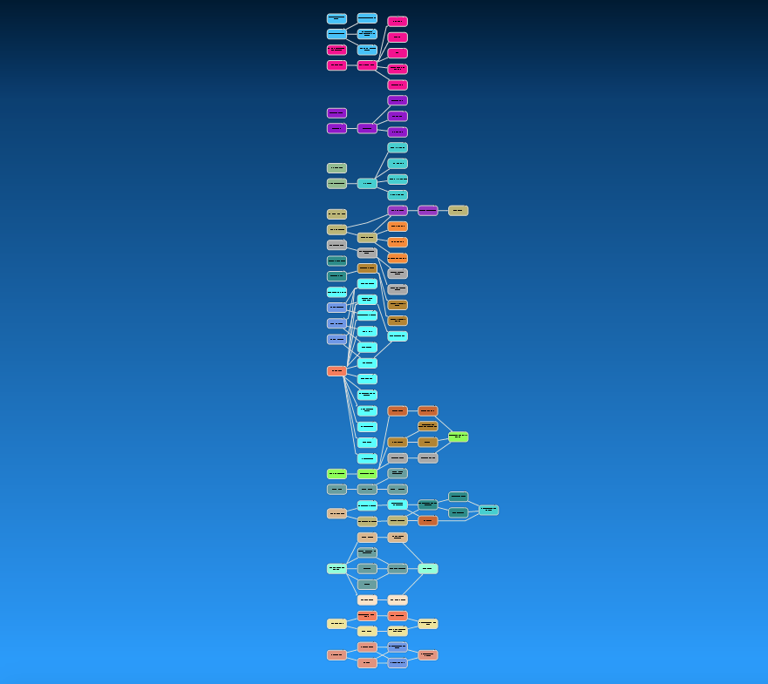
University of Central Florida

Slide 23
Bay Path University Student & Faculty View
Bay Path University
Amanda Buckley
Senior Director, Instructional Design and Online Support

Slide 24
Student View
Bay Path University

Slide 25
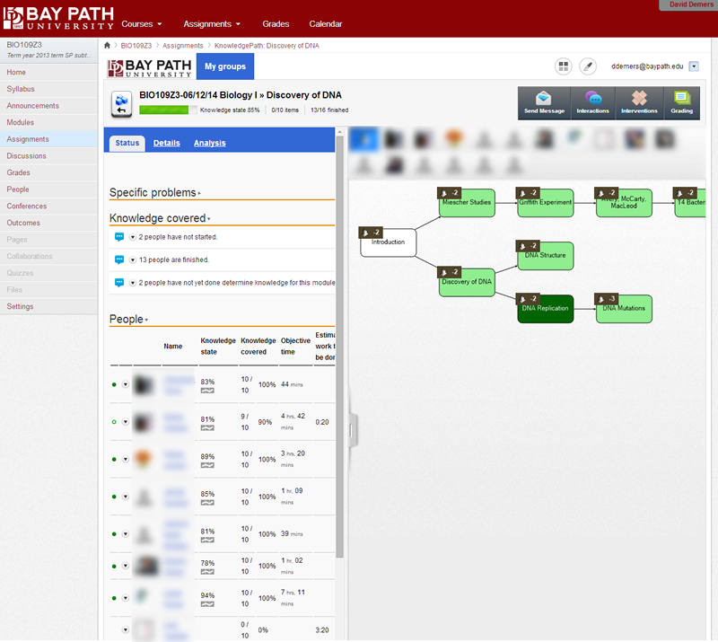
Instructor View
Student Progress
Quick Glance of Class Progress
# Students Completed
% Covered
Time Spent
Estimated Time Remaining
Knowledge State*
Bay Path University

Slide 26
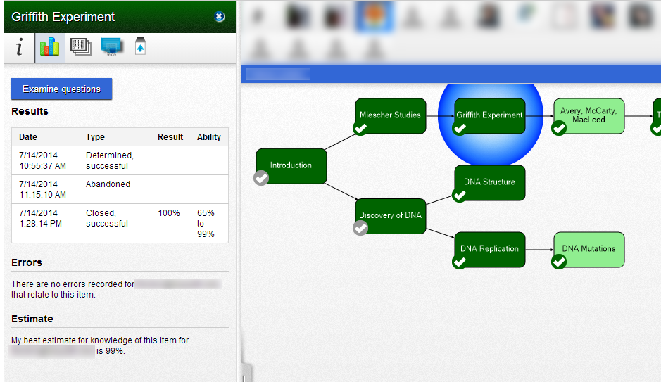
Instructor View
Individual Student Performance
Visual Map
Log of Attempts/ Scores
Estimated Knowledge
Bay Path University

Slide 27
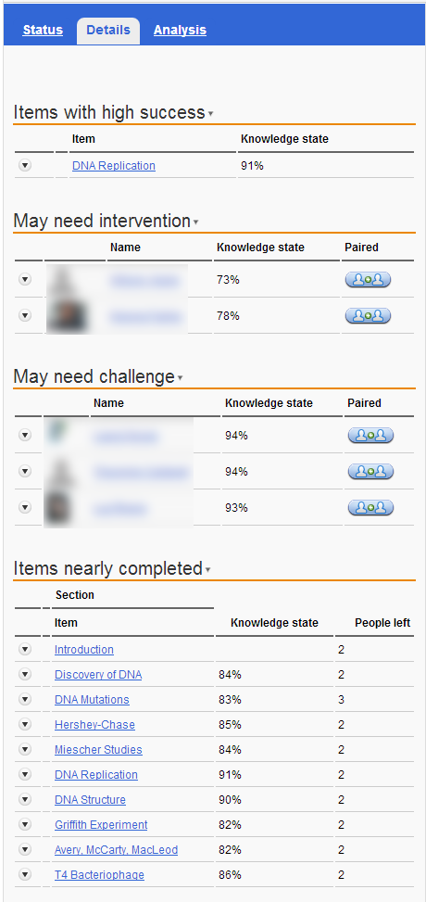
Instructor View
Objective Analysis
Nodes with highest success
Individuals requiring assistance
Can assign practice, revision prompts
Individuals requiring additional challenge
Compiled Knowledge State by Node
Bay Path University

Slide 28
Example Node Map
Bay Path University

Slide 29
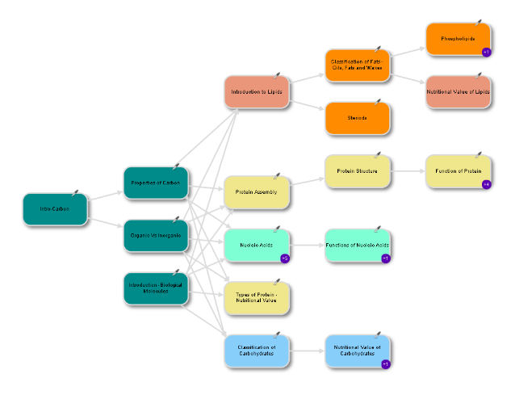
Knowledge Map Activity (10 min)
Your table has been provided with:
Series of discrete information ‘nodes’
‘Digital Video’ unit from Digital Media course (UCF)
Bundle of strings of varying length
Packet of glue dots
Your task:
Assemble the nodes provided into a knowledge map which shows the relationship between the various nodes
When finished constructing your map, please photograph and submit/upload:
twitter hashtag: #AdaptiveMap
Email: askus@realizeitlearning.com

Slide 30
Knowledge Map Activity Sharing (10 min)
Group Examples
twitter hashtag: #AdaptiveMap
Email: askus@realizeitlearning.com

Slide 31
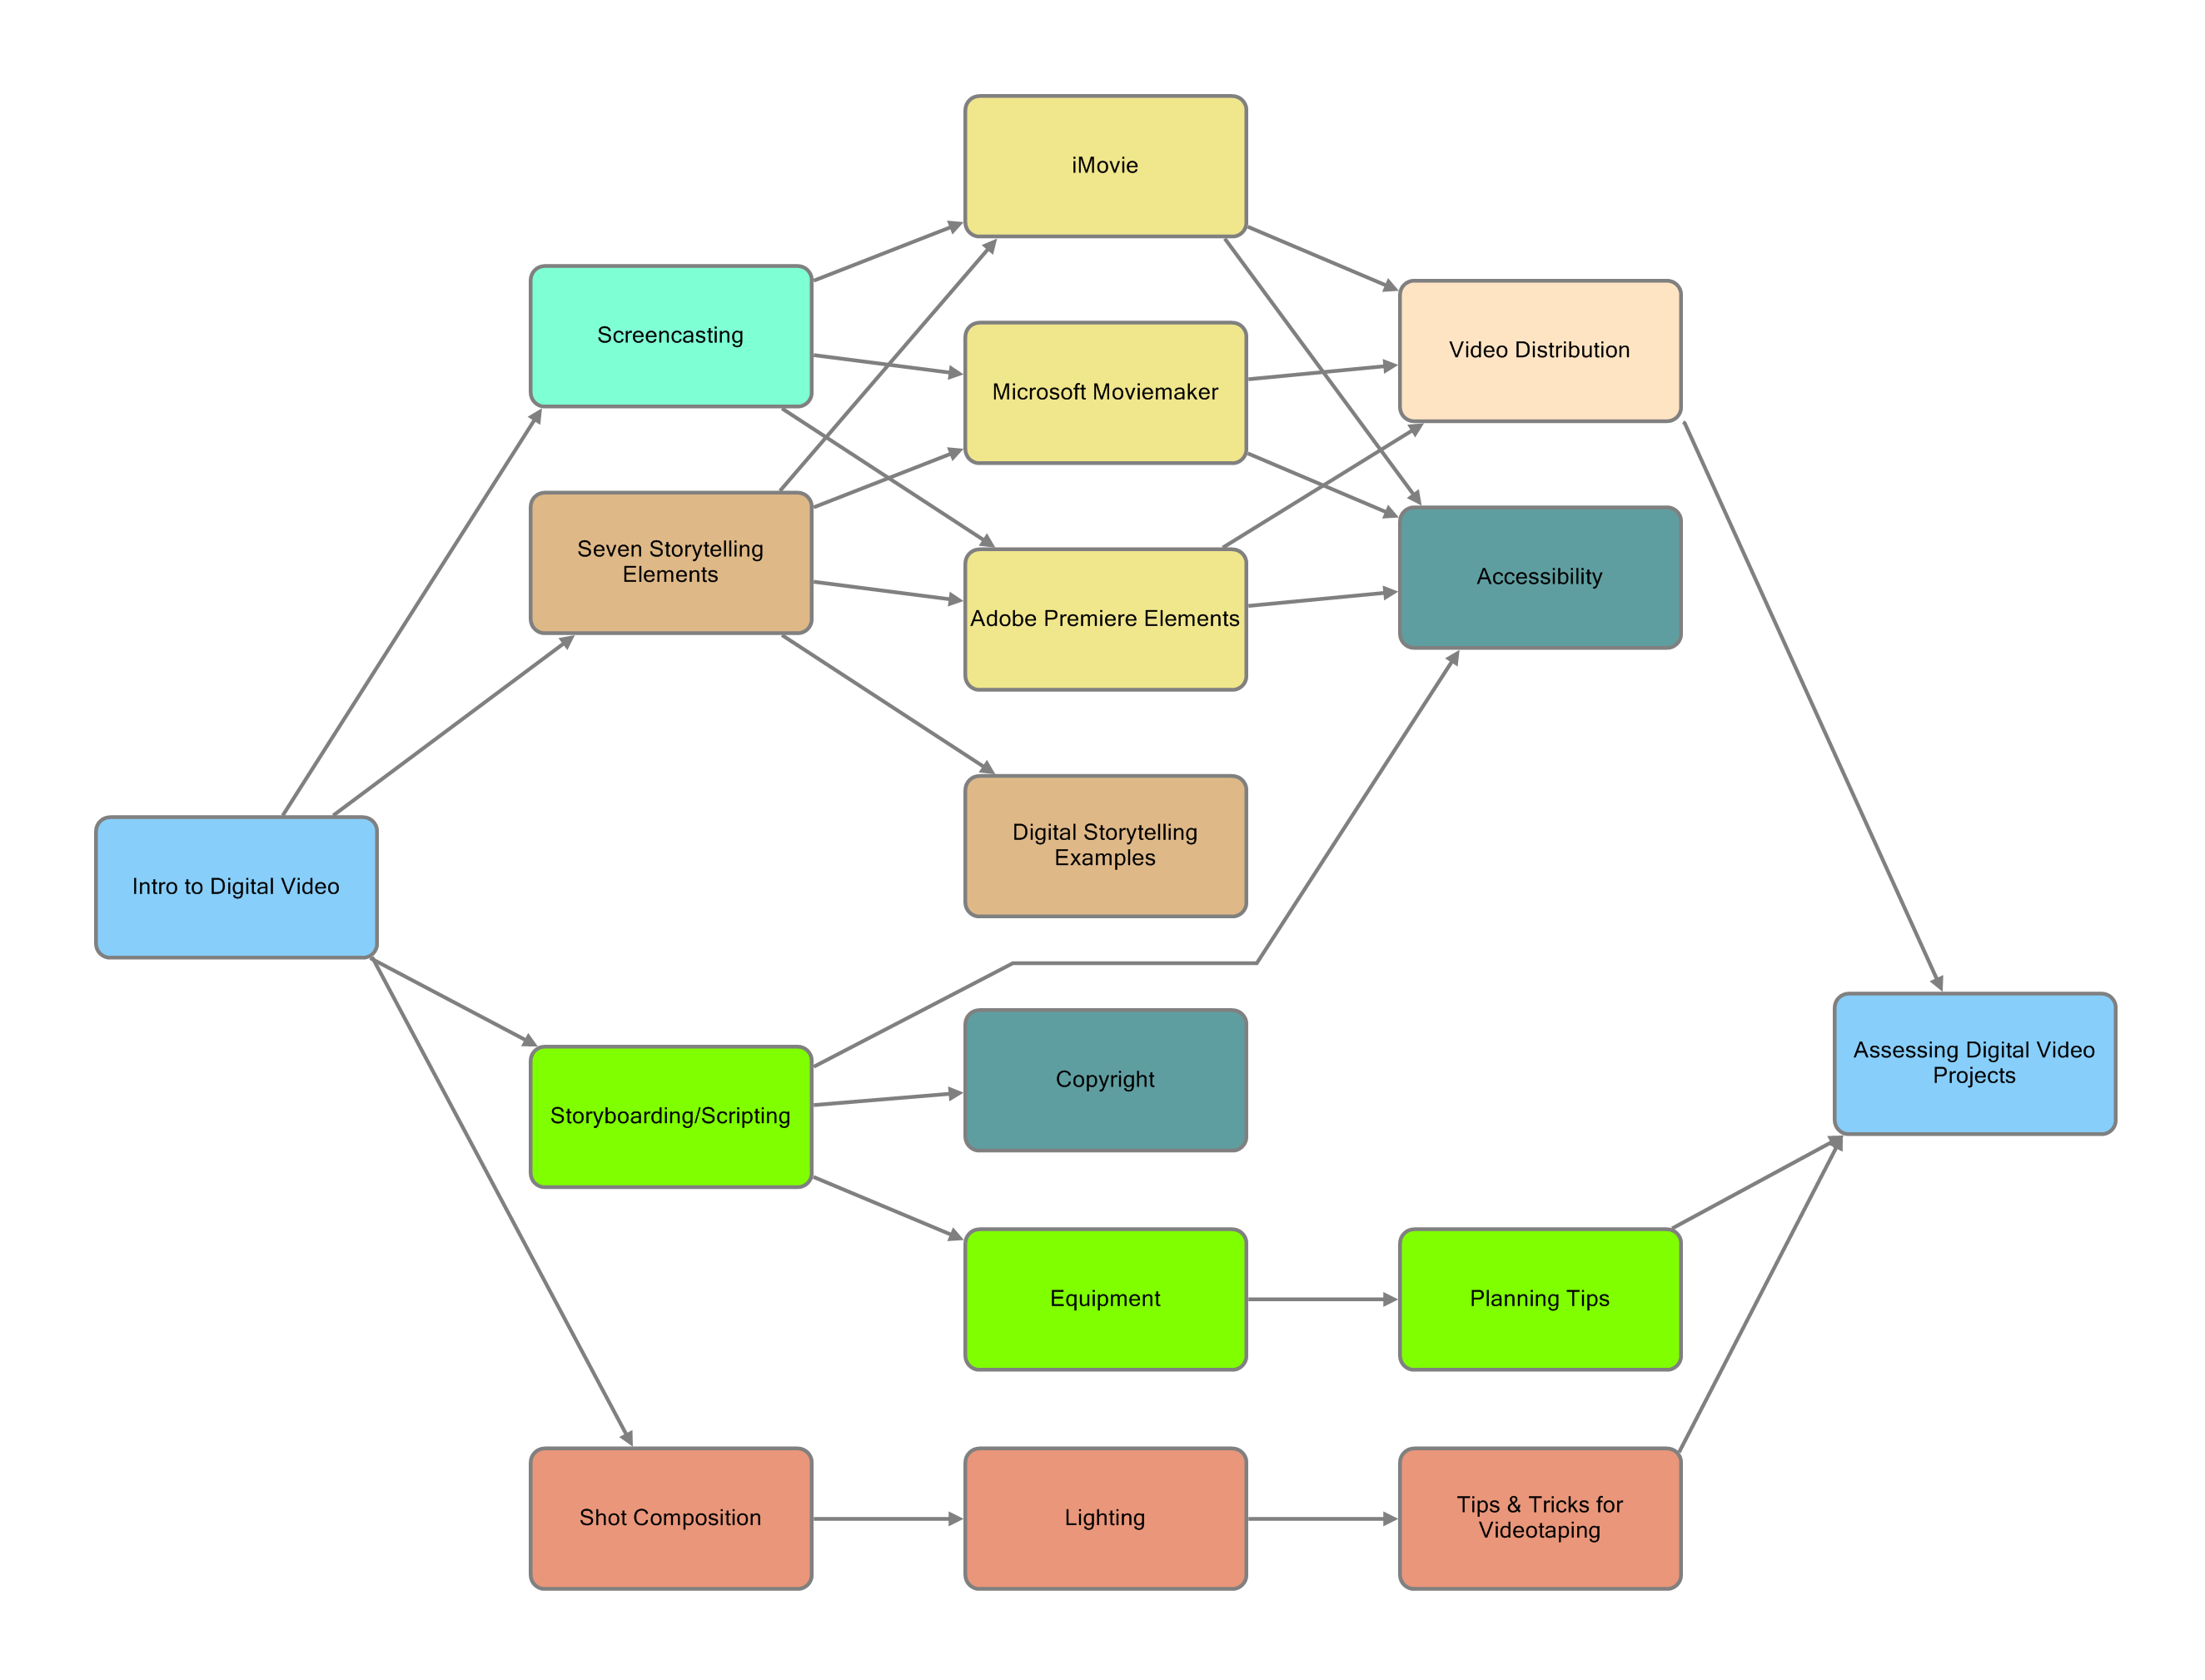

Slide 32
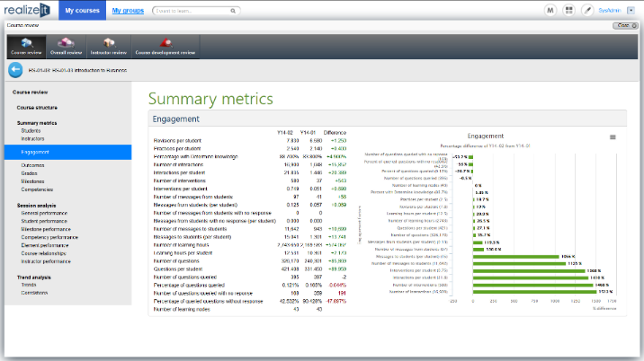
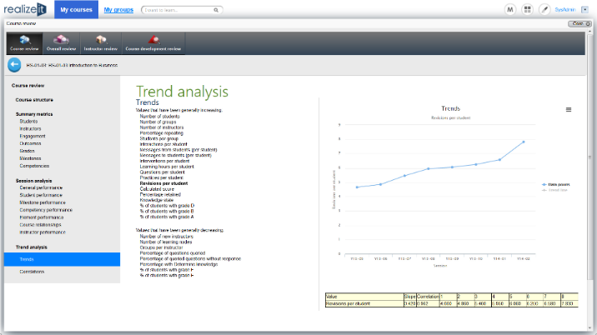
Analytics
Admin Dashboard and Reporting
Analytical Reviews
Data Extraction

Slide 33
Adaptive Learning
Curriculum Prerequisite Map
Granular measure of ability
Knowledge gaps
Multiple learning paths
Adaptive assessments
Adaptive Learning Content
Personalized content
Tailored to meet an specific learning requirements
Reuse content and questions

Slide 34
Efficacy
Colorado Technical University
Exam results: 67% → 75%
Retention: 81% → 93%
Persistence: 72% → 87%
University of Central Florida - Student surveys
81% - increased their engagement
87% - system helped them stay on track
83% - learned the material better as a result of Realizeit
84% - would use Realizeit again
Western University – Exam Results
Class Year | Lab Exam | Written Exam
Fall 2014 | 87% | 88%
Fall 2013 | 75% | 88%
Realizeit

Slide 35
www.realizeitlearning.com
Booths: 643/645

Slide 36
Bay Path Lessons Learned
Can be time-consuming to build quality
Learning curve for authoring tool
Scalability
Adaptive vs standard instructional design
SME understanding of adaptive learning
Node granularity/objectives vs weekly topics
Content suitability
Granular topics (STEM)
Not well-suited for opinions and/or self-reflection
Bay Path University

Slide 37
UCF Lessons Learned
Course Analysis: review content for proper formatting, copyright, accessibility.
Adaptive platform exposes weak courses
Challenge to implement collaboration and interaction activities
Can be time-consuming to build quality
Learning curve for authoring tool
Faculty development is necessary (e.g. Implementing new strategies)
Team to assist faculty create content/use software
Must communicate with faculty and students to reset performance expectations
Supplement the syllabus with pertinent information related to the platform (e.g., how to use, grading).
University of Central Florida

Slide 38
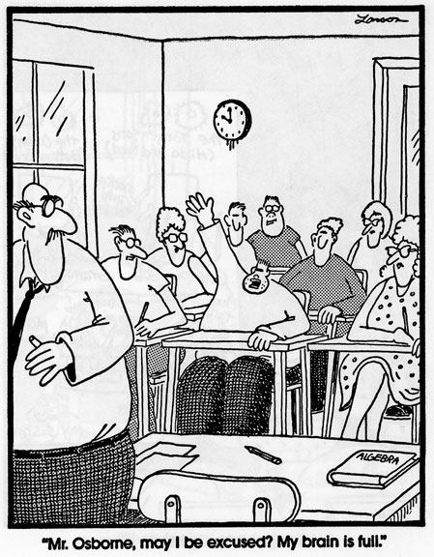
Questions?

Slide 39
Help Us Improve and Grow
Thank you for participating
in today’s session.
We’re very interested in your feedback. Please take
a minute to fill out the session evaluation found within
the conference mobile app, or the online agenda.

