Slide 1
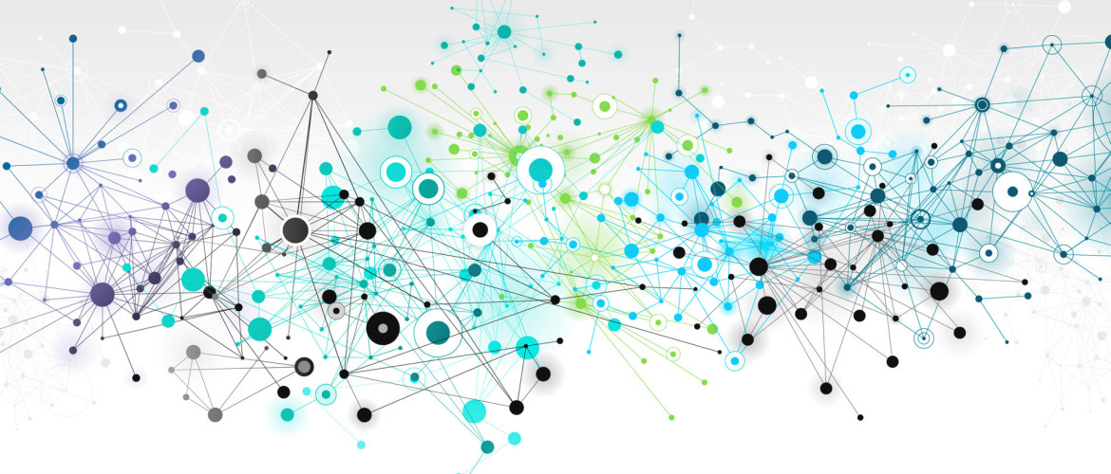


Predictive Learning Analytics: Fueling Actionable Intelligence
2015 EDUCAUSE Conference
Thursday, October 29, 2015

Slide 2






Predictive Learning Analytics:
Fueling Actionable Intelligence
Josh Baron
Assistant Vice President
Information Technology
for Digital Education
John Whitmer
Director for Analytics and Research
Blackboard Inc.
Shady Shehata
Principal Data Scientist
Business Intelligence Manager
Notes:
Introduce myself…this session will primarily focused on a new ECAR/ELI Report on the emerging field of Predictive Learning Analytics so before I introduce my colleagues I would like to take a moment to recognize the larger Working Group who helped write the report…

Slide 3
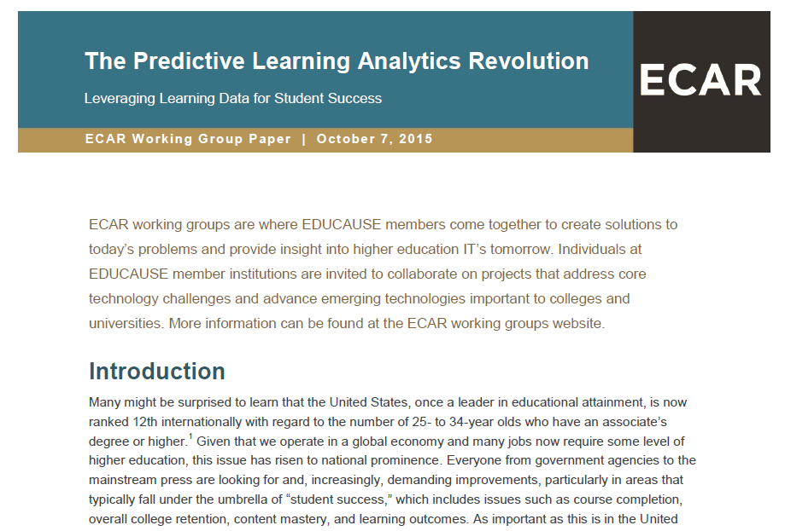

Slide 4

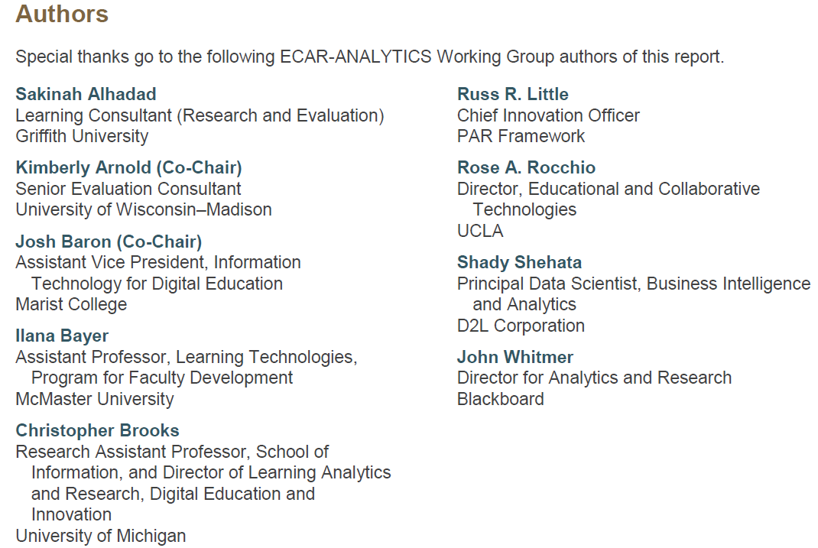
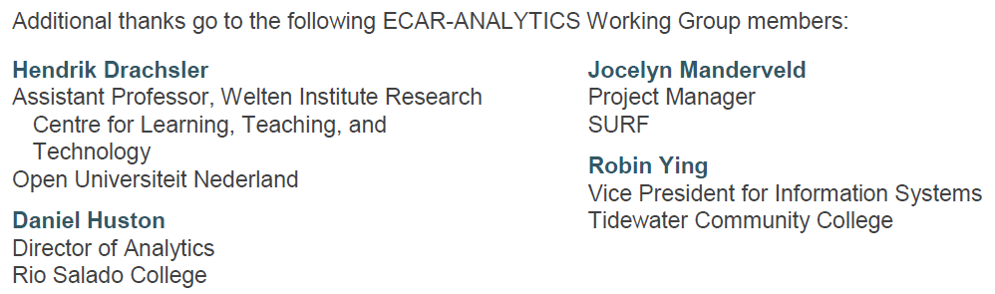
Special thanks to Karen Wetzel
for helping to facilitate the group’s work!

Slide 5
Predictive Learning Analytics:
Fueling Actionable Intelligence
Josh Baron
Assistant Vice President
Information Technology
for Digital Education
John Whitmer
Director for Analytics and Research
Blackboard Inc.
Shady Shehata
Principal Data Scientist
Business Intelligence Manager
Notes:
Introduce myself…this session will primarily focused on a new ECAR/ELI Report on the emerging field of Predictive Learning Analytics so before I introduce my colleagues I would like to take a moment to recognize the larger Working Group who helped write the report…

Slide 6
Presentation Overview
Introduction and Context (5 minutes - Josh)
Data Sources, Relevance & Diversity (10 minutes - John)
Life Cycle & Cleaning Data (10 minutes - Shady)
Strategic Implementation Considerations (10 minutes - Josh)
Q & A (All 15 mins)

Slide 7
39%
Reference: Integrated Postsecondary Education Data System (IPEDS) - https://nces.ed.gov/programs/digest/d14/tables/dt14_326.10.asp
Notes:
I think I can summarize the strategic importance of the emerging field of PLA with one number…
You can debate the specifics of how this number is derived but few would argue that it is a “good” number…
This number has implications well beyond higher education…

Slide 8
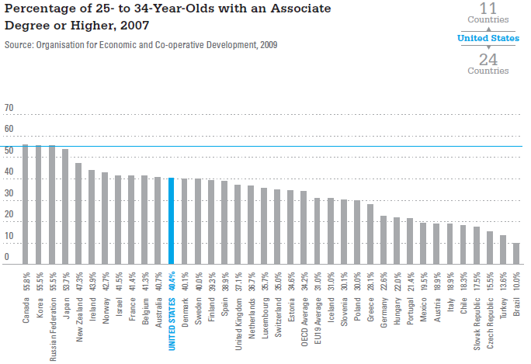
Notes:
Just as one example of the larger challenges that low graduation rates are having…
And, as we all know, the issue has caught the attention of mainstream media and major governmental groups….

Slide 9
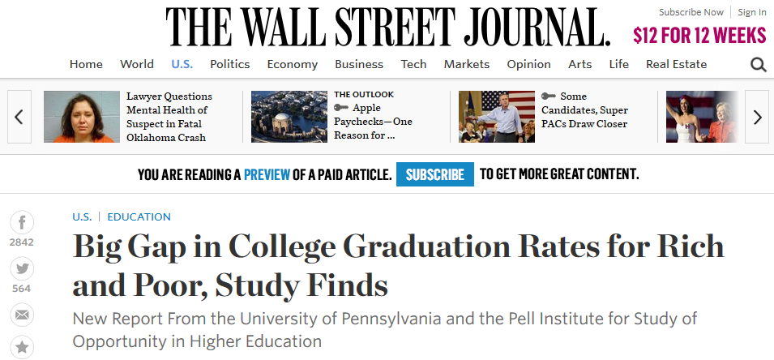
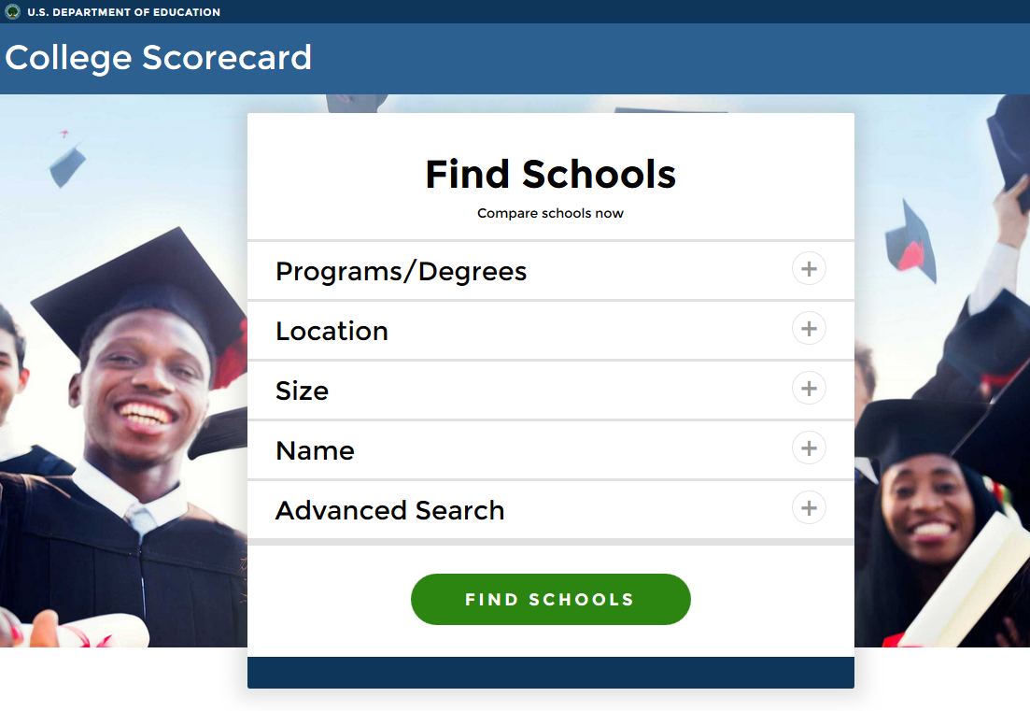
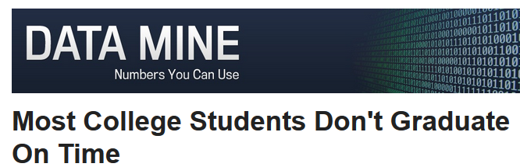

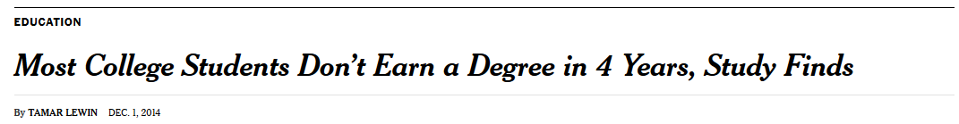
Notes:
And, as we all know, the issue has caught the attention of mainstream media and major governmental groups….

Slide 10
How can Predictive Learning Analytics help?

Slide 11

“Marty, you are going to fail Introduction to Physics during your sophomore year, make sure you see a tutor after the first week of class and you’ll ace the final exam!”
Notes:
At a very fundamental level the ability to predict the future, at some reasonable level of accuracy, provides us with the opportunity to “intervene“ as means to change that future outcome

Slide 12
What is Predictive Learning Analytics?
Predictive Learning Analytics: The statistical analysis of historical and current data derived from the learning process to create models that allow for predictions that improve learning outcomes.
  A subset of larger “learning analytics” field
  Uses sophisticated mathematical models rather than user-defined rules
  EXAMPLE: Academic Early Alert Systems that use predictive models
Notes:
So, what do we really mean by the term “Predictive Learning Analytics”?...
Use of sophisticated statistical analysis and “big data” to create mathematical models which can predict future learning outcomes and factors related to “student success”

Slide 13
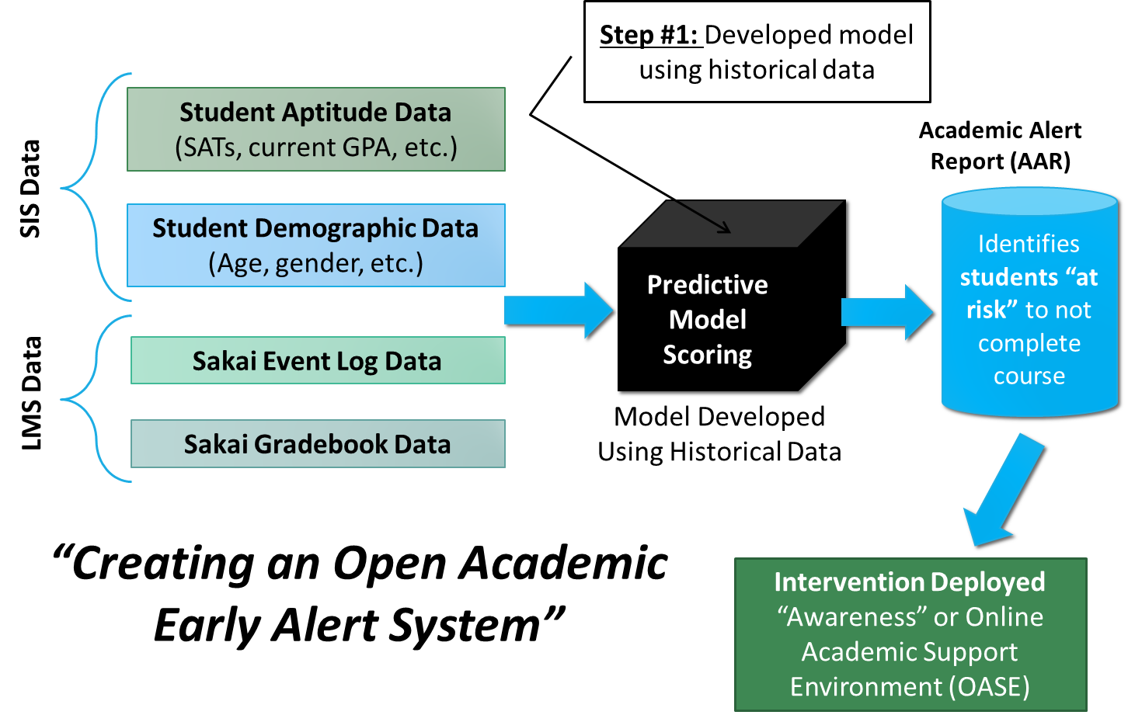
Open Academic Analytics Initiative (OAAI)
Notes:
I’ll talk about our intervention strategies in a little more detail a bit later on in the presentation…

Slide 14
More Research Findings…
Jayaprakash, S. M., Moody, E. W., Lauría, E. J., Regan, J. R., & Baron, J. D. (2014). Early Alert of Academically At-Risk Students: An Open Source Analytics Initiative. Journal of Learning Analytics, 1(1), 6-47.

Slide 15

Want the latest updates?
Join the mailing list!
analytics@apereo.org
(subscribe by sending a message to analytics+subscribe@apereo.org)
Apereo Learning Analytics Initiative
Wiki: https://confluence.sakaiproject.org/x/rIB_BQ
GitHub: https://github.com/Apereo-Learning-Analytics-Initiative
Josh Baron: Josh.Baron@marist.edu

Slide 16
Data Sources, Relevance & Diversity

Slide 17
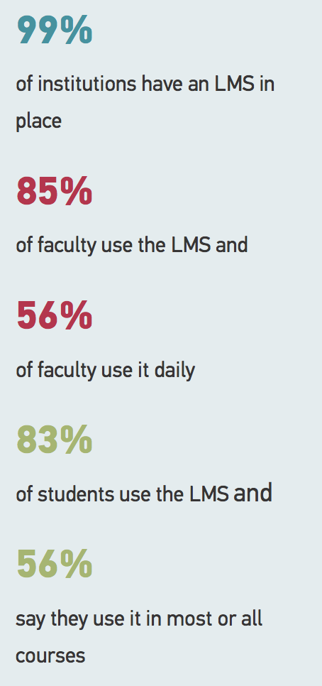
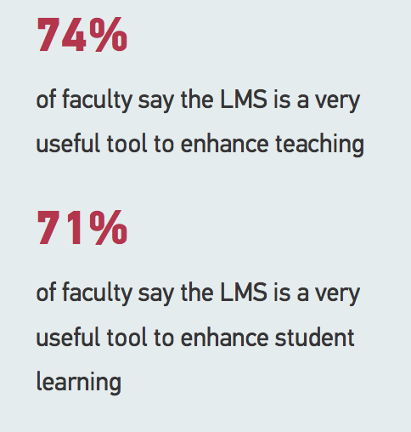
LMS: Academic Technology’s First Killer App
^{From:}
Eden Dahlstrom, D. Christopher Brooks, and Jacqueline Bichsel.
The Current Ecosystem of Learning Management Systems in Higher Education: Student, Faculty, and IT Perspectives. Research report. Louisville, CO: ECAR, September 2014.
Available from http://www.educause.edu/ecar.

Slide 18
What data from conventional data sources (e.g. SIS) are systematic, significant predictors of course success?
High School GPA? Race/Ethnicity? First in Family to Attend College?
Trick question: NONE.

Slide 19
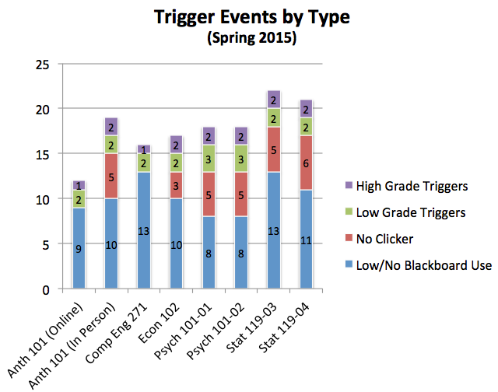
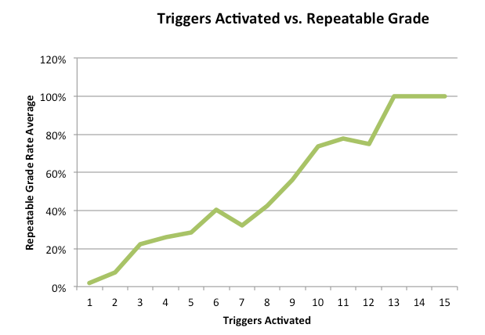

Academic Technology Data is a Systematic Predictor of Course Success*
*Assuming, of course, that technology is integrated into the course in a deep and meaningful way

Slide 20
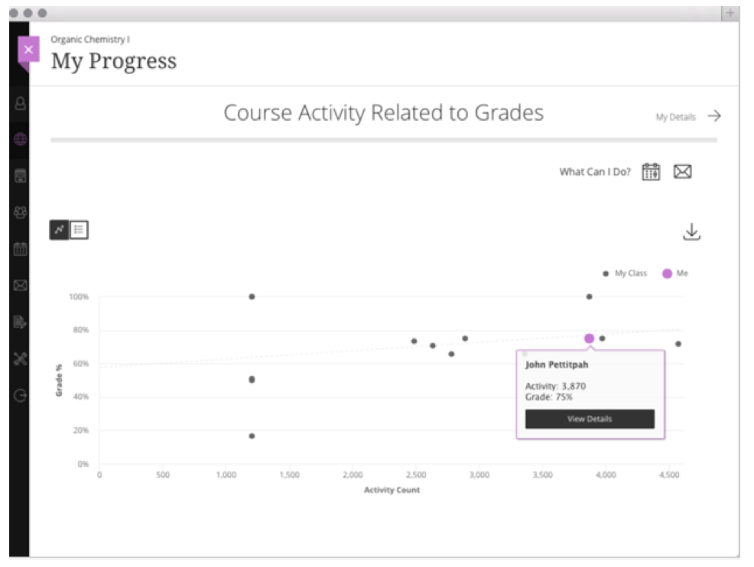
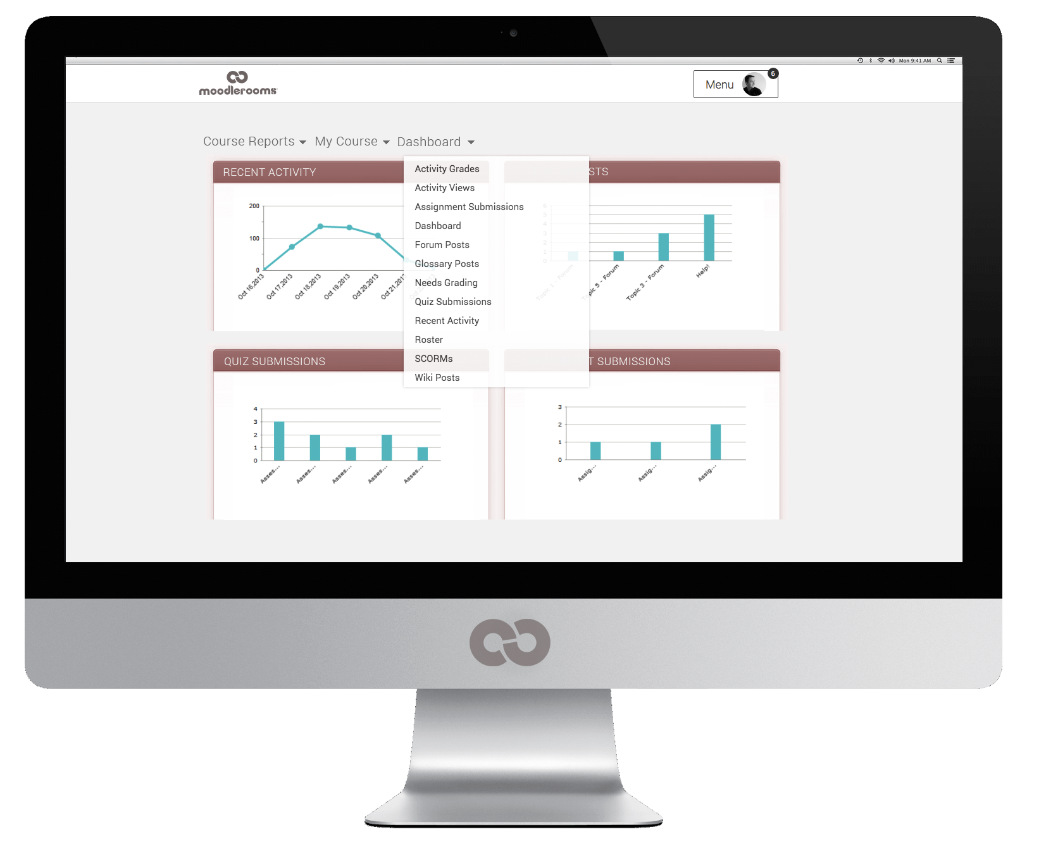
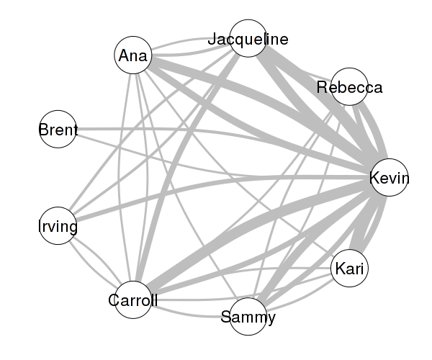
Embedding Predictive Analytics
Blackboard Learn SaaS – Ultra Course View
Discussion Forum “Critical Thinking” – Moodlerooms
X-Ray Learning Analytics

Slide 21
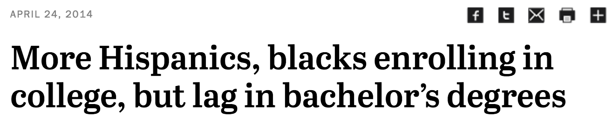

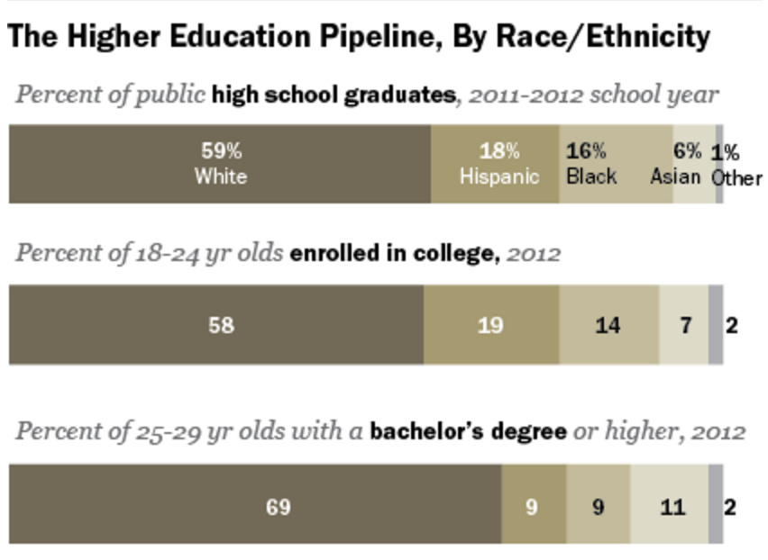
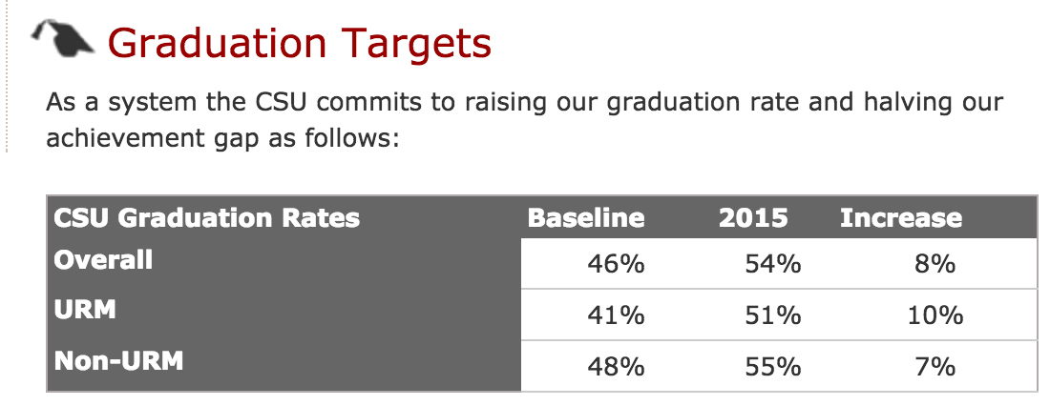
Strategic Importance other Data Points
Source: Calstate.edu, 2015
Source: Pew Research Center, 2014

Slide 22
Conclusion: Learning Data comes in Many Flavors and Relevance
Activity (Behavioral) Data
Digital Content
Personal Response Systems (Clickers)
Streaming Video Servers
Web Conferencing
Static Data
Survey Data
Student Aptitude
Extra-Curricular Activities
Demographic Factors & Prior Educational Experience
Where (and when) does the data fit into your initiative?
Outcome? In-Course Predictor? Day 0 Predictor? Targeting Feature?

Slide 23
Factors affecting growth of predictive learning analytics
New education models
Enabler
Clear goals and linked actions
Data valued in academic decisions
Resources
($$$, talent)
Tools/systems for data
co-mingling and analysis
Academic technology adoption
Data governance (privacy, security, ownership)
Rare
Widespread
Not invented here syndrome
Low data quality (fidelity with meaningful learning)
Difficulty of data preparation
Constraint

Slide 24
Predictive Analytics,
How it works?
What is the data impact?
Predictive Learning Analytics: Fueling Actionable Intelligence

Slide 25

How Predictive Analytics Systems Work?

Slide 26
How it really works?
Historical Data
Predictive Analytics
Predictive Model
To Simplify
We want to predict student final grade and all data we have is course content view in the LMS Web application
Input: # of course content views to LMS
Output: Final Grade
It was found that in the last 10 course offerings of Math 101, students who viewed the course content in the first month more than 100 times, his/her final grade is over 90
Trend
or
Pattern

Slide 27

How it really works? _{(cont.)}
After the first month, predictive model can provide predictions of the final grades based on the # of content views of the students in the current course offering of Math 101
New
Data
Predictive Model
Current Offering of Math 101
Predictions

Slide 28
Examples of what can go wrong?
What if students are viewing the content from Mobile Application?
Data is not complete.
What if one of the historical course has hundreds of course topics where other courses have tens of course topics?
Data is not accurate.

Slide 29
What does that mean?
Predictive Analytics Systems are Data Driven Systems
Garbage in, Garbage out

Slide 30
Why Data Quality?
“Poor data quality is costly. It lowers customer satisfaction, adds expense, and makes it more difficult to run a business and pursue tactical improvements such as data warehouses and re-engineering.”
- Thomas C. Redman

Slide 31
Data Quality
Accuracy
  The data was recorded correctly.
Completeness
  All relevant data was recorded.
Uniqueness
  Entities are recorded once.
Timeliness
  The data is kept up to date and information is available on time
Consistency
  The data agrees with itself.
Validity
  They measure what they are intended to measure.
Reliability
  The data are measured and collected consistently; definitions and methodologies are the same over time.
Integrity
  The data are protected from manipulation for any reason.

Slide 32
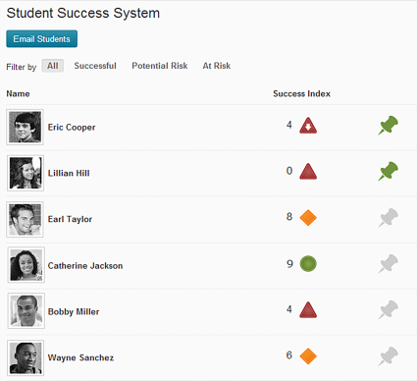
Brightspace Student Success System
Best Poster Award (LAK 2015)

Slide 33
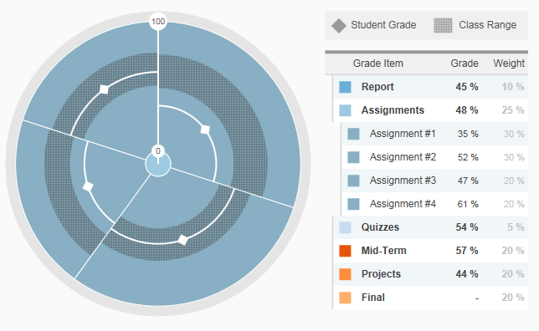
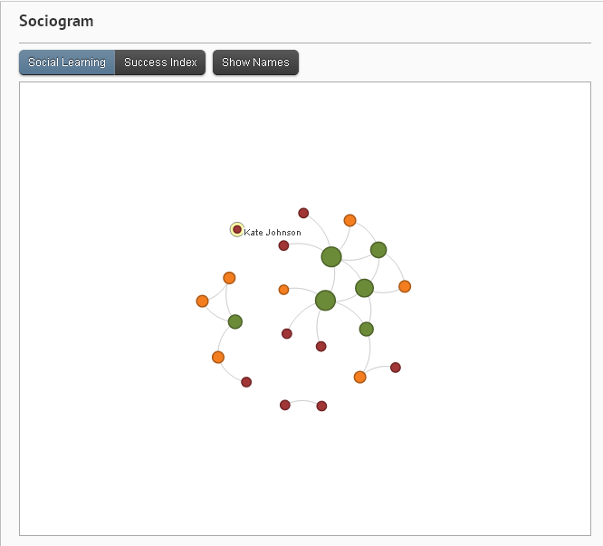
Brightspace Student Success System
Best Poster Award (LAK 2015) _{(cont.)}

Slide 34
Brightspace Student Success System
Best Poster Award (LAK 2015) _{(cont.)}
Higher ED Institution (5768 students)
Prediction Error over 45 courses = 0.12
College Institution (1270 students)
Prediction Error over 36 courses = 0.14

Slide 35
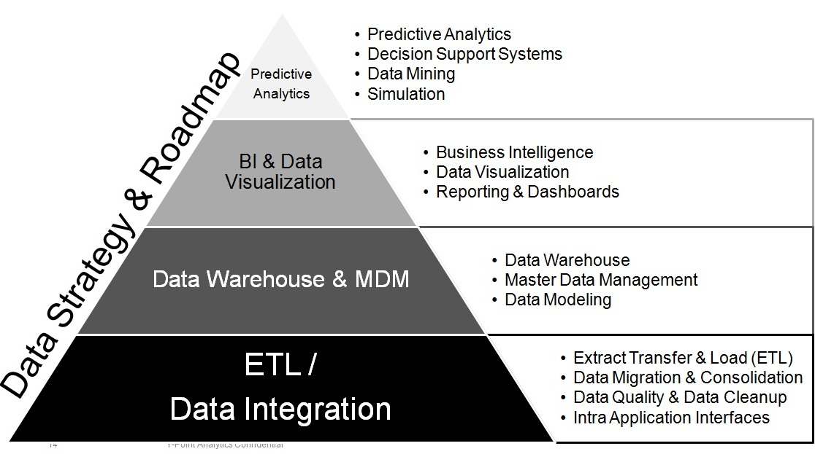
Data Strategy
Reference: ypoint analytics

Slide 36
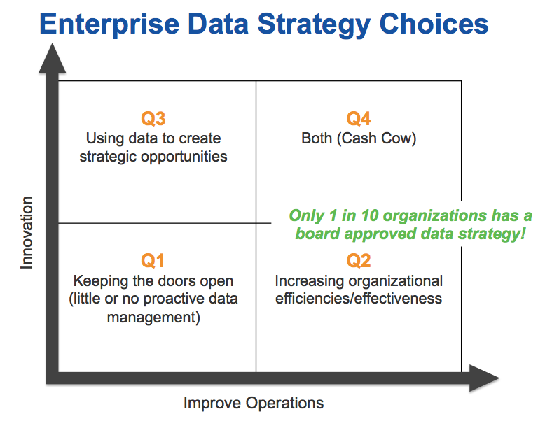
Data Strategy _{(cont.)}
Reference: datablueprint

Slide 37

Strategic Implementation Considerations
Predictive Learning Analytics: Fueling Actionable Intelligence

Slide 38
Strategic Implementation Considerations
#1
Institutional Stages of Analytics Usage
#2
Organizational Leadership, Culture & Skills
#3
Gaining Access to Learning Data
#4
Ethics &
Privacy

Slide 39
Institutional Stages of Analytics Usage
Predictive Analytics
Use large amount of historical data to create predictive models
Automated Analytics
Automatically perform analytics and provide results directly to end-users
Basic Analytics
Report on past trends and data observations

Slide 40
Organizational Leadership, Culture & Skills
Having a senior organizational champion can be critical
  Breaking down data silos and support policy change
  Addressing resource requirements
  Develop a data-driven decision making culture
Having division, faculty and student champions is also important
  Coordination on data extraction, transformation and loading (ETL)
  Assist with communication across entire community
Investing in new skill sets is an imperative – see report for specifics

Slide 41
Graining Access to Learning Data
Learning Data: Data produced by learners as they engage in the learning process.
  Examples: course grades, GPA, library data, LMS event log data, test scores
Learning data is the “fuel” on which LA runs
Access can be an implementation barrier
  Data may have not been intended for LA use originally
  Challenges extracting data from cloud-based SaaS
  Data in local systems can be “hidden” or encrypted
Extracting sample data sets is often a good start

Slide 42
Ethics and Privacy
Ethics: Using LA for “good” and not “evil”
Privacy: Balancing the need to protect confidential records while maximizing the benefits of LA.
Often requires new policies and procedures
Learning Analytics “task force” to address ethics and privacy issues
Jisc Code of Practice - https://www.jisc.ac.uk/guides/code-of-practice-for-learning-analytics
SURF Learning Analytics SIG - https://www.surfspace.nl/sig/18-learning-analytics/93-ethics/

Slide 43
Let’s Talk!
Josh Baron: Josh.Baron@marist.edu
John Whitmer: John.Whitmer@blackboard.com
Shady Shehata: Shady.Shehata@D2L.com

