Slide 1
20 Years: What the Data Show and What They Don’t
Chuck Dziuban & Patsy Moskal
Center for Distributed Learning
Research Initiative for Teaching Effectiveness (RITE)
University of Central Florida

Slide 2
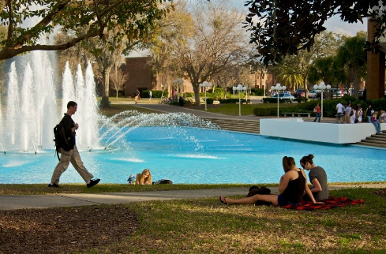

About UCF
Orlando, FL
Over 63,000 students; 2nd largest university in U.S.
Carnegie classification: RU/VH Research University
216 degree programs; 11 colleges; 11 campuses
Academic Year 2014-15
  38% of total university student credit hours
  78% of all students took at least one online course
    80% of all undergraduates (47,116)
    61% of all graduate students (6,469)

Slide 3



The Evaluation Plan
Students
Faculty
Institution

Slide 4


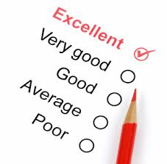
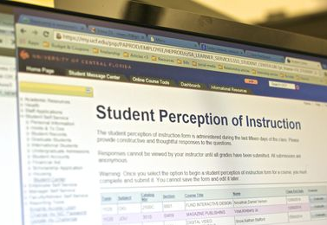

Where’s the data??
SIS
LMS
Surveys
SPI
Applications

Slide 5
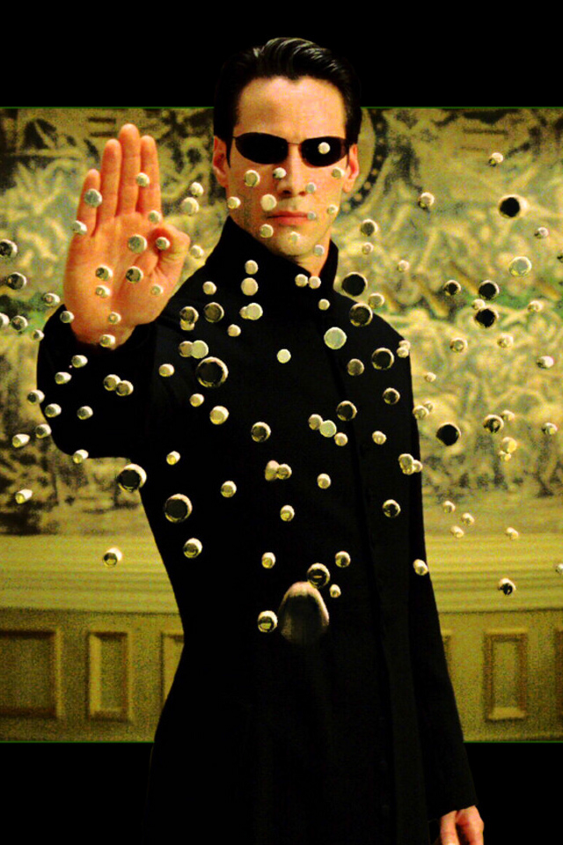

The end goal…
Turning data…
…into INFORMATION

Slide 6
Some Lessons Learned Through the Years

Slide 7

Success

Slide 8
Success
Percent

Slide 9
Success
Does success equal learning?
  Answer: No
Are the differences significant?
  Answer: Yes

Slide 10
Question that was never asked and should have been…
Is there selection bias in your data?
  Answer: Yes

Slide 11

Significance may not be significant

Slide 12

The question for all ages
“How large does my sample have to be?”

Slide 13
Statistical (classical) hypothesis tests are a function of 3 things:
Significance Level
.05? .01? …or something else?
2) Sample Size
Tiny? Small? Medium? Large? Huge?
3) Some Effect Size
A difference that means something to me
∆₁ –Doesn’t matter
∆₂ –Really important to me

Slide 14
How much is enough?
∆₁
I don’t care about this

Slide 15
How much is enough?
∆₂
I care about this

Slide 16
Statistical significance testing (SD = 15)
Sample Size
2750
2500
2250
2000
1750
1500
1250
1000
750
500
x₁=100 x₂=101 ES=.06
.01
.02
.03
.04
.05
.07
.10
.14
.20
.29
Significant
Not
Significant

Slide 17
So the strategy is…
1) Pick ∆₂ first → This is important to me
2) Then pick a significance level
.05, .01, or something else
3) Pick a sample size that will catch
∆₂ but not ∆₁

Slide 18

When treatment is not treatment

Slide 19






Blended learning as a boundary object
Evaluators
Journalists
Blended Learning
Provosts
Faculty
Librarians
Students
Deans

Slide 20
The way we blend
Online tutorials
Tech equipped classrooms
E-mails
Computer cluster room
Tele-web software
Discussion
WEB MODULES
Supplemental web activities
Evidence-based practice
Internet tutorials
CoMpUtEr LaBs
Virtual experiments
Electronic field trips
Optional websites

Slide 21
The way we measure
Self-confidence scales
APPREHENSION TESTS
Class work
Reading power
student ratings
Cooperativeness scales
Electric circuit tests
Conceptual tests
Self-report surveys
Placement tests
Mathematics anxiety scales
Achievement tests
Motivation questionnaires
MuLtIpLe ChOiCe
Class ranks

Slide 22

Can you predict success and bandwidth analytics?

Slide 23
Add one logistic regression analysis for predicting non-success DFW (n=258,212)
 | R²
Modality | .003
Course Level | .022
Class Size | .024
Gender | .029
Ethnicity | .035
Age | .035
SAT | .034
College | .047
High School GPA | .074
Cumulative GPA | .405

Slide 24


Classification and regression tree for predicting
non success in online courses
Overall Non Success
13.3%
n = 70948
D* 1-2
D* 3-10
34.3%
n = 39646
7.5%
n = 31302
D* 2
D* 1
24.4%
n = 14070
44%
n = 25576
* Deciles
Prediction Accuracy 94%

Slide 25
Scarcity and the cognitive bandwidth tax
Can you take action on GPA?
  Answer: Yes and No
Why does GPA predict?

Slide 26

  Could it be scarcity?

Slide 27
Scarcity and the cognitive bandwidth tax
Scarcity
Cognitive Band Width
Tuition
Housing
Books
Transportation
Child Care
Work
Add. Cost
Safety
Scarcity Factors

Slide 28
Scarcity and the cognitive bandwidth tax
Cognitive Bandwidth
Cognitive Band Width
Tuition
Housing
Books
Transportation
Child Care
Work
Add.Cost
Safety
Scarcity Factors

Slide 29
Is there an answer to scarcity?

Slide 30


Harris Rosen

Slide 31
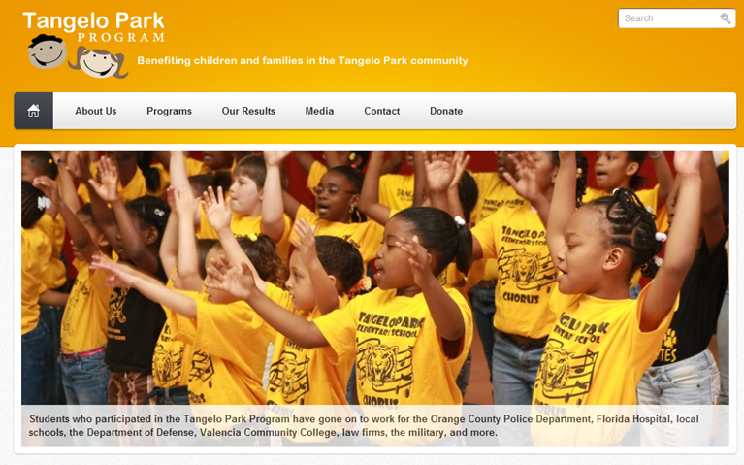
www.tangeloparkprogram.com

Slide 32

Program Components
Early Childhood Education
Parent
Leadership
Alumni
Vocational
Scholarships

Slide 33
Tangelo Park Crime Rates 1994-2013
Standardized by 1993 Figures
+3%
20
+4%
-4%
0
-33%
-35%
-20
-30%
-47%
-45%
-48%
Crime Rates
-38%
-49%
-53%
-40
-38%
-45%
-53%
-52%
-66%
-60
-61%
-67%
-66%
-80

Slide 34
Completion rates for those who entered

Slide 35
TPP Budget: 2-yr-old program and scholarship (percent of total)

Slide 36
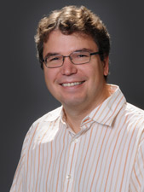
Return on Investment to Society
Total 20 year investment: $10,000,000
Half for Early Childhood program
Half for scholarships
Lance Lochner,
University of Western Ontario
Return on investment: $7 for every $1 spent

Slide 37
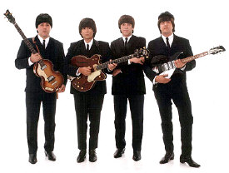
Come together blended research

Slide 38
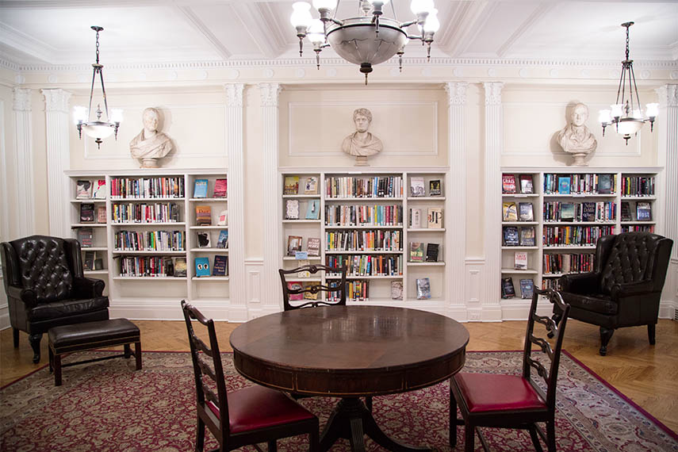
Louis Guttman meets Brené Brown meets the Center for Fiction
Literary Criticism
Grounded Theory
Image Analysis
Survey

Slide 39
Research Initiative for Teaching Effectiveness
For more information contact:
  Dr. Chuck Dziuban
  (407) 823-5478
  Charles.Dziuban@ucf.edu
  Dr. Patsy Moskal
  (407) 823-0283
  Patsy.Moskal@ucf.edu
  http://rite.ucf.edu
  http://www.if.ucf.edu/

