Slide 1
BI + IR: Shotgun Wedding,
or Marriage Made in Heaven?
Hank Childers, Executive Director University Analytics & Institutional Research, University of Arizona

Slide 2
Introduction
Like other higher education institutions, the University of Arizona feels the information landscape changing significantly just as we feel tremors in the foundations of the higher education as a whole. It’s confusing and conflicting. But the pressure for relevant and better information is certainly clear enough. With BI and IR we see overlap and opportunity involving two of the most important groups formally involved in information. So we have decided to combine them. It’s not unprecedented, but it’s also not that common, and often invokes a spirited response. Why? What’s really going on? This is our attempt to better understand and then act on what we learn.
Hank Childers, 2015

Slide 3
Definitions & Disclaimers
BI = Business Intelligence
  ‘DW/BI’ might be better, as it includes both the Data Warehouse and the BI reporting function
IR = Institutional Research
  Includes production and reporting of official numbers (e.g., IPEDS) and fulfillment of information requests
Lots of organizational variations!
N.B. These are my thoughts and opinions, not necessarily those of the University of Arizona

Slide 4
Polling Question
  Have you thought about combining BI and IR?
  We have already combined them or have decided to combine them.
  We have decided not to combine them.
  We are actively considering it.
  We are very interested in the idea.
  We are curious.
  We aren’t interested. (But I wanted to come to this session anyway!)

Slide 5
Agenda
UA experience in combining IR and BI
What other institutions are thinking and experiencing
Conclusions & recommendations

Slide 6
Section 1 – UA Experience in Combining IR and BI

Slide 7
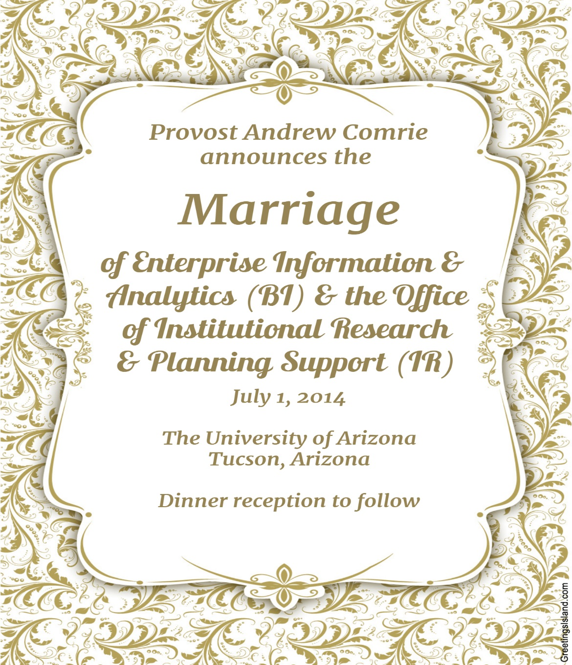
Announcement

Slide 8
Before…

Slide 9
After…

Slide 10
History – Mosaic Project
2008-2012 Mosaic Project implemented new administrative systems:
  Employee (Oracle PeopleSoft HCM)
  Financials (Kuali Financials)
  Research (Kuali Coeus)
  Student (Oracle PeopleSoft CS)
  Business Intelligence (Oracle EPM & OBIEE)
Dramatic increase in amount and quality of data
100’s and 100’s of new BI dashboards & reports

Slide 11
History – After Mosaic Project
BI environment serving 1500-2000 distinct operational users per month, averaging 20-25K queries per day
Not serving senior administrators nearly as well
  Apparently different results from BI environment and IR environment
  Lots of training and support for BI users, but very little metadata for campus analysts
  Deans expressed concerns re where to go for information and what to believe
  Provost said: let’s talk

Slide 12
History – From Virtual to Real
2013 - Joint discussion with IR and BI leadership
  Clarified and distinguished the missions of BI and IR
  Asked IR and BI to work together as a “single virtual organization” as seen by campus units
  Joint projects
    Decision Support Data System (DSDS)
    Predictive Analytics for Student Success (Civitas)
    Responsibility Centered Management (RCM)
2014 – Retirement of head of IR…Provost decision to formally combine the units

Slide 13
Why the Decision to Combine?
Things working pretty well with BI & IR, but reliant on the very good working relationship between BI head and IR head…wanted to formalize
Vision that the information worlds of IR and BI would overlap even more in the future
  Pressure for ever more information available to decision makers
  Desire to move more into predictive analytics (which needed both units)
  Opportunity for exploiting complementary strengths

Slide 14
Opportunities for Synergy
BI Strengths
IR Strengths
Understanding of operational data
Technology
Financial, HR, & Research data
Understanding of data in context
Data presentation
Student & Faculty data
We need data that is integrated
  Across the value chain of raw to refined data
  Across the different realms of data
Notes:
There are other opportunities as well.
Campus accesses BI thru a facility we call “UAccess Analytics”—that environment is a useful “distribution mechanism” for some IR information, particularly when it is detailed data to be used by analysts
Work together to keep IR from being pushed or perceived as the “external reporting” function and BI from being pushed or perceived as interested only in operational data
We want to do more predictive analytics!

Slide 15
Issues to Overcome
Why don’t most institutions combine their BI and IR functions?
Why do they often not get along very well?
Structural Differences
  IR often aligned with Academic Affairs or Planning & Budgeting
  BI often aligned with IT
Cultural Differences
  Different backgrounds & values
Timing
  Conflict in the past
  Can current needs trump the past?
Notes:
Seque In: If this is such a good idea, why haven’t others tried it?
Some have and/or are, and we are very interested in comparing notes
In the past (10-15 years ago) the two UA groups quietly worked together and created the previous generation of campus data sources, but this fell apart…why?
UA outgrew the solutions put in place
Big issues in the underlying data quality (addressed with Mosaic)
Changes in leadership
This seems usually a pretty hard thing to do (to combine these groups)
Issues cited here are not UA issues per se, but our perception of the general situation
Timing very good for UA:
BI previously reported to the CIO, but separate from IT
Just implemented brand new enterprise systems, including attention to data quality & integration
IR leadership change due to retirement
BI & IR already working together as a combined “virtual” organization focusing on our “Decision Support Data System”

Slide 16
How’s It Going So Far?
Work in process
  Separate BI and IR functions within UAIR
  Strong directors w/shared vision, but new roles
Success on some key projects
Moving deliberately by design in first year
Looking to have a common shared physical space
Need to consolidate and integrate data and server environments
Substantial work pressures, including budget pressures
Some fear and confusion about future
Makes us wonder what other institutions are experiencing and thinking

Slide 17
Section 2 – What Other Institutions Are Experiencing and Thinking

Slide 18
As Yogi Berra put it…
“When you come to a fork in the road…
take it!”

Slide 19

Shotgun Wedding?

Slide 20

Or Marriage Made in Heaven?

Slide 21
Talked with…
14 other institutions
18 structured interviews
23 interviewees
Numerous informal conversations

Slide 22
Asked Them…
What do you think? If your institution set out to combine IR and BI, how would you characterize it?
  Marriage made in heaven?
  Arranged marriage?
  Shotgun wedding?
  Las Vegas wedding?

Slide 23
Some Responses
“The opportunity is right now! But no one sees it.”
“[IR & BI] get along just fine, would not seek
marriage.”
“…hasn’t worked well in the past,
would have to be arranged.”
“…would have to be a very arranged marriage, and
would need significant upper level facilitation.”
“…no parents to arrange the marriage.”
“…right now it would need a shotgun.”
“…like marrying your brother!”

Slide 24
Best Response
“I absolutely think that BI and IR should be combined…and it should report to me!”
Anonymous

Slide 25
Polling Question
What do you think? If your institution set out to combine IR and BI, how would you characterize it?
  Marriage made in heaven?
  Arranged marriage?
  Shotgun wedding?
  Las Vegas wedding?

Slide 26
Marriage by the Numbers—Interviews

Slide 27
Marriage by the Numbers—AAUDE

Slide 28
Where Do IR and BI Report Today?
BI
  IT – 10 (In 2 cases, IT reports to the President)
  IT & non-IT Split – 2 (DW to IT)
  Finance – 1
  Distributed – 1
IR
  Provost/Academic Affairs – 8
  Budget/Finance/Planning – 3
  Chief Data Officer – 1
  Decision Support – 1 (IR + BI, excl DW)
  Don’t Know – 1 (Interviewer error)

Slide 29
Where Would BI + IR Report?
IDK – 5 (IDK = “I don’t know”)
Provost? – 3
Provost – 1.5
Chief Operating Officer (if there was one) – 1
President – 1
CIO for Now, President Later – 1
Chief Data Officer? – 1
Institutional Effectiveness – .5

Slide 30
How IR Perceives BI Today
“It just takes too long!”
“IT is a monolith. They hold all the cards.”
“IT is only interested in sexy technology.”
“BI is taking over.”
“All the big investments are going to BI.”
“[BI approach is to] let 1000 flowers bloom.”
“BI people don’t care about the impact of sharing
data. They are not careful enough.”
“They build reports; they don’t know data and policy.”
“BI people like the plumbing, not the contents…want to
make sure the water is flowing.”

Slide 31
BI & IT Footnote
BI is part of IT in most cases
But at several institutions it was not always that way
And BI is often not comfortable being in IT
  Several believe it could be or should be housed elsewhere
Irony is that IR perceives BI to be IT, but BI often does not see it that way

Slide 32
How BI Perceives IR Today
“We got an Xbox for student employees—IR was shocked!”
“They won’t reveal the ‘secret sauce.’”
“They seem mostly in the business of protecting IR.”
“It’s the difference between [the disciplines of] accounting & finance.”
“IR is really really conservative.”
“Asked IR candidate to define success, and the response was ‘if
nobody calls me up and tells me my numbers are wrong.’”
“IR needs to be the facilitators of information, not the gatekeepers.”
“IR slaps us whenever we put anything out.”
“They don’t have an appreciation for the enterprise
perspective…what the campus really needs.”

Slide 33
On the Other Hand
“Not excited at first [about working together]. Working very well now, but not initially.”
“It took a long time to get there. It seemed to go against
the grain.”
“Certainly friction, but the relationships are familial.”
“Nobody can do anything important without collaborating.”
“We did a collaboration a year ago.... It went very well,
mended bridges, and built foundations.”
“There’s an opportunity to work together anyway…ask
permission later.”
“We are working really well together.”

Slide 34
How Well Do IR & BI Work Together?
IR & BI work well together today:
1=Strongly Agree (very positive)
2=Agree (somewhat positive)
3=Neutral (okay)
4=Disagree (somewhat negative)
5=Strongly Disagree (very negative)
Note—I did not ask this question directly, so these values are inferred.

Slide 35
Observation
“England and America are two countries divided by a common language.”
George Bernard Shaw*
*Per phrases.org.uk/quotes/misquotes this does not appear in any of the writings of GBS.

Slide 36
Hypothesis
If BI & IR are divided by the common language of data, then we should look at the reasons for that.
“Things are the way they are
because they got that way.”
attributed to Kenneth Boulding, Economist

Slide 37
Common Structural Differences

Slide 38
Common Cultural Differences

Slide 39
Common Cultural Differences (cont.)

Slide 40
Polling Question
  Based on the findings from this set of institutions, are you now?
  Happy…this marriage is meant to be
  Hopeful…you know it just might work
  Determined…we’re going to make it work
  Discouraged…this is never going to work

Slide 41
Section 3 – Conclusions & Recommendations

Slide 42
Conclusions
Combining IR & BI is currently not common…of the 14 institutions:
  One has done it in great part
  Two see an opportunity right now (both due to turnover and need to rebuild)
  Note these tend to be smaller institutions
Very wide range of responses around how well IR & BI work together today
Local forces matter a lot
People matter a lot
Structural and cultural differences between IR and BI are real and explainable

Slide 43
Observations About Working Well
Recognition of differences
Recognition of larger forces at play
Willingness to work together towards larger goals
  Playing to strengths
  Ability to find compromise
Leadership
Successful projects

Slide 44
Observations About Not Working Well
Recognition of differences
Limited recognition of larger forces at play
Less willing or able to work together towards a larger goal
  Disagreements on authority
  ...technology
  …methodology
  Less trust
Unsuccessful projects

Slide 45
Larger Forces at Work
Demand for information that is:
  Relevant (type, currency)
  Usable (trusted, understandable, integrated)
  Available (time-of-day, technology, self-service)
Expectation that information is a “free good” like the Internet
  Available & searchable
  Tolerance for variation in presentation (but probably not an attitude of caveat emptor!)
Growing interest in Predictive Analytics
See data as institutional asset…less tolerance for silos
Increasing technical savvy of users
Pressures on higher education & political instability

Slide 46
Recommendations
It’s a big problem if BI & IR are not working well together
Start by understanding the differences between the two groups
Develop a vision of how things could & should work
Conduct successful joint projects to move forward
Do not take project success for granted
  Leadership needs to be strong & executive oversight is critical
Consider combining BI & IR as a way to:
  Capitalize on a good working relationship (marriage made in heaven)
  Or force an improved working relationship (arranged marriage)
Get the reports-to structure right.
  Very high
  Institution-wide in perspective, both in fact and in perception

Slide 47
More Specifically
Treat the production of official numbers as a process
  BI supplies raw numbers via the Data Warehouse
  IR reviews and revises numbers as necessary
  Official numbers go back into the Data Warehouse
  Opportunities to semi-automate are identified and exploited
Move toward a single common store for reporting and analysis data
  Either the Data Warehouse, or something that includes the Data Warehouse
  Allow/encourage multiple tools for accessing the data, including visualization
Address the most important data management issues
  Provide common definitions in business terms
  Create a vehicle for prioritizing and addressing data quality issues
Accept and manage much more open access to data and more distributed expertise
Work together towards the information that is really needed to inform and help steer the institution

Slide 48
Notes:
This is a high-level architecture of our internal information environment
Organizational integration shows itself as data integration in the way that data is sourced, processed, and delivered to users
The arrows indicate data transformations and which function is mainly responsible
1st row: Operational reporting done by BI (30,000 queries per day)
2nd row: Official external reporting done by IR (20+ agencies and growing, not to mention ad hoc analysis)
3rd row: Decision support is a highly integrated activity and our current focus
In particular we couldn’t deliver DSDS without this integration.

Slide 49

And with a Nice Cup of Coffee…

Slide 50
Wrap Up

Slide 51
Big Thanks!
Boise State University
Cornell University
Georgia Tech
Hawaii Pacific University
Illinois State University
Indiana University
Miami University of Ohio
Purdue University
Virginia Tech
University of Illinois
University of Maryland
University of Maryland, Baltimore County
University of Washington
University of Wisconsin

Slide 52
Help Us Improve and Grow
Thank you for participating
in today’s session.
We’re very interested in your feedback. Please take
a minute to fill out the session evaluation found within
the conference mobile app, or the online agenda.

Slide 53
Contact
Hank Childers, Executive Director
  University Analytics & Institutional Research (UAIR)
  University of Arizona
  hankc@email.arizona.edu
  520-626-6779 (ofc) 520-603-6063 (cell)

