Slide 1
Trust and Identity in Education and Research: Identity for Everyone
Ron Kraemer, Notre Dame • Kevin Morooney, Penn State • Ann West, Internet2 • Steve Zoppi, Internet2

Slide 2
Goals of Today’s Meeting
TIER Quick Overview
Program Status
Work In Progress
International Implications
Campus Readiness
Notes:
Audience: Architects and CIOs
Ron and Dennis

Slide 3
What is Trust and Identity in Education and Research (TIER)?
Notes:
Audience: CIOs
Ron and Dennis

Slide 4
What is TIER
T(rust)
I(dentity)
Management of individual principals, their authentication, authorization, and privileges within or across system and enterprise boundaries.
E(ducation)
R(esearch)
Communities of students, teachers and scholars interacting on a global scale.
An increasingly virtual, mobile and global research community.
A secure and privacy-preserving trust fabric for research and higher education, and their partners.

Slide 5
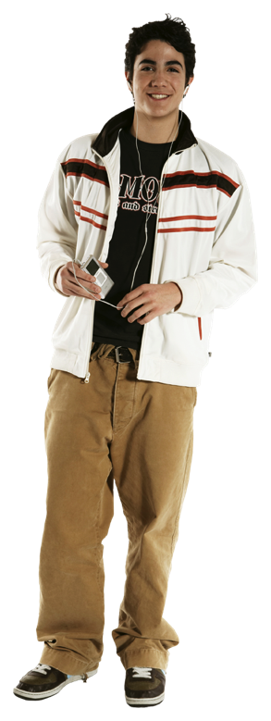
What is Trust and Identity and Education and Research?
Notes:
TIER is about getting it right for these folks.
It’s about
Enabling the individual to access academic resources seamlessly
Aligning how HE does identity and access so we can create an identity “network” that’s pluggable
Leveraging what the I2 community has done in the past with InCommon , shibboleth and Grouper and building on that to create a suite of services and software that HE can use and Corp partners can leverage to enable the individual.
Ron and Dennis

Slide 6
Summary: What is TIER all About?
Sustain components that we've developed together.
Fill the gaps by providing a set of integrated components that addresses IAM as a whole.*
Address community requirements across the components.
* Includes Corporate and Community Partnerships
Notes:
Audience: CIOs
Ron and Dennis

Slide 7
TIER vision
We believe that identity will be a service
We believe that it will be a cloud service with campus localization
We believe that if we do not develop it we will have to accept that someone else will (this means social identities)
We believe that effective collaboration with partners will be key (and that includes federal agencies)
We know we are at least 3-5 years from achieving this vision

Slide 8
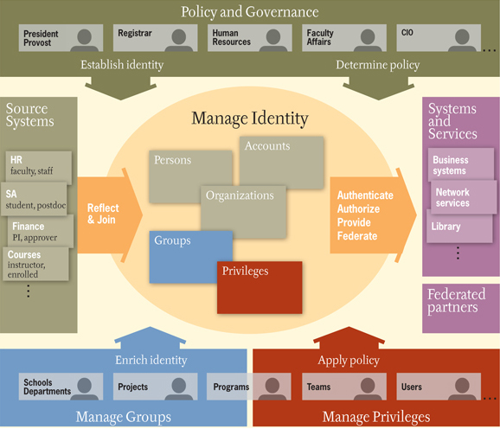

Slide 9
TIER Goal: Unified (& Scalable) Model
Secure Directory, Identity and Metadata Services
Single Signon and Identity Components
AuthN (Who)
AuthZ (What)
Registry Services
Persistence and Replication
Federated Registry (Directory Search / Lookup)
Network Objects (Files, Datasets, etc.)
People
Nodes
Multi Factor
Workflow Services
Automated Provisioning / Deprovisioning and Rules Enforcement
Multi-Level (Groups)
Business Rules Engine / Grammar
Files / Datasets
Notes:
This slide needs to summarize attribute, taxonomy and release requirements. This will make the population of a federated (registry) easier. Scalable is lkey

Slide 10
TIER Moves from Investor to Sustainable Model (Financials and Governance)
Notes:
Audience: CIOs
Ron and Dennis

Slide 11
TCI and TCIC
More to Explore
With 2.5 Years Remaining …
How should we think about new TCI members?
Replace as need arises?
More structured renewal? Note: loss of time in onboarding (2 year appointment minimum)
How do we start up a permanent governance structure?
TIER Community Investor / Council
Limited in Charter
Duration: 3 years
Scope: Initial Investment Oversight
The Need for Permanence
Funding (dues and fees)
Governance (Internet2 PAG model)
Notes:
Audience: CIOs
Ron and Dennis

Slide 12
TIER Community Investor Council
Klara Jelinkova Rice University (Chair)
Dennis Cromwell Indiana University
Eric Denna University of Maryland
Tracy Futhey Duke University
Chris Holmes Baylor University
Ron Kraemer University of Notre Dame
Kevin Morooney Penn State University
John O’Keefe Lafayette College
Kelli Trosvig University of Washington
Melissa Woo University of Oregon
Shel Waggener Internet2

Slide 13
Future Governance Structure
Internet 2 Board of Trustees
TIER Steering/Board
InCommon Steering Committee (ICSC) *
External Relations Subcommittee (includes members from ICSD and SDSC)
Service Development Steering Committee (SDSC)
* Rescoped InCommon Steering Focuses only on Federation

Slide 14
Membership and Early-Phase Funding Model
Dynamically
Scalable Operations
Program
Participants
Subscriptions
& Access Fees
Internet2
Members
Today: TCI & TCIC
Program Operational Acceleration
Core Program Administration
Tomorrow: PAG Needed
Capital Calls
Host Organizational Capacity
Dues
Notes:
Audience: CIOs
Ron and Dennis and handoff to Steve and Ann

Slide 15
Current Committed Participants
Institution Name
Baylor University
Boston University
CALTECH (California Institute of Technology)
Carnegie Mellon University
Case Western Reserve University
Clemson University
Cornell University
Duke University
Harvard University
Indiana University
Lafayette College
Louisiana State University
MIT
New York University
Northwestern University
Old Dominion University
Oregon State University
Institution Name
Pennsylvania State University, The
Purdue University - Main Campus
Rice University
Stanford University
Tulane University
University of Arizona
University of California – Berkeley
University of California – Merced
University of Chicago
University of Florida
University of Hawaii
University of Illinois – Urbana Champaign
University of Iowa
University of Maryland – Baltimore County
Institution Name
University of Maryland – College Park
University of Michigan - Ann Arbor
University of Missouri - Columbia
University of Nebraska - Lincoln
University of North Carolina - Chapel Hill
University of Notre Dame
University of Pittsburgh - Pittsburgh Campus
University of Utah
University of Virginia
University of Washington
University of Wisconsin - Madison
Washington University in Saint Louis
Yale University
Notes:
43 Participants as of Oct 26

Slide 16
Program Status
Notes:
Audience: CIOs
Ron and Dennis

Slide 17
Internet2 Program Support
Ann West (AVP Trust and Identity)
Technology
Steve Zoppi (AVP Services Integration and Architecture)
Sustainability
Community Engagement and Membership
Community
Notes:
Ron and Dennis

Slide 18
Targeting …
2016 First Integrated Release
Minimal Installation / Configuration User Interfaces
Preliminary Requirements will be set for Scalable Consent
Objective: Point In Time Consistency
Notes:
Steve

Slide 19
Primary Focus for Release 1
Container/Packaging
Initial Deployment
Continuous Update Cycles
APIs
Documentation
Community Identity Provider?
Under Consideration for R2
Scalable Consent?
Notes:
Steve

Slide 20
Revised Program Timeline (Funding Driven)
Progress
Communities of Interest
Financial Tracking and Reporting
MOU Management
Community Forum (Online!)
Technical Requirements Revision
Dependencies Identified
Relationships Identified
Working Groups
Component Leadership In-Place and Roadmap Underway
First Two Corporate Partnerships
Unicon ()
Shibboleth
Grouper
Spherical Cow Group ()
COmanage
 Complete  Pending
Notes:
Steven/Ann

Slide 21
Meaningful Impacts
Milestone | Impact
Communities of Interest | Form working groups quickly
Financial Tracking and Reporting | Report out on cash flow and project spend to the community
MOU Management | Bring in seed funding to support early stages of the program
Community Forum | Enable community input, discussion and decision making
Technical Requirements Revision | Finalize for TIER developers. Enable best coherent first release.
Working Groups | Develop key specifications per community requirements.
Notes:
Steven/Ann

Slide 22
Sponsors of the Work
Community responsible for Higher-Education standards
Internet2 responsible for industry approaches
Currently convened under Internet2 (rather than TCIC) … … but with connections to both and InCommon
Notes:
Audience: Architects
Ann

Slide 23
TIER Working Group Structure
Optimized Approach*:
Several Key working groups will be composed of Appointed Community Participants (Rather than having an “Open Call”)
Rationale: Expeditious movement using smaller, focused Teams
Open / Published
Charter / Chair / Participants
Forum
Summaries
Feedback and Vetting (Includes International Review)
* Note that Community Adoption Working Group WILL be conducted as an “Open Call”

Slide 24
Community Working Groups “Group A”
Data Structures and APIs (Keith Hazelton) | Participate in working groups related to exploration of Data Structures and APIs commonly supported, implemented and exchanged between ALL TIER and TIER-Related Components.
Packaging and Containerization (Jim Jokl) | Participate in working groups related to exploration of Packaging and Containerization practices and procedures commonly supported and implemented in ALL TIER Components.
Security & Audit | Participate in working groups related to exploration of Security practices and procedures commonly supported and implemented in ALL TIER Components. (INCLUDES “3M” INSTRUMENTATION AND REPORTING)
User Acceptance | Participate in working groups related to exploration of User Acceptance practices and procedures commonly supported and implemented in ALL TIER Components. (INCLUDES TEST AUTOMATION AND USABILITY)
Notes:
Ann/Steve

Slide 25
Community Working Groups “Group B”
Accessibility | Participate in working groups related to exploration of Accessibility practices and procedures commonly supported and implemented in ALL TIER Components.
Defect & Vulnerability Management | Participate in working groups related to exploration of Defect Management practices and procedures commonly supported and implemented in ALL TIER Components.
Document Management | Participate in working groups related to exploration of Document Management technologies, practices and procedures commonly supported and implemented in ALL TIER Components. (SHOULD THIS BE BOARDING GROUP “A”?)
Internationalization (I18N) | Participate in working groups related to exploration of Internationalization practices and procedures commonly supported and implemented in ALL TIER Components.
Partnerships and Third-Party Engagement | Participate in working groups related to exploration of Partnerships and Third-Party Engagement practices and procedures commonly supported and implemented in ALL TIER Components.
User Interface / User Experience | Participate in working groups related to exploration of User Interface / User Experiences practices and procedures commonly supported and implemented in ALL TIER Components.
Notes:
Ann/ Steve

Slide 26
“3M” Working Group Needed?
Instrumentation: Monitoring, Measuring, Managing
Continuous, Meaningful feedback on how the community is utilizing the components - Everywhere
Tune-In: tier-discussion@internet2.edu

Slide 27
Community Adoption Working Group Needed?
Community Adopter Coordination:
Process Management
Early Adopter Management
Case Studies (Success/Failure Criteria Measurement) {Continuous Improvement}
Training Required
Tune-In: tier-discussion@internet2.edu

Slide 28
Emerging Community Contribution
Soon Calling For:
Subject Matter Experts
Topic Owners
Community Forum
Mailing Lists (1st Responders)
Tune-In: tier-discussion@internet2.edu

Slide 29
Emerging Community Contribution
Documentation {Authoring}, {Tagging}, {Writing} …
Automated Test Cases
CI (Continuous Integration)
Tune-In: tier-discussion@internet2.edu
Tune-In: tier-architecture@internet2.edu

Slide 30
Emerging Community Contribution
Software Specialties
Logging and Instrumentation: Error/Messages/Stats
Analytics: Making “server-exhaust” More Useful
Tune-In: tier-architecture@internet2.edu

Slide 31
International Community Contribution
Software Opportunities and Realities
Federation Operations Management
Shared Features
Shared Architectures and Data Structures
Federation Interoperation: eduGAIN
Tune-In: tier-architecture@internet2.edu

Slide 32
Work in Progress
Notes:
Audience: CIOs
Ron and Dennis

Slide 33
Launching the Program: Ad Hoc Architecture Strategy Group
Pulled requirements for the TIER Community Investor Council to prioritize
Tightened up the requirements once prioritized so they could be given to working groups
Spinning up the first working groups
Helping to define the TIER process and who does what
Notes:
Ann

Slide 34
Launching the Program: Ad Hoc Architecture Strategy Group
Tom Barton University of Chicago
Paul Caskey Internet2
Jacob Farmer Indiana University
Keith Hazelton University of Wisconsin-Madison
Jim Jokl University of Virginia
Ken Klingenstein Internet2
Nate Klingenstein Internet2
Nick Roy Internet2
Notes:
Ann

Slide 35
TIER Prioritized Requirements
Requirements (Prioritized)
https://internet2.box.com/TIERInvestorReview
Remember these?
How do we bring these to a specification against which we can build?
All background materials:
https://internet2.box.com/TIERInvestorBackgroundDocs
Notes:
Audience: Architects
Steve/Ann

Slide 36
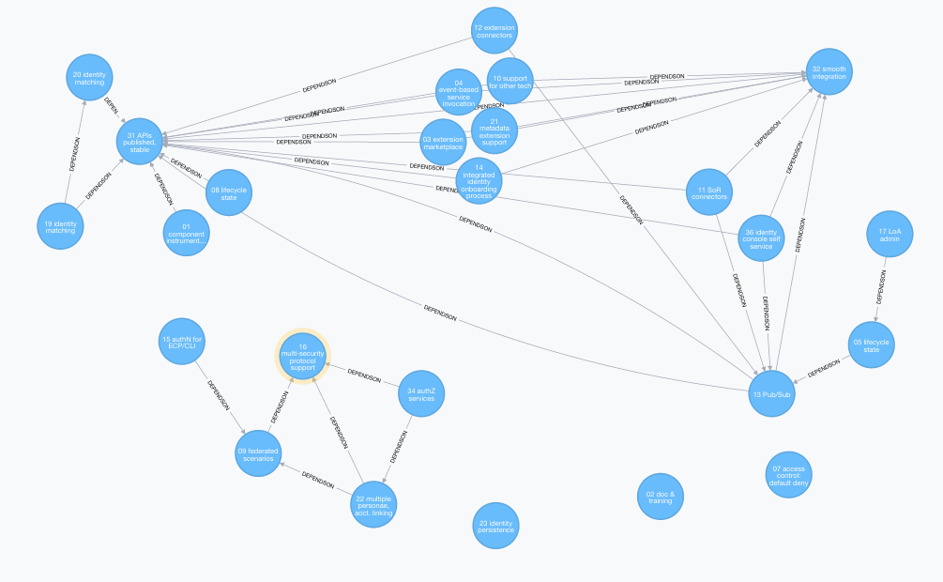
Requirements Dependency Analysis
Confirming the Linkages ensures that we sequence solutions in the right order….
Map Credit: Keith Hazelton
Notes:
Audience: Architects
Steve

Slide 37
TIER Component Architects
Scott Cantor Shibboleth
Chris Hyzer Grouper
Benn Oshrin* COmanage
Ken Klingenstein Scalable Consent
Nate Klingenstein Community Identity Provider and Person Registry
Keith Hazelton APIs and Data Structures
Jim Jokl Packaging and Containerization
Nick Roy Federation Manager
* Commercial partner
Notes:
Ann

Slide 38
Staffing Progress and Priorities (First Wave)
Existing Contracts / Assignments (Renewed)
Grouper Dev Replacement (Done)
Sr. Technical Project Manager (Under Contract)
UI/UX Technology Lead (Recruiting)
UI/Front End Developer (Recruiting)
DEV/QA and Packaging Engineer (Recruiting)
Campus “Enablement” (Defining)
Information Architect (Next)
Notes:
Ann
Steve and Ann

Slide 39
Campus Preparation
Notes:
Ann
Ron and Dennis

Slide 40
Release 1 is Important
It establishes…
New and current baseline for all products
Foundation for future (incremental) updates and enhancements
Simple upgrades using latest integration techniques
Simple deployment into a scalable environment
Releases are instrumented for continual feedback and improvement of the product (Anonymized data / Opt-In Data)
API: forward compatibility; abstracted plug-in point for commercial partner integration; framework for further inter-campus collaboration by establishing common points for provisioning and deprovisioning
Participate in shared-adoption cohorts
Notes:
Ann/Steve

Slide 41
More Ways to Prepare:
Upgrade to the current version of Grouper
Upgrade to Shibboleth Identity Provider 3.x
Familiarize yourself with CIFER-> TIER-API Framework
TIER Components will have public interfaces on these APIs and their successors
Track the InCommon Federation Interoperability Group
Will impact your local systems
Notes:
Audience: Architects
Ann

Slide 42
Help Us Improve and Grow
Thank you for participating
in today’s session.
We’re very interested in your feedback. Please take
a minute to fill out the session evaluation found within
the conference mobile app, or the online agenda.

Slide 43
Thank You!

Slide 44
Trust and Identity in Education and Research: Identity for Everyone
Ron Kraemer, Notre Dame • Kevin Morooney, Penn State • Ann West, Internet2 • Steve Zoppi, Internet2

