Slide 1
Digital Preservation Use Case: Indiana University’s Media Digitization and Preservation Initiative
Jon W. Dunn
Assistant Dean for Library Technologies
Indiana University Bloomington Libraries
jwd@iu.edu
EDUCAUSE 2015 - Indianapolis
October 30, 2015

Slide 2
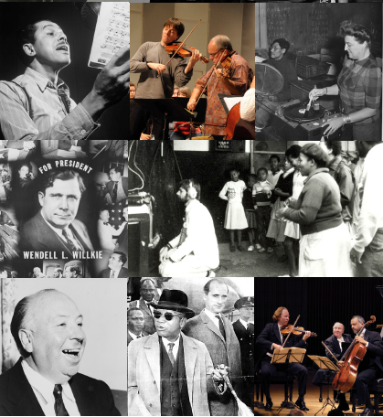
Indiana University Context
Over 3 million special collections items at IU Bloomington
Within and outside the Libraries
Many sources of A/V
Music and other performing arts
Ethnomusicology, anthropology
Public broadcasting stations
Film collections
Athletics
History of work on media digital libraries
Variations digital music library
EVIA Digital Archive
Avalon Media System

Slide 3
2009 Media Preservation Survey Findings
More than 560,000 audio, video, and film objects are owned by the Bloomington campus on more than 50 formats housed in more than 80 units
Actively degrading, obsolete formats, high risk of loss of content over the next decade
We have a 15- to 20-year window of opportunity to digitally preserve audio and video holdings.

Slide 4
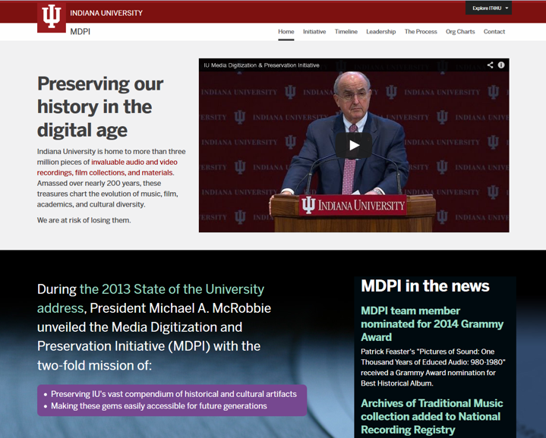
2013 Announcement: Media Digitization and Preservation Initiative
Goal: Digitize, preserve, provide access to rare and unique audio and video by 2020 – all IU campuses
$15M investment

Slide 5
Public-Private Partnership
Memnon Archiving Services, A Sony Company
Brussels, Belgium

Slide 6
What We Need to Preserve
~7 petabytes over four years
9 terabytes per day peak
Motion picture film = even more data!
Preservation Master Files:
Audio: Broadcast WAV (96/24)
Video: FFV1 lossless (.mkv)
Mezzanine Files:
Audio: Broadcast WAV (96/24)
Video: 50 Mbps Iframe-only MPEG-2

Slide 7
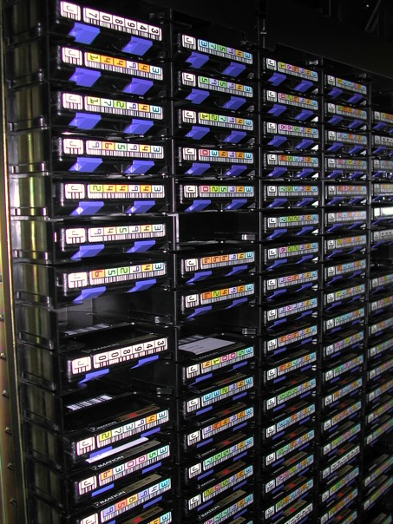
Local Digital Preservation Storage
Bit Storage:
IU Scholarly Data Archive (SDA)
40PB+ HSM system (IBM HPSS)
Mirrored between Bloomington and IUPUI
File and Metadata Management:
HydraDAM2 IU-WGBH collaboration

Slide 8
Long-Term Preservation Strategy
Good local storage situation, but risky for preservation
Out of region storage options:
APTrust
DPN
Data swap agreements
8

Slide 9
To Be Continued…
mdpi.iu.edu

