Slide 1
APTrust and Georgetown University Library
Salwa Ismail
Head, Library Information Technology
Georgetown University Libraries
salwa.ismail@georgetown.edu

Slide 2
“Digital media last forever or five years–whichever comes first.”

Slide 3
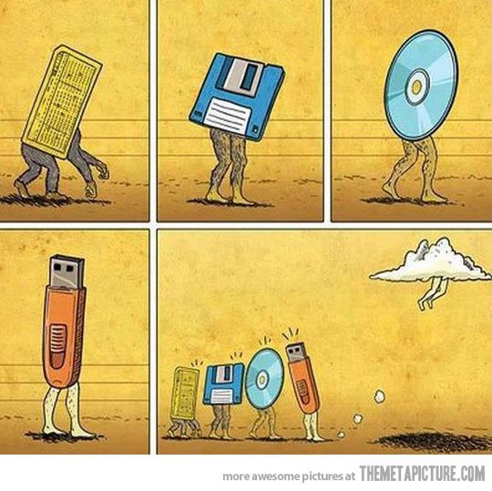
Digital Preservation
Scattered Content
Disks, CDs, network drives, USBs, external HDDs, computers
Textual, images, video, audio, moving image
Multiple constituents: Different Territories

Slide 4
Digital Preservation Strategy
Born digital (archives), digitized, scholarly records.
APTRUST, DPN, Chronopolis, HathiTrust
APTrust July 2015

Slide 5
IT, Can you help, PLEASE!?!
Dial in for IT help – Library IT
Parking Space
Accordion Style
Start line
Negotiations commenced

Slide 6
Where to start? And how?
No reinventing the wheel
Conversations with UVa and Columbia
Strategies, metadata, handling, tools, processes
Supportive community, groups – growing!
Internal Decisions/Workflows
Varied stakeholders
How do we want to go it?

Slide 7
How to APTrust?
Let’s BagIT up
Specifics
Automate?
Metadata and Bitstream(s)
Audit mechanisms: Checksums, fixity checks
Local workflows
*BagIt is a hierarchical file packaging format designed to support disk-based storage and network transfer of arbitrary digital content.

Slide 8
Let’s start Bag(ging)IT
Accept content -- Fedora, DSpace or on file system -- format agnostic
Local automation modules
Shared tools
Staging area testing/receiving buckets
DEPOSIT AWAY

