Slide 1
How to Use the EDUCAUSE Core Data Service to Support Student Success
Laurie Heacock • Susan Grajek • Celeste Schwartz • Lou Kompare

Slide 2
This presentation leaves copyright of the content to the presenter. Unless otherwise noted in the materials, uploaded content carries the Creative Commons Attribution-NonCommercial-ShareAlike license, which grants usage to the general public with the stipulated criteria.

Slide 3




PANELISTS
National Director of Data, Technology and Analytics
Achieving the Dream
Vice President
Data, Research and Analytics
EDUCAUSE
Vice President
IT & IR
Montgomery County Community College
Director, Information Systems and Services
Lorain County Community College

Slide 4
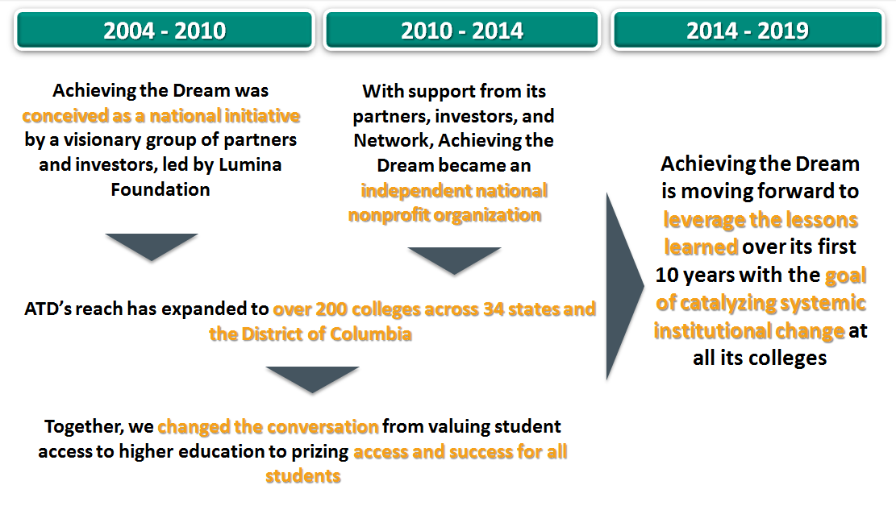
10 Years of ATD

Slide 5
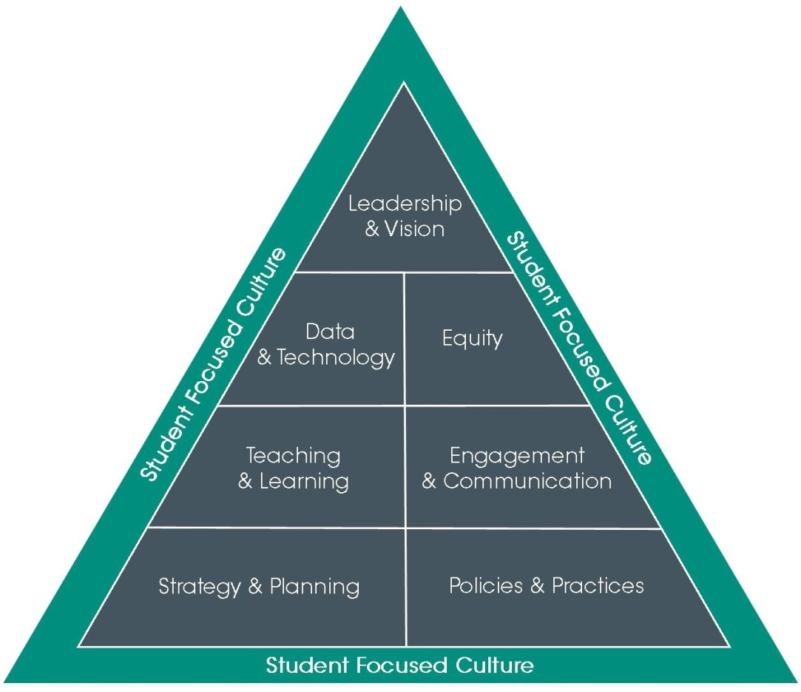
Achieving the Dream’s
Institutional Capacity Framework

Slide 6





Slide 7
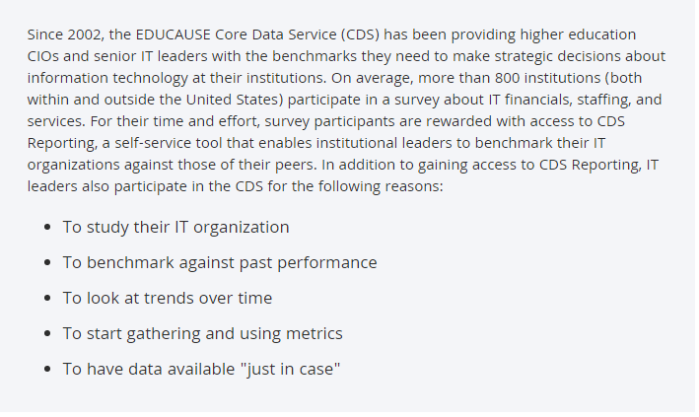
What is the Core Data Service?

Slide 8

TOP 10 IT ISSUES, 2015
#4
Improving student outcomes through an institutional approach that strategically leverages technology

Slide 9
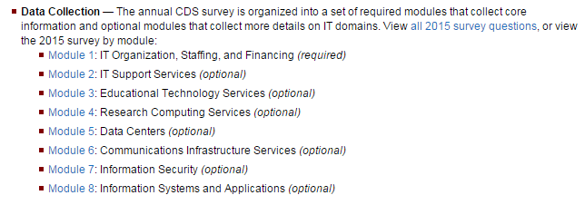
Core Data Service Modules

Slide 10
EDUCAUSE Benchmarking Reports
Notes:
EDUCAUSE is developing a new online service, built on the Core Data Service database, that will help IT leaders communicate the value and relevance of information technology to non-IT leaders, as well as help them assess and benchmark maturity and technology deployment for a suite of strategic initiatives. Development and prototyping of the new service is under way, and the service will enter production in the first quarter of 2016.
This new suite of maturity indices:
measure the capability to deliver IT services and applications in a given area
examine multiple dimensions of progress, technical and nontechnical, such as culture, process, expertise, investment, and governance
enable institutional leaders to determine where they are in delivering a service, and where they aspire to be
measure the degree to which an institution has deployed the technologies related to delivering a service, based on a standard scale reflecting stages of deployment
measure maturity in innovation broadly, reflecting on key elements to help develop and maintain a culture of innovation that supports the use of new technology in support of institutional and student success

Slide 11
Student Success Technologies
Maturity Index
Leadership and governance: Committed leadership, investment, formal governance
Collaboration and involvement: Cross-institutional participation and support
Advising and student support: Involvement and support of faculty and advising services
Process and policy: Flexible, documented; data safeguards
Information systems: Needed systems, integrations, training
Student success analytics: Analytics are embedded in decision-making.

Slide 12
Student Success Technologies Maturity

Slide 13
Student Success Technologies Maturity
Percentage of institutions

Slide 14
Student Success Deployment Index
Advising center management
Advising case management system for student interaction tracking
Education plan creation/tracking system
Credit transfer/articulation system
Academic early alert system
Course/program recommendation system
Degree audit
Student extracurricular activities management system
Student co-curricular activities management system
Student self-service referral to social/community resources
Student success analytics dashboards
Student success data warehouse/operational data store

Slide 15
EDUCAUSE Benchmarking Services
Goal
Provide higher education institutions with a reliable, affordable, and useful set of tools to benchmark and improve the cost and quality of IT services, improving the value and efficiency of IT's contribution to higher education

Slide 16
Basis of service
Core Data Service and ECAR research
Maturity indices
measure the capability to deliver IT services and applications in a given area
  culture, process, expertise, investment, and governance
Deployment indices
measure stages of deployment for specific technologies and services

Slide 17
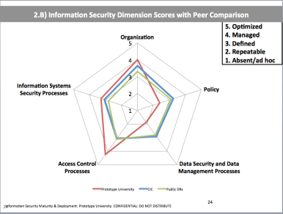
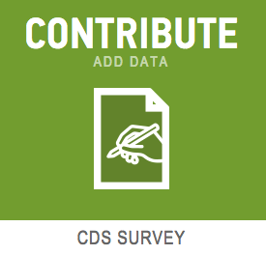
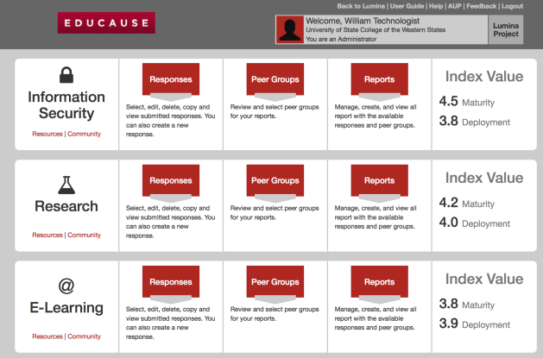
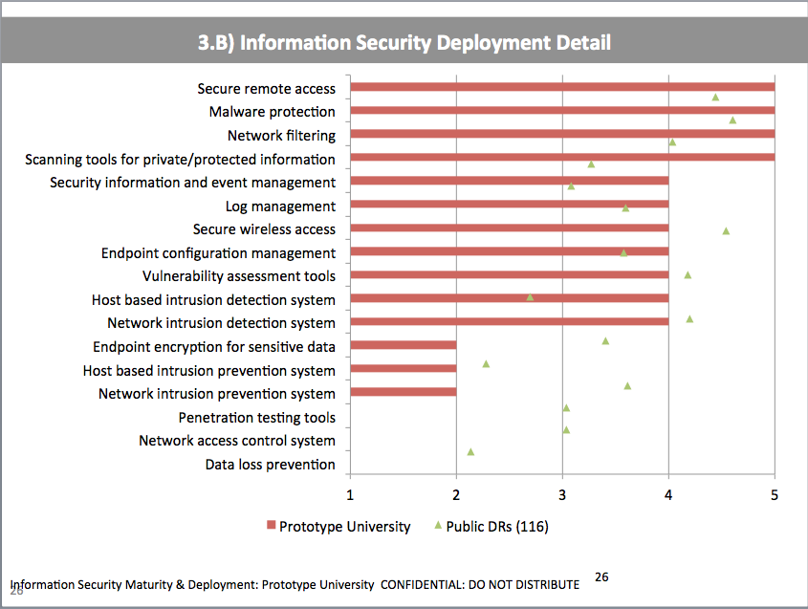
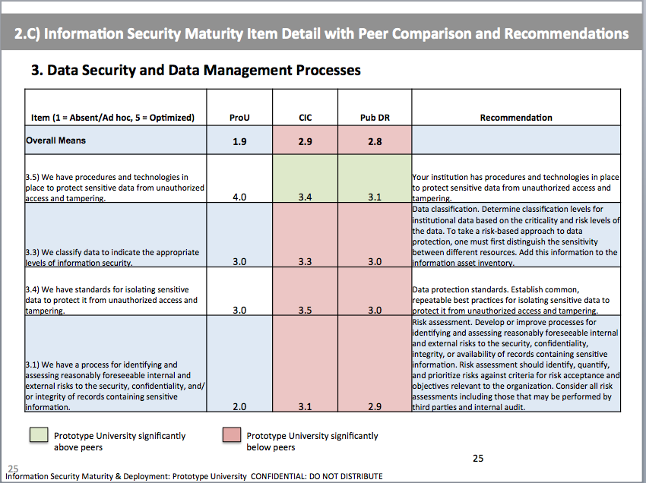
Process for members
Hours
Minutes
Minutes
Complete CDS
Order and configure reports
Receive and use reports

Slide 18
Reports available by Q1 2016

Slide 19

EDUCAUSE Benchmarking Reports
1) Build reports with customized peer groups on demand
Notes:
Our new online service will build on the CDS database and reporting tools and will leverage other EDUCAUSE data and analytical frameworks to create a snapshot of internal performance and how your institution compares to customized peer groups. Development and prototyping of the new service is under way, and the service will enter production in the first quarter of 2016.

Slide 20
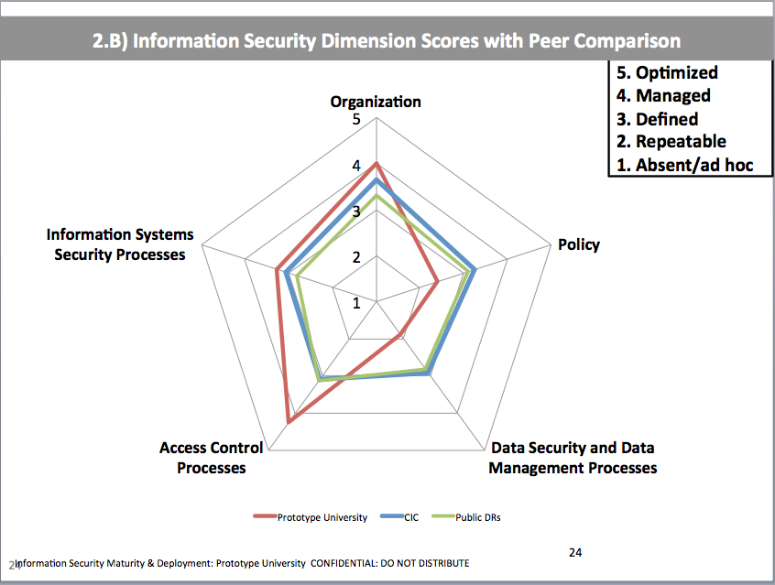
EDUCAUSE Benchmarking Reports
2) Benchmark maturity and technology deployment
Notes:
The reports will provide the status of your maturity and technology deployment in a given area, benchmarked against the peer groups you’ve selected.

Slide 21
EDUCAUSE Benchmarking Reports
3) Receive recommendations for improvement
Notes:
The reports will also include a set of recommendations for how to improve in areas that may be challenging for your institution. If you have any questions about this new service, please e-mail benchmarking@educause.edu

Slide 22
Q & A

Slide 23
Help Us Improve and Grow
Thank you for participating
in today’s session.
We’re very interested in your feedback. Please take
a minute to fill out the session evaluation found within
the conference mobile app, or the online agenda.

