Slide 1
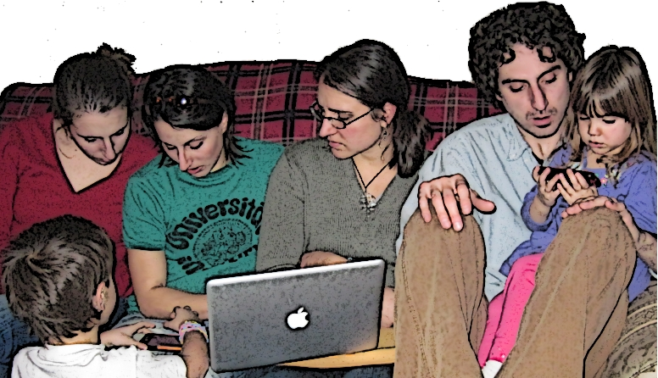
Blended and Online Learning
Learning ^{e}: the exponential power of learning whenever, wherever…
Hot Topics:
State Authorizations
Training
Web conferencing software
Compensation for faculty
3D Web

