Slide 1
The low hanging fruit is gone!
Go after the big transformational items.

Slide 2
Stop Making Plans, Start Making Decisions
Mankins, M.C. & Stelle, R. (2006). Harvard Business Review, 84(1), 76-78
”forward looking companies have thrown out their calendar-driven, business-unit-focused planning processes and replaced them with continuous, issues-focused decision making”
”failure of most strategic planning is due to two factors: It is typically an annual process, and it is most often focused on individual units”
”effective strategy planners spread strategy reviews throughout the year rather than squeeze them into a two or three month window”

Slide 3
A Model for Agile Strategic Planning
Assess
Context
Budget
Projects
Staff
Deliver
Start with biggest pain point and provide solution that is good enough
Tell story
Plan
Urgent (90 days)
Need Attention Soon (120 days)
Long term (1 yr)
Horizon (1-5 yrs)

Slide 4
Agile Planning is a great approach for the university on the move!

Slide 5
Must Be Transformative

Slide 6
A Manifesto for Agile Software Developers
The Agile Software Development Manifesto© is an intentionally streamlined expression of the core values of agile project management. Use this manifesto as a guide to implement agile methodologies in your projects.
We are uncovering better ways of developing software by doing it and helping others do it. Through this work, we have come to value:
Individuals and interactions over processes and tools
Working software over comprehensive documentation
Customer collaboration over contract negotiation
Responding to change over following a plan
That is, while there is value in the items on the right, we value the items on the left more.
©Agile Manifesto Copyright 2001: Kent Beck, Mike Beedle, Arie van Bennekum, Alistair Cockburn, Ward Cunningham, Martin Fowler, James Grenning, Jim Highsmith, Andrew Hunt, Ron Jeffries, Jon Kern, Brian Marick, Robert C. Martin, Steve Mellor, Ken Schwaber, Jeff Sutherland, Dave Thomas.
This declaration may be freely copied in any form, but only in its entirety through this notice. (http://www.dummies.com/how-to/content/agile-project-management-for-dummies-cheat-sheet.html)

Slide 7
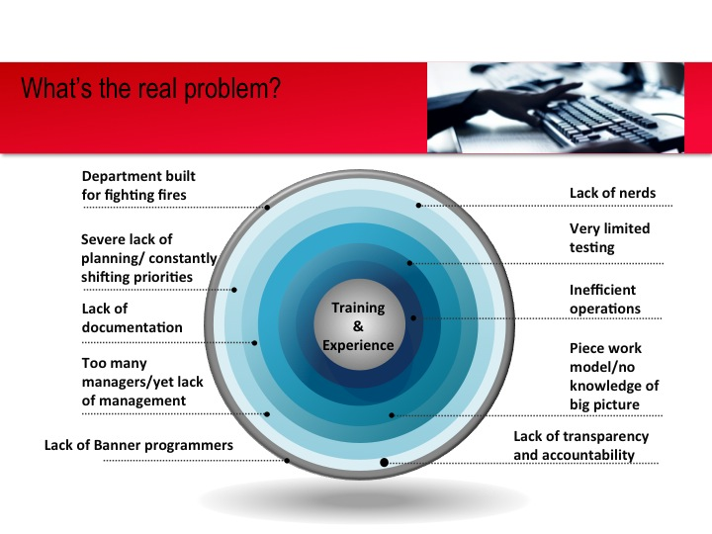
Assessment
Do quickly and aim for 80% correct
Put existing IT governance on hold
Benchmark
Interview partners
Examine helpdesk tickets
Triage in-flight projects

Slide 8
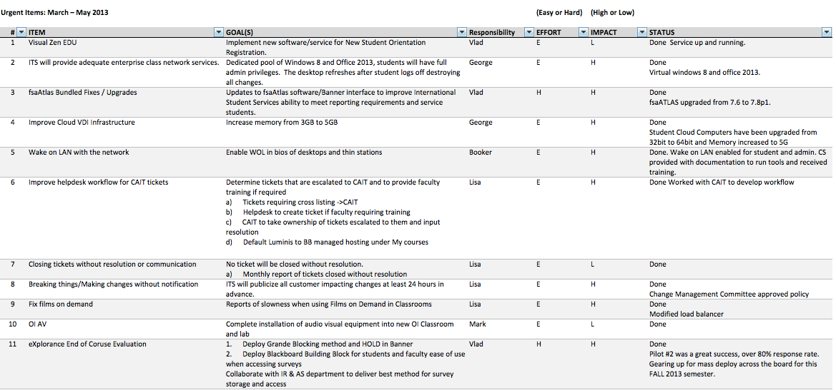
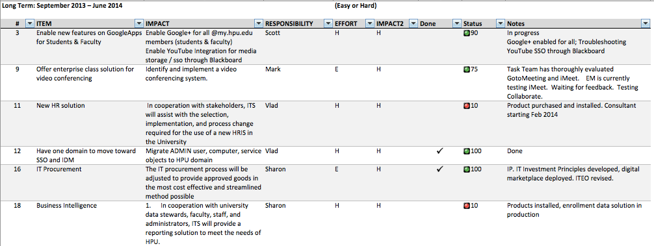
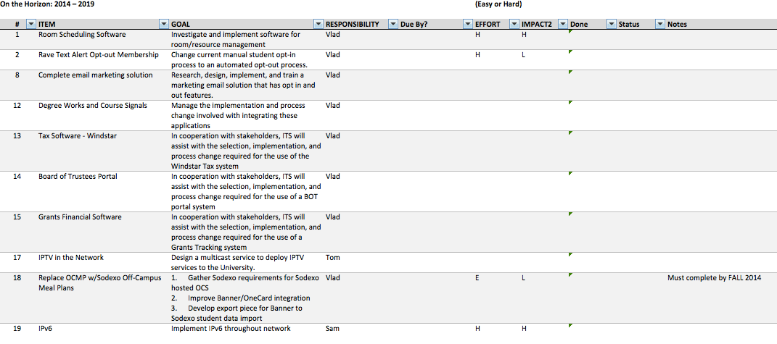
Plan

Slide 9
Repeat Every 30-90 Days

Slide 10
Agile Project Management's LifeCycle Includes five phases:
Envision - ascertaining the product vision, assigning accountability for who will be doing what, clarifying roles and responsibilities, and laying the foundation in how the team will work together.
Speculate - discerning the feature-based release, milestone, and iterative plan.
Iteratively deliver features - deliver the tested features in quick turnaround timeframes
Monitor and Adapt - review the deliverables, the current business environment, and the team's performance - and make changes as necessary
Close - conclude the project, resolve any outstanding items, and reward the team. (http://www.anticlue.net/archives/000988.htm)

