Slide 1
Exploration:
ITSM + PPM Evolution in IT Management

Slide 2
Goals
Understanding of related trends in higher education
Group identification of key benefits
Group identification of common roadblocks
Explore solutions to common roadblocks via shared experiences

Slide 3
Agenda
Exploration of ITSM + PPM Trends and Drivers
Facilitated Conversation
Summarization and Follow Up

Slide 4
Presentation

Slide 5
Client Sample

Slide 6
Higher Education Industry Trends

Slide 7
Project, Portfolio and Service Management Software Built for Higher Education
More colleges and universities depend on TeamDynamixHE PPSM than any other solution
Shifting Paradigms

Slide 8
Traditional Work/Fulfillment Silos
Focus
Requests
Governance, Projects, Portfolios
Projects Completed
(PPM Discipline)
Customers
Focus
Requests
Service Desk & Assets
Incidents Closed
(Support Discipline)
Customers
Focus
Operations & Change Management
Work Orders Completed
Requests
Tickets
(Chang/Ops Discipline)
Customers

Slide 9
Moving Towards a “Service to Customer” Focus
Service to Customers
PPM
ITSM

Slide 10
Project, Portfolio and Service Management Software Built for Higher Education
More colleges and universities depend on TeamDynamixHE PPSM than any other solution
Change Driver:
Adjusting to Evolving Expectations

Slide 11
Expectations of the CIO
Increase the organization’s velocity towards meeting strategic objectives
Continually increase efficiency and drive down costs
Minimize service outages
CIO
President

Slide 12
Reality
Understaffed to meet strategic expectations
Firefighting & changing priorities disrupt desired progress towards strategic goals
Lack visibility to make confident management decisions and push back on unreasonable expectations
Resources largely consumed by “keep the trains running” activities
CIO

Slide 13
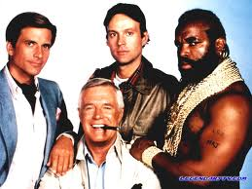
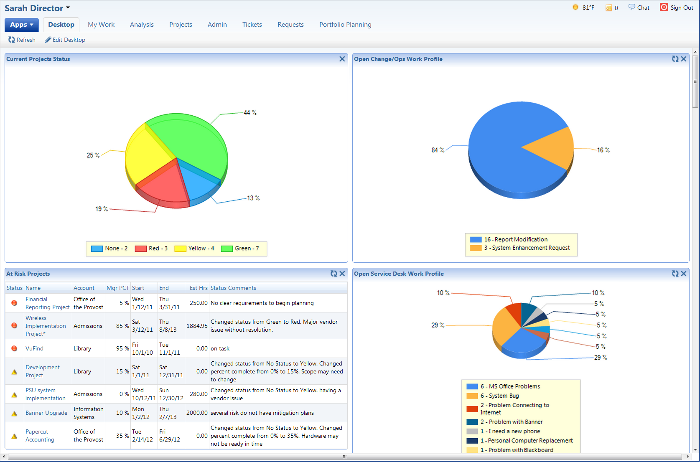
Communication: Internal Leadership Team
Key Purpose:
“Canaries in the Mine”
Identify and prevent potential problems early
Making confident decisions to increase velocity
Committing resources to projects
Changing resource commitments to adjust to change
Prioritizing work
Identifying opportunities for improvement

Slide 14
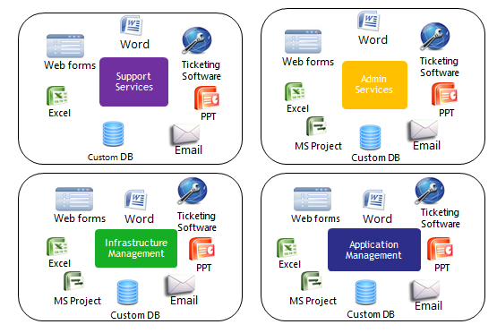
“Complicating” Factors
IT
#EDU12 Too many tracking tools and request channels necessitates massive amounts of manual reporting, making decision-making difficult

Slide 15
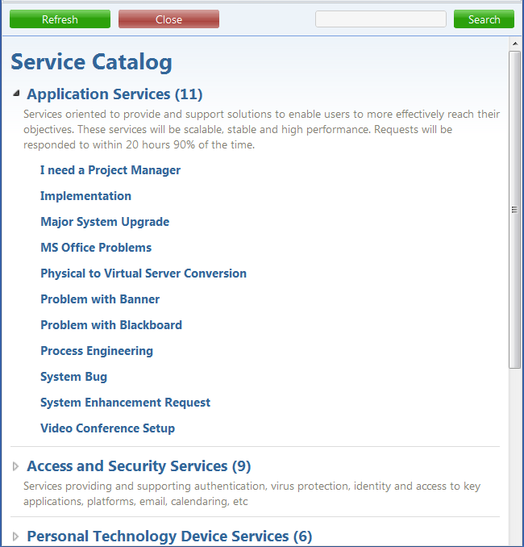
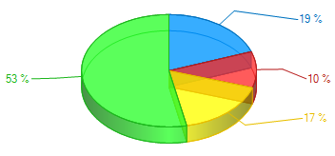
Holistic View of IT/Service Organization
Work Requests
Work Request Fulfillment Streams
Service Catalog
Governance & Projects
Productivity
MyWork®
Email
Routing Logic
Service Desk & Assets
TDMobile
Web Forms
TDCommunity
Operations, Config. & Change Management
Web Services
Tickets
Resource Management
TDAnalysis Reporting
Web Services: Service-Oriented Architecture

Slide 16
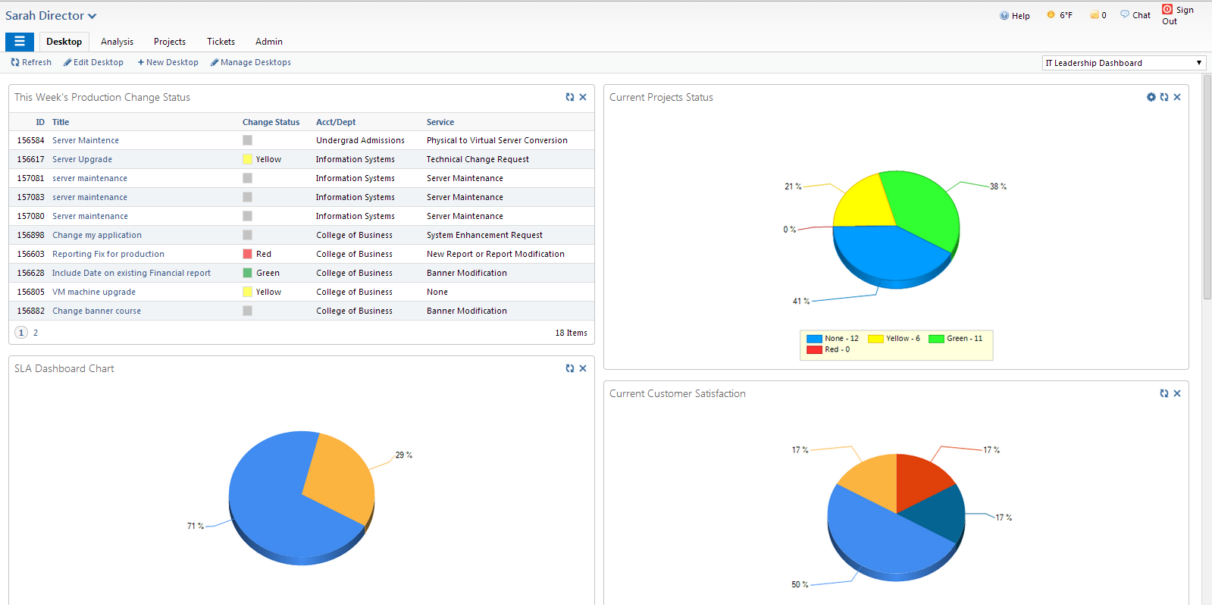
Leadership Insights

Slide 17
Leadership Insights

Slide 18
Leadership Insights
Notes:
Shows project data as well as incident or problem data

Slide 19
Leadership Insights
Notes:
Shows project data as well as incident or problem data

Slide 20
Project, Portfolio and Service Management Software Built for Higher Education
More colleges and universities depend on TeamDynamixHE PPSM than any other solution
Change Driver:
Addressing Perceived Value Challenges
(Lack of Visibility)

Slide 21
Stakeholders Have Limited Visibility
“I just don’t know what they do with $10M per year”
Stakeholders often have a limited frame of reference and don’t understand the full scope of IT work
Application Management
Learning Management System (LMS)
Student Information System (SIS)
Infrastructure Management
Servers
Content Management System (CMS)
Facilities Management System
Custom Development
Networks
Security
Support Services
Student Help desk
Faculty Help Desk
PC/Phone Mgmt.
Telephony
Admin Services
Application Hosting
Compliance
Project Services (PMO)
Email
A/V Equipment
Security
Limited Understanding
Limited Understanding
Notes:
These stakeholders often approve budgets

Slide 22
Communication: Stakeholders
President
Deans
Key Purpose:
Build understanding of:
Value provided
Constraints (capacity/budget)
Workload profile
Backlog of work
Foundation for fact based conversations around scheduling, hiring, risk, priorities, budgets
Faculty
Researchers
Notes:
Increase understanding of value and constraints.

Slide 23
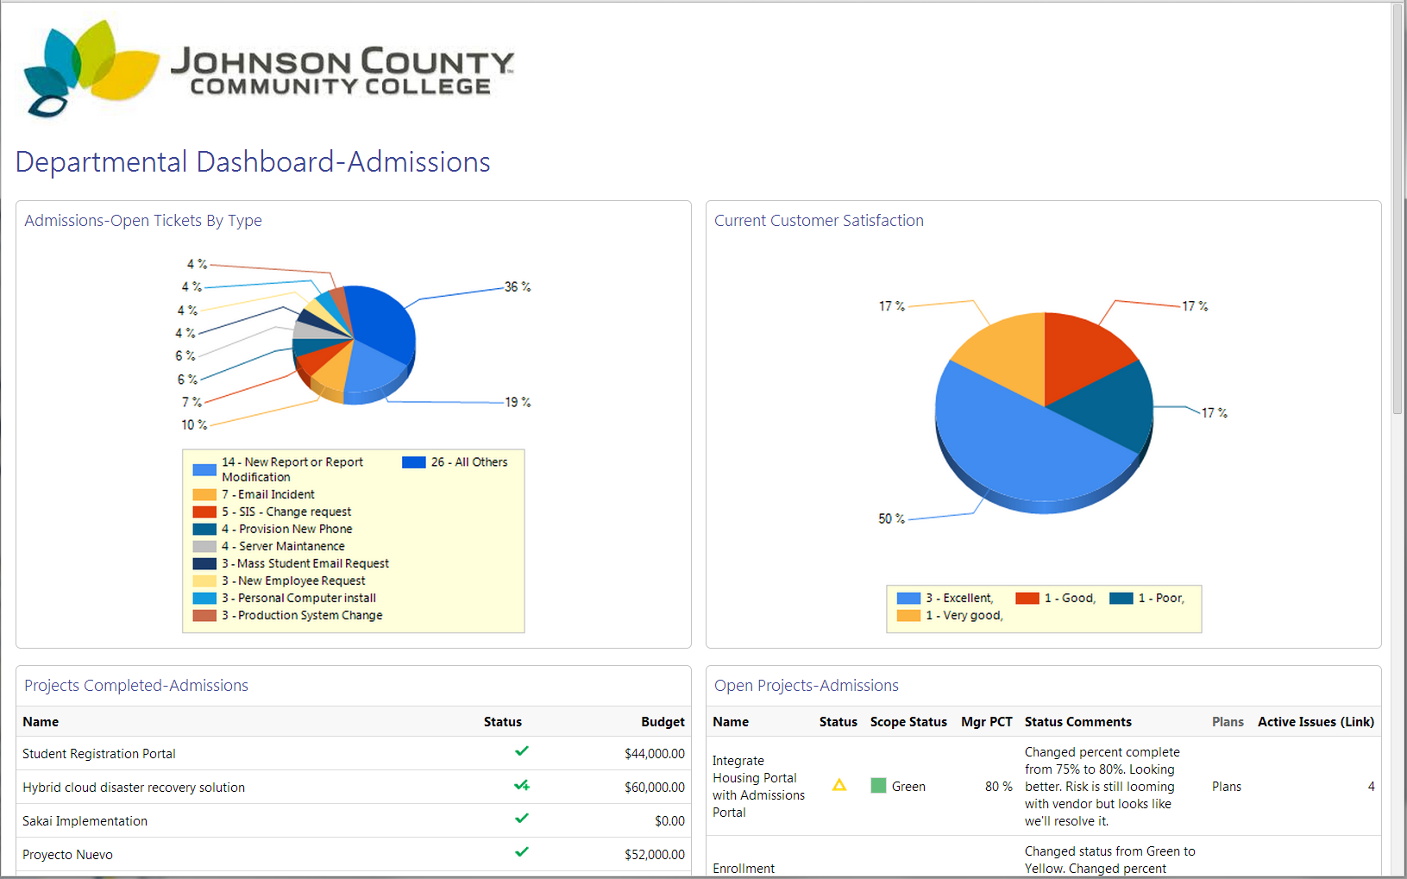
Stakeholder Education

Slide 24
Stakeholder Education

Slide 25
Stakeholder Education

Slide 26
Stakeholder Education

Slide 27
Project, Portfolio and Service Management Software Built for Higher Education
More colleges and universities depend on TeamDynamixHE PPSM than any other solution
Change Driver:
Customers Feel that IT is Difficult to Work With

Slide 28
Customers Find IT Difficult to Engage
“I don’t know how to request a new report. I guess I’ll email my friend Ken. He’ll handle it.”
Web forms
President
“I email requests to IT but never know what happens to them. It’s frustrating.”
Docs
Deans
“I need a new laptop. Who do I talk to? It’s hard to deal with IT. It will probably take forever to get it anyway.”
Conversations
Faculty
Email
“For an applications project I email a word doc request. For a hosting request I go to a web site, and for an AV need I submit a ticket. What happens to all of my requests, and how do I check on their status?
Students
Service Desk

Slide 29
Convergence of Request Management
PPM
Service Desk
Request Fulfillment (ITSM + PPM)
Change/Ops

Slide 30
Simple and Branded Service Catalog

Slide 31
Project, Portfolio and Service Management Software Built for Higher Education
More colleges and universities depend on TeamDynamixHE PPSM than any other solution
Staff is Overburdened with Work and Administrative Activities

Slide 32
Different Resources = Different Work Streams
Incidents
Projects
Operations
Incidents
Projects
Operations
=
Projects
Operations
Incidents

Slide 33
Individual Administrative Burden
Word
Excel
Assets/CIs
PPT
MS Project
Ticketing Software
Personal To-Do Lists

Slide 34
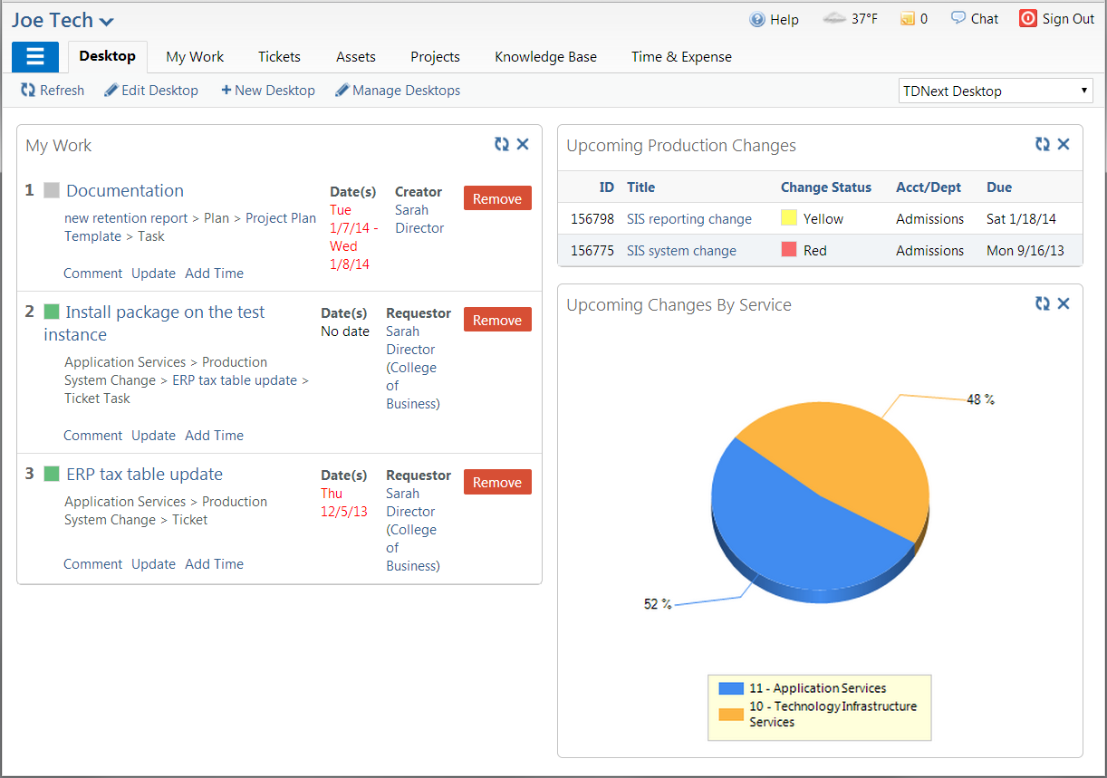
One Page View

Slide 35
One Page View

Slide 36
One Page View

Slide 37
Facilitated Dialog

Slide 38
Identify the 3 top benefits of integrating ITSM & PPM processes
Table Discussion: 5 min
Presentation: 5 Minutes

Slide 39
2. Identify the 3 main roadblocks to integrating ITSM & PPM processes
Table Discussion: 5 min
Presentation: 5 Minutes

Slide 40
3. Identify 3 shared experiences in overcoming identified roadblocks
Table Discussion: 5 min
Presentation: 5 Minutes
Notes:
These don’t have to be the exact same challenges but can be parallel in nature

Slide 41
Q&A + Open Discussion
Happy Hour:
Tomorrow 5-7pm
Filini Bar
221 N. Columbus
Andrew Graf
agraf@teamdynamix.com

