Slide 1
ERP Hosting - Finally, Why Didn’t We Do This Sooner?
Educause Connect Chicago
March 17, 2014
Copyright Steve Reinhardt and Colleen Nagy 2014. This work is the intellectual property of the author. Permission is granted for this material to be shared for non-commercial, educational purposes, provided that this copyright statement appears on the reproduced materials and notice is given that the copying is by permission of the author. To disseminate otherwise or to republish requires written permission from the author.

Slide 2
Presenters
Colleen Nagy
Senior Director, Design & Build
CWRU
Central ITS division
30 years in IT
Lego fan
Steve Reinhardt
Associate Director, Build
CWRU
Central ITS division
Almost 20 years in IT
Father of three, all Lego fans
Notes:
16+ years in IT.
10 years in hosted solutions with IBM.
2 years in Higher Ed
Explain lego reference
Asked 7-yr-old son for some lego jokes (most common medical procedure, hate to stay in the box “claustropho-brick”)

Slide 3
Lessons Learned
Remain committed, but listen openly to constituents
Remember what the key objectives are throughout
Quantify, quantify, quantify
Engage experts when group realizes limitations
Communicate often with stakeholders at all levels
Notes:
SJR
We had executive commitment which propelled initiative, but had to stay open-minded to all parties
There were many other potential benefits raised, but had to keep scope to the four key ones
We were MUCH more successful when we could show our work
I was surprised how much better we all were when we strategically engaged experts – vendor, contracts, partners
We had couple stretches when we were heavily engaged in committee work. Had to make sure all levels knew what was going on. Especially staff.

Slide 4
Other Challenges
Deferred maintenance
Staffing issues
Budget constraints
Contract process
End user concerns
Notes:
MCN
Servers are still Solaris and nine years old
End users and support teams were like Princess Uni-Kitty
Had built a pretty wonderful world, but struggled when we couldn’t make changes fast enough or continued to have support problems
Very patient and never unreasonable, just an indicator that we had to do something

Slide 5
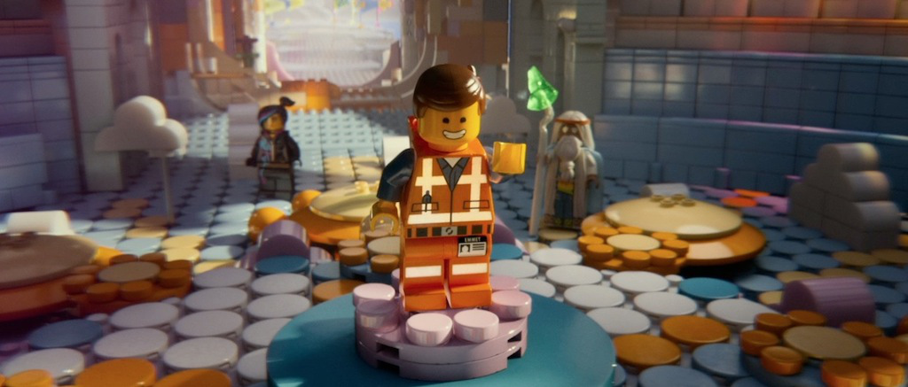
The Master Builders
There are a lot of great people to help you solve your problem…in ways you might not expect
Notes:
SJR
Made up of the service owner from each pillar, directors from ITS and me to facilitate
Partner also brought their master builders

Slide 6
Initiative Timeline
2010
Oracle presented proposal on hosting approach
2011
Formed steering committee with higher ed consultant
Committee defines four objectives of the initiative
2012
Release RFP to six vendors (March)
Compared responses and narrowed to two (May)
Committee reviewed solutions, costs (July-December)
Data Center visits with vendors (December)
2013
Selected final vendor (March)
Engaged contract specialist (March)
Contract negotiations (April – June)
Executive final recommendation (June)
Board of Trustees presentation (September)
Notes:
MCN
Central ITS re-organized in July 2011, which shifted whole org to D-B-R
I was hired in 2012 as the RFP was sent to vendors

Slide 7
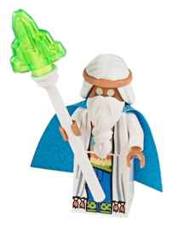
Master Builder / Micromanager?
Notes:
SJR
Explain the two characters (Vitruvius & micromanager)
Contract specialist -
PRO: Very good terms added to final contract, created boilerplates for other contracts
CON: Contract went from 20 – 120 pages, partner was unaware this was coming, significant delay, was outsourcing focused, not hosting
Lesson is try to do big things like this quickly and openly so adequate planning

Slide 8
RFP Split in Four Parts
Hosting Services
Infrastructure & non-application support, plus D/R and backups
Production Support
Break-fix, service request and interfaces
Maintenance
Application and database patching, bundles, regulatory releases and feature packs, including PeopleTools
Application Development
Cost of one full-time developer for 1800 hours
Notes:
MCN
Vendors were allowed to bid on some or all of the components
We were allowed to select some or all of the components

Slide 9
Vendor RFP Scorecards
Notes:
SJR
How we compared the RFPs
Had each member of the steering committee fill out the form and then tallied vendor scores
Weighting was agreed to by the committee beforehand
I went through each RFP and mapped the critieria to the section and page
I have embedded a generic version on the last slide of the slidedeck

Slide 10
How We Compared RFPs
Hosting Services | Weight
Data Center details, including security, power, D/R site | 3
Company's three-year capital strategy | 2
Security - certifications | 3
Security - monitoring and monitoring tools | 3
Security - compliance, including FISMA, FERPA, HIPAA | 3
Security - D/R test procedures | 3
Security - access procedures for Tier 2 and Tier 3 access | 3
Architecture - hardware of the environment, what is provided | 3
Architecture - Capacity of servers, including scalability | 2
Architecture - interfaces and secure file transfer | 3
Architecture - fees for additional modules | 3
Network - network solution | 3
Network - network management including detection | 3
Transition - proposed strategy & roadmap, + 11gR2 upgrade | 2
Hosting Services Fee Structure | 3
Notes:
SJR
Better detail of the type of criteria we used.

Slide 11
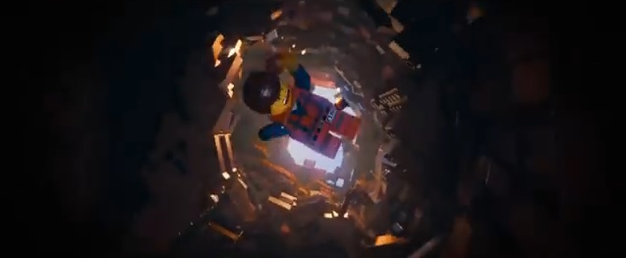
Key Objectives
Improve Service and Raise Performance Levels
Reduce Risk
Enhance Business Continuity
Shift Resources to University Priorities
Notes:
MCN
These were the guiding principles throughout the entire life of the initiative and still frame what we are doing with the transition

Slide 12
1. Improve Service
Current Issue | Benefit of Hosting to University | Cost Avoided by University
Limited PeopleSoft skillset | Technical resources with deep technical knowledge, current with new releases Leverage core competency of Vendor | Additional training dollars
Case is a “small fish” to Oracle | AT&T is a Platinum partner, which will speed our time to resolve (avg. duration is >25% shorter) Vendor can leverage experience with similar Oracle issues (avg. number of tickets expected to be >20% reduced) | Staff time managing tickets (605 over 5 years) with average time to close of 56 days
Cost of inexperience in performance tuning | Gain resources for performance tuning | Spent $37K to tune CS for 1500 students registering concurrently
Herculean efforts are made to keep aging infrastructure stable | AT&T’s Infrastructure is totally new Ability to scale in critical computing times | Increased staff time for emergency incidents Increased HW repair costs Increased production delays
Notes:
MCN
1. We struggle to learn new functionality with each new release. IB was one example, customization cleanup after bundles was another.
2. Sought a partner that had a strong relationship with Oracle. Platinum partnership. Struggling with time to close Oracle incident tickets
3. Performance tuning was a two-edged problem. Had to spend significant money to have the tuning solution, but only used it once in three years.
4. SOLARIS – very limited support knowledge. EOL HW.

Slide 13
2. Reduce Risk
Current Issue | Benefit of Hosting to University | Cost Avoided by University
Hiring and retaining staff with PeopleSoft technical knowledge ($$$) | Stable/flexible pool of technical resources for PeopleSoft and infrastructure | Lost six key staff personnel over the last two years As of 7/2012: 20-25 PeopleSoft technical positions open in the state of Ohio (careerboard.com) Ohio PS developer salary gap: $99,598-$85,408 = $14,000 ¹
End of life for hardware and storage limitation | Upgraded infrastructure including scalable storage capacity Best practice data management Better server redundancy | $600,000 over two years to replace old servers
CWRU Data Centers are below best practice standards ² | Data Center with highest industry certifications (Tier 3, SSAE 16 & ISO) Reduce CWRU energy consumption Return space to library | Approximately $13,000/year is spent on electricity supporting the ERP servers
¹ indeed.com data 7/2013
² 2013 IBM Data Center assessment
Notes:
SJR
1. Retirees were never backfilled. Planned transitions out of PS support caused issues as project timing took longer. Cleveland ITS market is very competitive.
We have about 800GB of production data, but use about 8 TB on NAS. Data centers are also physically constrained.
One data center is below ground in basement of library. No auditable security access, space is desired by library

Slide 14
3. Enhance Business Continuity
Current Issue | Benefit of Hosting to University | Cost Avoided by University
Lack of offsite Disaster Recovery | Full Disaster Recovery Solution included in cost Also includes one annual DR test | $122,000/year to have single test retainer. No real disaster site usage.
A disaster for both data centers could take weeks to restore | Restoration time improved to less than 48 hours with no more than 24 hour of data loss AT&T staff in multiple locations away from data centers | Time to restore in a catastrophe is currently measured in days or weeks, not hours.
CWRU data centers are located only 1000 feet apart | Enhance reliability with physical diversity (NJ & CA) | Data Centers are located in different areas of the country. Quantified it would cost CWRU $4.5 million to build and maintain comparable capability.
Notes:
SJR
1. CFO demanded (rightly so) that we start doing D/R drills in 2012.
2. Probability is low, but the risk is very high.
3. Having true redundancy is an example of the value add proposition…while staying cost-neutral.

Slide 15
4. Realign to CWRU Priorities
Current Issue | Benefit of Hosting to University | Cost Avoided by University
Unable to focus IT resources on the mission of the university (Teaching, Learning, Research) | Redirect IT staff to focus on university priorities versus writing computer programs | Need to move realigned ITS staff back to ERP support: Faculty Lifecycle Initiative architect Document Mgt. service owner Document Mgt. developer
Ability to fluctuate correct amount of resources just-in-time during development peaks and valleys | Vendor resources allow us to not have to staff and stage equipment for peak demand. We would be able to use fewer people during valleys in demand and more during peaks. | 3 FTE dedicated to supporting ERP environments, and no easy ability to reassign them in slow periods or bring new staff on during peak demand
IT departments across all industries are expected to do more with less | Leverage vendor to help reduce costs | Budget cut over the last two years was $1.6M with the elimination of four positions. Rehiring retired resources could redirect funds from priorities.
Notes:
MCN
1. If we decided not to move to ERP as a Service, other key initiatives are hampered.
2. Many presentations this week will talk about flexibility in peak usage periods. We are no exception.
3. We have had no budget increase and staff reductions have actually lowered the overall ITS budget.

Slide 16
One More: Cost Neutral
Spent significant time building cost comparison models
Used 5-year, then 10-year, TCO
We found the cost stayed same, but services and reliability significantly improved.
Value add, not cost add
Resonated most with senior executives
Notes:
SJR
Lego joke:
What do lego fans use to create simple cost models and ROI comparisons?
Mini-Figures

Slide 17
Not all ideas seem good
Had our differences on the final approach
agreed to keep listening
Notes:
MCN
We had points in the process where the service owners felt they hadn’t been listened to, and we continued to talk
Example of ESC meetings with competing status reports
Flexibility balanced with best practices
Balance creativity with following the instructions…like the movie

Slide 18
Points of Pride
According to Oracle, first AAU school to move from PS self-hosted to vendor-hosted
CWRU Legal reported contract is most university-fair they have encountered
Negotiations were very even from both sides
Notes:
Negotiations were extremely amicable with both sides approaching them with openness

Slide 19
Lessons Learned
Remain committed, but listen openly to constituents
Remember what the key objectives are throughout
Quantify, quantify, quantify
Engage experts when group realizes limitations
Communicate often with stakeholders at all levels
Notes:
SJR
We had executive commitment which propelled initiative, but had to stay open-minded to all parties
There were many other potential benefits raised, but had to keep scope to the four key ones
We were MUCH more successful when we could show our work
I was surprised how much better we all were when we strategically engaged experts – vendor, contracts, partners
We had couple stretches when we were heavily engaged in committee work. Had to make sure all levels knew what was going on. Especially staff.

Slide 20
Next Steps
Started transition in September 2013
Joint project management
Completed first migration, Phire, in February
Lots of work, especially testing
HCM, SIS & FIN cutover in May, July and finally September
FIN and HCM upgrades going to RFP for 2015 completion
Notes:
Very pleased with relationship so far

Slide 21
Questions?

Slide 22
Contact
Colleen Nagy
E-mail: colleen.nagy@case.edu
Phone: 216-368-8593
Steve Reinhardt
E-mail: steve.reinhardt@case.edu
Phone: 216-368-0404
Vendor RFP Scorecard template.xls

