Slide 1
GET EVERYONE ON BOARD!
TECHNOLOGY, ACCESSIBILITY & COURSE REDESIGN
BRETT CREECH
EDUCATIONAL TECHNOLOGIST

Slide 2

ALL ABOARD!
Don’t leave anyone behind!
Why is accessibility so important?
Is it simply good practice to ensure that all students have access to the same materials?
Do we want all students, regardless of their individual physical, learning, or emotional status to have the same learning experience?
Are there policies and/or laws we must be aware of?

Slide 3
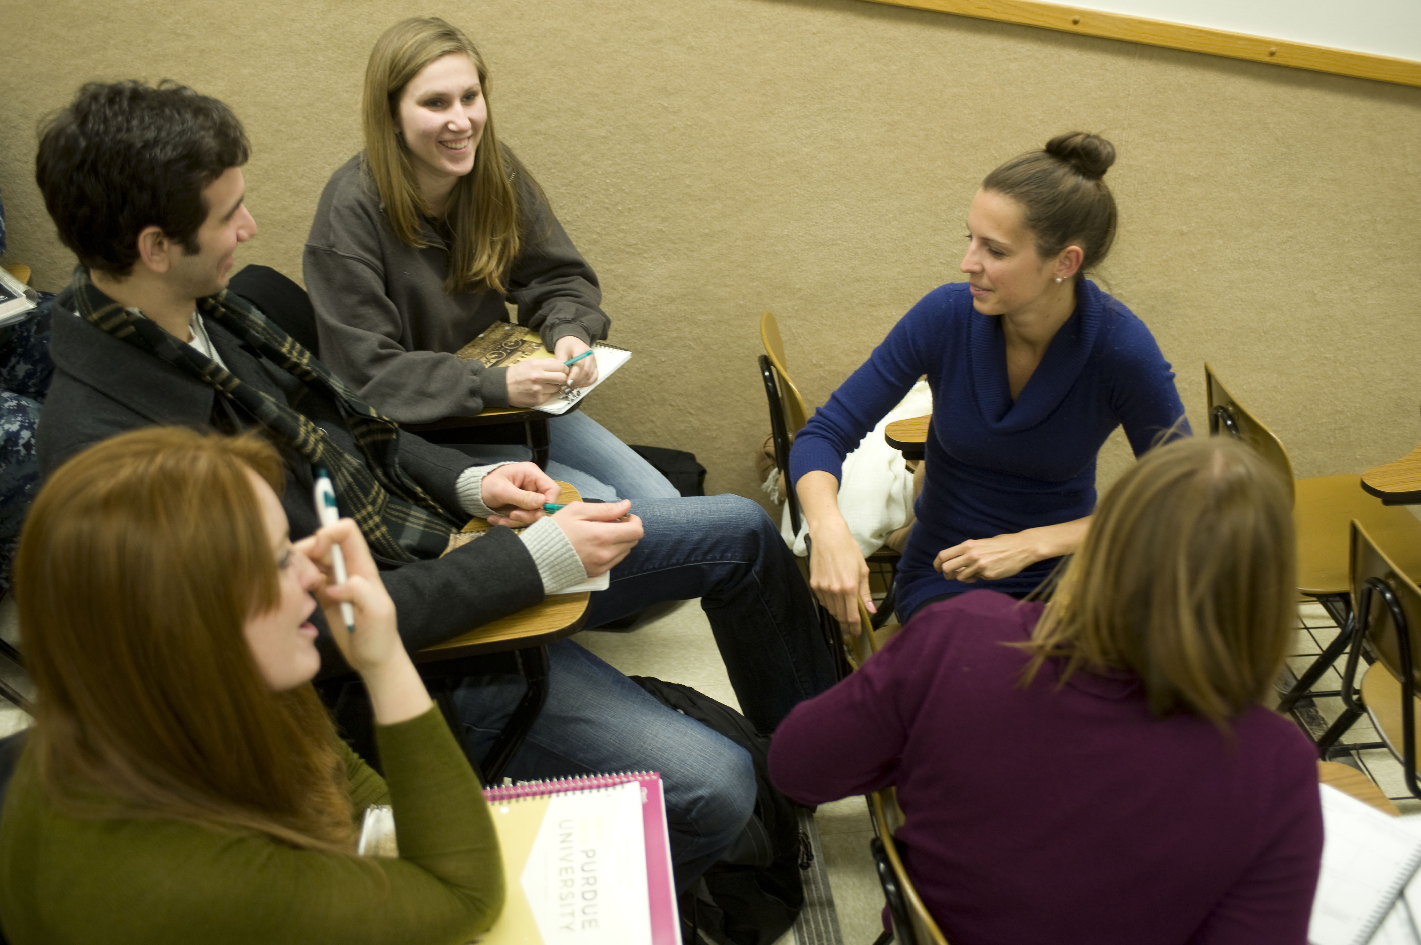
Is Accessibility for Everyone?
Do we see accessibility as something all students can benefit from?
Think about the following…
Curb cuts on sidewalks?
Captions in videos?
Transcripts for audio?
Careful use of colors in learning materials?
What about learning styles?

Slide 4
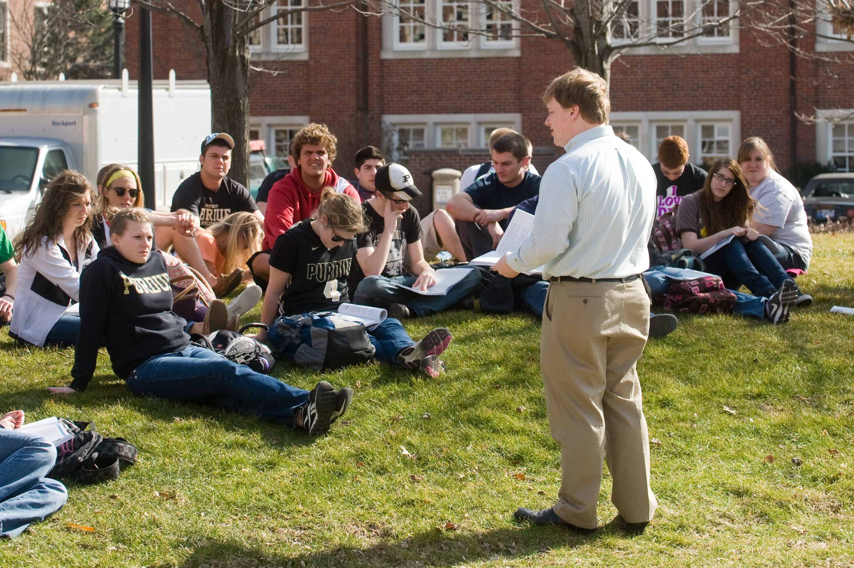
An Honest Poll…
Just to see what we think!
Let’s ask the following:
For those of us here, how many of us think making material as accessible as possible is important?
Do you think accessibility is always high on the priority list of those developing classes?

Slide 5
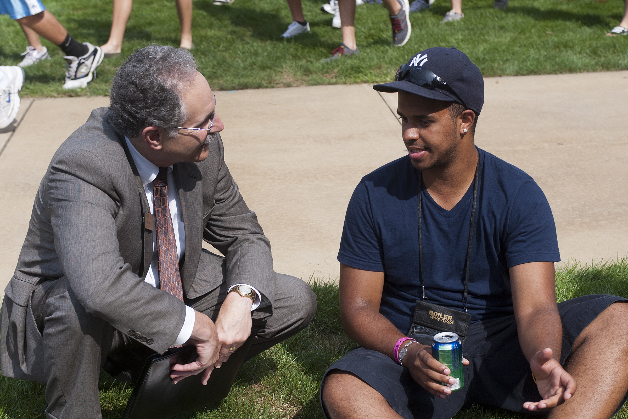
Video Activity
Put yourself in the place of a learner.
Let’s look at four videos…
These videos are embedded into a Blackboard course.
We’ll watch each video, then do a quick initial reaction discussion.
After all the videos are over, we’ll come back and talk about our overall view of the videos.

Slide 6

What About Other Course Content?
We talked about videos. What other course content may need review?
As courses evolve to either being fully online, or to courses that blend online content to support the in-class experience, what other accessibility needs may be present:
Documents
Images
Font face/colors used on websites
Online assignment/assessment settings?
More?

Slide 7
Thank you for attending!
Brett Creech
Educational Technologist
Purdue University
Email: creechb@purdue.edu
Twitter: @brett_creech
Please complete the session evaluation! Your feedback is appreciated!

