Slide 1
Cloud-Based Project Management
Southern New Hampshire University
University of Notre Dame
Notes:
11:45 – 11:48

Slide 2
Agenda
Introductions
Project Management in Academia
What we need in a tool
Next Evolution
Collecting Lessons Learned
Project Lessons Learned Report
Identifying Recurring Patterns
Q&A
Notes:
11:48-11:49

Slide 3


Presenters
Southern New Hampshire University
      Mary Higgins
    AVP Communications &
    Program Launch, COCE
  Bill Harlow
    Director of Academic Technology
    & Faculty Development, COCE
University of Notre Dame
  Frederick Nwanganga
    Manager, Database Services
  Sharon Hayward
OIT Project Manager
Notes:
11:49 – 11:50

Slide 4


Project Lifecycle
Initiation
Planning & Design
Monitoring
&
Controlling
Executing
Closing
Notes:
11:50 – 11:52
Considering the project management process as a whole, we’ll speak to these key areas.
Commonalities in how we approach project mgt.
At SNHU (Notre Dame as well?) we break down most new initiatives to 60-90 day projects.
The example we’ll use is a recent Blackboard upgrade.
Sharon and Fred will speak to specific additional steps taken to learn from past projects, capture those lessons and apply them in planning new projects.

Slide 5
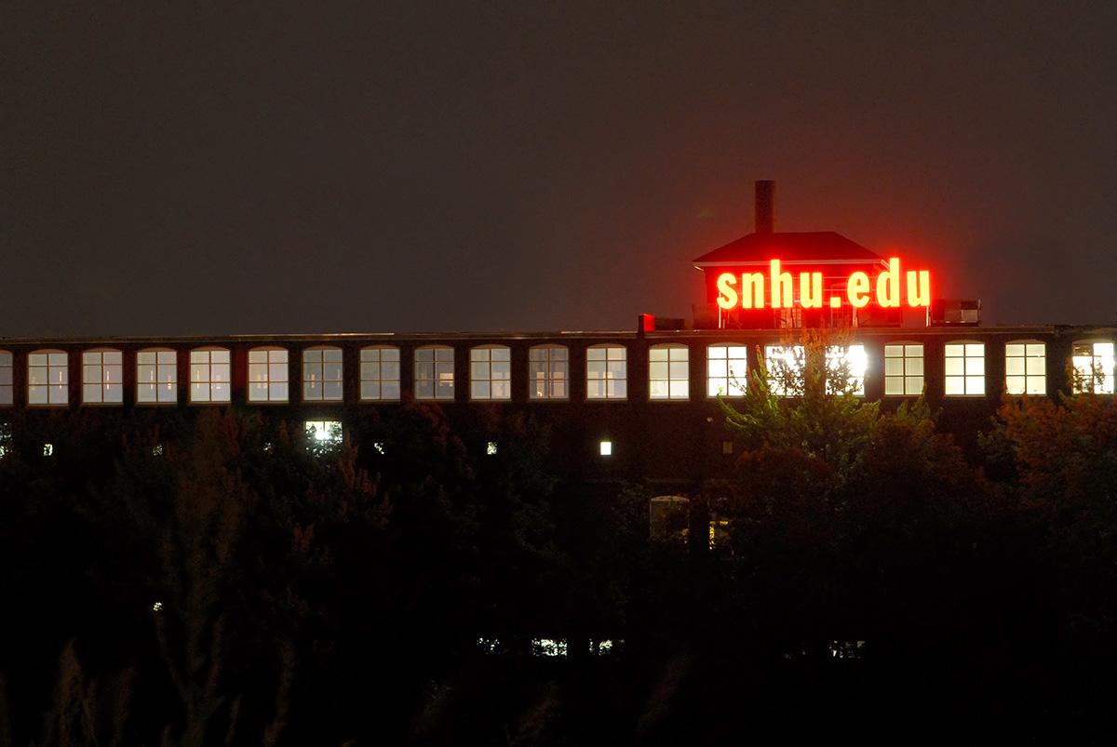

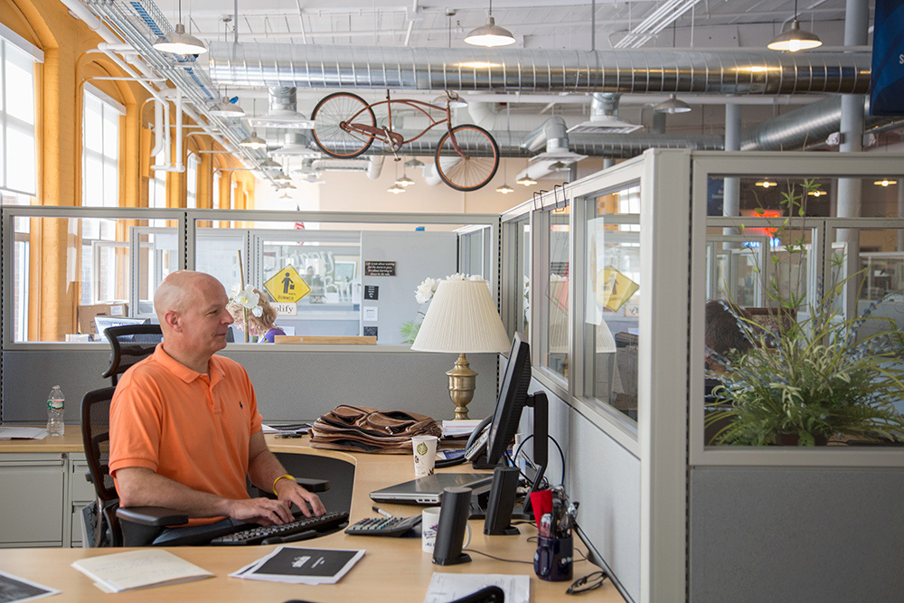
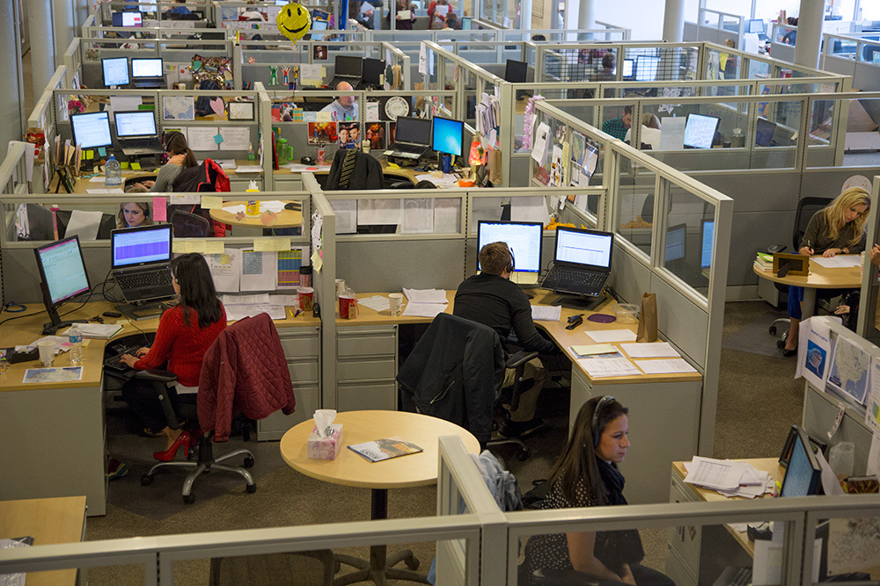
Notes:
11:52 – 11:54
COCE Academics Environment:
COCE is one of colleges w/in SNHU. We serve online students, primarily adults; our other 2 colleges include a traditional campus serving our UG FT student and CFA, serving working adults seeking a competency based program.
Fast growing online college –In 2006 we moved from campus to historic Millyard
We were then 25 ee’s, and now 800 ee’s.
Extremely focused on student success.
Rapid growth, fast, data driven decision making
Measurement and accountabilities

Slide 6
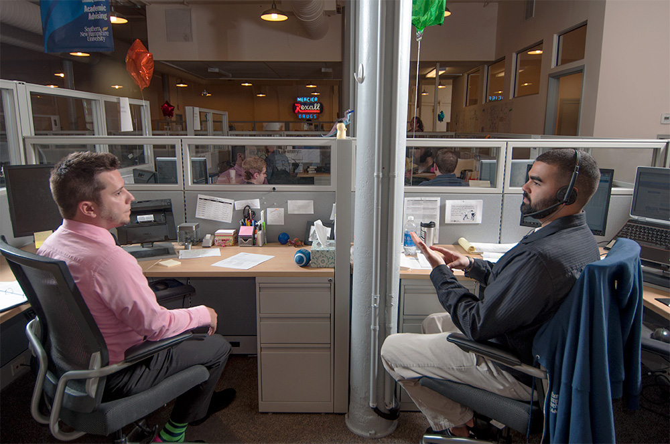
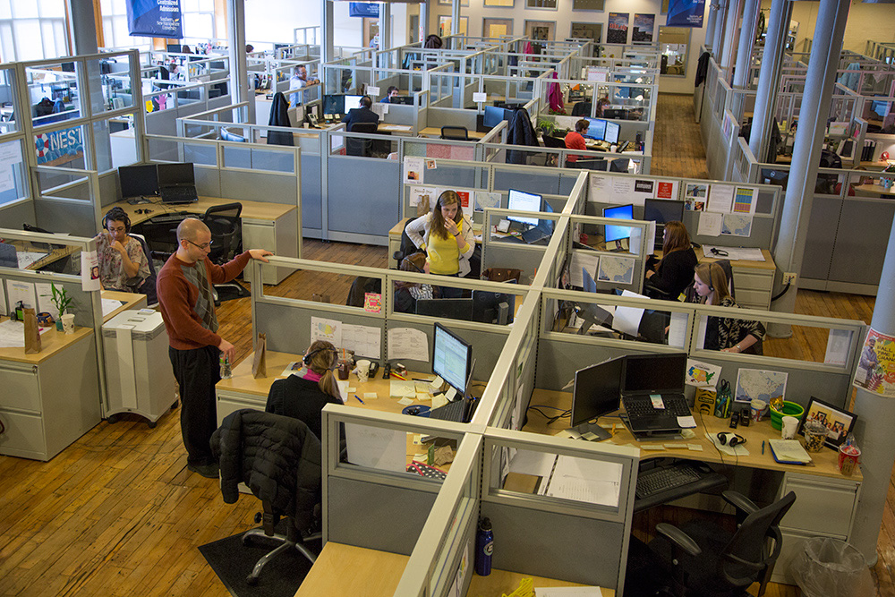
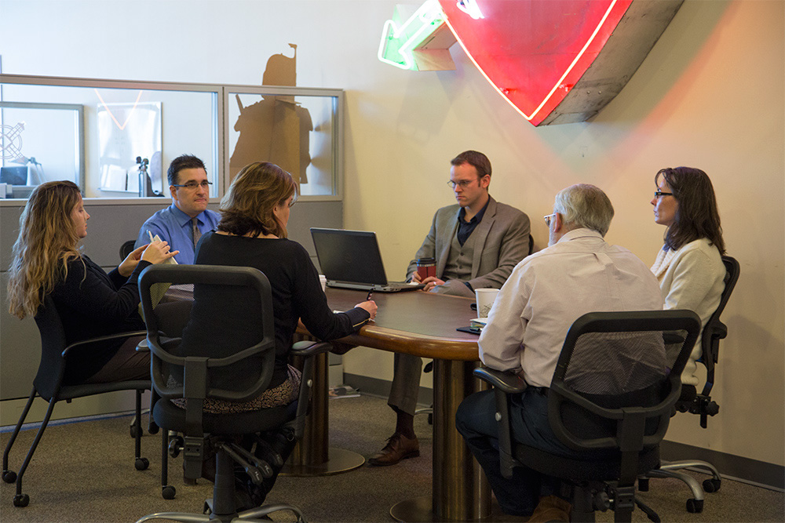
COCE
Academic
Team
Notes:
11:54 – 11:57
Academic Team Environment
Separate from our University IT organization
Multiple stakeholders –
- Internal (e.g. Deans, Course Design, Advising, Marketing, Admissions, Campus)
- External (e.g Faculty, Students, accreditation groups)
Project management within our culture –
an academic group, considerable resistance to complex, overly prescriptive, difficult to learn project mgt applications or methodologies
Project Charters and RACI’s - well received and very useful to clarify project roles and responsibilities
Project tasks and milestones necessary
Collaboration – important to have central site to easily access project work/files from anywhere. Inboxes fill to easily.
Calendar view of projects - important to quickly see how multiple projects overlap

Slide 7
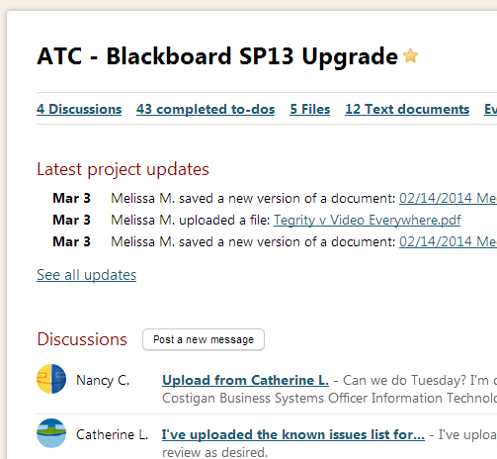
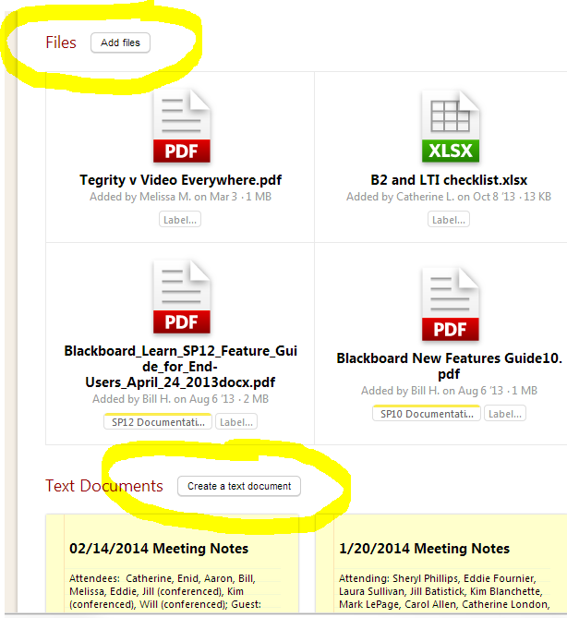
Ease of Use
Notes:
11:57 – 12:00
Why Basecamp
Quick learning curve/Minimal training
Easy to use/intuitive
access projects in the cloud from anywhere – fits our team located across country
Facebook-like

Slide 8
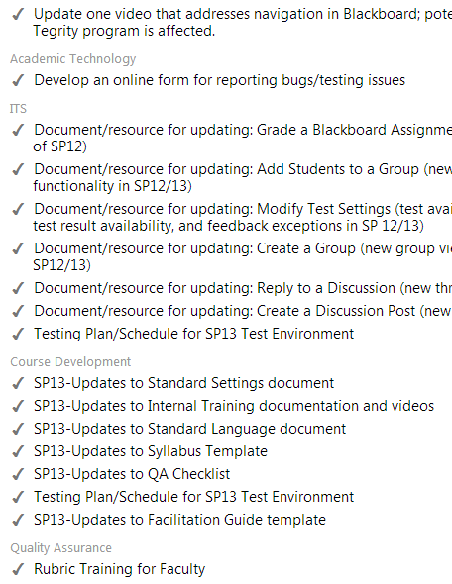
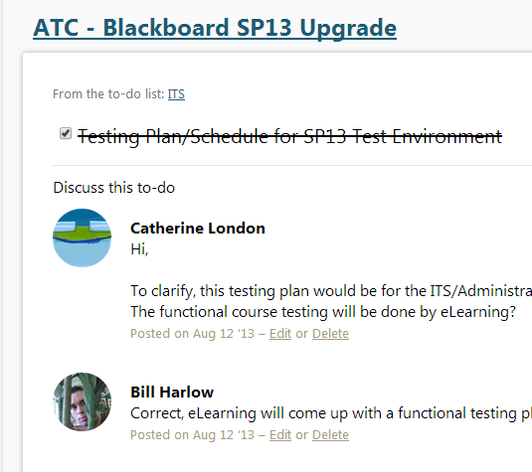
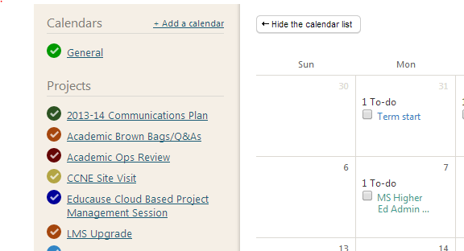
To Do’s, Collaboration
Notes:
12:00– 12:03
Tracking work completed/work remaining and ability to quickly collaborate on projects key features -
Calendar
Document sharing/storage
Tracks work completed, work remaining, due dates, assignments

Slide 9
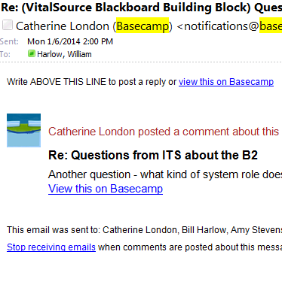
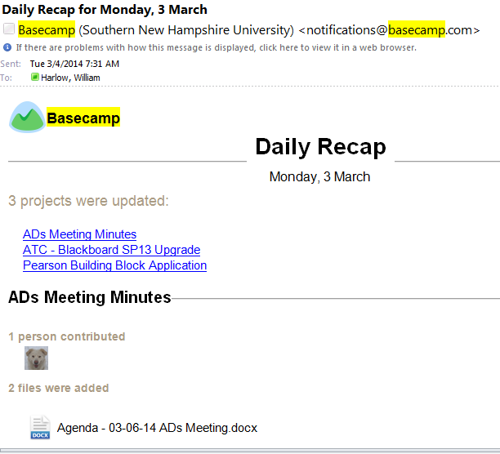
Plays well with Outlook
Notes:
12:03-12:04
Project reminders, recaps, activity posted to inbox; fits naturally into current work habits.
COCE – heavy reliance on MS outlook email
Emails activity within projects – e.g. team member posted comment to project
Daily recap emails
Subscribe ical – see project calendars side by side w outlook calendar

Slide 10
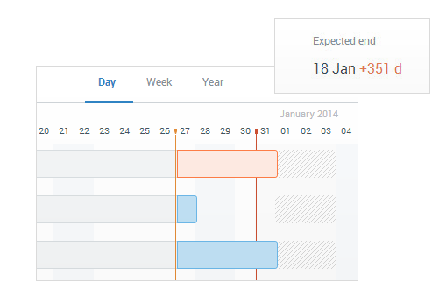
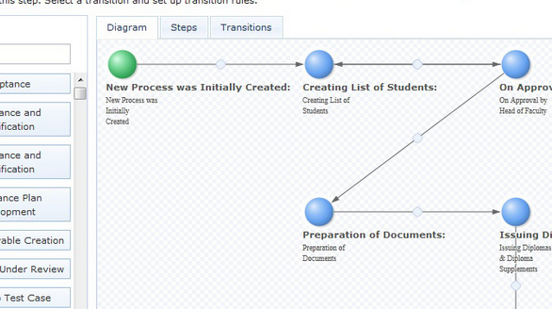
Next Steps
Process workflows
View projects and ongoing processes
Notes:
12:04 – 12:05
Next phase:
Now hiring project managers in key teams (course development)
Ready to formalize key workflows to replace multitude of excel spreadsheets
Need quick sign offs on key decisions and tracking of those sign offs
Also need to contrast ongoing processes (course dev) with new projects (3 PV)
And view ongoing processes (course dev), and new projects (Bb upgrade) along with key operational events (term starts)
Remaining Slides 12:05 -30

Slide 11


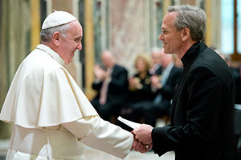
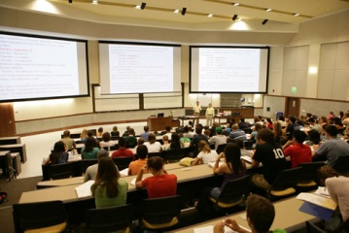
Notes:
12:05 – 12:06
Office of Information Technology at Notre Dame:

Slide 12
Project Lifecycle
Collect Lessons Learned
Initiation
Planning & Design
Monitoring
&
Controlling
Executing
Closing
Notes:
12:06 – 12:07

Slide 13

Lessons Learned Preparation
Project Management
Went Well Needs Improvement
Governance
Went Well Needs Improvement
Technical Execution
Went Well Needs Improvement
What you need:
Large posters for each category
Sticky notes – all the same color
Pens or markers – all the same color
A room with plenty of wall space
Participants
Notes:
12:07 – 12:08
Participants will act as members of a project team and will participant in a hands-on demonstration of a standardized lessons learned meeting.
View an example of one collection method
Have an example sticky of a lessons learned on each poster

Slide 14
Lessons Learned Categories
Communication/ Communication plan, Change Management, Status Updates
Change Management (team, steering committee, sponsor, etc.)
Governance Management Support, Steering Committee/ Management
Product Vendor, Software, Hardware, Procurement, Legal review
Project Management Scope Management, Methodology, Timeline, Risk Management, Meeting Management, Change Control, Task Management, Estimation, Budget, Resource allocation
Requirements Clarity of requirements, functional & technical requirements gathering
Teamwork Collaboration, ability to work together, cooperation, functional/ technical
Technical Execution Architecture, Infrastructure, Security, Interfaces, Environments, Configuration, Installation, Cutover, Quality Assurance, Testing
Training End-user, support/admin of product, user guides, training materials, Support Documents, End User Training, Admin Training, Help Desk
Other
Notes:
12:08 – 12:09
Establish a standardized way of collecting and storing Lessons Learned

Slide 15

Collecting Lessons Learned
Project Management
Went Well Needs Improvement
Participants write down specific lessons learned on sticky notes
Use the categories to help generate ideas
Put the lessons on the posters
Review
Rank the top three lessons
Notes:
12:09 -12:15
Participants will act as members of a project team and will participant in a hands-on demonstration of a standardized lessons learned meeting.
View an example of one collection method
Once you complete the lessons learned meeting, the posters can be given to the person entering them into SharePoint or you can take a photo of each one and send it to them

Slide 16
Lessons Learned Data
Notre Dame SharePoint – Lessons Learned Data
Notes:
12:15-12:18
Notre Dame is using SharePoint to store the Lessons Learned data in a list
Set up LMS Upgrade project in SharePoint
Ask participants to share one lesson they collected

Slide 17
Project Lessons Learned Report
Notre Dame SharePoint – Lessons Learned Report
Notes:
12:18 – 12:20
Generate a lessons learned report for a particular project.

Slide 18
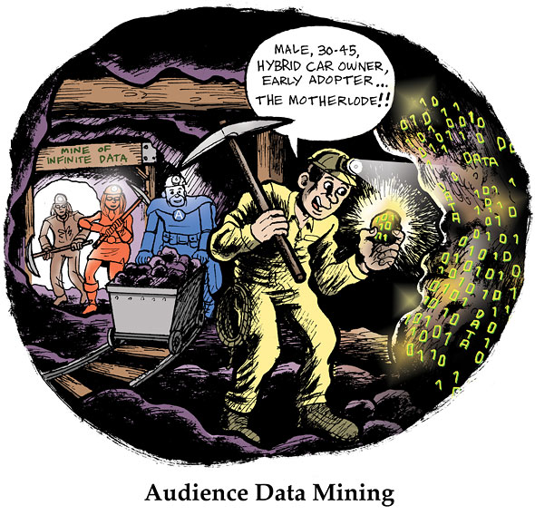
Notes:
12:21-12:25

Slide 19
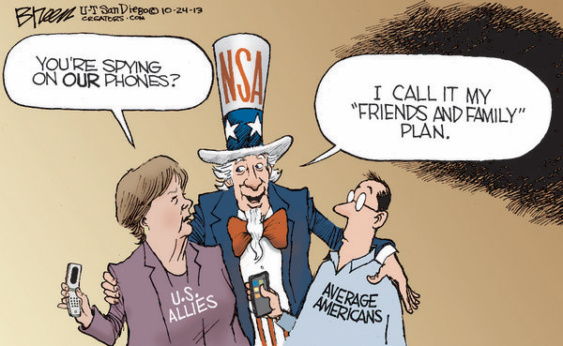
Notes:
12:21-12:25

Slide 20
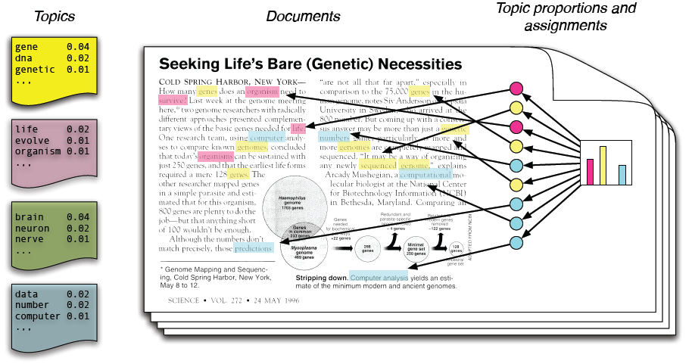
Notes:
12:21-12:25

Slide 21
Project Lifecycle
Review Past Lessons Learned
Planning & Design
Closing
Initiation
Monitoring
&
Controlling
Collect Lessons Learned
Executing
Notes:
12:20-12:21
Considering the project management process as a whole, we’ll speak to these key areas.
Commonalities in how we approach project mgt.
At SNHU (Notre Dame as well?) we break down most new initiatives to 60-90 day projects.
The example we’ll use is a recent Blackboard upgrade.
Sharon and Fred will speak to specific additional steps taken to learn from past projects, capture those lessons and apply them in planning new projects.

Slide 22
Questions?
Notes:
12:25 – 12:30

