Slide 1
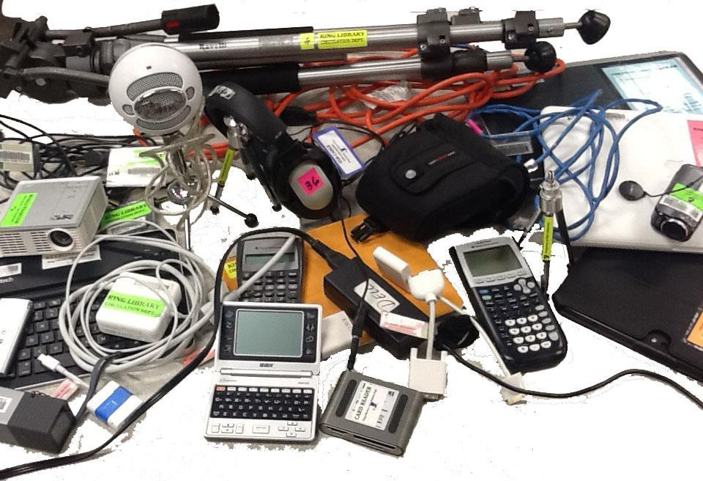
Creating and Supporting a Borrowable Collection of Portable Digital Technology
Rob Withers Miami University Libraries

Slide 2
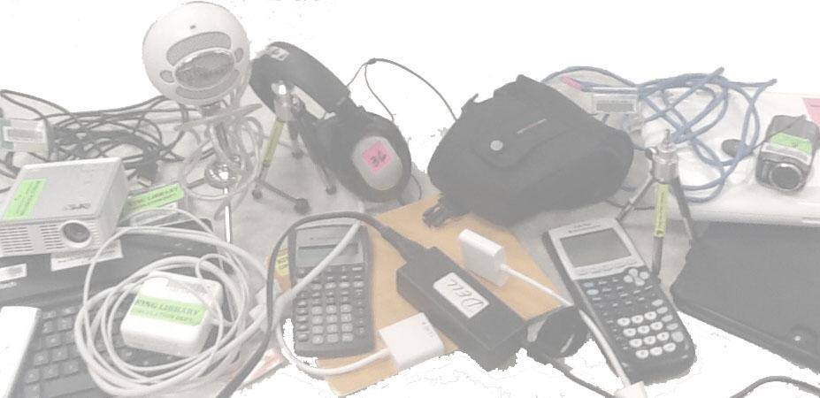
Outline
I. Overview of Miami University:
Institutional stats
Service points
Available equipment
Usage patterns

Slide 3
Outline
II. Developing models for YOUR environment
Participant backgrounds
Brainstorming challenges
Discussing solutions
Brainstorming a collection & delivery model

Slide 4
Miami University: Background
Undergraduate emphasis
Residential environment
Affluent student body

Slide 5
Service Point Background
Library-based service
24/7 Operations during academic year
347,309 checkins / checkouts per year
4,000 informational transactions per year
8 FTE staff + 6.5 FTE student employees

Slide 6
Equipment: Laptop & Tablets
Windows Laptop (33)
Macintosh Laptop (13)
iPads (31)
Nexus Tablets (6)
iPad keyboard covers (10)
Power cords (46 Mac, 47 Dell, 13 HP)

Slide 7
Equipment: Cameras & Recorders
Digital Video Cameras (76, of 6 types)
Digital Still Cameras (8)
Digital Audio Recorders (28, of 3 types)
Microphones (16)
Tripods (16, of 2 types)
Tripod dollies
Steadycam + weights

Slide 8
Equipment: Miscellaneous
Headphones (76)
Calculators (14 Graphing, 27 Financial)
Projectors (23, of 2 types)
Computer mice (4)
Foreign language translators (10)
Electrical extension cords (2)
Portable Lectern w/microphone (1)

Slide 9
Annual Usage
20k+: Mac Power Cords
10k+: Headphones, Mac Laptops, PC Power Cords
7k+: Windows Laptops
1-2k: iPads, Dig. Video Cameras, Calculators,
Network Cables
100+: Dig. Still Cameras, Voice Recorders, Projectors

Slide 10
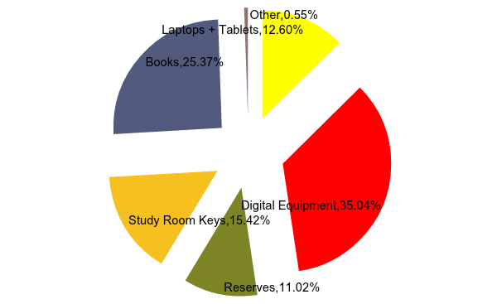
Usage: Central Service Point

Slide 11
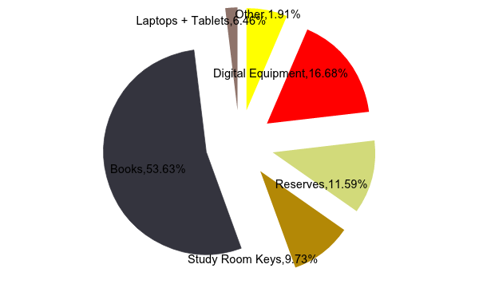
Usage: Central Service Point+Branches

Slide 12
Brainstorming: Challenges
How will we pay for it?
Will it be used?
How will it be supported?
What do YOU envision for YOUR environment … ?

Slide 13
Discussion: Possible Solutions
Thinking of YOUR environment, how would you deal with:
Budgeting
Wear & Tear
Privacy Concerns
Troubleshooting
What else … ?

Slide 14
Brainstorming: Developing Your Model
In YOUR environment:
What types/quantities of equipment?
How much staffing?
What types of services?

Slide 15
Discussion: Wrap-up questions
What questions do you still have?
Any revelations?

Slide 16
Further Information
Rob Withers
Access Services Librarian
witherre@miamioh.edu

Slide 17
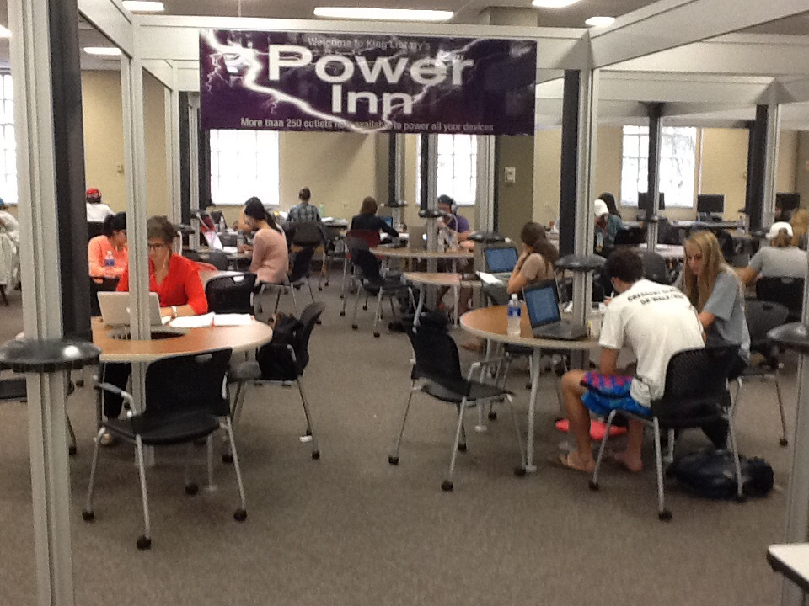
Challenges:

