Slide 1
Finding the Communication Sweet Spot and Sending the Right Message, at the Right Time, to the Right Audience EDUCAUSE Connect Chicago March 17, 2014
Notes:
Intro, quick agenda

Slide 2
Communication is a Strategic IT Asset
What communication does for you
What happens if you don’t communicate
What happens if you communicate, but not well
Notes:
What communication does for you:
Guides perception of IT services (for good or ill)
Communication from IT encourages communication to IT – getting that elusive and valuable feedback from users that should help guide our service offerings
Proactive communication is your chance to control the message
Even when the message is bad news, better to acknowledge that you are aware of what you can be sure your users already know [examples]
Creates trust between IT and users
What happens if you don’t communicate?
Absence of it guides perception of IT services (for good or ill) – if you’re not communicating, your users are free to develop their own version
Creates a disconnect between IT and users
Encourages free agent IT
What if you do communicate, but not well?
Guides perception of IT services (for good or ill)
Inconsistent messages, voices, and/or sources can dilute the effectiveness of the message
Non-verbal communication can be harmful if not positive
Erodes trust between IT and users and risks creating a disconnect
Understanding of communication as a strategic asset is so important – every interaction IT has with a user is a chance to communicate a common message
Worth the effort!

Slide 3
Notes:
Poll Title: What are the top communication challenges at your campus? http://www.polleverywhere.com/free_text_polls/e68ezWUwwoWdEmw

Slide 4
Crafting the Right Message
Question 1: What is the message?
Determine core message
Translate geek speak
Omit needless words - shorter is better
Don’t bury the lead
Notes:
There are 4 questions to answer before sending any IT communication… question 1, what is the message?
Determine the core message you wish to convey - spending time on distilling the core message will make the finished product more succinct, clear, and ultimately, more effective

Slide 5
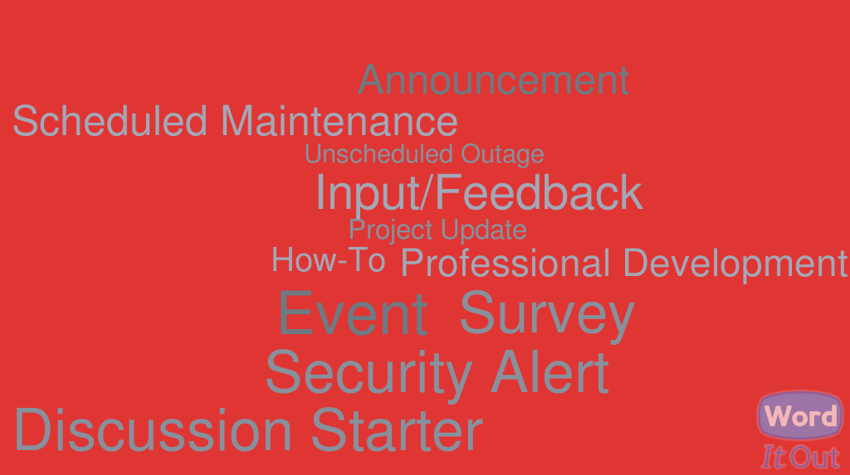
Types of IT Messages

Slide 6
Sending to the Right Audience
Question 2: Who should receive the message?
Know your audience – target
Tailor the language
Notes:
We all receive a lot of messages. Sending messages to people unaffected by them is a great way to encourage them to ignore the messages they are affected by. Do everything you can to target exactly the right group for the core message. Allow subscriptions and opt-out where appropriate.
Now that you know your audience, tailor the language of your message to it specifically. This may mean several versions of the same core message for several audiences.

Slide 7
Typical IT Audiences
Notes:
Or any slice or combination of the populations

Slide 8
Sending at the Right Time
Question 3: When should the message be sent?
Choosing the right time to send
Time of day and day of the week matter
Notes:
Choosing the right time to deliver your core message to the right audience can have a great effect on the attention paid to the message
Time of day and day of the week matter – Monday morning isn’t the best time to get faculty and staff attention, students are best reached after noon
Consider other communications efforts that may be going on, events on campus that might distract, etc. when you have the freedom to choose when a message is sent

Slide 9
Possible Time Frames
Notes:
*** need word cloud here

Slide 10
Using the Right Communication Channels
Question 4: How should the message be sent?
Multiple channels where possible
Non-traditional communication channels
Notes:
The answers to the previous 3 questions drive the answer to question 4
Multiple channels of communication are good – be careful to keep the number of push notifications to a minimum
Don’t forget non-traditional forms of communication like support visits – can be effective for certain types of messages

Slide 11
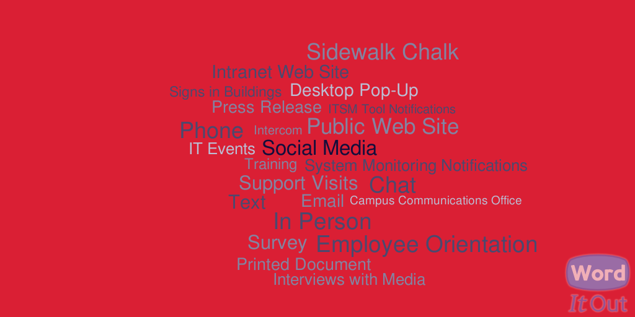
Communication Channels

Slide 12
Notes:
Poll Title: What are the top 3 communication channels for your campus? (choose 3) http://www.polleverywhere.com/multiple_choice_polls/KUc92J4xHHcBnL4

Slide 13
Exercise #1
Remember…
Omit needless words
Don’t bury the lead
Translate geek speak
Notes:
One of my favorite rules from Strunk & White is: Omit needless words.
It’s a perfect sentence. Every word is necessary to convey its meaning. As communicators in the written word we must adhere to this principle. When writing a message to campus, make it short. Omit needless words.
Another rule to live (and die) by: Don’t bury the lead.
This is a rule of journalism. It means you should start with the most important or attention-grabbing piece of information. Your readers won’t bother wading through paragraphs. Get to the point in the first sentence.
Last, remember to: Translate geek speak.
This means considering your audience. A message to the entire campus can and should be different from a message sent to IT staff. Regular people—those that don’t work in IT—look at the big picture when it comes to technology. How’s it going to affect me?
For our first exercise, we would like for each table to take the sample project update message and rewrite it with these rules in mind. 1) Omit needless words. 2) Don’t bury the lead. 3) Translate geek speak.
So what is your table going to talk about? First, figure out the most important part of the message. Whatever it is, that should come first; that’s the lead. Then it’s just a matter of putting the facts out there—but maybe not all of them. Your audience includes all IT units on campus so take that into consideration. What does your audience want to know, and what do you need them to know?
You have 10 minutes for this exercise.
Go!

Slide 14
Exercise #1 Wrap-Up
How did it go?
How many words?
Relevant information included?
Notes:
OK, time’s up. Hopefully you’ve all had a chance to finish your revisions. Let’s see how everyone did. First, count the number of words in your new version.
Each table tells their word count.
OK, you had the lowest Table X! Let’s hear your version.
He or she reads it.
Great job!
- You got all the relevant information in there.
- What about <the thing you missed>? Should that have been in there?
<General Discussion>

Slide 15
Streamlining Communication
Consistent communications
Benefits
Challenges
IT Communications Office?
Notes:
What does it mean to have consistent communications? If central IT is made up of several departments, and each director takes responsibility for sending messages to campus, will your communications be very consistent? Probably not.
There are several benefits to being consistent in your communications.
Readers trust the message – The more consistent your communications are, the more trustworthy they become. Erratic messages may be ignored or questioned by your recipients.
Readers read the message – When your messages follow a standard, readers can learn to quickly jump to the parts of the message that matter to them.
Readers value the message – Consistent communication breeds appreciation in readers because they feel connected to the organization.
How do you accomplish this? The answer: streamline communication.
Trusted Source – If possible, send your communications from as few trusted sources as possible. This means picking one (or two or three) public-facing organizations on your campus and have all communications sent from that office.
One Voice – One of the biggest challenges in streamlining communications is making sure your messages use consistent language. Different people use different terminology, but as a communicator, you need to choose your words carefully and all messages should at least sound like they were written by the same person. Inconsistent language leads to confusion, which is big no-no when it comes to communication.
Uniform Style – Build a template and make sure all communications use that template. This means making sure graphics, colors, and formatting are the same across all major communications. Take the time to produce an aesthetically-pleasing, rich text template to encourage your readers to take notice of your message instead of disregarding it.
This is not to say that it will be easy. Here are a few challenges you might face:
Timeliness – As you develop and implement a process to support streamlined communications, you may increase the possibility of a delay as messages go through writing and review.
Staff & Other Resources – Setting all this up is not a trivial task. It will require resources to build the process and maintain it going forward. You’ll likely need a style specialist to help develop the template, a writing specialist to help develop the proper language you want to achieve, and training to ensure all message authors understand the vision.
You may find it is a constant battle to ensure the communications process is properly carried out, but the return you see on this investment will be well worth it in the long run.

Slide 16
Notes:
Poll Title: Do you have an IT communications office for your campus? http://www.polleverywhere.com/multiple_choice_polls/yBkUEQYU8hJ33gM

Slide 17
ISU’s Streamlined Process
ISU Facts
IT Decentralized
Client Services handles most IT communications
Notes:
Quick facts about ISU: 21,000 students, 3500 faculty/staff, single campus, some distance ed and small remote sites
IT is decentralized – 2 central units (Administrative and Academic Technologies), all faculty/staff have assigned IT staff that live in and report to their departments
Everyone has option of contacting the campus-level service desk, the Technology Support Center (TSC)
The TSC is part of Client Services, which also includes my Service Communication & Training team, which handles training and documentation
Together the TSC and Service Communication & Training team typically handle the following types of mass IT communication: outage notifications, announcements, knowledge base, coordination of IT events, security alerts, CyberSecurity Awareness information, notifications from system monitoring, IT training, surveys
This process hasn’t been without challenges, but we feel it has worked very well

Slide 18
Outage Communications
Technical Messages
Non-Technical Audience
Time pressure
Notes:
When handling outage communications, you face many of the same challenges as with other communications, but they can be exacerbated because of the time pressure.
Like always, you need to consider:
Your audience – Most readers are non-technical people
Your subject – By the very nature of outage communications, they are technical.
Our guidance is the same as with other communications:
Omit needless words
Don’t bury the lead
Translate the geek speak
We’ll just add one for outage communications:
Do it fast

Slide 19
ISU’s Tech Alerts system
alerts.IllinoisState.edu
Trusted Source
One Voice
Uniform Style
Notes:
At Illinois State, we post outages and other issues to our Tech Alerts website.
Feel free to bring up the site on your phone or laptop while I’m talking about if you want.
4 categories of Tech Alerts – outage, network, security and phishing
Process Overview:
Sysadmin sends outage notification to an email address which creates a High priority ticket in out ITSM
Service desk translates the geek speed and includes only the most relevant information
The sysadmin’s original message is also posted as “technical details” to the site
Unscheduled outages are posted within 15 minutes
Configurable Notification Options:
IT staff are mandatorily subscribed to Outages and Scheduled Maintenance
IT staff can opt in to receive text messages for these alerts
Anyone can subscribe to email and/or text alerts, by subject
RSS available for other sites

Slide 20
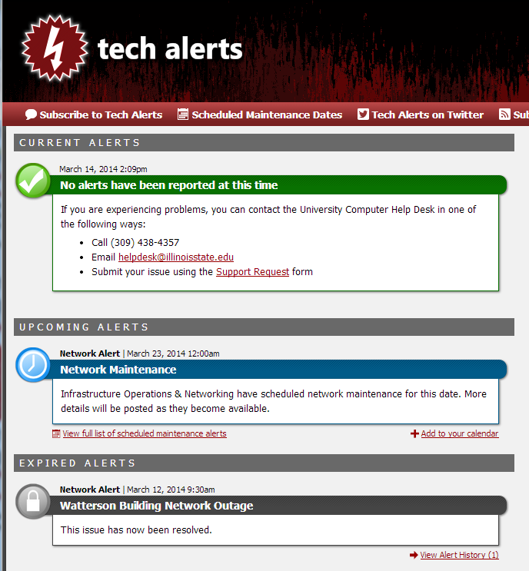

Slide 21
Exercise #2
Remember…
Report only what you know to be true
Translate the geek speak
Tailor the message to the audience
Control the message
Notes:
We all handle outage communications – unless, of course, your campus never has outages. Or you don’t talk about them when you do!
Those that have experience with posting those outage communications will have learned as we have that: The Network is Not Down.
For example… We had gotten reports from users that the network was down. Doing our duty, we posted that it was down. As you might imagine, the Director of Networking had words for us about that. It turned out that users were unable to authenticate to our LDAP server, which made them come to the wrong conclusion that the network was down.
The problem was twofold. First, we weren’t probing deep enough into the user experience to make an accurate determination as to what was going on. They said the network was down. We took them at their word. Mistake number one. Second, we didn’t have the authority to state that the network was down. Even if it was. Because we are not network engineers. We are the service desk.
Now, we only post what we know to be fact. Even if all of campus drops network connectivity and the phone is ringing off the hook and our inbox is flooded with emails, but we haven’t got confirmation from a network engineer, here’s what we say:
We have received reports that…
We only say what we know to be true. No one can dispute the fact that you’ve gotten a hundred calls and emails about whatever the problem is. Lest I need to remind you:
THE NETWORK IS NOT DOWN.

Slide 22
Exercise #2 Wrap-Up
How did you do?
What do we know to be true?
Would the Director of Networking approve of your message?
Would a user understand it?
Notes:
What we know to be true: enough users are reporting off-campus website outage, there was network maintenance today, the networking team is investigating
Distractors: maintenance might not be related even if the timing stinks, online game report only 1 user, networking has not yet confirmed there is an issue

Slide 23
Takeaways
How would you evaluate your campus’ IT communications?
Sticky Note Action Plan – what are…
3 things you think your campus does well in communication?
3 things you’d like to improve?
3 action items for the next 3 months?

