Slide 1
Leading a Revolution:
How to Create a World-Class Service Organization in Just One Year
Raechelle Clemmons & Scott Crevier March 18, 2014

Slide 2
Legal Stuff
Copyright Raechelle Clemmons & Scott Crevier 2014
This work is the intellectual property of the authors. Permission is granted for this material to be shared for non-commercial, educational purposes, provided that this copyright statement appears on the reproduced materials and notice is given that the copying is by permission of the author. To disseminate otherwise or to republish requires written permission from the author.
raechelle.clemmons@snc.edu | scott.crevier@snc.edu

Slide 3
The 3P’s
PEOPLE
PROCESS
PLACE

Slide 4
Reflection
Write at least one challenge or roadblock to change in your organization – People, Place, Process, or Other? Be specific…
Discuss your obstacle(s) at your table.
Which of the 3Ps (or Other) is the most predominant at your table?

Slide 5
PEOPLE

Slide 6
Challenges
5+ years of organizational changes
Weak leadership
2 teams that acted like 3
“Us” versus “them”
Flat organizational structure

Slide 7
Structure
Culture
Leadership Support

Slide 8
Organizational Structure
Key Questions:
Do you have the right type of bus?
Do you have the right people on the bus?
Do you have the right people in the right seats on the bus?

Slide 9
Organizational Structure
Strategy: Major Restructuring
Benchmark size and structure
Create new organizational chart
Eliminate and move positions
New job descriptions & classifications
Hire!

Slide 10
Culture
You can build any team you want now…
Key Questions:
How do you build team?
How do you keep from making the culture even worse, after such quick and sweeping changes?

Slide 11
Culture
Strategy: Engagement & Fun
Meetings (1:1, team, divisional, leadership)
Old & new leadership
Divisional retreat
Working groups
Lunch & learns
Birthday celebrations
Team naming contest
Group volunteerism
Lunches, celebrations, picnics
Holiday video

Slide 12
Culture: Get Silly Together
http://youtu.be/J9IKBT5V5Sk

Slide 13
PLACE

Slide 14
Office Space
Key Questions:
How do we bring our teams together in one place with no new space?
What role can space play in shaping a team’s culture?
Strategy:
No walls – open concept office space

Slide 15
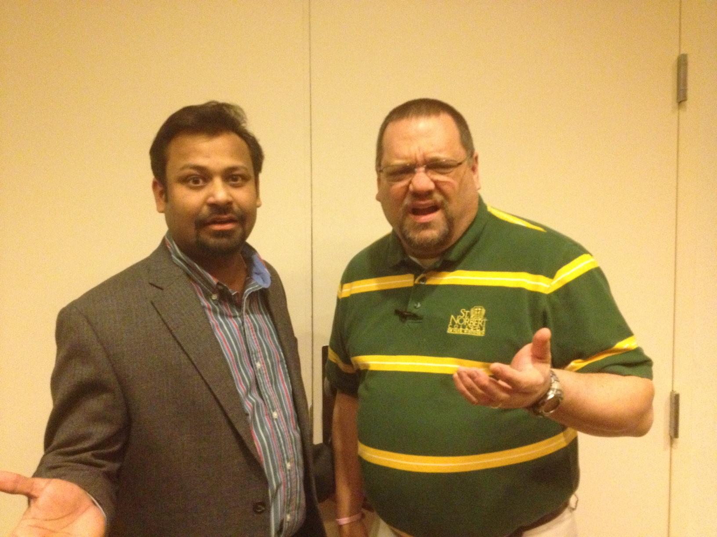
Uh Oh….
WTF?!?
NEW CHALLENGE!
How can we move beyond our private office culture?

Slide 16
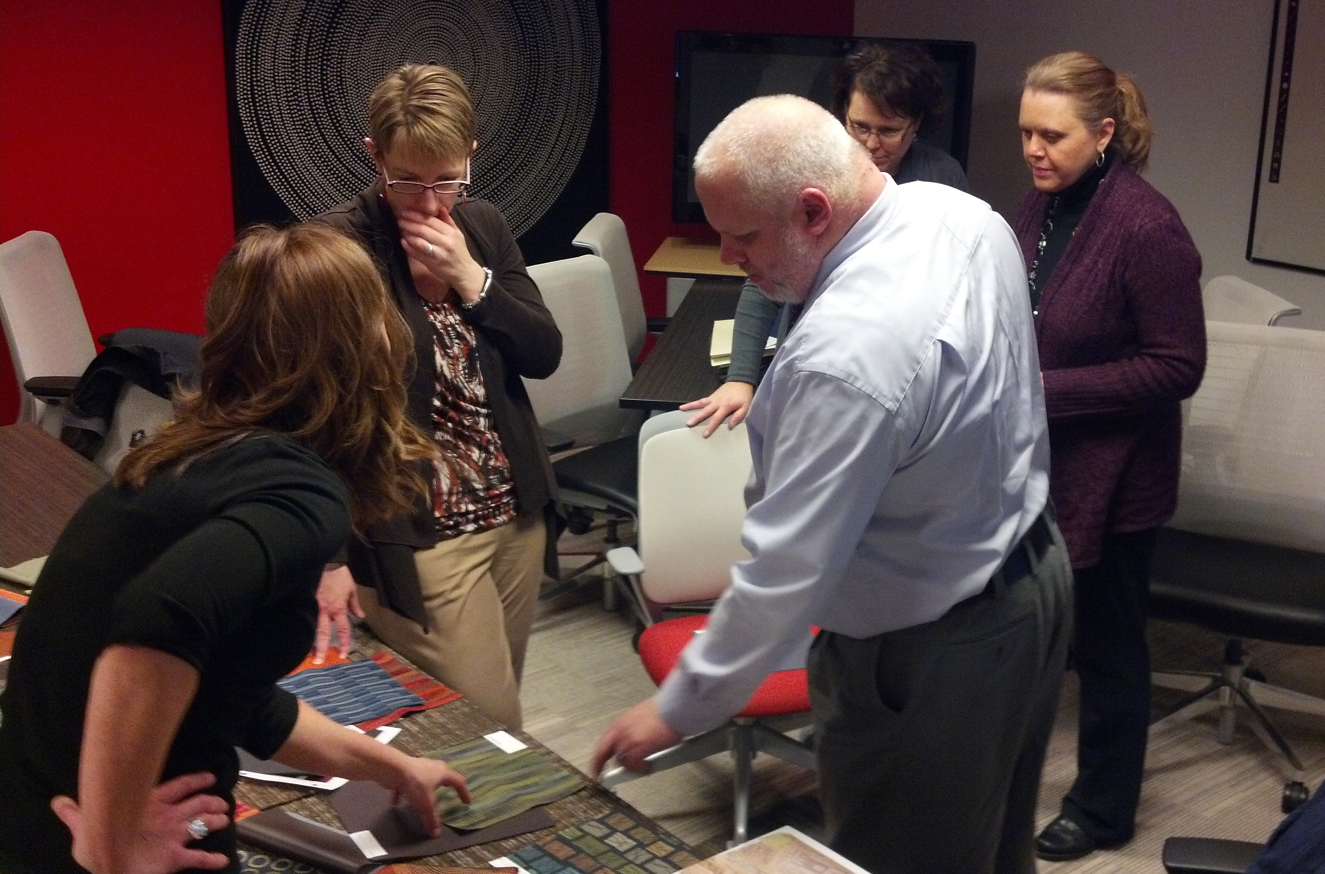
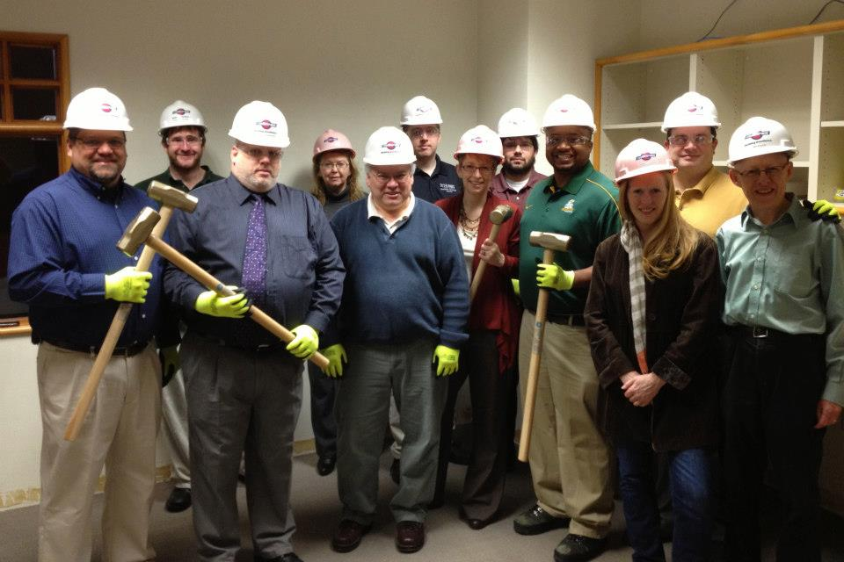
Strategies: Process
Get key influencers on board
Engage everyone in decision-making
Wall-breaking ceremony
Room naming contest

Slide 17
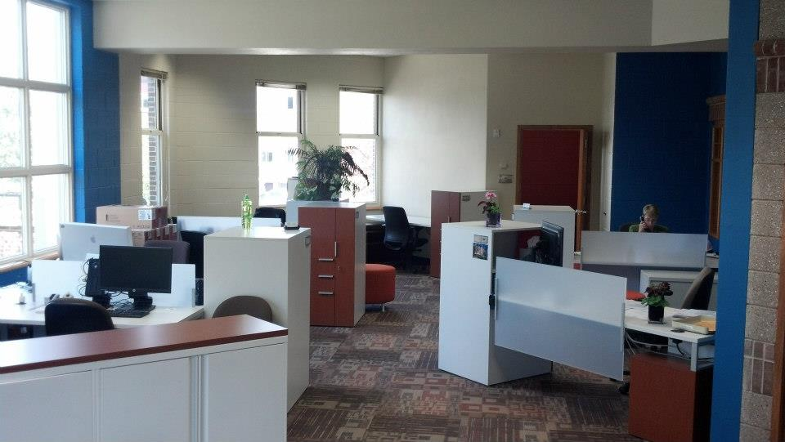
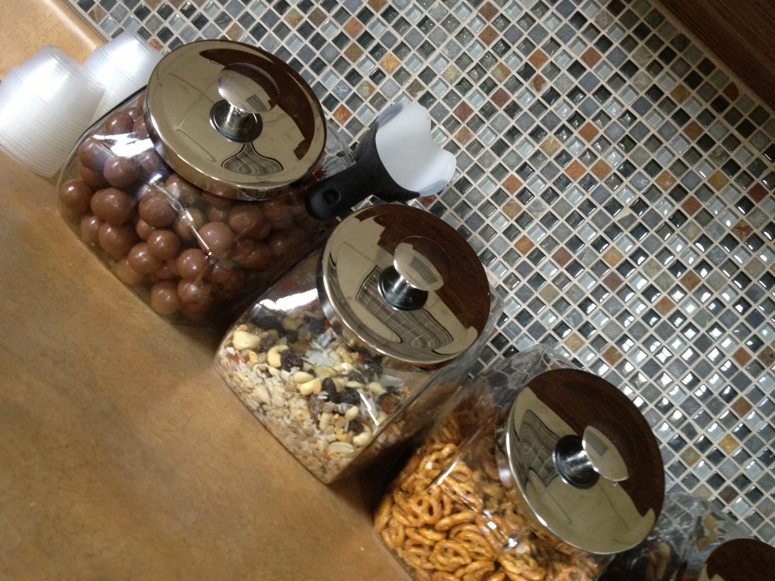
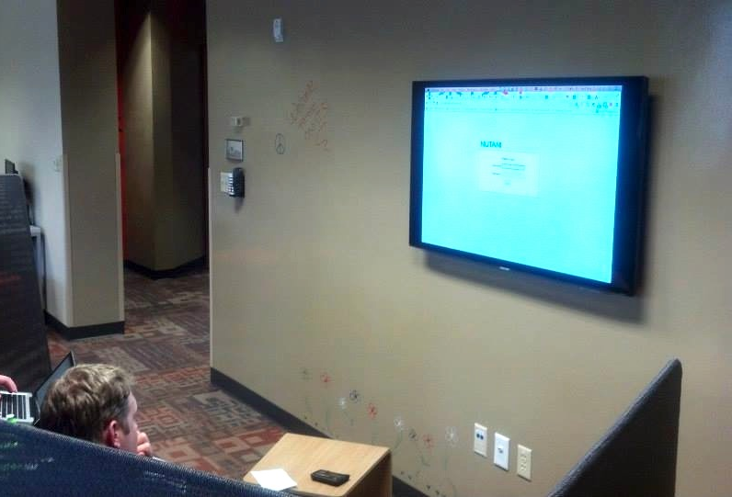
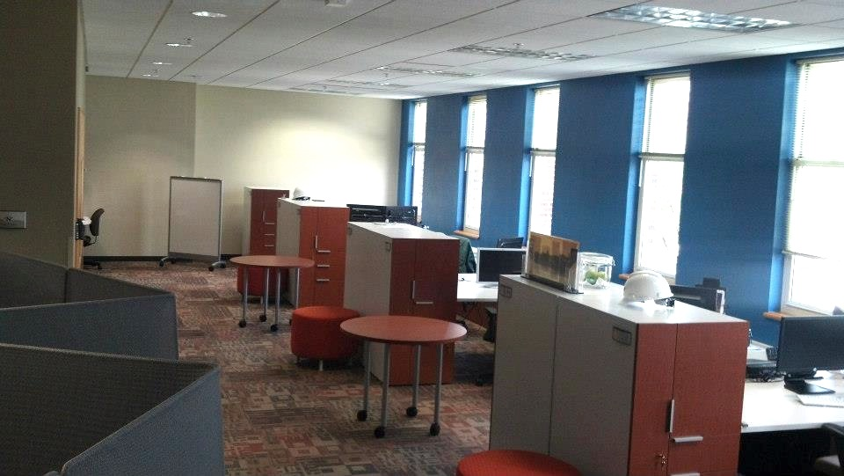
Strategies: Space
Level the playing field
Palate of place
Moveable, writable, untethered
Focus on amenities
ITS space as a “point of pride”

Slide 18
PROCESS

Slide 19
Challenges
Old/irrelevant services
Students leading frontline support, isolated from professional staff
No clear ownership of issues
Lack of trust (internally & externally)

Slide 20
Strategy
Intentional move from HELP Desk to SERVICE Desk
Hire dedicated professional staff
Situate in central location
Focus on “true” customer service

Slide 21
Strategy: SD Process
Processes for managing/escalating tickets
Ticket tracking & reports
Formalized programs & processes
Internal & external training & workshops
Consistent communications
Special service “blitzes”

Slide 22
WRAP-UP

Slide 23
Reflection
Write one idea for each of the 3P’s: People, Place, Process - key takeaway or an idea that you got today that you might want to bring back to your organization to affect change in this area
What ideas or reflections from today would you like to share?

