Slide 1
Developing Mobile Apps to Meet the Needs of Faculty in Teaching and Research
Andy Goldstein, University of Wisconsin-Madison
3/17/2014

Slide 2
Agenda
Quick Poll: Self-Identification
Feature Simplicity: Less Can Be More
The Importance of the User Experience
Native vs. Responsive (vs. Hybrid)
Activity
Development Challenges And Strategies
Discussion

Slide 3
Feature Simplicity: Less Can Be More
Applying The UNIX Philosophy To Mobile

Slide 4
“This is the Unix philosophy: Write programs that do one thing and do it well.”
– Doug McIlroy (Bell Labs)
Notes:
Benefits of feature simplicity:
Crystallizes focus on a specific need/problem to solve.
Makes functional requirements easier to define.
Shortens development iteration time.
Leads to a higher-quality app.
Drives higher-quality outcomes for users.

Slide 5
The Importance Of The User Experience
Easy Is Hard

Slide 6
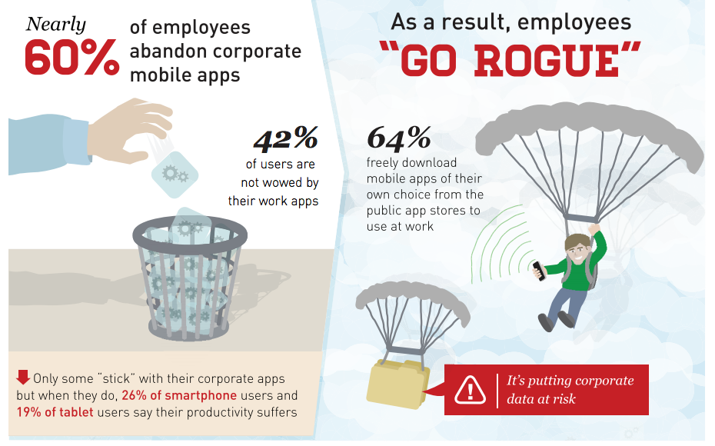
Source: Mobiquity, “Employee Mobile App Satisfaction Report” (October, 2013)

Slide 7
Native vs. Responsive (vs. Hybrid)
Choose Your Own Adventure.
Notes:
ACTIVITY BEFORE GOING TO NEXT SLIDE:
Have each table come up with a list of reasons to go mobile. Share back to group.

Slide 8
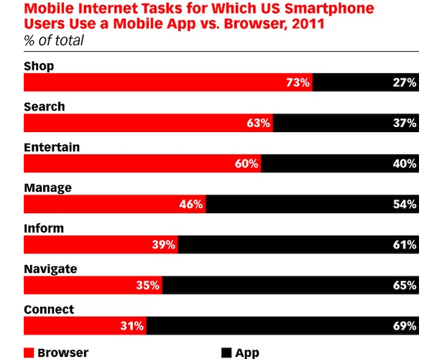
What Do We Use Mobile Apps For?
Source: Yahoo! And Ipsos, “Mobile Modes: How to Connect with Mobile Consumers,” Aug, 2011
Notes:
Reasons to “Go Native”:
Provide functionality dependent upon on-board device capabilities (e.g. GPS, accelerometer or camera).
Support spontaneous, brief, informal and “burstable” activities.
Intrinsic need for a touch interface
Leverage placed-based social tools.
Connect local groups of users in the wild.
Passively collect data.
“Stickiness.”

Slide 9
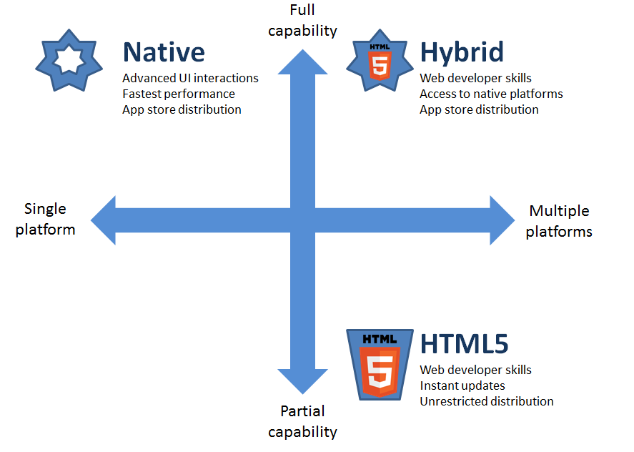
The Mobile Sweet Spot?*
Source: PhoneGap DevHaus
Notes:
* Ignore the location of “Hybrid” in this slide – it should be closer to the middle-bottom

Slide 10
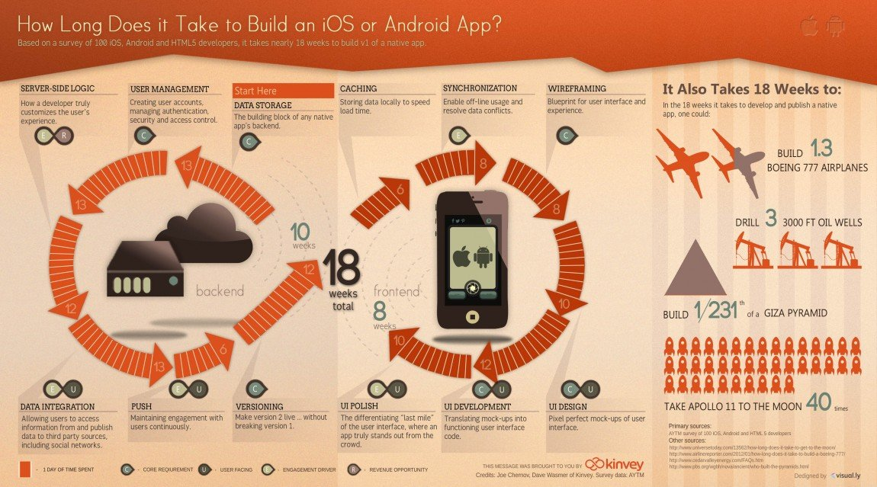
Going Native Takes Commitment
Source: Visua.ly
Notes:
Reasons to “Go Native”:
Provide functionality dependent upon on-board device capabilities (e.g. GPS, accelerometer or camera).
Support spontaneous, brief, informal and “burstable” activities.
Intrinsic need for a touch interface
Leverage placed-based social tools.
Connect local groups of users in the wild.
Passively collect data.
“Stickiness.”

Slide 11
Activity
What’s your mobile idea? How would you approach it?
Notes:
Have each table:
Come up with an idea for a Teaching, Learning or Research app:
Come to a decision about whether it needs to be native

Slide 12
Development Challenges & Strategies
Making The Mobile Magic Happen
Notes:
ACTIVITY BEFORE GOING TO NEXT SLIDE:
Have tables come up with lists of challenges/barriers to mobile development in Teaching, Learning and Research. Then share back.

Slide 13
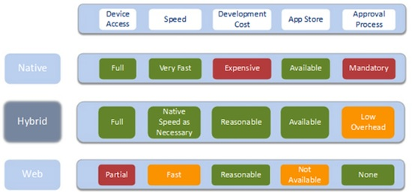
Developer Considerations *
Source: TitaniumDev

Slide 14
The Hybrid Model
Source: Business Insider

Slide 15
Challenges
Differences between operating systems
Differences between devices
Upgrade roulette
Security/data governance
Access constraints
App/settings conflicts and customization
Accessibility
Funding complexity/rigidity
“Scope-creep”

Slide 16
Strategies
Use native app strategy judiciously
When possible, lock devices down
Target as few device types as possible
Don’t collect any data that isn’t needed
Make UX part of your project plan
Work iteratively, test constantly
Leverage students as testers
Use the hybrid approach with caution

Slide 17
Discussion

Slide 18
Thank You
Andy Goldstein agoldstein4@wisc.edu

