Slide 1
Resources and Actions
EDUCAUSE Connect Baltimore
Malcolm Brown
Director, EDUCAUSE Learning Initiative
mbrown@educause.edu
May 2014
Notes:
M and V hello

Slide 2


Slide 3
ECAR

Slide 4
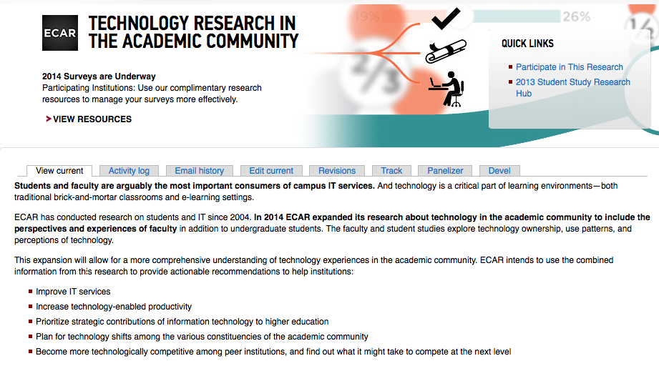
http://www.educause.edu/ecar/about-ecar/technology-research-academic-community

Slide 5
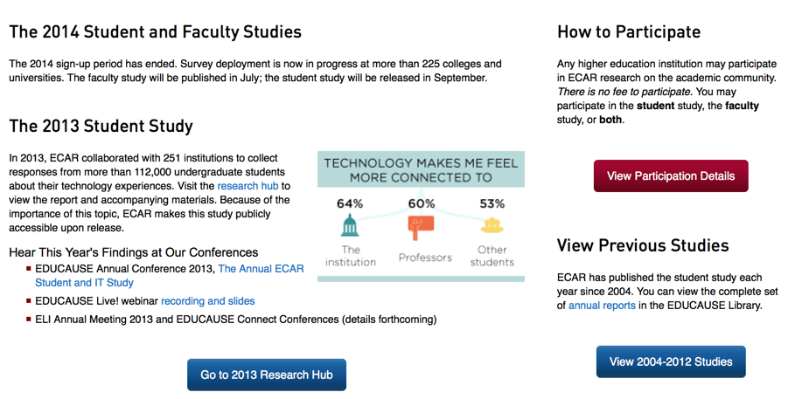

Slide 6
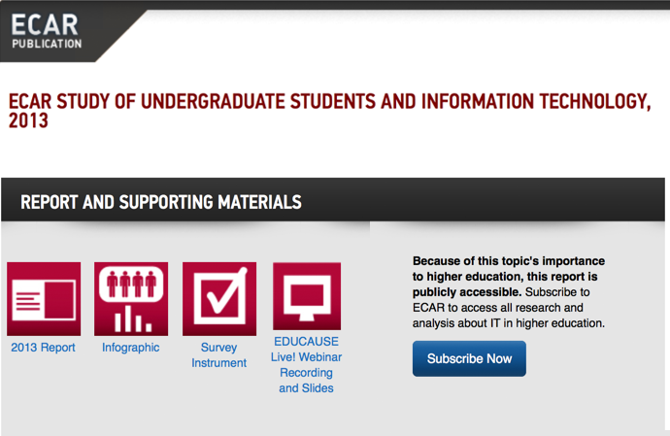

Slide 7
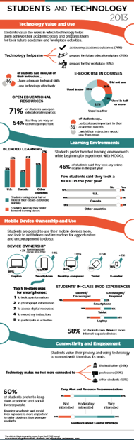

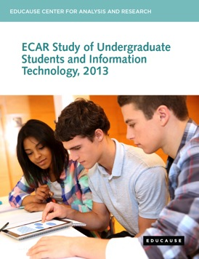
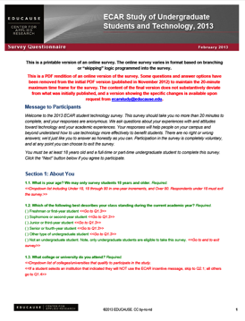
Research Products
Notes:
what you’ll find as student study research products

Slide 8

Participate

Slide 9
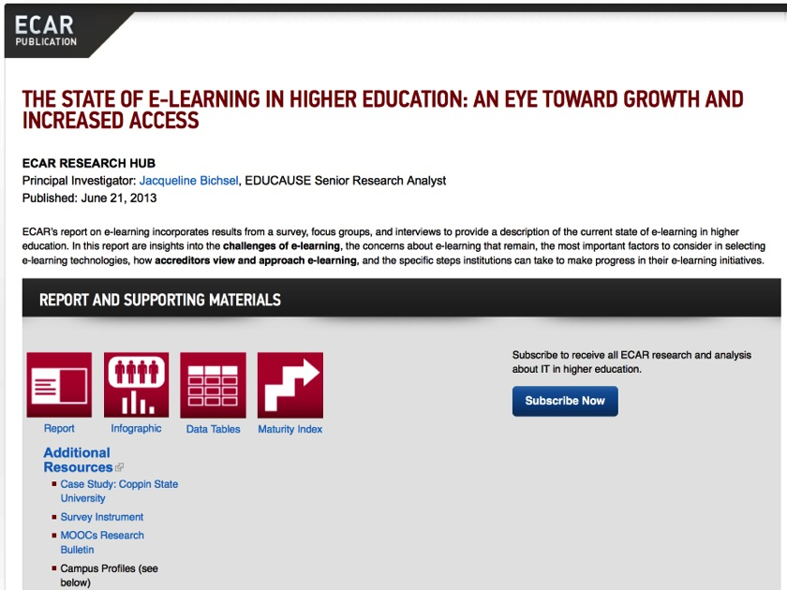
http://www.educause.edu/library/resources/state-e-learning-higher-education-eye-toward-growth-and-increased-access

Slide 10
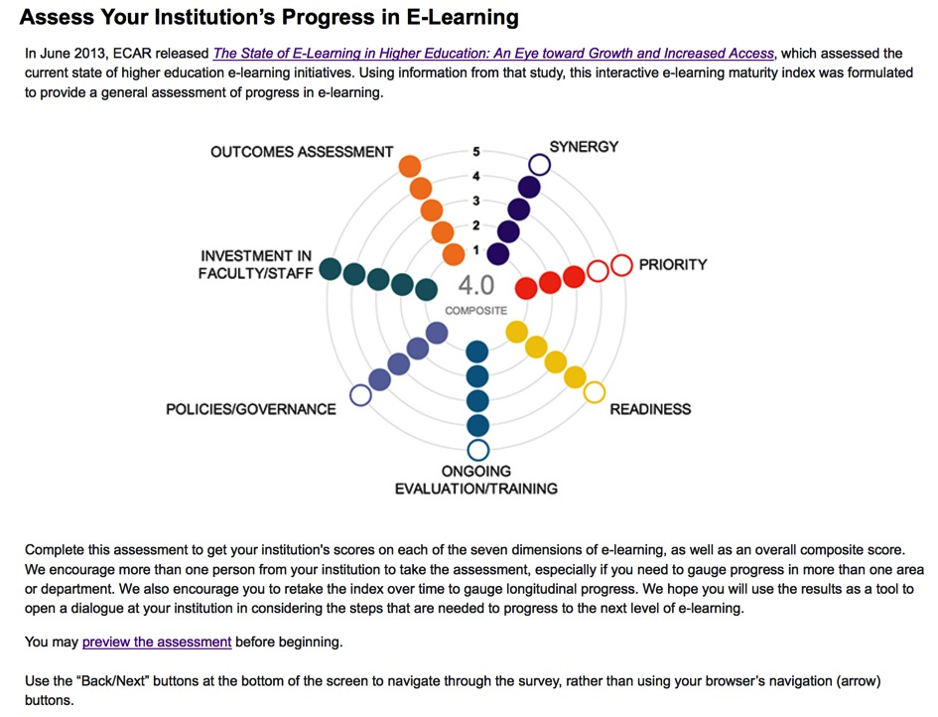

Slide 11
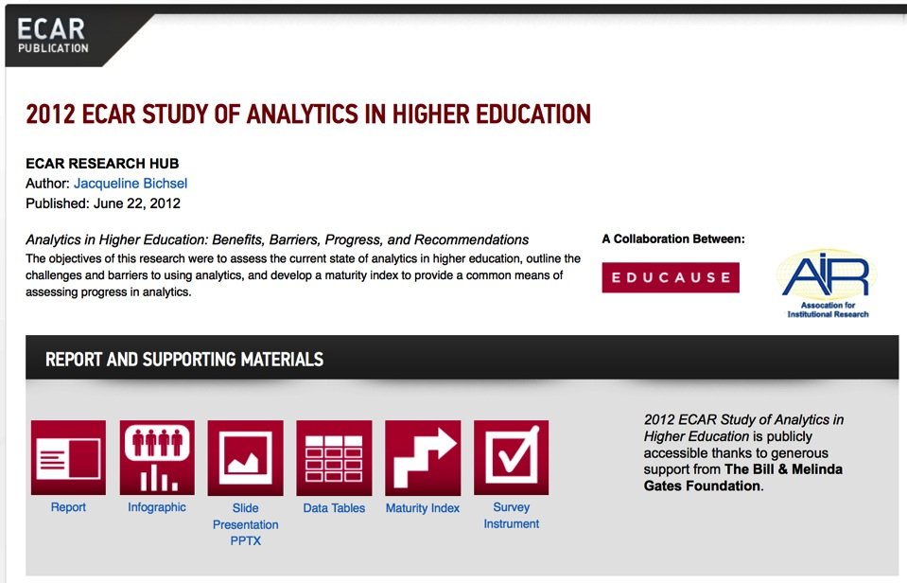
http://www.educause.edu/library/resources/2012-ecar-study-analytics-higher-education

Slide 12
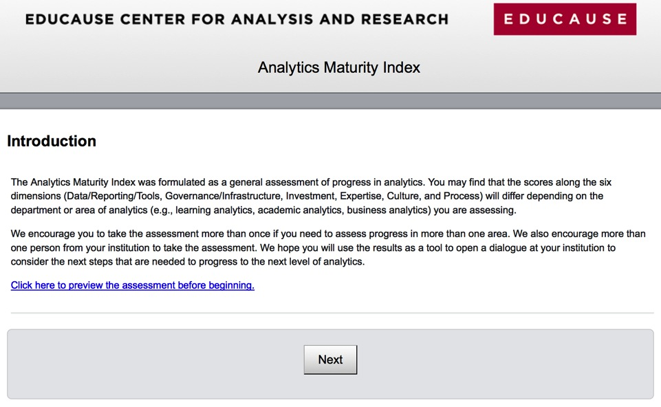
https://www.surveygizmo.com/s3/1020013/Analytics-Maturity-Index

Slide 13
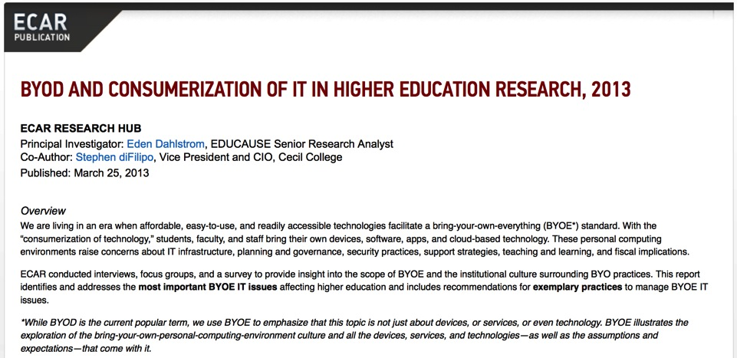
http://www.educause.edu/library/resources/byod-and-consumerization-it-higher-education-research-2013
Notes:
ECAR conducted interviews, focus groups, and a survey to provide insight into the scope of BYOE and the institutional culture surrounding BYO practices. This report identifies and addresses the most important BYOE IT issues affecting higher education and includes recommendations for exemplary practices to manage BYOE IT issues.

Slide 14
EDUCAUSE Learning Initiative
(ELI)

Slide 15

Content
Anchors

Slide 16
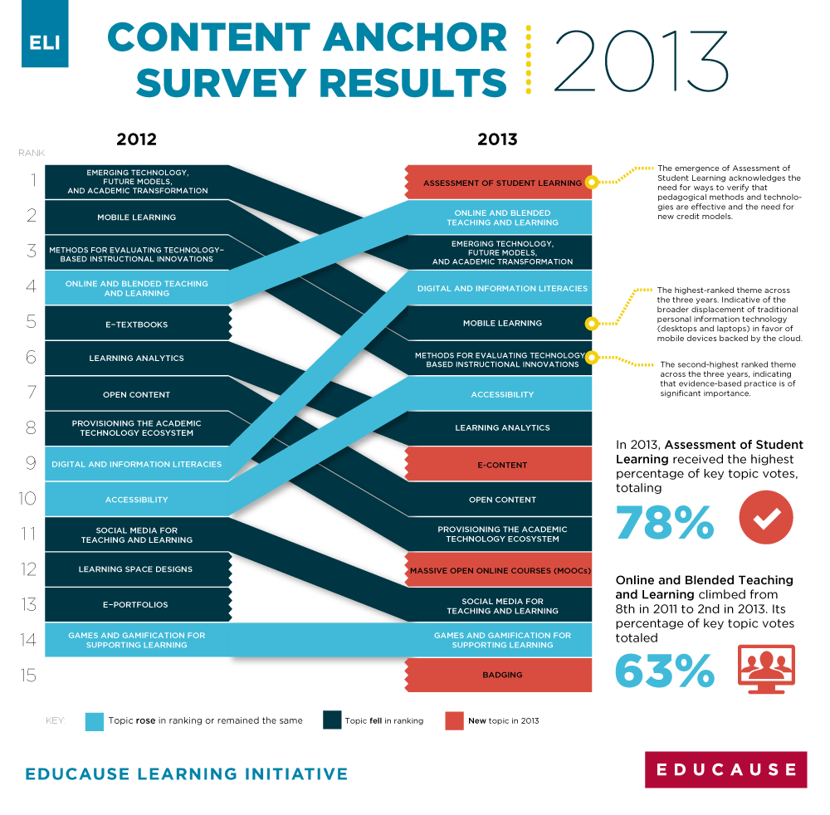
http://www.educause.edu/eli/programs/seeking-evidence-impact/content-anchors
Notes:
Please vote and encourage your colleagues to vote

Slide 17
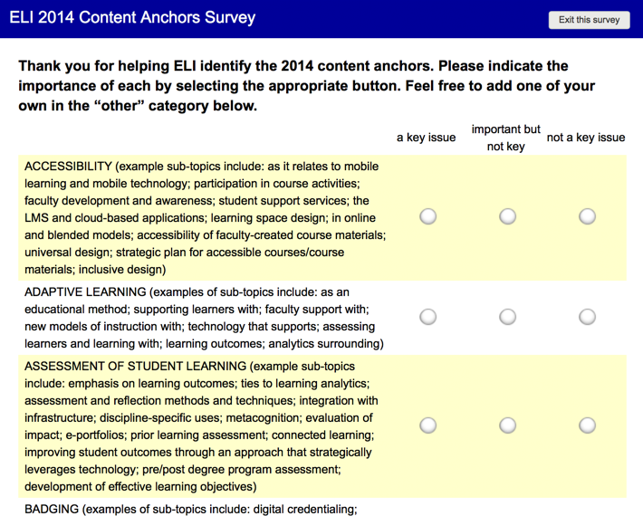

Slide 18
key issue
important but not key
not a key issue

Slide 19
 | 2012 | 2013 | 2014
1 | emerging tech & academic transformation | assessment of student learning | assessment of student learning
2 | mobile learning | online and blended T&L | online and blended T&L
3 | methods of evaluation | emerging tech & academic transformation | faculty development
4 | online and blended T&L | digital literacies | emerging tech & academic transformation
5 | e-textbooks | mobile learning | learning analytics
6 | learning analytics | methods of evaluation | methods of evaluation

Slide 20
 | 2012 | 2013 | 2014
1 | emerging tech & academic transformation | assessment of student learning | assessment of student learning
2 | mobile learning | online and blended T&L | online and blended T&L
3 | methods of evaluation | emerging tech & academic transformation | faculty development
4 | online and blended T&L | digital literacies | emerging tech & academic transformation
5 | e-textbooks | mobile learning | learning analytics
6 | learning analytics | methods of evaluation | methods of evaluation

Slide 21
 | 2012 | 2013 | 2014
1 | emerging tech & academic transformation | assessment of student learning | assessment of student learning
2 | mobile learning | online and blended T&L | online and blended T&L
3 | methods of evaluation | emerging tech & academic transformation | faculty development
4 | online and blended T&L | digital literacies | emerging tech & academic transformation
5 | e-textbooks | mobile learning | learning analytics
6 | learning analytics | methods of evaluation | methods of evaluation

Slide 22
 | 2012 | 2013 | 2014
1 | emerging tech & academic transformation | assessment of student learning | assessment of student learning
2 | mobile learning | online and blended T&L | online and blended T&L
3 | methods of evaluation | emerging tech & academic transformation | faculty development
4 | online and blended T&L | digital literacies | emerging tech & academic transformation
5 | e-textbooks | mobile learning | learning analytics
6 | learning analytics | methods of evaluation | methods of evaluation

Slide 23
 | 2012 | 2013 | 2014
1 | emerging tech & academic transformation | assessment of student learning | assessment of student learning
2 | mobile learning | online and blended T&L | online and blended T&L
3 | methods of evaluation | emerging tech & academic transformation | faculty development
4 | online and blended T&L | digital literacies | emerging tech & academic transformation
5 | e-textbooks | mobile learning | learning analytics
6 | learning analytics | methods of evaluation | methods of evaluation

Slide 24
 | 2012 | 2013 | 2014
1 | emerging tech & academic transformation | assessment of student learning | assessment of student learning
2 | mobile learning | online and blended T&L | online and blended T&L
3 | methods of evaluation | emerging tech & academic transformation | faculty development
4 | online and blended T&L | digital literacies | emerging tech & academic transformation
5 | e-textbooks | mobile learning | learning analytics
6 | learning analytics | methods of evaluation | methods of evaluation

Slide 25
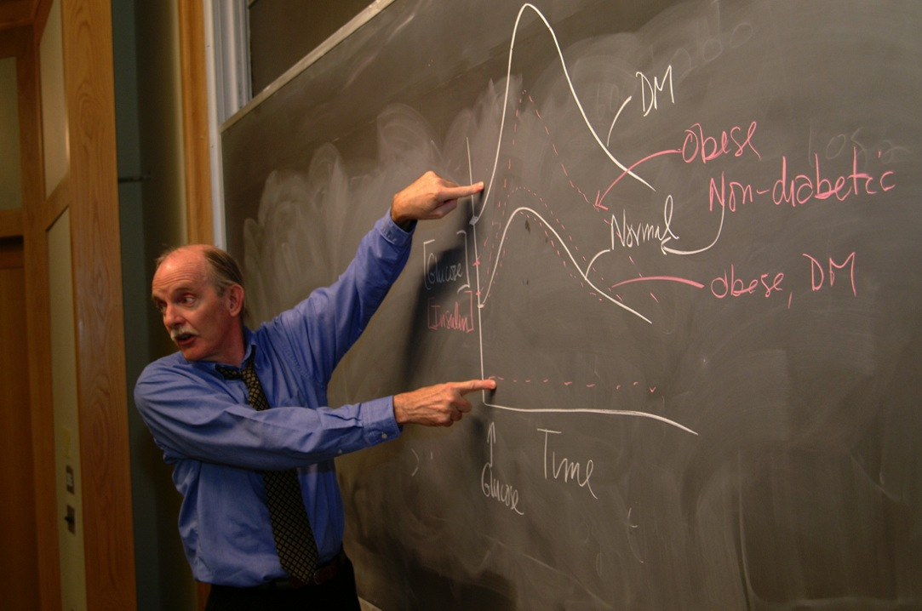
faculty development

Slide 26

ELI Online
Spring Focus Session
Faculty Development
April 1-3, 2014
educause.edu/eli/events

Slide 27
Themes
Management
Demonstrating institutional alignment
Emerging/innovative approaches
Incentives and faculty rewards
Evidence of impact
Business and financial models
Notes:
Management: coordinate, plan, treat fac as customer

Slide 28

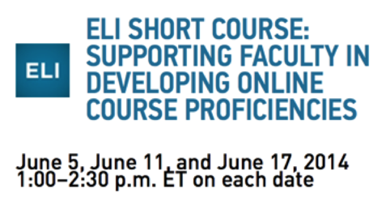


April 21, 2014
March 17, 2014

Slide 29
7 Things You Should Know…™ Series

Slide 30
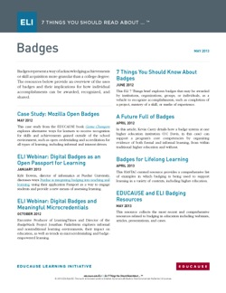
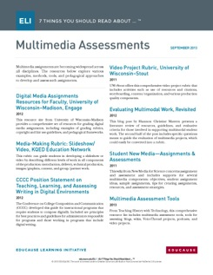
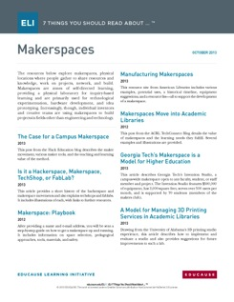

7 Things You Should Read About…™ Series
A curated set of resources on topics important to the teaching and learning community.
Available in ePub format

Slide 31

http://www.educause.edu/library/resources/2014-horizon-report

Slide 32
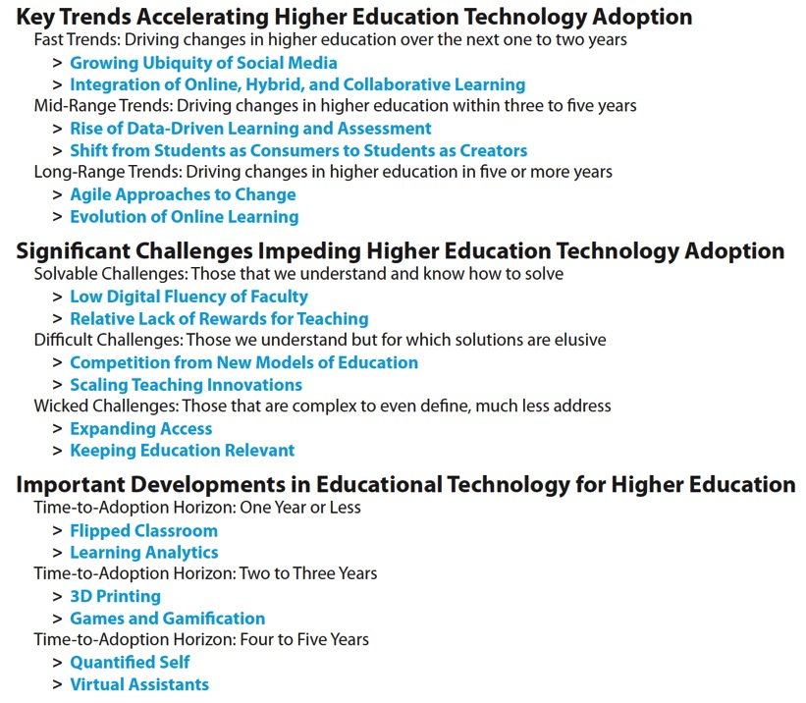

Slide 33
ELI Focus Sessions

Slide 34
3 days
18 speakers
Cases of effective practice
Tools to explore and do
Resources (15-40 minute presentations; white paper)
Public in 3 months

Slide 35

http://www.educause.edu/library/resources/faculty-engagement-and-development—effective-and-innovative-practice-report-eli-focus-session
Notes:
http://www.educause.edu/library/resources/faculty-engagement-and-development—effective-and-innovative-practice-report-eli-focus-session

Slide 36
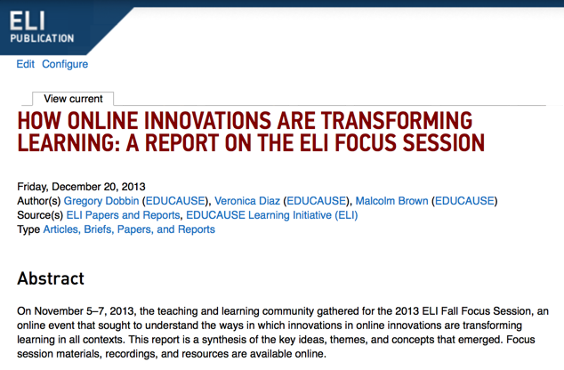
http://www.educause.edu/library/resources/how-online-innovations-are-transforming-learning-report-eli-focus-session
Notes:
http://www.educause.edu/library/resources/how-online-innovations-are-transforming-learning-report-eli-focus-session

Slide 37
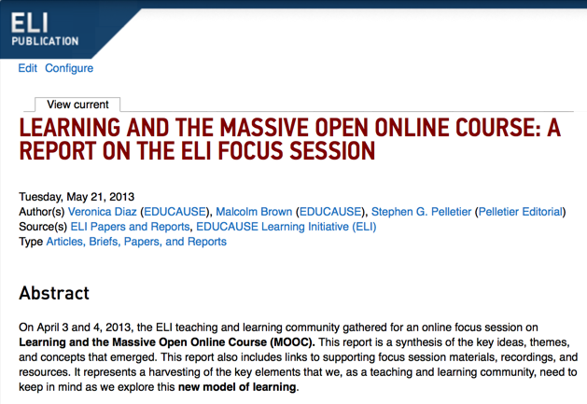
http://www.educause.edu/library/resources/learning-and-massive-open-online-course-report-eli-focus-session
Notes:
http://www.educause.edu/library/resources/learning-and-massive-open-online-course-report-eli-focus-session

Slide 38
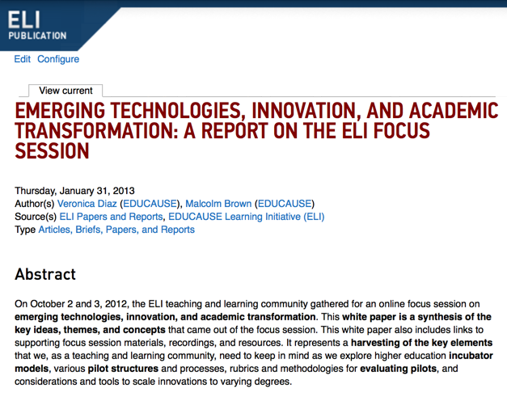
http://www.educause.edu/library/resources/emerging-technologies-innovation-and-academic-transformation-report-eli-focus-session
Notes:
http://www.educause.edu/library/resources/emerging-technologies-innovation-and-academic-transformation-report-eli-focus-session

Slide 39
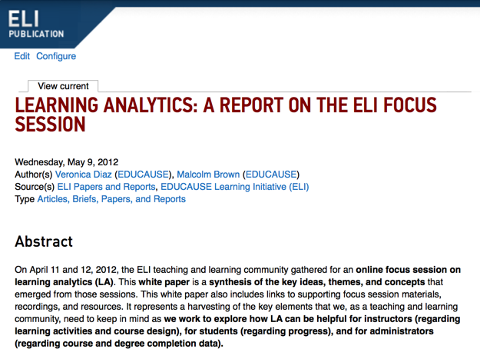
http://www.educause.edu/library/resources/learning-analytics-report-eli-focus-session
Notes:
http://www.educause.edu/library/resources/learning-analytics-report-eli-focus-session

Slide 40




Slide 43


Slide 44


Slide 45

components of an action plan:

Slide 46
Which ideas are most relevant?
What are the components of a good action plan?

Slide 47


