Slide 1
From Lab Management to vLearning
John D. Hoh
Campus Technology Officer
ITS @ Penn State Harrisburg others @Penn State Harrisburg/ John D. Hoh / Campus Technology Officer
This presentation can be downloaded at: https://sites.google.com/site/johndhoh/

Slide 2
How do you get anything done in a highly decentralized, geographically diverse ecosystem that are often managed by feudal lords??
Alternate Title
Quick Facts for the Penn State University
IT Budget > $250 M
IT Professionals > 1300
IT Departments > 130
Campuses > 20
IT Leadership Council (75) and Board (9)

Slide 3
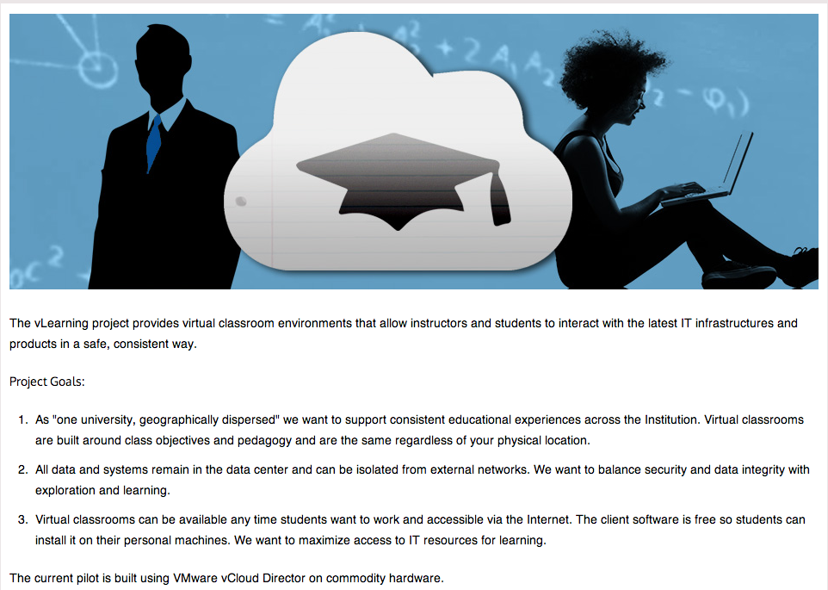
What is vLearning?

Slide 4
Strategic Roadmap Led to. . .
Seven Task Forces
One of them being Lab and Desktop Management
I was assigned the task of leading the initiative
(the setup for the first exercise)
A diverse group of semi-willing individuals got together and . . .
Which I countered with. . .
And finally we got. . .
MY STORY – begins here!
Follow along on the diagram.

Slide 5
Exercise #1 – You be “me”
Given the responsibility - with limited or no authority – what would you do to get this task done?

Slide 6
Some Answers. . .
You learn from your mistakes
You regroup
You stare in disbelief
You remove and add members to your team
You had better find the “coalition of the willing” to help with the journey
BTW, in case you had forgotten. . .
Politics and Culture EAT Strategy

Slide 7
Alternative Title #2
How do you evolve from implementing a technology to providing a service?

Slide 8
Executive Summary
CREATE a more consistent look and feel for students/faculty across the campuses and colleges – thereby minimize the current concern of “haves and have nots.”
REDUCE both capital and operational costs by repurposing systems to extend their and by redeploying existing FTE involved in end user support.
ENHANCE our ability to remotely reproduce the resources currently found in our computer labs and office systems in a far more secure fashion.
ENABLE our existing lab spaces to evolve into collaborative learning spaces.

Slide 9
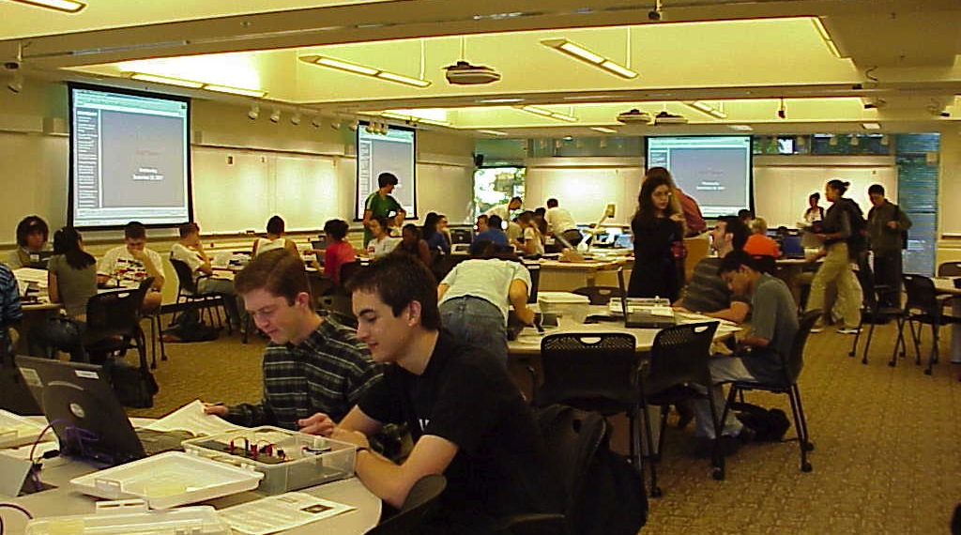
Discussion moved from Efficiency to how to “better” Enable Learning

Slide 10
The 3 Step Methodology to surviving the leadership role in a task force.
Get ‘er done
Apologize (aka the Friction Reduction phase)
Collaborate as peers and colleagues

Slide 11
IT Principals Impacted
We will/are:
align IT resources and plans with the University’s Strategic Plan.
committed to responsible stewardship of human, financial, and environmental resources.
make our systems and services accessible.
committed to collaboration and open communication across all units.
encourage innovation.
actively develop and support our staff.
maximize value and reduce cost through collaborative processes for sourcing and high utilization of enterprise services.
identify risks, implement proactive security measures, and be consistent with policy and law.

Slide 12
Bringing up a new service
Your unit, campus, or University is going to roll out something new to the academic community. (In our case, vLearning).
What has to happen for this to be successful?
What should happen to assist in the adaptation of the new service.
If we lived in a perfect world, what would be the icing on the cake to ensure a flawless implementation?

Slide 13
Exercise #2: Build the Pyramid
Gotta Have Would be Nice I Could Dream

Slide 14
Final Exercise: What have you walked away with from this conversation? Some “ME” time.
Name a few. . . I will start you off with one.

Slide 15
Cows* are Good!
*Coalitions of the Willing

