Slide 1
A Learning Analytics Approach to Academic Assessment
Presented by:
Denise Bollenback
April 2014

Slide 2
Assessment Technology Examples
  College Dashboards
    Enrollment statistics
  Learning Management System
    Alignment/Mapping of Outcomes in Course Templates
    Evidence Collection (Primary or Secondary Evaluations)
    Rubric Statistics Reports
    Student Performance Reports
    Course Coverage Reports
    Analytics For Learn Reports
  ePortfolios
    Evidence Collection
    Statistics Reports

Slide 3
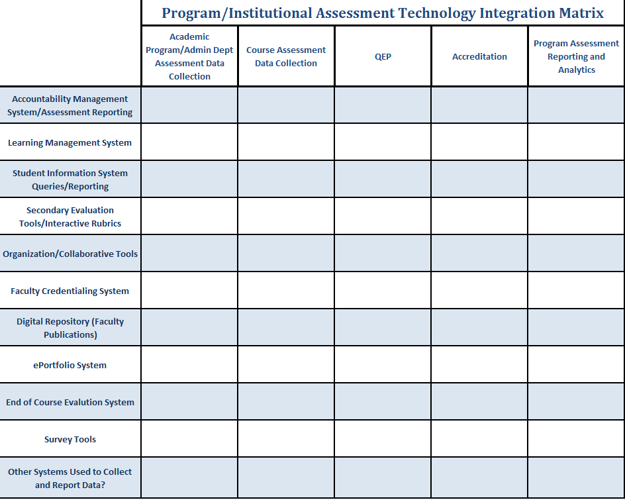
Academic Assessment Technology

Slide 4
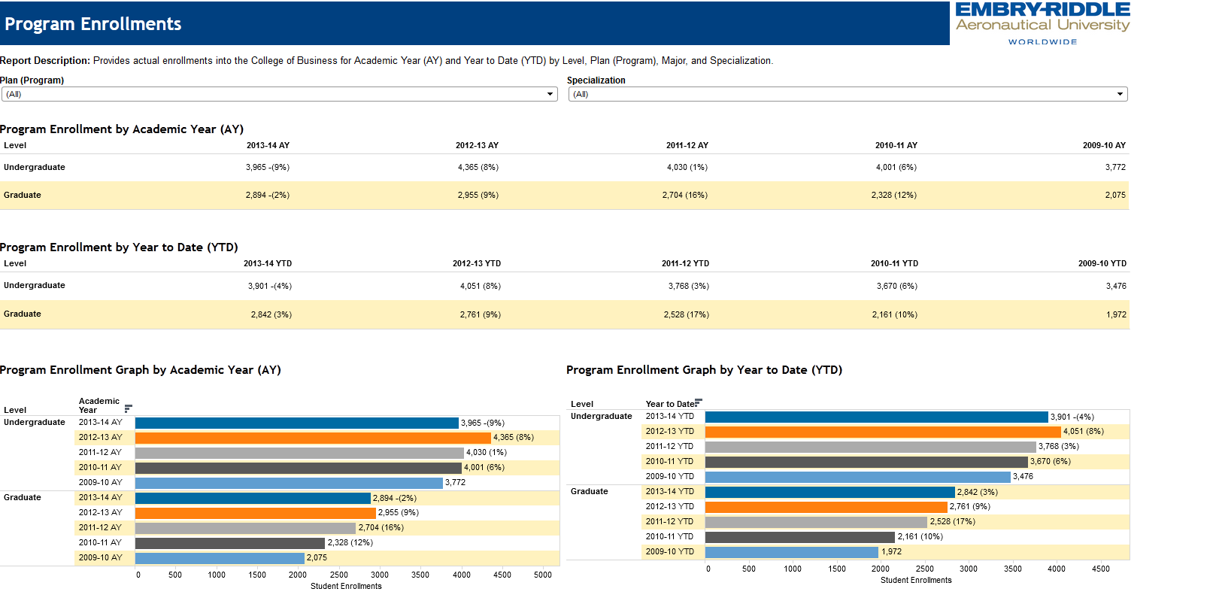
College Dashboards

Slide 5
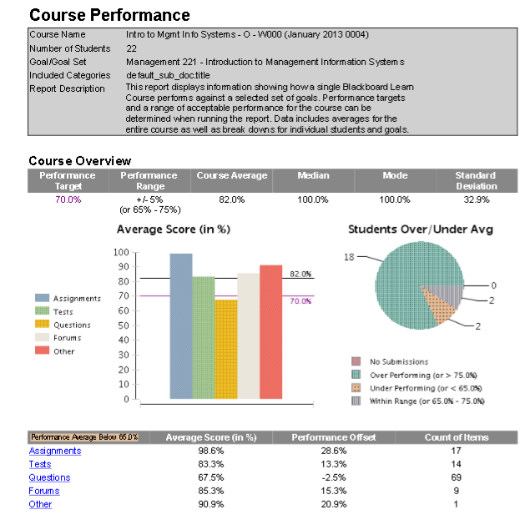
Learning Management System:
Student Performance Reports
Student performance reports are based on all outcomes, which are aligned to assignments, tests, questions, forums, or “other.” In this case, “other” was a group assignment.
Interactive reporting also allows for the drilling down of data by specific student, activity, outcome, or set of outcomes, depending on the desired information needed.

Slide 6
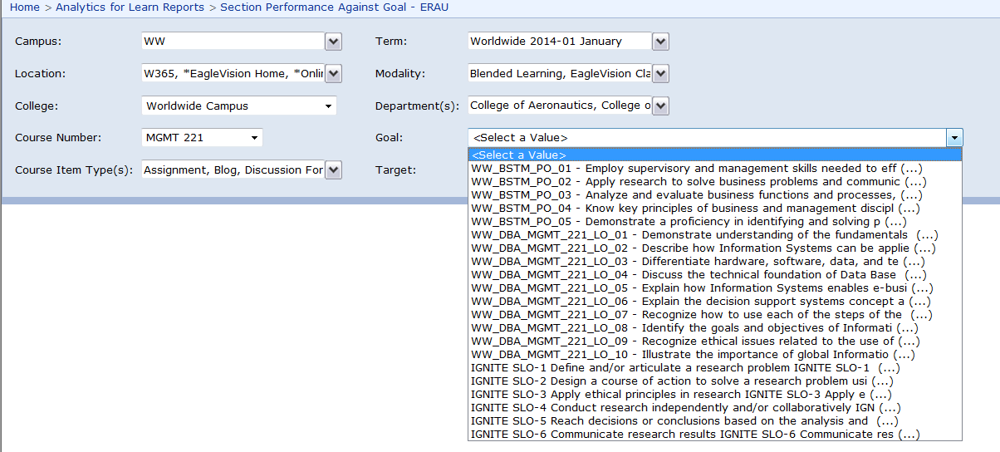
Analytics For Learn
Outcomes-Based Reporting
Goal Performance Exception Report
School Performance Against Goal
Section Performance Against Goal

Slide 7
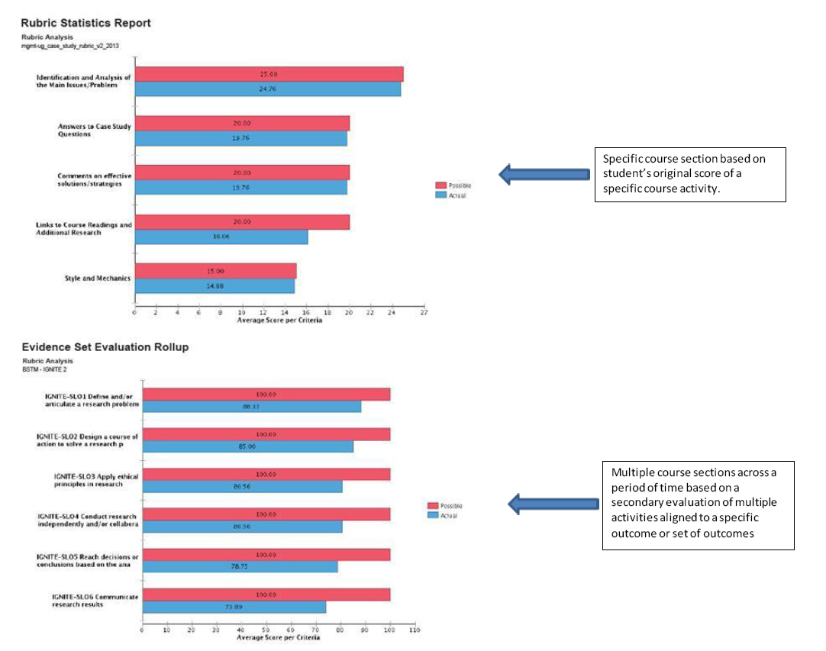
Learning Management System:
Rubric Statistics Reports
Can be used for interrater reliability

Slide 8
Scholarly Commons:
Last month, ERAU Scholarly Commons had 3507 full-text downloads and 228 new submissions were posted.
The most popular papers were:
  The Edwards Personal Preference Schedule as a Predictor of Success in a Collegiate Professional Pilot Training Program (302 downloads) http://commons.erau.edu/jaaer/vol6/iss2/9
  The Evolution of the ATC Selection and Training Process (123 downloads) http://commons.erau.edu/jaaer/vol21/iss2/9
  Avion (114 downloads) http://commons.erau.edu/avion/66
The most popular publications were:
  The Journal of Aviation/Aerospace Education & Research (2623 downloads) http://commons.erau.edu/jaaer
  Avion (192 downloads) http://commons.erau.edu/avion
  Charles Russell Scrapbook Images (182 downloads) http://commons.erau.edu/charles-russell-images
ERAU Scholarly Commons now holds 1487 records, which have been downloaded a total of 17,716 times.

Slide 9
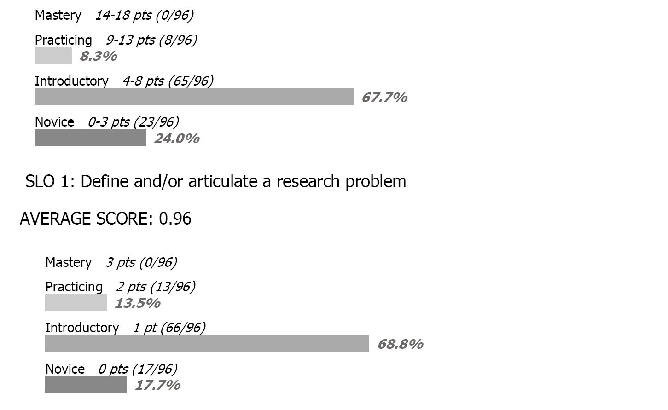
ePortfolios:
Student Performance Report
Report Example: Introductory Course
96 Artifacts Collected and Evaluated for Fall 2013

Slide 10
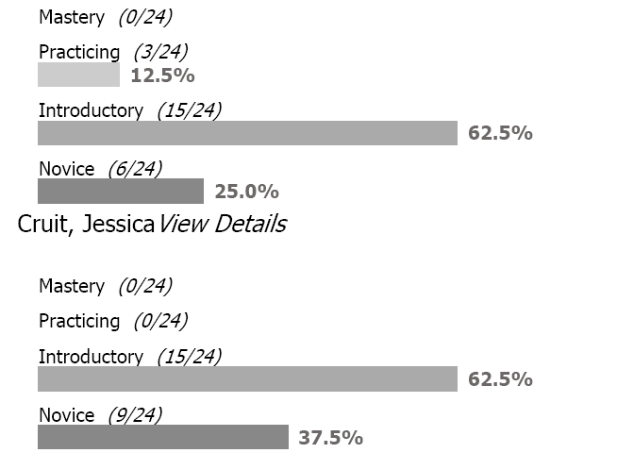
ePortfolios:
Interrater Reliability Report
Report Example: Introductory Course
Comparing two different evaluator’s results for one course

Slide 11
Assessment Techniques
Challenges, Barriers, Missed Opportunities
  College Dashboards
  II. Learning Management System
                A. Data Validity: How do we ensure the data is valid?
                B. Multiple Modalities: Online/Blended/Classroom, etc.
                C. Templates necessary for large scale implementation
                D. Access to create alignments and reporting
  III. ePortfolios
                A. Limited licenses for evaluation templates
                B. Manual processes embedded in collection process for
                creating random samples
                C. Requires multiple submissions by students
                Final Thoughts?

Slide 12
Thank you for your time and participation!
Interactive Activity – Assessment Technology Matrix!

