Slide 1
Planning a Quality Roadmap to Reinvent and Improve Services
Gil Gonzales and Bryan Kinnan
January 29, 2015

Slide 2
Agenda
Introductions
Are you in the right place?
Gil Gonzales
University of New Mexico’s Quality-Centered Management Approach
Bryan Kinnan
UNL Extension Technology 2020 Plan
Group Interaction
Plus/Deltas
Wrap-up

Slide 3
Are You in the right place?
Focus IT Organizational Efforts on Engaging and Reaching Customers
Develop and Implement a Vision to Achieve a Competitive Advantage
Evaluate the Tools and Professional Development Needed

Slide 4
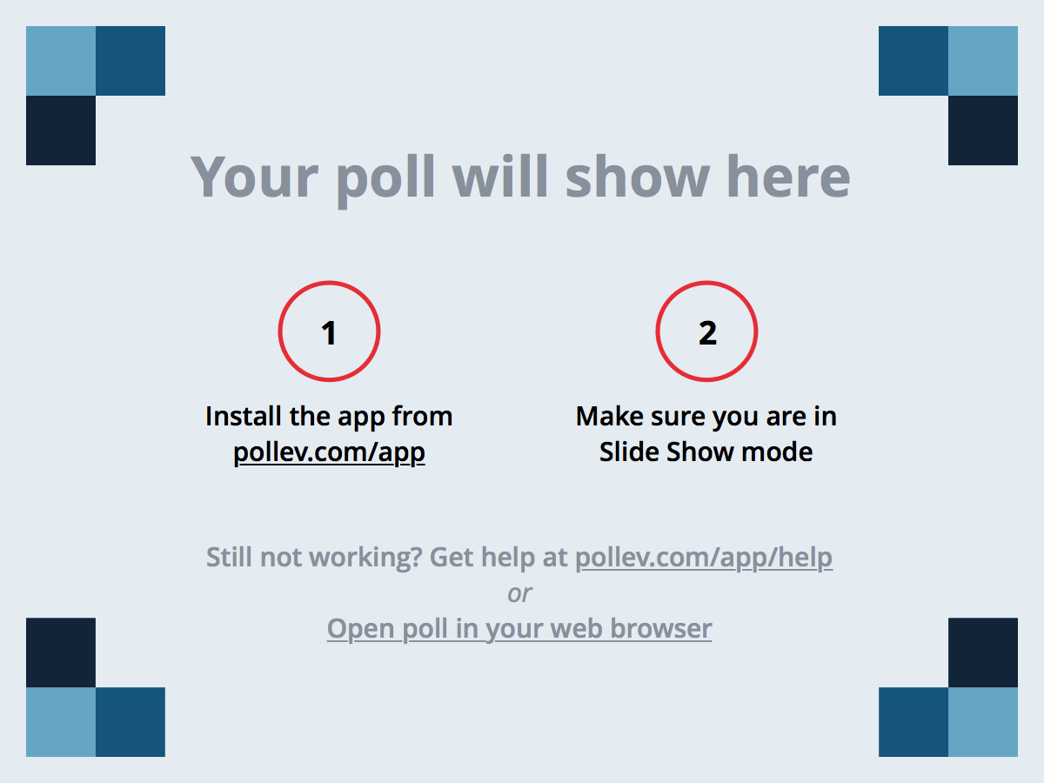
Notes:
Poll Title: How often does your University/College/Department develop a plan for long-term technology needs? https://www.polleverywhere.com/multiple_choice_polls/CfLuox7OjZ2z7c4

Slide 5
Gil Gonzales
University of New Mexico’s Quality-Centered Management Approach

Slide 6
UNM Information Technologies
Enterprise IT service provider for UNM
Banner ERP, Computer classrooms & labs
Partners with HPC, Research, Learning Mgt
GigaPoP, Western Regional Network (WRN)
150 IT Staff, 80+ Student Employees
ITIL certification of over 50% of technical staff
PMI certification of project managers
Baldrige Quality Performance Excellence recognition in NM 2011 & 2013

Slide 7
Quality IT @ UNM
IT adheres to IT-industry standard best practices for IT service and project management
IT engages our workforce of 150 staff and 50 students, and integrates & trains new leadership and staff
IT involves stakeholders and constituents collaboratively in strategic and operational planning
IT services are extensively utilized and are highly available, reliable and secure
IT offers multiple programs to extend technology use in the academic and wider New Mexico communities
Sustains an overall customer satisfaction of 4.5 out of 5

Slide 8
Significant Improvement Measures
Levels are established in workforce satisfaction and have increased in communication satisfaction
Reliability and availability of key systems has increased along with usage of these systems, including:
Enterprise administrative applications
Email & calendar
Instructional & learning technologies
Printing & storage
Web & mobile applications
Wired & wireless networking
UNM IT aligns with peer higher ed institutions in scaling common good services for efficient and reliable delivery to campus stakeholders
IT manages power consumption, negotiates hardware and software vendor contracts to save money for taxpayers, students and to benefit smaller public education institutions in the State

Slide 9
Bryan Kinnan
Future-Focused Planning at the University of Nebraska - Lincoln

Slide 10
Can you predict the future?
Apple IIe > Dell Laptop
Floppy Disk > USB Thumb drive
Buddy Holley > Ramones > Nirvana

Slide 11
Technology 2020 Plan
What is it?
Technology strategy through 2020
How was it formulated and implemented?
Plan a verb, not a noun.
Should be revisited on a regular basis
How do we work…
Not necessarily a Tech Plan
Notes:
Plan that Extension has put together to guide its technology strategy through the end of the decade. The goal of this plan is to position Extension to “set the course for how the organization will, in (the) future, identify, adopt and apply information technologies to complement its educational mission.”

Slide 12
Collaboration
Extension
UNL OITS (Office of Information Technology Services)
University of Nebraska CSN (Computing Services Network)
UNL UCOMM (University Communications)
eXtension
Nebraska State Educational IT Office
Internet Nebraska
Outside University Affiliates
Microsoft
UNL EdMedia (Educational Media)

Slide 13
Milestones
Develop campaign-driven multi-channel approaches to engage and reach audiences.
Develop Web resources for use on multiple devices, including mobile, with intelligent “wrappers” that link people to relevant content, consistent branding and important services.
Develop a portfolio of high-quality online learning modules, courses, and mobile applications that support the educational responsibilities of Action Teams and initiatives.
Develop a culture of evaluation to improve our understanding of audience needs, guide project development and communicate impacts.
Frame the organization’s expectations for faculty and staff professional development with regard to using and applying technology programmatically.
Provide professional development programs to help Extension faculty and staff acquire needed technology skills to engage and reach audiences, and develop and deliver educational programs.
Participate in learning networks to listen to, engage and reach audiences.
Provide access to value-added services that are critical to meeting organizational goals and executing the Technology 2020 Plan.
Research and identify event registration and fee payment services to support organizational events and activities.
Increase the level of bandwidth serving statewide offices.

Slide 14
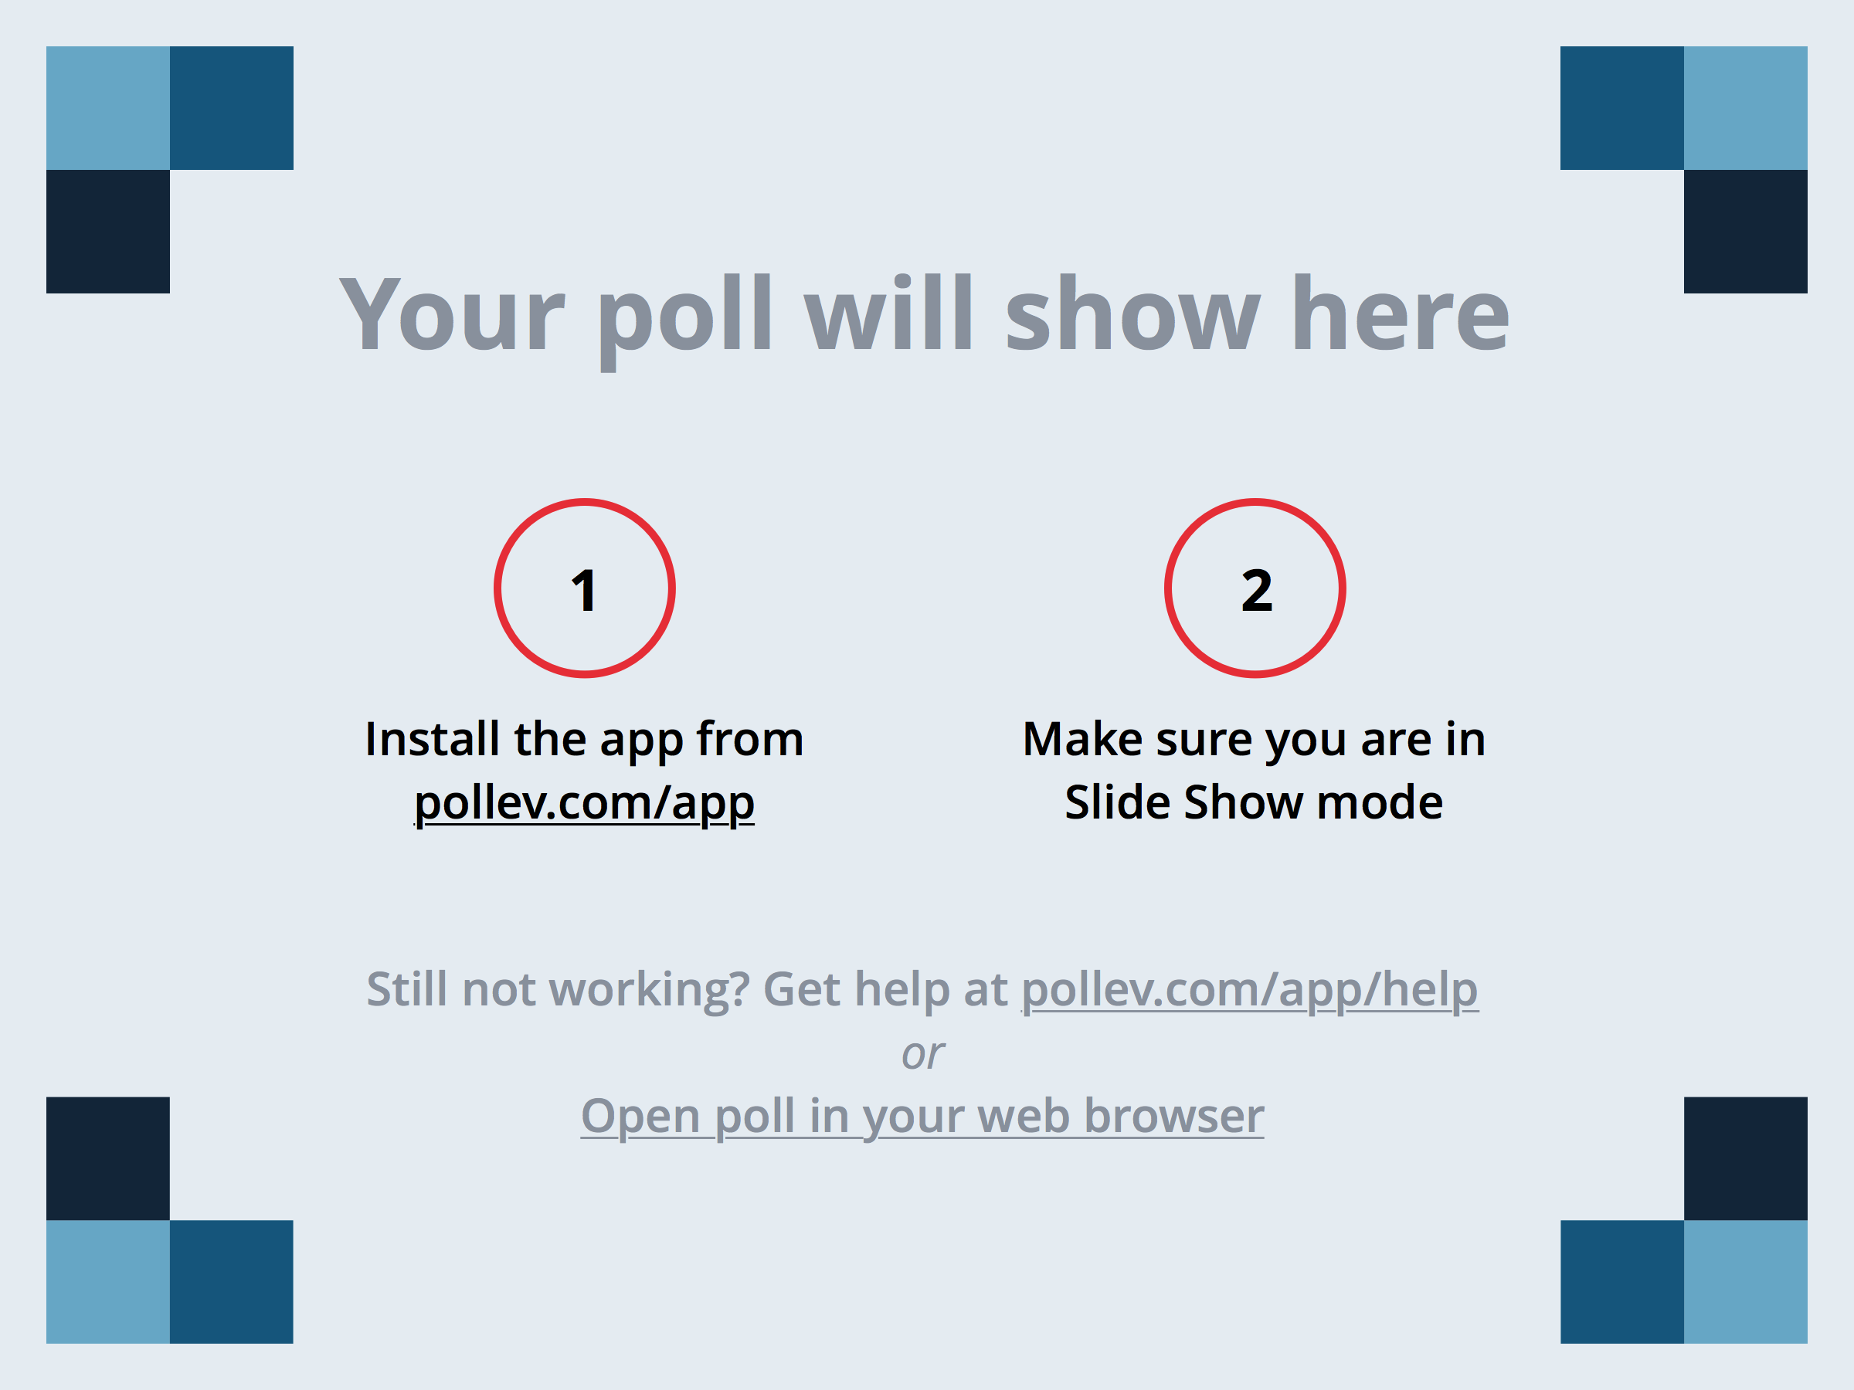
Notes:
If your University/College/Department has a plan, what processes does your University/College/Department use to develop the long-term plan for technology needs? https://www.polleverywhere.com/free_text_polls/iPxlvHNX83TPQQw

Slide 15
Notes:
Does your University/College/Department have a plan for long-term technology needs? https://www.polleverywhere.com/multiple_choice_polls/jUlKGqfwRpYux0J

Slide 16
a. How do you engage your community in support of change?
b. How do you prepare your organization to adopt change?
c. How do you assure your administration that your organization is accountable and competitive?
d. How to you measure your success?

Slide 17
Notes:
How often should your University/College/Department develop a plan for long-term technology needs? https://www.polleverywhere.com/free_text_polls/8xMxWNHuj4QsEW5

Slide 18
Plus/Deltas

Slide 19
Closing

