Slide 1
Campus Collaboration in the Cloud
3 @ ~45 min each presentations:
Andrew Keating: Cloud Overview
Thomas Trappler: Risk Mitigation
Dan Cotton: Campus Case Study
~45 min panel discussion and Q&A
January 30, 2015

Slide 2
Andrew Keating, PhD
Director, NET+ Cloud Services

Slide 3

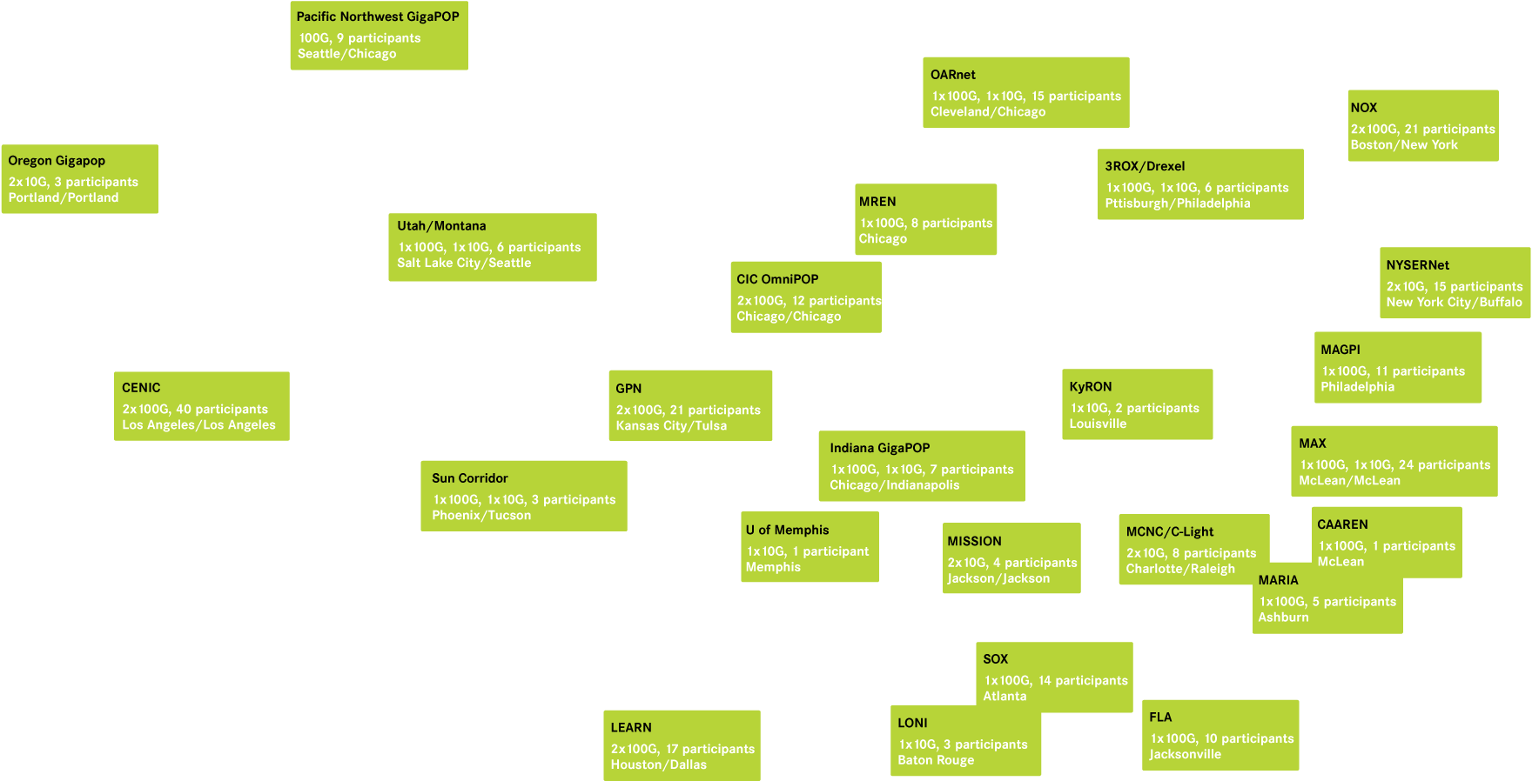
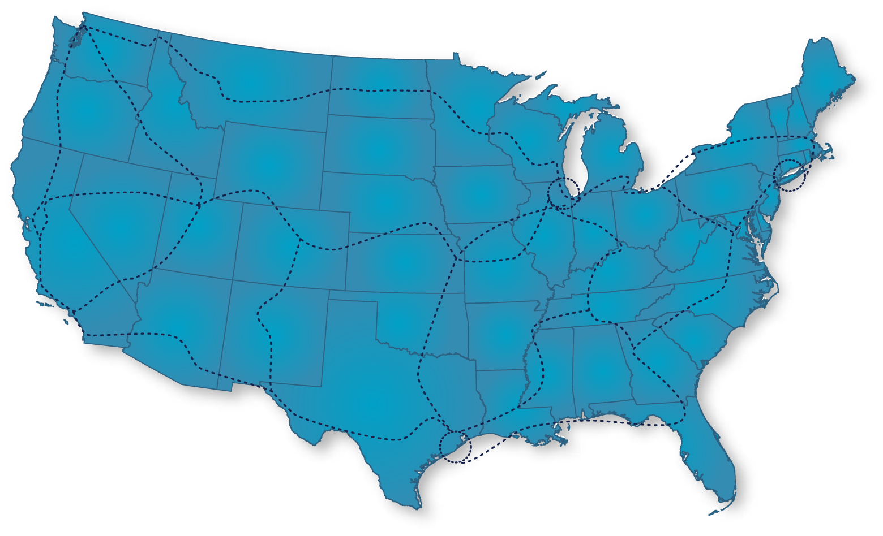

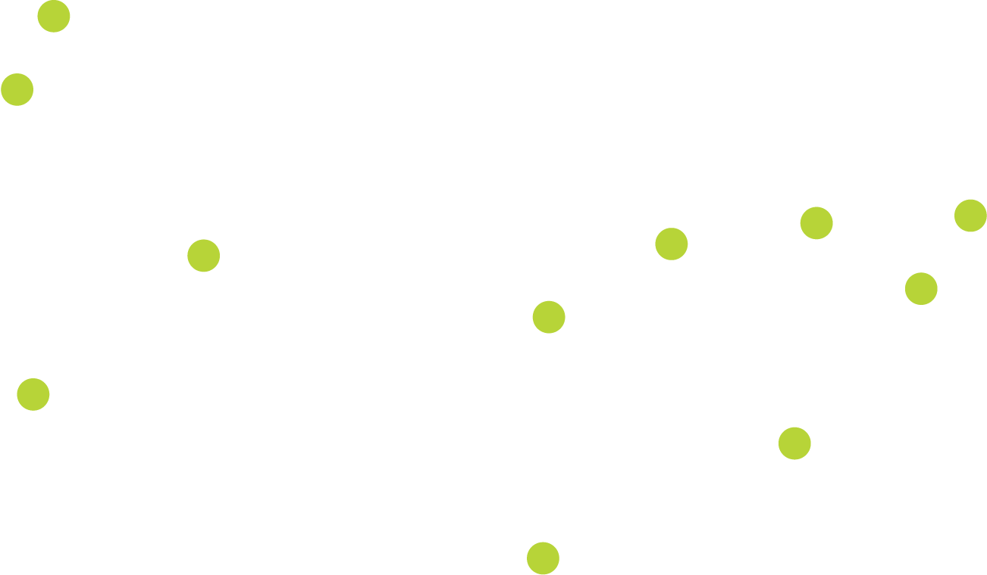
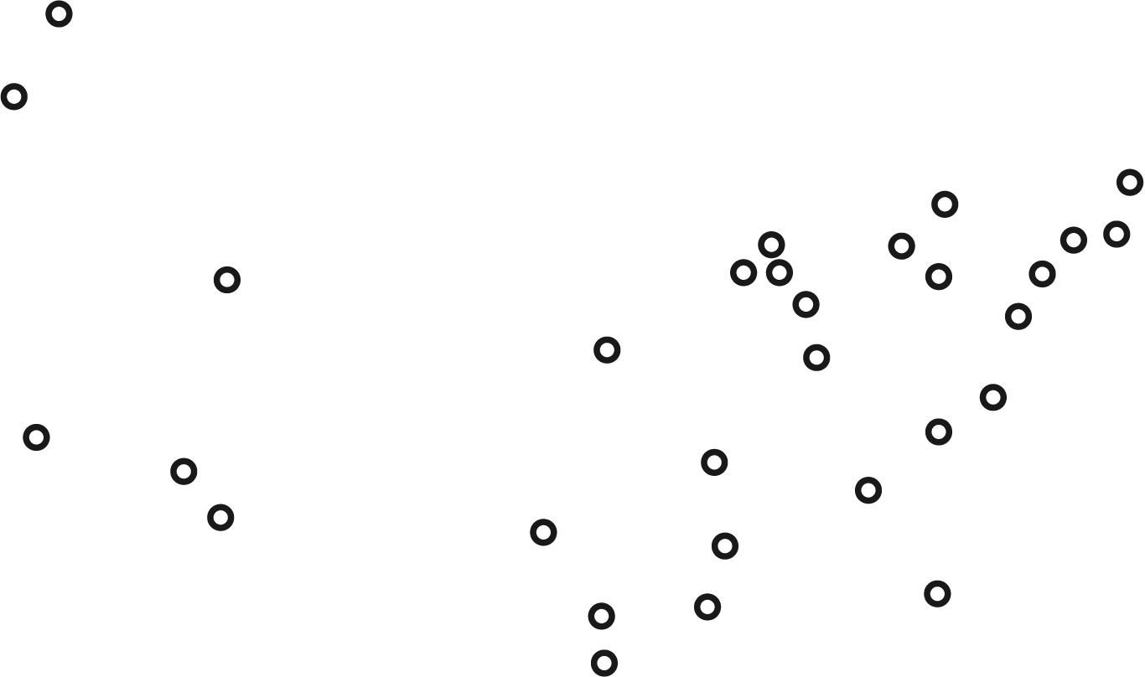
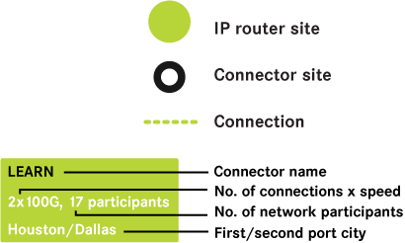
R&E organizations connecting directly to the Internet2 Network
Network
Connectors
Notes:
We have talked about the Internet2 network already but a quick reminder of its nationwide reach and capacity; core community asset
Internet2 is building the next innovation platform
Internet2’s core mission is to be the “forward leaning leader” of the R&E community—to facilitate the next innovation platform and to keep our campuses “way out in front” of commodity offerings
Membership has expanded from 34 to 270+ universities, plus 150 leading industry, network and affiliate members—including government agencies and laboratories
Internet2 broader community has expanded to over 66,000 community anchor institutions across the U.S. and over 100 international networking partners representing over 50 countries

Slide 4





Trust, Identity and Middleware
Provides guest Single Sign-On
Informs 3rd-party authorization for access to protected resources
Honors privacy of visiting user
Allows Collaborative Organizations to securely co-operate key tools
Secure and effective framework for science and research objectives
Provides SSL and certificates
Federated identity management for US R&E community (6 million users)
Affordable multifactor authentication
Inter-institutional task management
Enterprise access administration
Addresses organizational diversity common to Universities

Slide 5

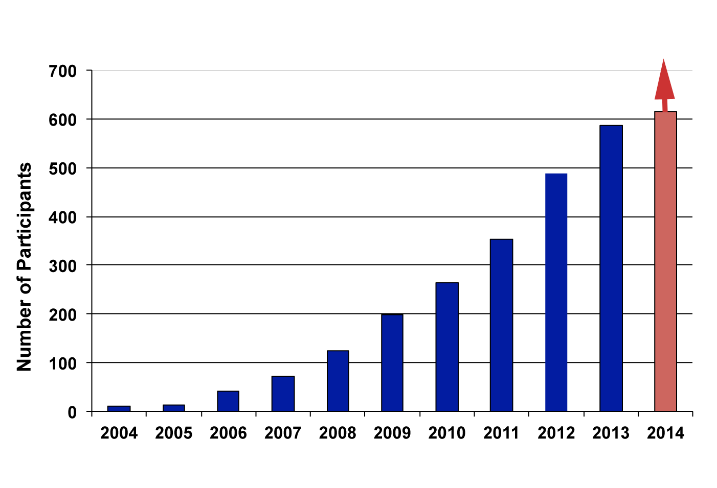
Foundation for Trust & Identity
15 425+
2 160+
0 2000+
7.8 million
Academic Participants
Sponsored Partners
Registered
Service Providers
Individuals served
by federated IdM
Notes:
InCommon provides the trust and identity fabric for research and education; another core community asset similar to the network
Formed by 17 organizations in 2004
Has grown to 615 participants, including 425 colleges and universities, 30 government and research centers, 160 corporate sponsored partners
Established by campus-based expertise, which also gave rise to Shibboleth, Grouper, and other middleware. The late R.L. “Bob” Morgan instrumental in development of federated identity management.
Now the centerpiece for Internet2’s Trust and Identity in Education and Research
Other sectors modeling their federated identity and access management strategies after InCommon

Slide 6
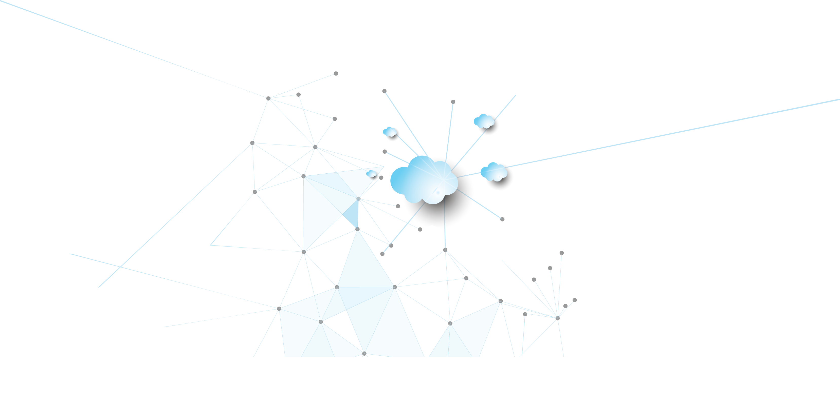
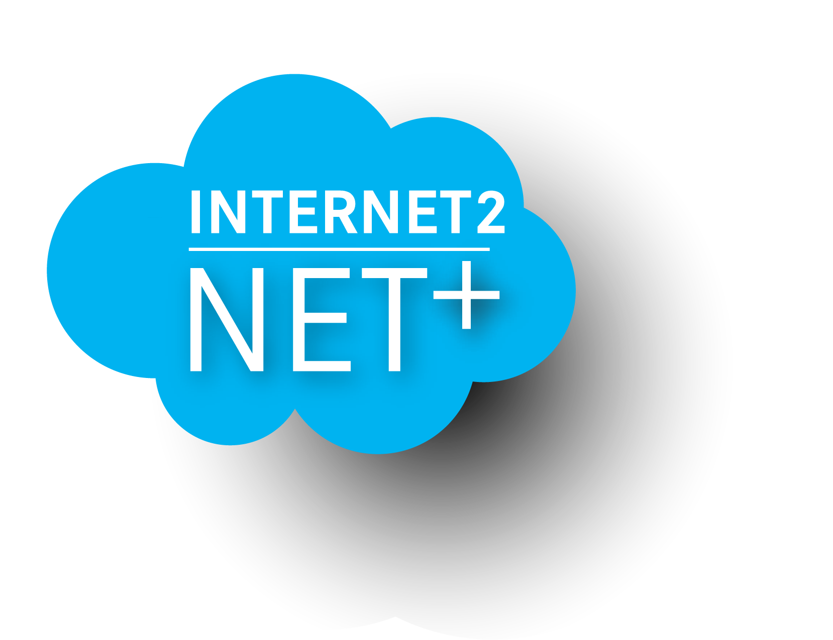
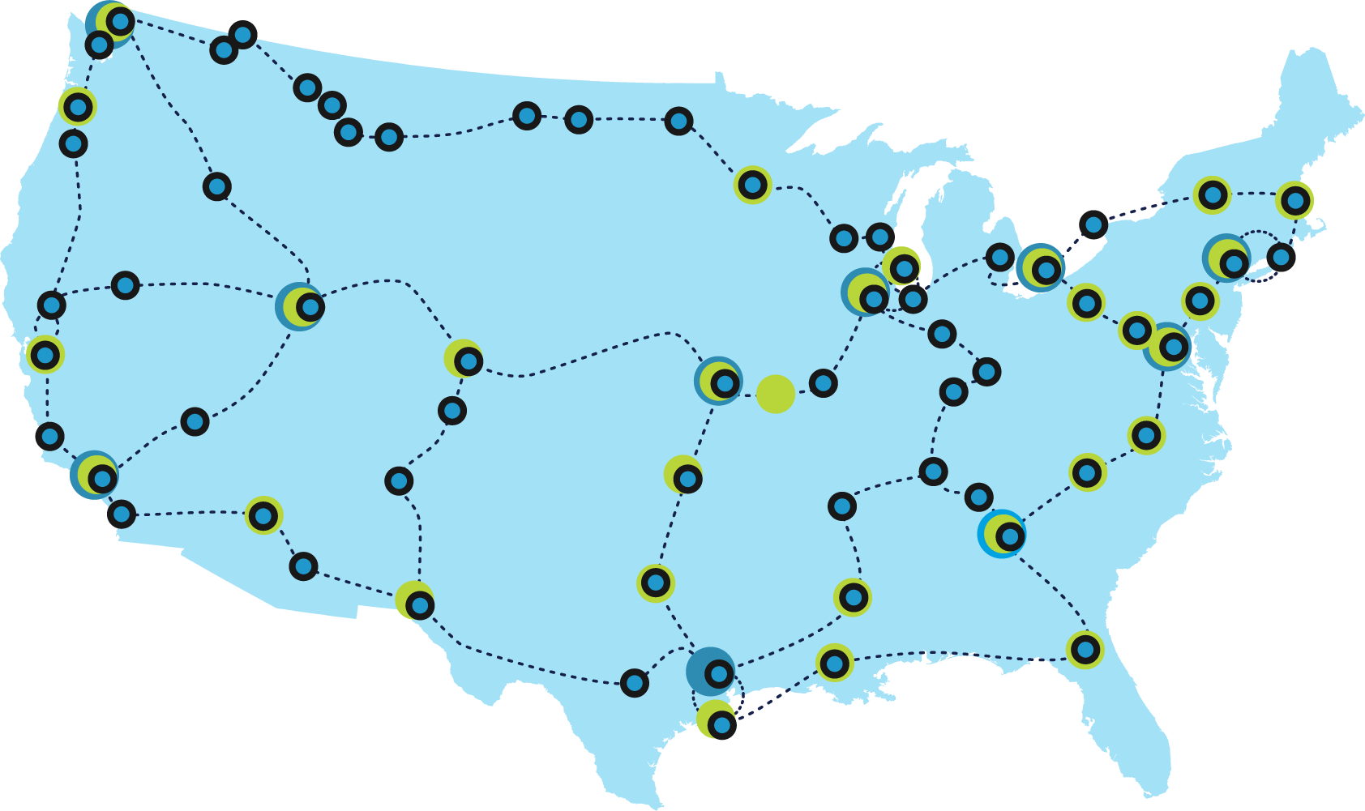

COMPLETE CLOUD DEPLOYMENT
PLATFORM FOR THE ACADEMY
SCALABLE AND AGILE
TO MEET BROAD USER
MOBILITY NEEDS
TRUSTED STANDARDS,
INTEGRATED IDENTITY AND
ADVANCED NETWORK DELIVERY

Slide 7
Cloud: 5th Generation of Computing: Still Nascent
1970s
Monolithic
1980s
Client-Server
1990s
The Web
2000s
Services Oriented Architectures
2009+
Cloud
Lessons From The Past *Still* Apply To The Future
Notes:
Look at history, we can say Cloud Computing is the 5th generation of computing, after monolithic, client-server, web, service-oriented architecture and now it’s cloud service.
Also think about as parallel to the history of Internet2: early network in the 70s/80s, Internet2 in the 1990s, InCommon in the 2000s, Cloud and NET+ today
Until recently, most software programs ran on your personal computer. With cloud computing, they now run on large networks of remote servers that enable the sharing of data-processing tasks, centralized storage and online access to computer services – all over the Internet.
Beyond its technical definition, cloud computing holds a host of benefits. By maximizing the effectiveness of shared resources, it achieves coherence and economies of scale, much like the electricity grid, for example.

Slide 8
What do we mean by “cloud”?
“[Cloud computing is a] paradigm for enabling network access to a scalable and elastic pool of sharable physical or virtual resources with on-demand self-service provisioning and administration.”
Source: ISO 17788:2014
“Cloud computing: overview and vocabulary”
Notes:
Scalable: can increase easily
Elastic: variable based on demand
Cycle Computing: Nov 2013 created a 1.21 petaFLOPS supercomputer w/156k cores for a day to run a chemistry job to increase efficiency in solar panels, cost $33k

Slide 9
Cloud Computing NIST Framework
Includes both commercial and community providers
Includes the entire connected community
NET+ Services Portfolio
Cloud Consumer
Cloud Provider
Cloud Broker
Service Orchestration
Tuned to community needs and validated by the community
Service Layer
Cloud Service Management
Privacy
Cloud Auditor
Security
Intermediation
Aggregation
Control Layer
Arbitrage
Resource Layer
Cloud Carrier
The Internet2 R&E Network and partner networks together define the Internet2 Community
* http://csrc.nist.gov/publications/nistpubs/800-145/SP800-145.pdf

Slide 10
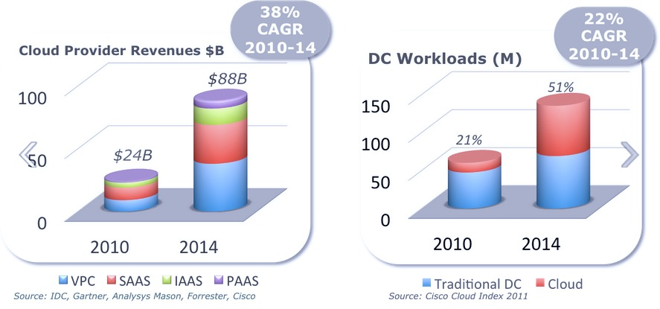
Yes, the Cloud Market is Growing…
Notes:
Dramatic growth in revenue among cloud providers globally
Cloud provider revenues in Billions of dollars; colors represent different categories of cloud services, most growth in SaaS and VPC (Virtual Private Cloud)
DC Workloads: another measure of growth and change between 2010 and 2014; other key interesting point to see is that the blue (traditional on premise data center) is not going down because of cloud, but actually holding steady or increasing slightly, the red representing dramatic growth in cloud is net new data center activity. Think about that as it might apply to a university environment, not going to get rid of datacenter, but may be adding to it for research or other activities with new capacity in the cloud

Slide 11
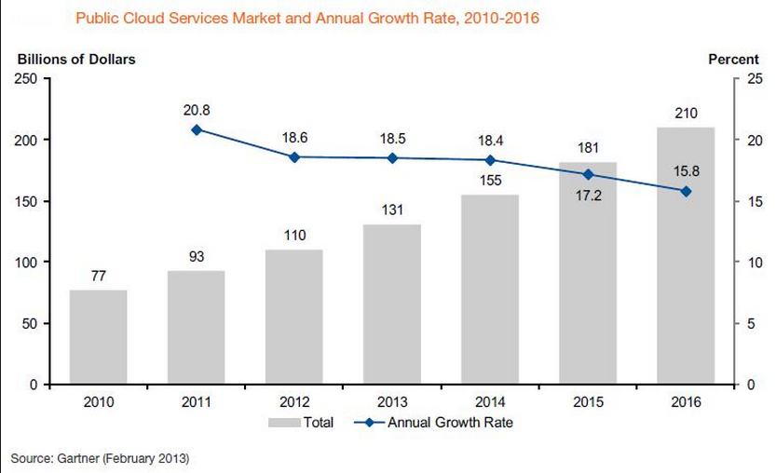
And growing …
$250 Billion by 2017
Notes:
Another representation of the overall growth in the cloud market. Grey bars are total provider revenue, so we see $77 billion in 2010, $155 billion this year. The blue line which is the annualized growth rate is the only thing that is decreasing slightly, and even with that decrease still projected to be nearly 16% annual growth rate in 2016 when cloud is a $210 billion market globally

Slide 12
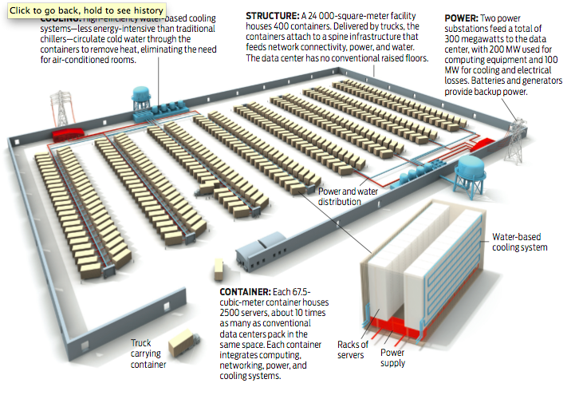
Cloud Scale:
Diagram of One Facility
Notes:
Schematic representation of an Amazon Web Services datacenter: football field sized, each of the small-looking containers is actually a shipping container that has hundreds of servers and thousands of cores. When a single server inside fails they don’t care, only when the hardware failure threshold for the entire container is reached do they back a truck in, remove it, and replace with a new one (or to do upgrades).
And this is only one facility

Slide 13
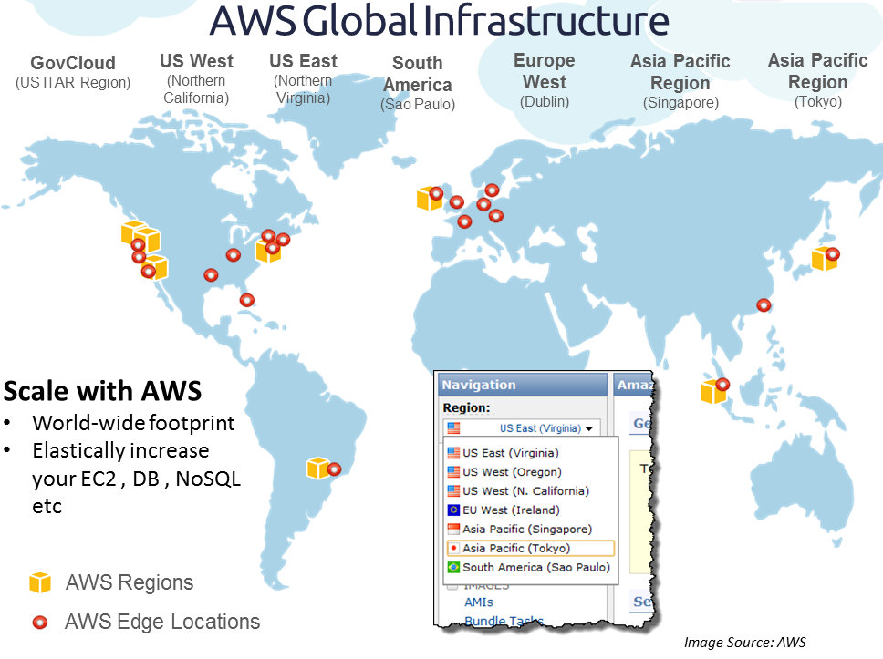
Cloud Scale: One Provider’s Global Footprint
Multiple Regions / Availability Zones
Multiple Datacenters
10,000s of servers
100,000s of cores
Notes:
Most large scale global cloud providers have multiple facilities for geographic redundancy and diversity
And this diagram showing Amazon datacenters around the world only represents one provider; Microsoft, Dell, Rackspace and others have similar global footprints

Slide 14
Cloud Scale: Growth
Every day AWS adds the same server capacity as:
(a) Its entire infrastructure had in 2004
(b) Would be needed to support a $7 billion company
Answer: Both; every day in 2014 AWS added the same capacity as it had in 2004 when it was a $7b revenue enterprise
Source: James Hamilton, VP and Distinguished Engineer; “AWS Innovation at Scale” AWS Re:Invent 2014

Slide 15
Cloud Scale: Growth
Every day AWS adds the same server capacity as:
(a) Its entire infrastructure had in 2004
(b) Would be needed to support a $7 billion company
Answer: Both; every day in 2014 AWS added the same capacity as it had in 2004 when it did $7 billion revenue annually
Source: James Hamilton, VP and Distinguished Engineer; “AWS Innovation at Scale” AWS Re:Invent 2014
Notes:
In 2010 they were adding same capacity to power a $2.76b enterprise (c 2000)

Slide 16
Cloud Scale: Pace of Innovation
Amazon Web Services
new services and major features:
2008: 24
2009: 48
2012: 159
2014: 449
1400 AWS products
“We are iterating and adding features at a very fast clip”
- Andy Jassy, AWS Sr VP
Source: James Hamilton, VP and Distinguished Engineer; “AWS Innovation at Scale” AWS Re:Invent 2014
Notes:
2008: 24
2009: 48
2010: 61
2011: 82
2012: 159
2013: 280
2014: 449

Slide 17

IT has often operated as a craft…
Notes:
In contrast to this kind of scale, IT work has often been individualized, reliant on local and personal knowledge, skill, and expertise. Both in university environments and elsewhere IT has often operated as a craft.

Slide 18
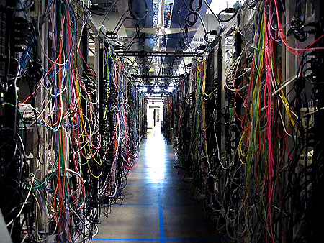
Unfortunately it’s HARD to do IT (as a craft) at SCALE.
Notes:
But it is hard to scale.
Of course no one’s datacenter looks like this one

Slide 19
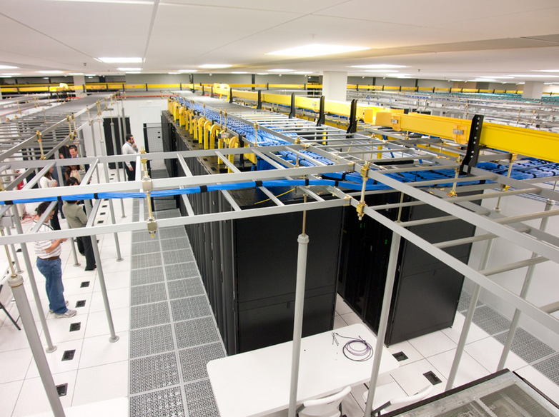
Even when done perfectly – it’s not CLOUD SCALE
Notes:
Your datacenter probably looks more like this one and probably works very well to meet campus needs. However, no single institution, and not even a group of institutions or the entire Internet2 membership could build on the scale of some global cloud providers

Slide 20
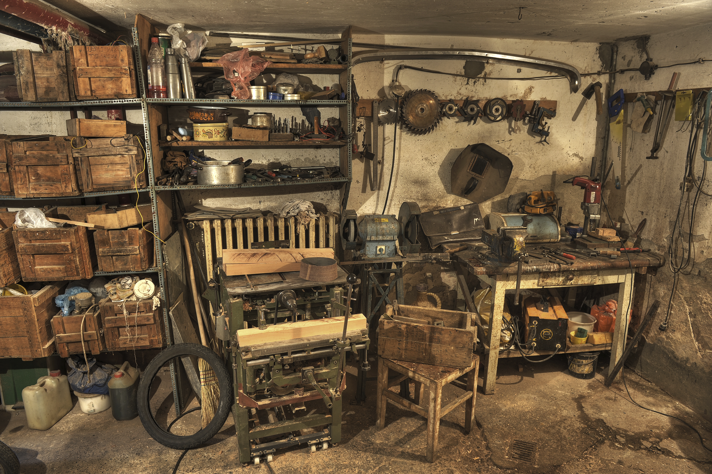
How do you start to move from Craftsmen to the Cloud?
Notes:
So the key question and challenge for the research and education community is how to leverage these services to help our communities, how do we take advantage of the technical and economic benefits of the cloud while keeping the focus on campus needs and ensuring security, privacy, compliance, etc.
How do we start to move from Craftsman to the Cloud?
One answer way the community has been making this move is through NET+ and we will talk about what that has entailed

Slide 21
Think about IT services and functions…
What is unique and specialized? | What can be generalized or scaled?

Slide 22
How do you assess a service?

Slide 23

Framework and process for Service Validation
Functional Assessment
  Review features and functionality
  Determine if the services meets your needs
  Tune the service for research and education
Technical Integration
  Determine optimal network connectivity
  Integrate with federated identity

Slide 24
Framework and process for Service Validation
Security and Compliance
  Security assessment: Cloud Controls Matrix
  FERPA, HIPAA, privacy, data handling
  Accessibility: WCAG AAA
Business and Legal
  Community contract
  Assess business model
  Define pricing and value proposition

Slide 25
Framework and process for Service Validation
Deployment
  Documentation
  Use cases
  Support model

Slide 26




Examples of Cloud Services Deployed at Scale
Community developed offerings, best value pricing, and higher ed contract terms
100+ universities cloud storage and collaboration campus-wide
55+ universities leveraging the NET+ Splunk offering
30+ universities moved their LMS to Instructure’s Canvas
20+ universities deploying Code42’s CrashPlan

Slide 27
Next steps: formulating your cloud strategy
Implement federated identity and robust connectivity
Determine core competencies
Select services that can deliver more value to your users and campus
Engage with the community to validate services
Use community contracts and pre-vetted agreements
Ensure security and compliance standards are met
Plan for continual engagement with service providers and your users

