Slide 1
EXPLORATION:
ITSM + PPM EVOLUTION IN IT MANAGEMENT

Slide 2
Goals
Understanding of related trends in higher education
Group identification of key benefits
Group identification of common roadblocks
Explore solutions to common roadblocks via shared experiences

Slide 3
Agenda
Exploration of ITSM + PPM Trends and Change Drivers
Facilitated Conversation
Summarization and Follow Up

Slide 4
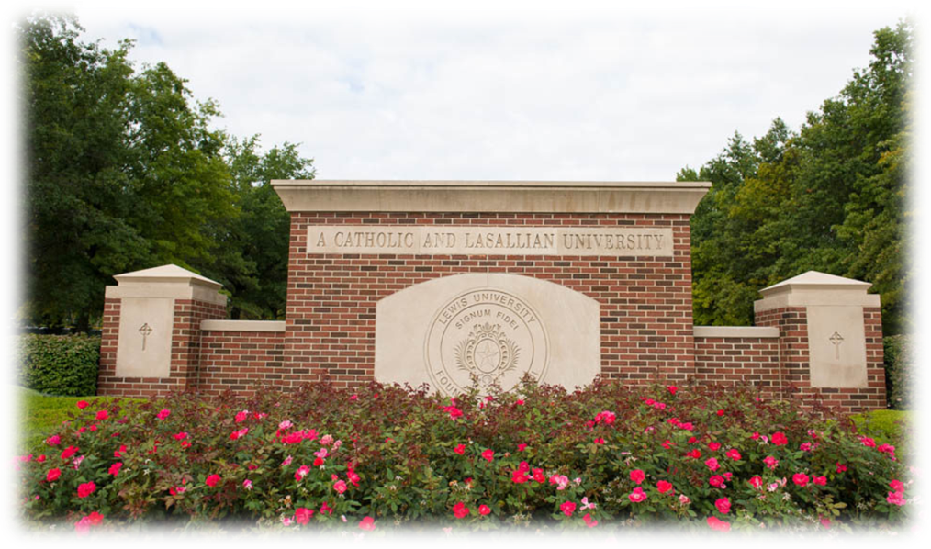
Case Study: Lewis University
Using PPM & ITSM Methodology
in IT Operations

Slide 5
About Lewis University
Located in the Midwest
Comprehensive, Catholic university
Focus on liberal arts and professional studies
Over 6700 students
Six campuses

Slide 6
Lewis University Strategic Plan
Strategy Direction III: Emerging Technologies
Engaging learners, streamline processes and enhance communication through emerging technologies.
Notes:
Strategy Direction III: Emerging Technologies
Strategy I – A: Advance effective teaching and learning everywhere through state-of-the-art technology.
Strategy I – B: Enhance learning through technology-based experiential and co-curricular opportunities.
Strategy I – C: Develop comprehensive, efficient, and sustainable technology systems to support teaching and learning, planning and decision-making, and administrative processes.

Slide 7
The Dilemma
The Problem:
How do we help our organizations understand the importance of technology?
The Cause:
Varying perceptions of the role of technology by academics and technology professionals.

Slide 8
Solution:
Adopt industry-standard methodologies that facility objective management of the Lewis University.

Slide 9
Areas of Focus
Notes:
During the first year of the new Office of Technology, the staff focused on three areas of improvement:
Capacity
The network bandwidth was increased.
Internet services were reconfigured to provide more reliability.
Network storage was reconfigured to provide more network storage.
Access
Wireless network access was improved and expanded
Network restrictions were lessen (without compromising security)
Support
The Technology Support Center adopted a new support methodology that led to more efficient and faster technology support for the campus community.
A new technology notification system has been implemented to inform the University community of technology-related issues.

Slide 10
Successful Technology Operations
PPM
Planning
Implementation
Evaluation
Renewal/ Sustainability
ITSM

Slide 11
Initial Results
Better, more appropriate technology services
Positive community feedback
Greater collaborating
Greater community involvement
Time consuming

Slide 12
Higher Education Industry Trends

Slide 13
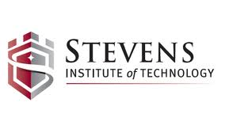

Slide 14
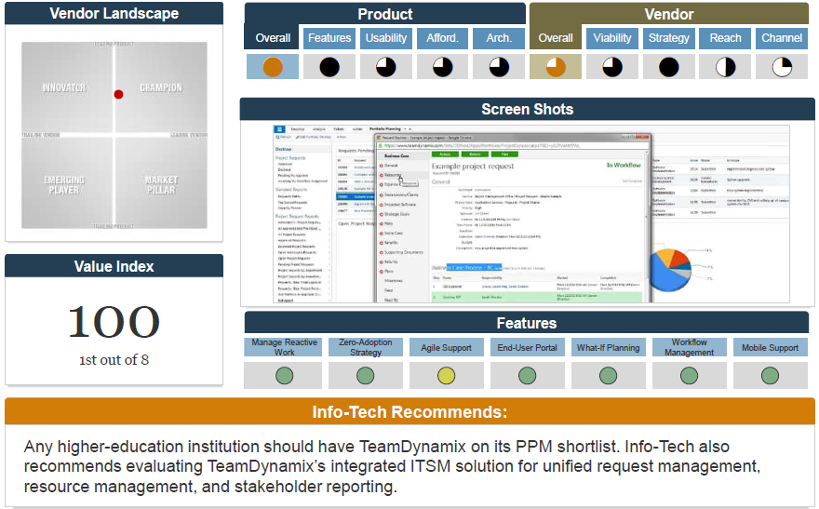

Slide 15
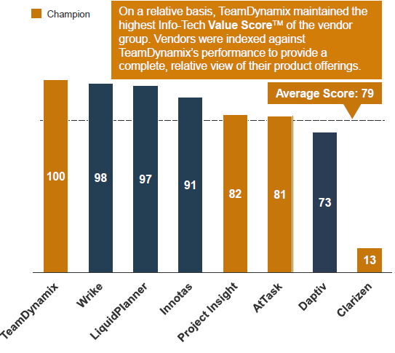

Slide 16
Shifting Paradigms

Slide 17
Move Big Rocks
=
Projects
Keep the trains running =
Ops/Change
Fix Stuff that’s Broken
=
Service Desk

Slide 18
PPM
ITSM
Move Big Rocks
=
Projects
Keep the trains running =
Ops/Change
Fix Stuff that’s Broken
=
Service Desk

Slide 19
PPM
ITSM
Move Big Rocks
=
Projects
Keep the trains running =
Ops/Change
Fix Stuff that’s Broken
=
Service Desk
Resources

Slide 20
Traditional Work/Fulfillment Silos
Focus
Requests
Governance, Projects, Portfolios
Projects Completed
(PPM Discipline)
Customers
Focus
Requests
Service Desk & Assets
Incidents Closed
(Support Discipline)
Customers
Focus
Operations & Change Management
Work Orders Completed
Requests
Tickets
(Chang/Ops Discipline)
Customers

Slide 21
Moving Towards a “Service to Customer” Focus
Service to Customers
PPM
ITSM

Slide 22
Change Driver:
Adjusting to Evolving Expectations

Slide 23
Expectations of the CIO
Increase the organization’s velocity towards meeting strategic objectives
Continually increase efficiency and drive down costs
Minimize service outages
CIO
President

Slide 24
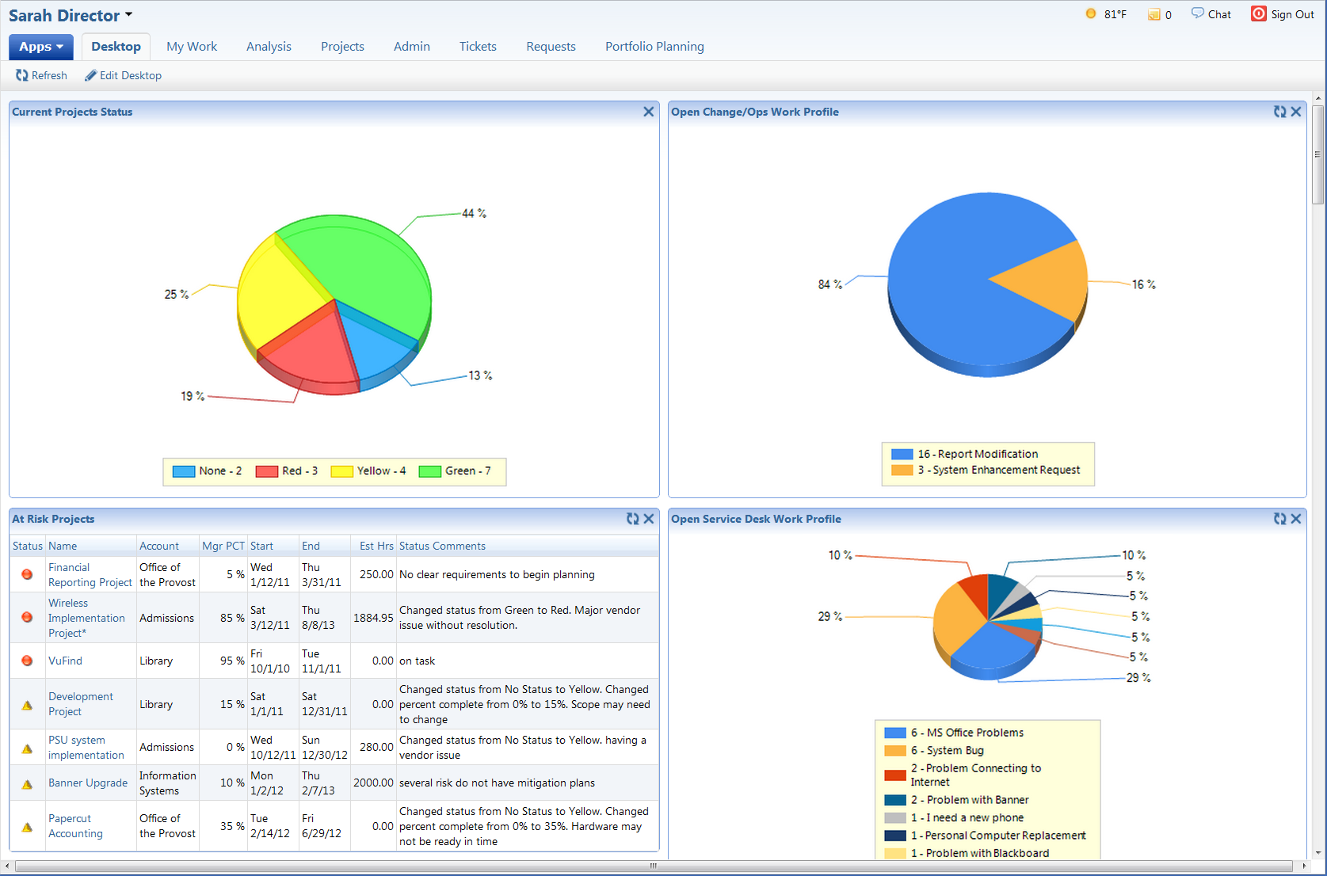
Communication: Internal Leadership Team
Key Purpose:
“Canaries in the Mine”
Enable confident decision making

Slide 25
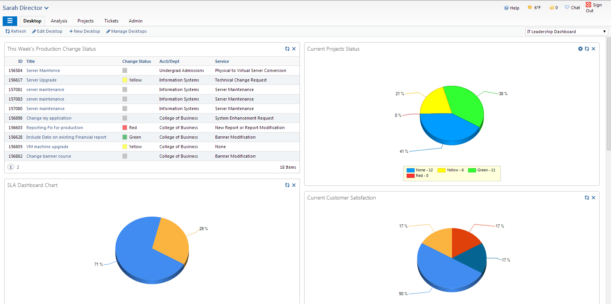
Leadership Insights

Slide 26
Leadership Insights

Slide 27
Leadership Insights
Notes:
Shows project data as well as incident or problem data

Slide 28
Leadership Insights

Slide 29
Change Driver:
Students and Faculty Feel that IT is Difficult to Work With

Slide 30
Improve Customer Satisfaction and Engagement
“I don’t know how to request a new report.”
President
Web forms
“I need a new laptop”
Docs
Faculty
“What happens to all of my requests?”
Email
Students
Service Desk

Slide 31
Convergence of Request Management
PPM
Service Desk
Request Fulfillment (ITSM + PPM)
Change/Ops

Slide 32
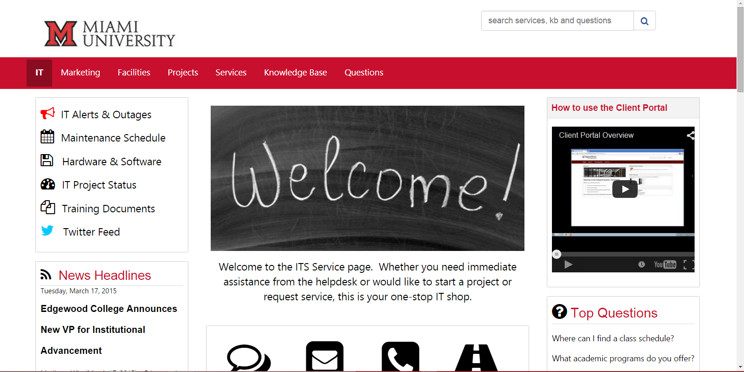
Simple and Branded Service Catalog

Slide 33
Staff is Overburdened with Work and Administrative Activities

Slide 34
Different Resources = Different Work Streams
Incidents
Projects
Operations
Incidents
Projects
Operations
=
Projects
Operations
Incidents

Slide 35
Individual Administrative Burden
Word
Excel
Assets/CIs
PPT
MS Project
Ticketing Software
Personal To-Do Lists

Slide 36
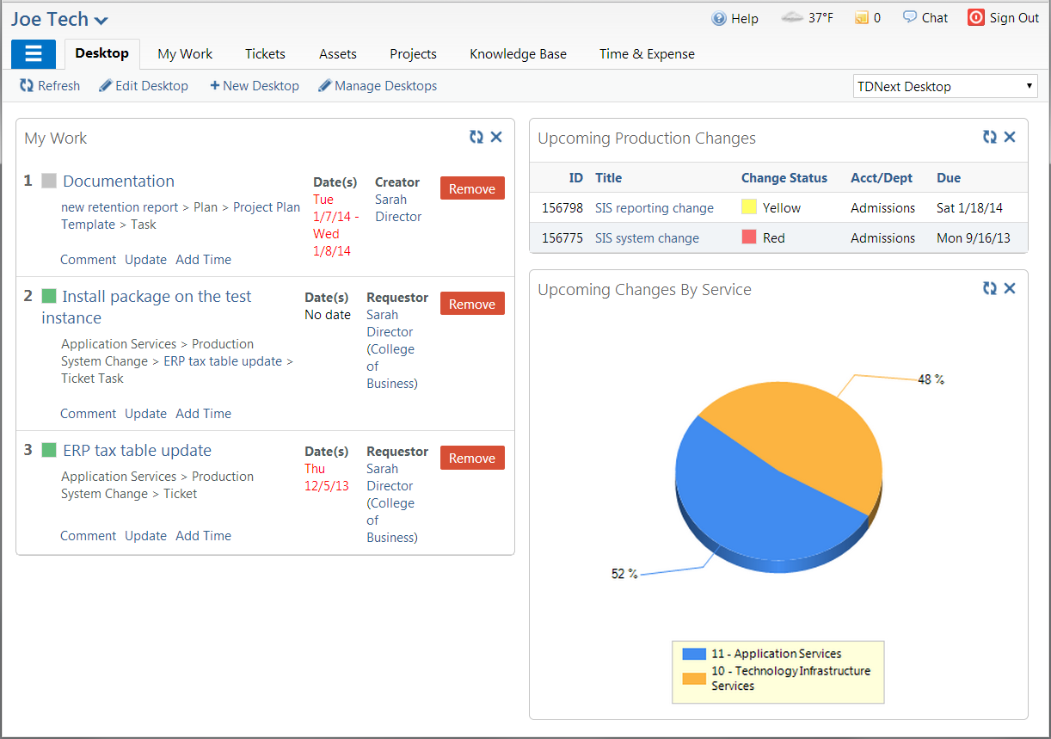
One Page View

Slide 37
Facilitated Dialogue

Slide 38
Should there be a blended approach? What are the benefits?
Table Discussion: 5 min
Presentation: 5 min

Slide 39
2. What are the 3 main roadblocks to integrating these processes?
Table Discussion: 5 min
Presentation: 5 min

Slide 40
3. Share approaches to overcome the main roadblocks and achieve the cultural change necessary to have them stick.
Table Discussion: 5 min
Presentation: 5 min

Slide 41
Q&A + Open Discussion
Dr. Leroy Butler
butlerle@lewisu.com
Happy Hour:
Bar Rojo (Tonight, here at the Hyatt!)
6pm-8pm
Andrew Graf
agraf@teamdynamix.com

