Slide 1
Studying Learning Success:
Exploring Factors, Questions, Data, and Ways of Using Your Analyses to Greatest Effect
Andrea Lisa Nixon, Carleton College Randy Stiles, Grinnell College

Slide 2
Student Success or Learner Success
For the purposes of this session, what topic will you pursue?
Notes:
Randy? Both?

Slide 3
STUDENT SUCCESS AND LEARNING SUCCESS
Social – psychological (non cognitive) factors
“Successful intelligence”
Trajectories
Engagement
Dynamics
More broadly-defined
Less easily quantified
Persistence
Grades and credits
Retention rates
Completion rates
Student Behaviors
More narrowly-defined
Observable
STUDENT SUCCESS
Notes:
Shall we omit this Randy?

Slide 4
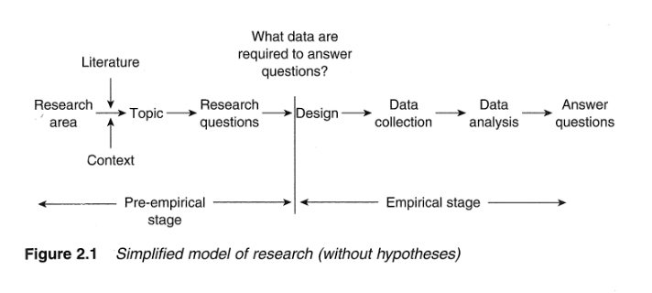
Research Model: Questions Determining Design
From “Developing Effective Research Proposals”
By Keith F. Punch, Second Edition
Notes:
Andrea – Research Model

Slide 5
What is the nature of your question(s)?
Reflection and Report Out

Slide 6
Sources of Data

Slide 7
Mapping Questions to Methods
 | Why? | Where? | How Many?
Sample Data Sources | Interviews, Focus Groups, Open-Ended Survey Items, and “Their words are your data.” | Logging working sessions | SIS Information, Surveys, and Measurement
Analytic Examples | Coding Schemes, and Identification of Themes | Spatial Analysis Through GIS | Descriptive and Inferential Analyses
Notes:
Andrea -

Slide 8
Qualitative Example: Faculty Interview Protocol
What motivated you to create this assignment?
What learning goals do you have in mind for your students?
How do you anticipate evaluating your students’ work?
Are there resources that would be of use to you or your students?
Are there types of support that would be of use to you or your students?
Notes:
Qualitative Examples

Slide 9
Notes:
GIS mapping work locations from a case study

Slide 10
Using Analyses to the Greatest Effect
Examples from the Field

Slide 11
KEY QUESTIONS ADDRESSED BY ANALYTICS*
 | Past | Present | Future
Information | What happened? (Reporting) | What is happening now? (Alerts) | What will happen? (Extrapolation)
Insight | How and why did it happen? (Modeling, experimental design) | What’s the next best action? (Recommendation) | What’s the best/worst that can happen? (Prediction, optimization, simulation)
From “Analytics at Work: Smarter Decisions, Better Results”
by Thomas Davenport, et.al.
Notes:
Randy – Is it okay to use the term “Data” instead of information to be consistent?

Slide 12
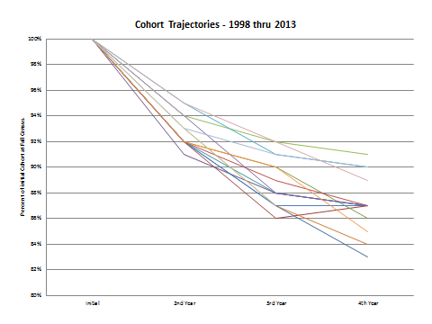
THREE EXAMPLES OF ANALYSIS
Attrition Trajectories
Notes:
Randy

Slide 13
Analytics: Data Mining, Alerts, and Predictive Modeling
X
GPA
(an outcome)
X
X
X
X
X
X
X
X
X
Admission Score
(a predictor)
Notes:
Randy

Slide 14
THREE EXAMPLES OF ANALYSIS
Early Indicators of Academic Success
20XX Cohort – R² Values
‘Coefficient of Determination’
in the relationship between
graduation or departure GPA and
an early indicator variable
Range 0-1
1 being a perfect relationship/fit
0 being no relationship/fit
 | Grads | Withdrawn
Admission Score | 0.326 | 0.124
Tutorial Grade | 0.391 | 0.691
1st Semester GPA | 0.664 | 0.773
Notes:
Randy

Slide 15
Probability of Graduation (Vertical Axis) by 1st Semester GPA (Horizontal Axis)
Vertical dashed lines approximate;
10th (2.58), 25th (2.98), 50th(3.33), and 75th (3.63) percentile
Notes:
Randy

Slide 17
CONCEPTUALIZING AND CATEGORIZING DATA
Qualitative
Time
Surveys
Focus groups
Initial conditions
Time-series data
Quantitative
Early Indicators
Retention
Completion
Credits
Cognitive
Non- Cognitive
Test scores
Grades
Grit
Success Navigator
Mindset

Slide 19
Making the Pitch

Slide 20
Thank you!!
Andrea Lisa Nixon, anixon@carleton.edu
Randy Stiles, stilesr@grinnell.edu

