Slide 1
UNSTEADY GROUND: Changes in IT Communications
Carlyn Chatfield
April 23, 2015
EDUCAUSE Connect – San Antonio

Slide 2
Notes:
Opening: Zumba music, Carlyn bounds in with her Zumba instructor opening, gets everyone on their feet, march in place and clap. 1.5 minutes max.
Ready for your Zumbaaaaaaaa fitness class?

Slide 3
Is this the first ZUMBA ® class you’ve taken with Carlyn Chatfield at an EDUCAUSE event?
Notes:
Question 1: Raise your hand for yes.
Look around the room, just get an idea…

Slide 4
Is this the first ZUMBA ® class you’ve taken at an EDUCAUSE event?
Notes:
Question 2: Raise your hand if…

Slide 5
Is this the first ZUMBA ® class you’ve taken?
Notes:
Question 3: Raise your hand if
OK, sit down so you can write notes.

Slide 6
Point 1: Simplify & Reduce
Notes:
Simplify. As a Zumba instructor, I only need to know how many people are brand new to Zumba, in case I need to make modifications for safety and health reasons. As an IT Communicator, give your audience simple statements, OR questions they can easily answer. Break down hard concepts into bites of information they can hear, read, absorb, swallow, accept, and own. And Reduce. If you are walking on Unsteady Ground these days with your IT Communications, take a minute to consider all the messages you are sending. Is every message about an Essential or Core Service? Is every message Important and Necessary? Perhaps… instead of pushing every message, you just need a web page where clients can go look for OIT updates.

Slide 7
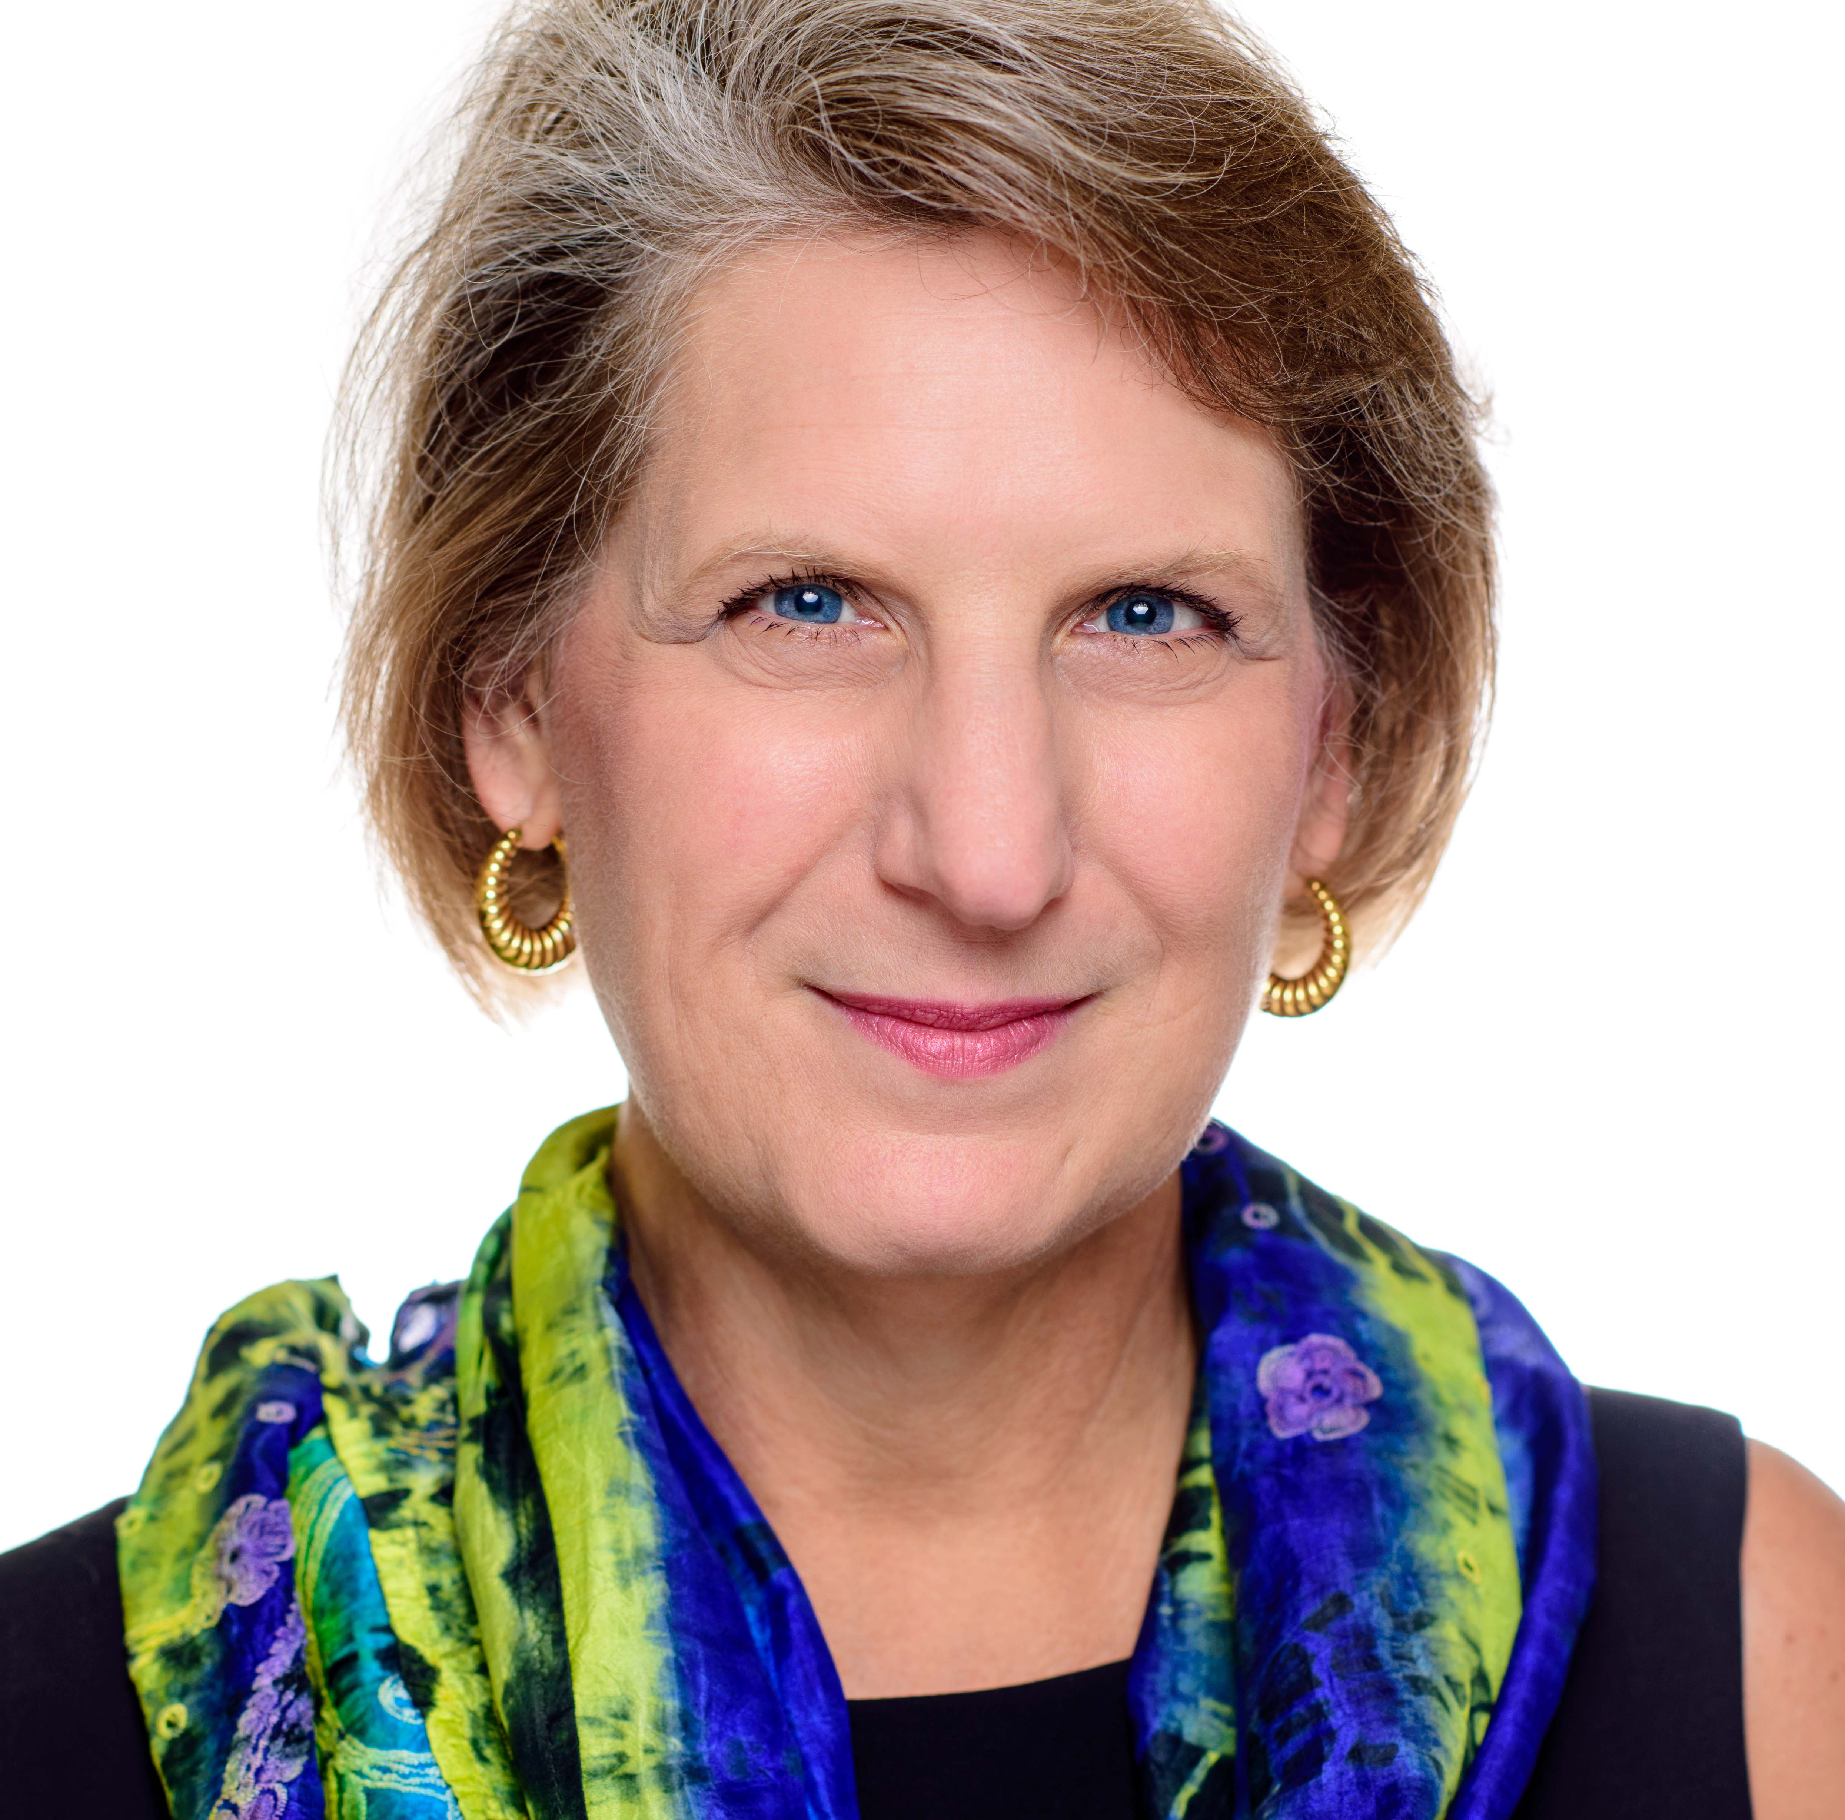
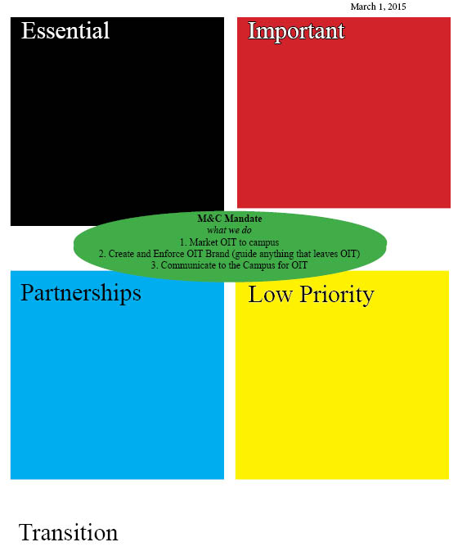
About Carlyn I’m only 34! …in work years…
1981 – Oil Bust
1982 – Sales & Marketing:
Freight Forwarding
Radio Advertising
Turnkey Interior Design Projects
Newspaper Advertising
1987 – Admissions – Art Institute of Houston
1990 - Financial Aid – AIH, College of the Canyons (CA)
1999 – Rice U Enrollment Division
Assistant Financial Aid Director, wrote a book
Business Analyst, Oracle SQL reports
2003 – Rice U Division
Web Coordinator
Mgr, Marketing & Communications Team (1.5 FTEs)
2009 – 65% IT M&C Budget Cut
2014 – IT M&C Team Realignment
2015 – New Rice CIO, re-org / new directions
Notes:
Now why am I here? It's not to lead a Zumba(R) fitness class - aren't you glad? I've had a hand in internal and external communications for IT at Rice University since 2003. Over time, the duties of our OIT Communications team grew from simply managing a web site and monthly newsletter to bridging the silos in central IT, actively participating in the change management process, moderating internal mailing lists, party planning with the OIT Events Committee, and taking photos of new employees to add to our pictorial index. As our OIT peers began to value the role of a designated OIT communicator, they began to give us more and more internal responsibilities. Then, we lost 65% of our budget in January 2009, but we kept running at maximum speed, using human resources when we had nothing else. That methodology eventually burned out my team and in 2014, we had to take drastic action to re-define and refine our daily responsibilities in order to stay true to our mission.

Slide 8
OIT Comms
Email
Web Site
Notes:
Most importantly for today’s session, I’m your content leader, and in this session, we are going to focus on the most important actions you can take to focus your resources on making the biggest impact for IT on the campus consciousness. You are here because you are interested in some aspect of IT Communications. Since 2003, my world has changed – A LOT! IT Communications used to mean we had a web site where our customers (and our colleagues) could go … to look up information. Sometimes, IT folks would send out email messages to everyone at Rice University, but that was not my responsibility.

Slide 9
OIT Comms
Leadership Meetings
OIT Liaisons
Groups:
Faculty, Staff
UG/GR
Project Mgrs
Targeted Addresses
Everyone @ Our U.
Internal Comms & Water Cooler Chats
Notes:
In 2015, OIT Communications means two way dialogues. If our OIT communications (web sites and emails) began as a type of megaphone, today’s OIT Communications require professionals who act more as a translator, a sieve (strainer), a funnel, a magnifying glass. As IT Communicators, we became pretty good at standing up and juggling our different projects. As our colleagues’ perceptions about our role began improving, we began inheriting other projects and responsibilities. For many of us, we continued juggling the IT-Community communications while internal tasks became the golf cart, then surrey, then bicycle and unicycle we were riding in or on. And the ground became very unsteady.

Slide 10
Unsteady IT Comms Ground?
To Regain your Footing:
Simplify & Reduce
Consolidate OR Empower
Target Message Delivery
Plan
Notes:
Today, we’ll be covering 4 points on how to gain or regain your footing if you find your IT Communications on unsteady ground. POINT ONE was to Simplify & Reduce your message.

Slide 11
Point 2: Consolidate OR Empower
Notes:
POINT TWO depends on the maturity of your own divisions’ OIT Communications program. If you are just beginning to the process to standardized OIT Communications, then Consolidate your voices and messages. If your OIT Communications practices are well established, focus on Empowering your peers to make some of the announcements.

Slide 12
Consolidate
Notes:
Let’s try an activity that illustrates both options. We’re going to write an IT message. Each table has an IT Message in an inner-office envelope. Each table, you need to consolidate your ideas on how to communicate about this theme. Each table needs to write a single announcement about the topic and send it to PollEverywhere.

Slide 13
Consolidated Message Activity
^{TEXT}
Your answer to 22333. Your answer must begin with 194485
^{TWEET}
^{your answer to @poll 194485}
^{TYPE}
^{your answer into a web page:} ^{PollEv.com/carlynchatfi108}

Slide 14
Notes:
Consolidated Message https://www.polleverywhere.com/free_text_polls/tE3ayM580cYI5TD

Slide 15
YOU WIN!
Notes:
Here’s a prize for the table with the shortest, yet understandable, message.

Slide 16
Empower
Notes:
So you just learned how to Consolidate the message and voices. Too many voices, or too many messages from the same voice, lowers the impact on for your audience. But if your IT Communications program is fairly mature, you’ve already consolidated the voices and your team may be feeling overwhelmed. In that case, EMPOWER selected colleagues to send out routine communications by providing a template and training them to use a specific communication channel.
Let’s repeat the previous activity using one of the tools I depend on to Empower my colleagues to send OIT update messages.
Open your Blue Inner Office Envelope for Activity 3, Bad News. Inside you’ll find a 3 Sentence Template that I use at Rice. You’ll also find several messages from a very bad day at Rice. Pick one of the messages and use the template to recreate it, then send your own bad news HEADLINE to PollEverywhere. One per table.

Slide 17
Empowered Message Activity
^{TEXT}
Your answer to 22333. Your answer must begin with 195792
^{TWEET}
^{your answer to @poll 195792}
^{TYPE}
^{your answer into a web page:} ^{PollEv.com/carlynchatfi108}
Notes:
So you just learned how to Consolidate the message and voices. Too many voices, or too many messages from the same voice, lowers the impact on for your audience. Let’s repeat that same activity but use one of the tools I depend on to Empower my colleagues to send OIT update messages.
Open your Blue Inner Office Envelope for Activity 3, Bad News. Inside you’ll find a 3 Sentence Template that I use at Rice. You’ll also find several messages from a very bad day at Rice. Pick one of the messages and use the template to recreate it, then send your own bad news message to PollEverywhere. One per table.

Slide 18
Notes:
Bad News Headline https://www.polleverywhere.com/free_text_polls/A52iEK18xgdtAM2

Slide 19
Point 3: Communications Plan for long-term or major initiatives
Notes:
Nice work, everyone! You had a tight deadline and lots of pressure. When you go back home, ease that pressure for your non-communications staff by providing templates –approved by IT management—to follow.
For your long-term or major initiatives, you need more than a simple template. You need a PLAN. That is Point 3.
This activity requires the handouts in those folders with the bright designs on them – blue/pink/ and green. Take out your pens. Think about the biggest technology initiative or project going on - or about to kick off - at your university. We're going to plan your STRATEGIC COMMUNICATIONS CAMPAIGN. That's all caps by the way. I once worked for a boss that had no strategic plan, but insisted I have a strategic communications plan. ALL CAPS.

Slide 20
Ask Questions, Create a Plan
What is the Initiative?
What is the Timeline?
What are the Messages?
Who are Challengers?
Who are Stakeholders?
Notes:
What is the Project?
Who is Impacted?
Do they know yet?
When will it / did it roll out?
Biggest push back from?
Timeline?

Slide 21
Strategic Communications Plan
Notes:
Complete your own Strategic Communications Plan. Work together as a table or in small groups to choose a common initiative like a new LMS or campus-wide Office 365.
OK. That was IT Communications Tip Number Four. Plan - that is the basic STRATEGIC COMMUNICATIONS PLAN (ALL CAPS). It is best if you can work with Project Managers early in the life cycle to schedule project communications. Work with your CIO on big stuff (annual survey, annual report)

Slide 22
Point 4: Targeted Communications
Notes:
OK. That was IT Communications Tip Number Three. Plan - that is the basic STRATEGIC COMMUNICATIONS PLAN (ALL CAPS). It is best if you can work with Project Managers early in the life cycle to schedule project communications. Work with your CIO on big stuff (annual survey, annual report) Last item –
MOST IMPORTANT IT Communications Point 4: Target your Communications. Not every person at your university needs to see every IT message. You need to find a way to customize the delivery of your messages to hit only the people impacted by the service described in the message.
Once again, you will work with your table. If you like to write out your own notes, Look for the IMPACT sheet in the orange folders on your tables.

Slide 23
IMPACT
Notes:
If you like to think large, use the 8.5x11 yellow stickies to map out your quadrants and the smaller stickies to identify communication channels or target audience groups like Building Representative, department representative, team rep for that service (data warehouse), Stakeholders, Fac/Staff/Student.
Select one project for each quadrant and discuss how the communication channels and audience groups need to differ.
You’ve only got about 5 minutes left for this activity. Hit it!

Slide 24
None of this works if your internal IT staff don’t talk to each other.
Use the last few minutes to explore the toys on your table. By providing structured “play” for the guys and women behind the curtains, you can coax them into dialogues that reveal problems and help identify solutions to IT issues.
Carlyn @ rice.edu
All materials can be found on the EDUCAUSE web site for this session.
JOIN the IT Communicators (ITCOMM) Constituent Group!
Notes:
This script, my templates, your photos, and other resources will be on the Connect web site tonight. Now let's cool down with a nice stretching song. Music swells, Carlyn starts leads stretching exercises.

