Slide 1
INTERPERSONAL COMMUNICATION
Mark Walbert
EDUCAUSE New IT Managers Program San Antonio – Connect April 2015
Please sit with people from different institutions and introduce yourself.
Notes:
Handouts:
Your Primary Communicating Style Worksheet
Surveys
Overview sheets
8:45-10:15
Break
10:30-12:00

Slide 2
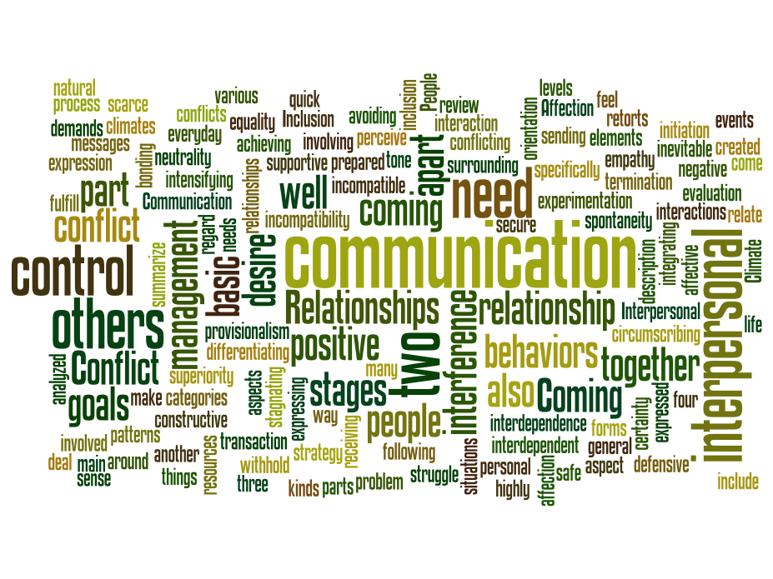
Notes:
Comments from Survey:
Communications – No meetings???
Project communication issues with customers across campus.
Need to develop standard communication methods…
Improving communication.
Lack of Communication on Major Projects.

Slide 3
Why interpersonal communication?
“Great leaders are almost always great simplifiers, who can cut through argument, debate, and doubt to offer a solution everybody can understand.”
– General Colin Powell

Slide 4
Why interpersonal communication?
“Everything should be as simple as it can be but not simpler.”
– Roger Sessions (attributed to Albert Einstein)
Notes:
The likely source for Sessions quote is a 1933 lecture given by Einstein:
It can scarcely be denied that the supreme goal of all theory is to make the irreducible basic elements as simple and as few as possible without having to surrender the adequate representation of a single datum of experience.

Slide 5
Exercise: Think - Pair - Share
Think about one interpersonal communication problem you have had.
Did you identify the source of the problem?
Did you reduce future occurrences of the problem?
Notes:
Can discuss in pairs or with the larger group at tables
Time: 10 min
[
Original text:
What do I want to get out of this session?
What am I willing to put in to get it?
Write down your answers.
]

Slide 6
Agenda
Your communicating styles
Improving your perspective
Context and adaptability
Communication channels
Notes:
Time:
What we’re doing here is not a graduate course in communication theory, it is about discovering some aspects of who you are, and learning how knowing more about who you are can help you learn how not to talk AT people, but talk WITH them because you’ve learned to be more sensitive to who they are.
My favorite notion about this:
Communication occurs when what you said equals what they heard. That is incredibly rare.

Slide 7
Notes:
The medium (channel) affects the message…
Source: http://www.slideshare.net/jfurlong912/lesson-one-the-communication-process

Slide 8
1. Communicating Styles
Many ways to think about communicating styles
Identifying your style helps you understand others
Identifying your style improves communications
Notes:
Many ways: Tone; body language, channel…
With a clear understanding of your own style, you can start to apply that new knowledge for effective communication.

Slide 9
Exercise: Survey
Communicating Styles Technology by Dr. Paul Mok
Patented tool based on personality typology of Carl Jung
Administered to 4+ million people in 5,000+ orgs
Used for training, development, conflict management, & team-building
Notes:
Mok founded Training Associates Press to market CST survey

Slide 10
Instructions
Take and score your survey
Don’t agonize; go with your gut feeling
Rank: 6, 4, 3, 1
Score when you’re through
Raise your hand for help
Notes:
Time: 20 minutes (start by 9:45-9:55)
Instructions:
Pencils down
Get a copy of the survey
Look up here
Walk through the Survey together
Read each and answer based on your current attitude and behavior in the workplace.
Don’t agonize. Go with your first instinct.
Each statement completion gets 4 numbers: one (each) of 6, 4, 3, 1
6 = most characteristic of you
1 = least characteristic of you
Score on your own (total each half = 126)

Slide 11
Interpreting your scores…
Everyone uses all 4 communicating styles
No one style is better than another
Self-assessment is subject to bias
Your assessment is dependent on initial conditions
Notes:
90 minutes left…

Slide 12
Recording your scores…
Your style under normal conditions
Dominant
Secondary
Your style under stressful conditions
Dominant
Secondary
Notes:
Write down your score for each style
Pass out overview cards
60% or more,
Don’t expect it to nail you in every aspect

Slide 13
Do you see yourself?
Notes:
To all or at table:
Observations?
Any surprises?
Are your results what you would have predicted?
Pass out OVERVIEW sheets, refer to colored side
Does this info reinforce your survey results?

Slide 14
Intuitor
Based on imagination, vision, speculation
Focuses on future stages of a project – long-range thinking
Is motivated by creative and unstructured tasks, discovery, using imagination
Feels uncomfortable with: structured areas, bureaucracy, strict accuracy
Likes reading, walking, climbing, chess, other intellect-related games
Communication type: abstract, ideas and vision oriented

Slide 15
Thinker
Emphasis on logic, organizing and problem solving
Focuses on all stages of a project : past, present, future
Is motivated by things that are well organized with a clear system
Prefers analytical tasks, likes to collect and use data – as detailed as possible
Thinks about consequences before making a decision… …
Feels uncomfortable with direct personal communication
Communication type: always structured and organized
Notes:
Sources:
http://www.hr-faq.com/2013/02/human-resources-mysteries-understanding.html
and
http://gom.sagepub.com/content/2/2/250.full.pdf

Slide 16
Feeler
Seeks human interaction, projecting feelings
Needs and likes to receive constant feedback and cares about what other people think
Focuses on past stages of a project
Is motivated by love, gratitude, the feeling of being useful
Feels uncomfortable with structured areas, receiving orders, impersonal situations, strict accuracy
Communication type: spontaneous, unplanned, informal

Slide 17
Sensor
Based on action, competition, results
Focuses on present stages of a project
Is motivated by clear tasks, practical situations, clear goals
Feels uncomfortable with: vagueness, situations with no clear purpose
Likes competitive work environment needing fast moves
Communication type: short sentences
Notes:
Sensors give the impression that they are always in a hurry, they tend to be perceived as aggressive, they tend to give the impression that they don’t listen, they like to be in control…

Slide 18
Group exercise
Leave things at your table
Get with others who share your communicating style under stressful conditions
Notes:
Time: 20 minutes
Feelers and Sensors go to same part of the room
Intuitors and Thinkers go to same part of the room

Slide 19
Group exercise
Develop your “Top 5 Tips for Communicating with a _____”
Think quietly for a few minutes, then share with your group
Record on flip charts
Be ready to share your tips, on a flip chart, with all
Notes:
Time:
Gather themes from earlier:
one challenge
most important thing to learn
Assign someone to be scribe

Slide 20
Break
Notes:
Scheduled for 10:15-10:30

Slide 21
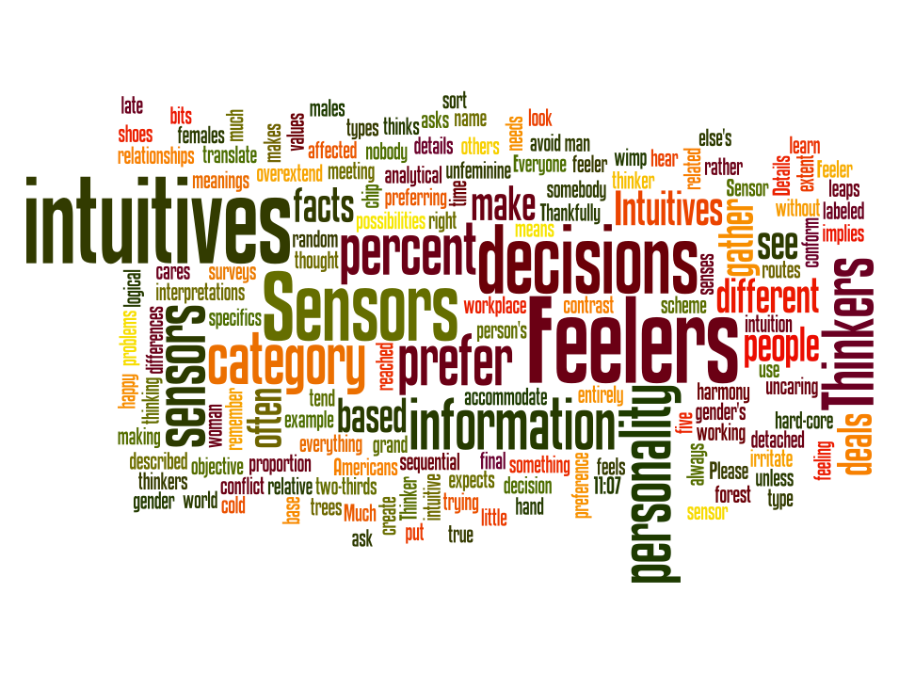

Slide 22
“Top 5 Tips” for each style
Report out
Listen to each perspective
Additions?
Questions and discussion with full group
Notes:
5 min for each style

Slide 23
2. Perspective
The real payoff is in what you do with this information. Apply this to:
observe
categorize
connect
Notes:
Now you have some other points of view
Apply what you’re learning

Slide 24
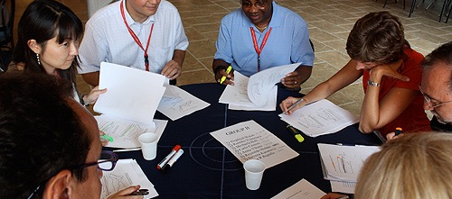
Do you see others?
Notes:
Did you hear someone you work with during our report-out?!

Slide 25
3. Context and adaptability
The goal is to connect
Connect by style-flexing
To be in-sync; not to manipulate
Be conscious of strengthening a style
Notes:
To persuade and lead, you must reach THEM where they are…

Slide 26
Communicating Style Plan
Goal: Reflect and apply
Consider 2 people you work with regularly
Guess each person’s dominant and secondary styles
How will you communicate with them differently?
Notes:
Plan for Better Communication HANDOUT.
10 minutes

Slide 27
Exercise: Think - Pair - Share
Think - Pair - Share your communicating style plan
Provide feedback and switch
Apply the perspective of others to your interactions with your colleagues
Notes:
10 minutes
Look around your table and find a style different from your own.

Slide 28
Where are we now?
Style is pervasive…
Understand your strengths and blind spots
Develop skill so you can stretch to meet others
Apply this to all communication channels

Slide 29
YOUR ROLES MAY INCLUDE:
Manager
Technical lead
Cross-functional team leader
Peer coach
What else?
Notes:
Persuasion is key here, and ties to Performance Management AND Managing Up later in series…

Slide 30
4. Channels
One-on-one conversations
Team meetings
Large group presentations to your division
Email message to campus
What else?
Notes:
Open
One-on-one coaching
Small group team meeting
Non-tech peers
Up, down, sideways
Regardless of venue/mode/channel, you are still talking to one person at a time

Slide 31
Notes:
Source: http://www.slideshare.net/jfurlong912/lesson-one-the-communication-process

Slide 32
Apply styles to your communicating channels
Message. What are my messages?
Which one is the most important?
Audience. To whom am I talking?
What keeps them up at night?
Why do they care about my message? “WIFM?”
What’s my story.
What will reach them and bring them to my message?
Notes:
Framework apply styles to channels; practical daily life
What’s In it For Me? (WIFM)
Know, feel, do
Who, What, Where, When, Why, How
Clear, simple language
Use of metaphor
– On Open Source software: “It’s free as in puppies, not free as in beer”

Slide 33
Where will this have impact?
Work environment
Collaboration
Teamwork and team building
Projects
Customer Service
Other areas…

Slide 34
Reflect
Within 2 weeks…
How will I begin?
Who will I ask for support?
What is the first thing I will do?
On what date will I review this?
Notes:
This is work, no easy answer, no magic pill…

Slide 35
Next steps…
3x5 card
Be specific
Self-address an envelope
Hand it in

Slide 36
Learning more…
Material we generated together
Resources (tap your faculty!)
Additional questions

Slide 37
LUNCH
Dig deeper…
Find someone from the group who shares a different communicating style under stress
Learn from them by exchanging a story about a time when you were feeling stressed out and could have communicated more effectively

