Slide 1
Time Management,
Prioritization,
and Delegation
Mark Walbert
EDUCAUSE New IT Managers Program San Antonio – Connect April 2015
Notes:
Time: 1:45-2:45
Comments from Survey:
Making time for the work that moves the unit forward amidst multiple "urgent" (not mission crucial) requests.
Management of my time and the time of my report[s].
Time management, and how to anticipate emergencies or unexpected priorities.
Time/Resource Management (Doing more with fewer resources) [including time]
Scarcity of time and how to make the most of the time I have.
Time! It seems the business day is meetings and reacting to issues, the work I need to get done occurs before 8am/after 5pm or weekends.

Slide 2
Exercise: Think – Pair – Share
What activities take up most of your time? (e.g., meetings, email,…)
What patterns do you notice in your use of time?
Notes:
Time: 5 minutes

Slide 3
Exercise: Think – Pair – Share
What are some of your most frequent time management frustrations?
Notes:
Time: 5 minutes

Slide 4
Exercise: Think – Pair – Share
What are some of your tried and true ways of fixing time management issues?
Notes:
Time: 5 minutes

Slide 5
Time Management Gotchas
Monkeys…
Procrastination
Interruptions/distractions
Meetings
Micromanagement
Multi-tasking
Notes:
Multi-tasking:
Email response while on the phone…
No one actually does this well…

Slide 6
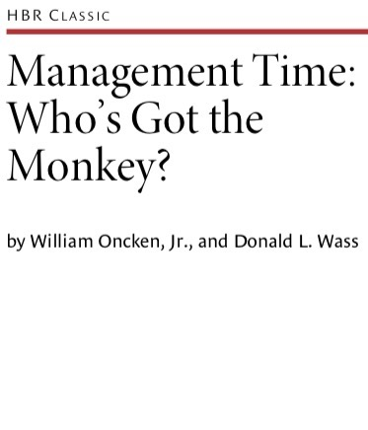
Who’s Got the Monkey?
“When you accept primary responsibility for a subordinate’s problem or action item, you may not realize it that very moment, but it’s as though you have allowed a monkey to be transferred from your subordinate’s back onto yours”.
Notes:
Harvard Business Review, November-December 1999
hbr.org

Slide 7
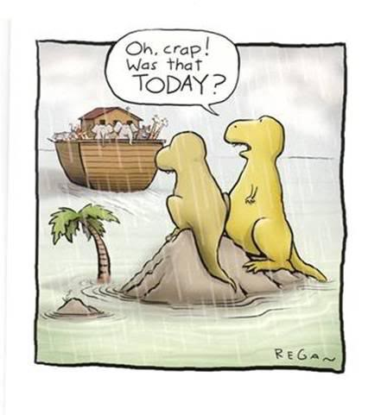
Procrastination
Recognize it
Break tasks down into smaller tasks
Do something else
Write it down
Time yourself (5 min)
Reward yourself
Be accountable to someone
Identify consequences of not doing task

Slide 8
Interruptions
Schedule and Block Time
Close your door
Go to the library/coffee shop
Have regular meetings if needed
Learn to say no
Have script for excusing yourself or setting parameters
Notes:
Hold M-F 8:00-9:00 for “Prep”

Slide 10
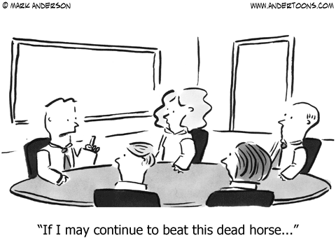
Meetings
Do stand-up meetings
Or just shorter meetings (30 min)
Best meeting practices - agenda, Who-What-When list, minutes
Stay engaged & fight the urge to multi-task
If makes sense, do preliminary work with collaborative applications (e.g. brainstorming and voting)
Get feedback from attendees

Slide 11
Micromanaging
Managers no longer get to do things…
Your job as manager is to provide direction, resources…
Then get out of the way!
See “Delegation”…

Slide 12
Prioritization
Align with higher level priorities and goals
Rankings - ABC and 80/20 rule (Pareto Analysis)
Eliminate and delegate
Organize and streamline day-to-day tasks
Constantly re-adjust
Understand deadlines
Notes:
“Higher level” = University SP; Division, SP, ITSP, etc.…
ABC
A: Tasks that are perceived as being urgent and important.
B: Tasks that are important but not urgent.
C: Tasks that are neither urgent nor important.
See Covey…
80/20 Rule
www.mindtools.com/pages/article/newTED_01.htm
Is really about the lack of symmetry between work and results
Started by Vilfredo Pareto

Slide 13
Time Management Systems
Covey Time Matrix
Getting Things Done

Slide 14
Covey Time Matrix
Notes:
http://www.projectexecutiveblog.com/index.html/2013/03/15/covey-time-matrix/

Slide 15
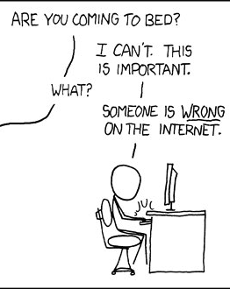
Urgent and
Not Important

Slide 16
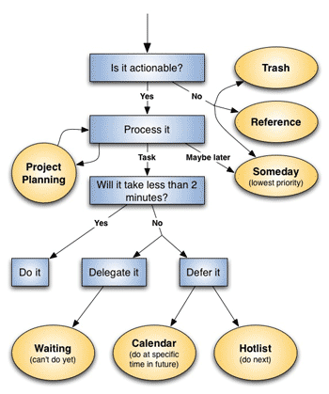
Getting Things Done
Notes:
David Allen, gettingthingsdone.com

Slide 17
Pros and cons of each system
Covey (First Things First)
Great for big picture prioritization, thinking and framing
Great for work/life balance
“Big rocks first”
Hard to figure out how to deal with all the little stuff
Allen (Getting Things Done)
Great for getting huge amounts of e-mails and tasks accomplished (e.g., “inbox zero”), breaking down projects
Great for only touching things once
Difficult to figure out higher level goals and projects

Slide 18
How to make it work for you
Find the components of each system that resonate and work for you
Mix and match tactics
Test the system
Tweak the system
Whatever works is good enough…

Slide 19
How to make it work for you
Block time to prep each day
Prep for meetings!
Leverage “Presence”… to reduce calls and IMs (and don’t respond!)
Schedule work time on calendar
Have “office hours”

Slide 20
Delegate!
But why delegate if you can do it better?
Notes:
Sounds like micromanaging…

Slide 21
Delegation
Opportunity cost of your time
Your skills
Value to institution
Teambuilding
Empowerment

Slide 22
How to Delegate
Determine and define task
Make yourself let go
Ask, don’t tell
Match tasks to people’s strengths
Encourage independent thinking
Provide necessary resources
Reward and recognition

Slide 23
SMART Delegation
Specific – what is the task or objective?
Measurable – how will it be measured?
Agreed – does everyone agree?
Realistic – is it realistic?
Time-bound – when does it need to be done?

Slide 24
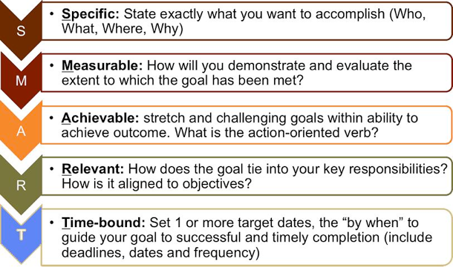
SMART Delegation

Slide 25
Exercise: Inbox Scenario
You are a new IT manager in Client Services. You’ve been away at management training and have returned. Prioritize and sequence the e-mail that has piled up while you’ve been gone. It is mid-semester…
Assume - CIO, CFO and Dean report to President
Notes:
Time: 10 minutes
Email messages handout…

Slide 26
Inbox questions
How would you sequence the tasks and why? What would you do for each?
What would you do yourself, and why?
What would you delegate, and why?
Where are there potential risks/pitfalls?
During what times of year might the criteria you use to prioritize your inbox change?
What other variables might you take into account when prioritizing and sequencing the tasks?
Notes:
Also as a handout…

Slide 27
Inbox Discussion and report out

