Slide 1
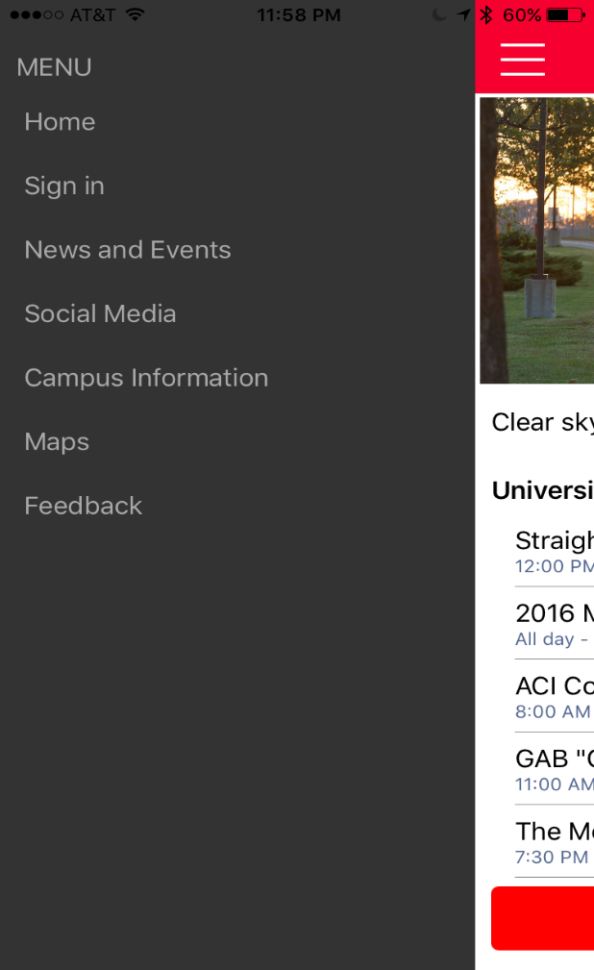

While you’re waiting… Download the Pitt State App on your Apple or Android device – We’ll be using it for this session. Then, find a partner for our activity!
Search for “Pitt State” in your app store
Look for the logo on the left and download the app
Sign in with the username: “educause” and the password: “Demo*16”

Slide 2
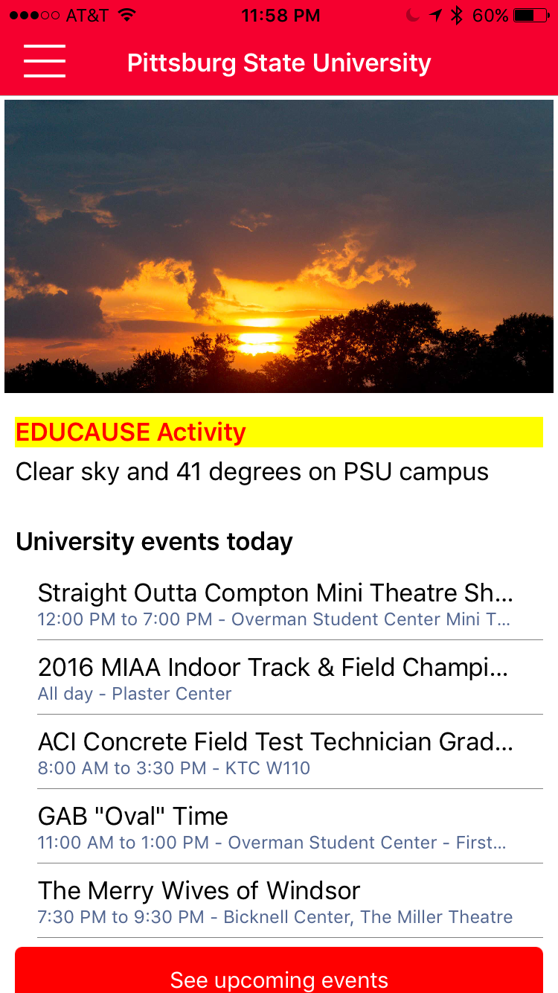
EDUCAUSE Connect Denver 2016 Pitt State/Ball State Gamification and Engagement Quiz
The players with the most achievement points and correct answers win!

Slide 3
Engaging Mobile App Development in Higher ED
John S. Kuefler
Pittsburg State University

Slide 4
Why Mobile for Higher Ed?
86% of students own smartphones
Students spend an average of 3 hours per day on their smartphone
Students receive about 65 notifications on their phone per day
79% of universities have mobile apps

Slide 5
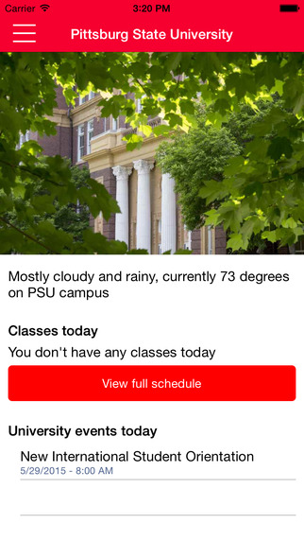

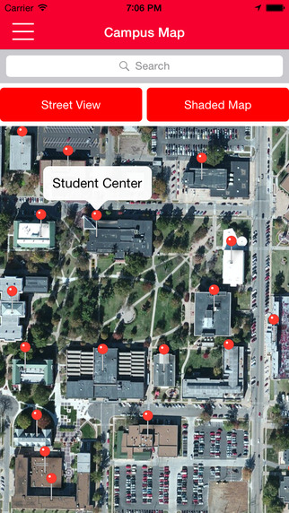
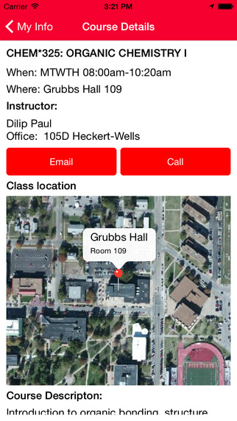
The Pitt State App: For the Community, by the Community

Slide 6
The response rate for unsolicited feedback in a mobile application is under 1%
Uh oh.

Slide 7
Where to Start
Buy it or make it?
Building engagement
  Create a grassroots movement
  Dangle the carrot early
  Bring in the community in cycles
Gathering feedback - keys:
  Gather feedback effectively - know the right questions to ask
  Qualitative vs Quantitive feedback
  Be responsive (critical early)
  Temper expectations of positive feedback

Slide 8
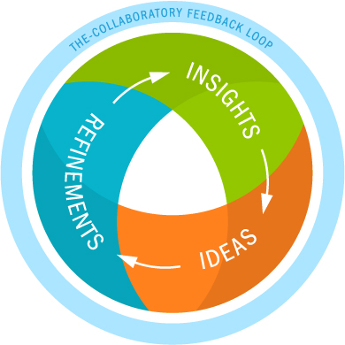
Source: Vanderbilt: http://vanderbilt.edu/emails/exact-target/2015/08/august-2015-issue-of-the-open-dore/

Slide 9
Continuous Engagement
Involve all stakeholders
Focus on the features the community wants, not what you think is needed
Use incentives to keep the feedback coming

Slide 10
Ball State Achievements & Gamification
Scott Reinke
Ball State University

Slide 11
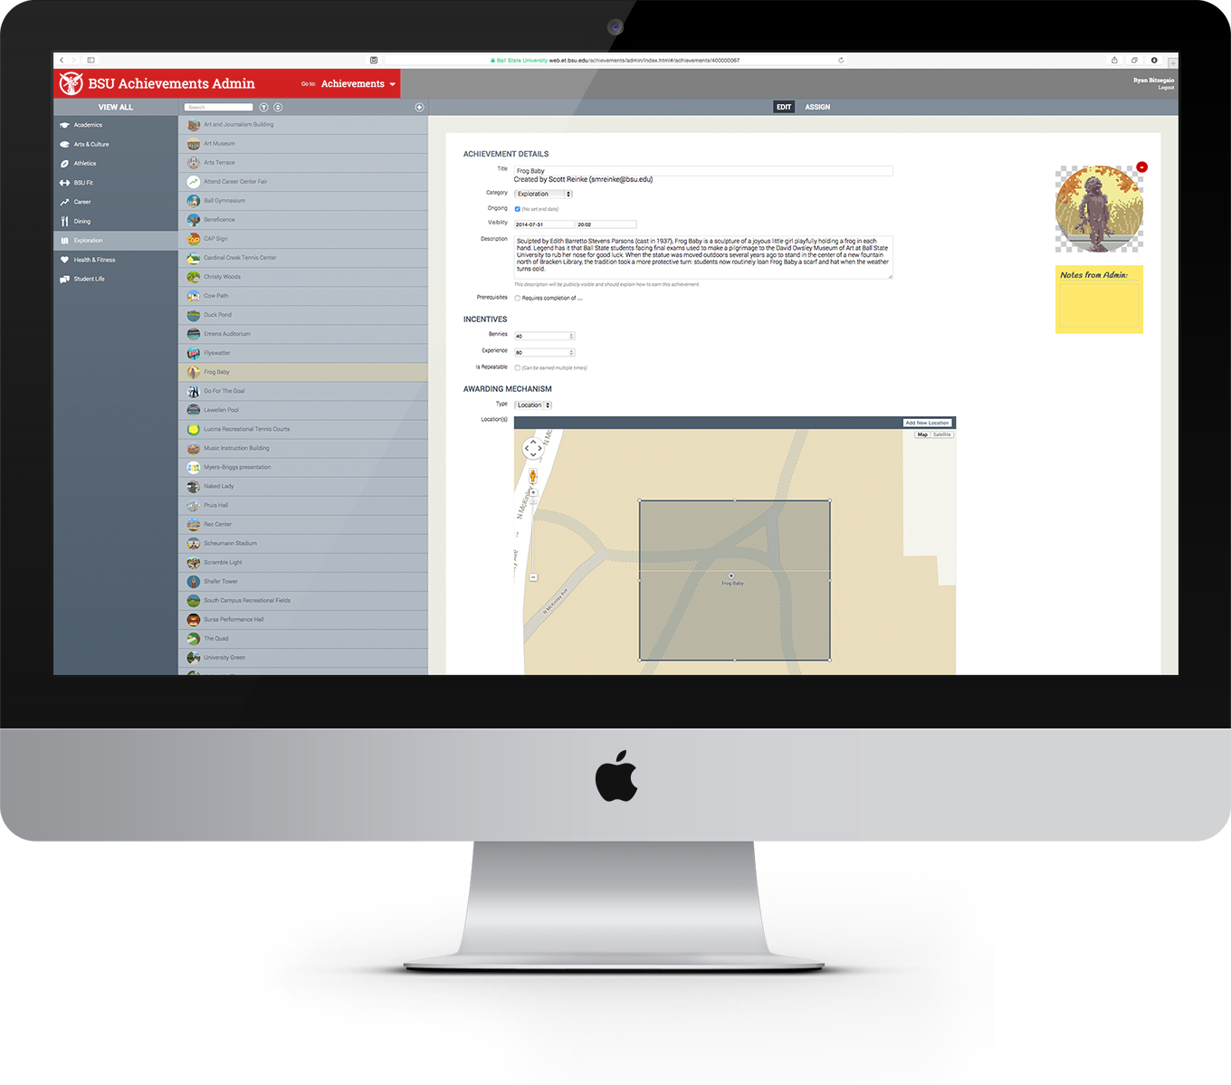
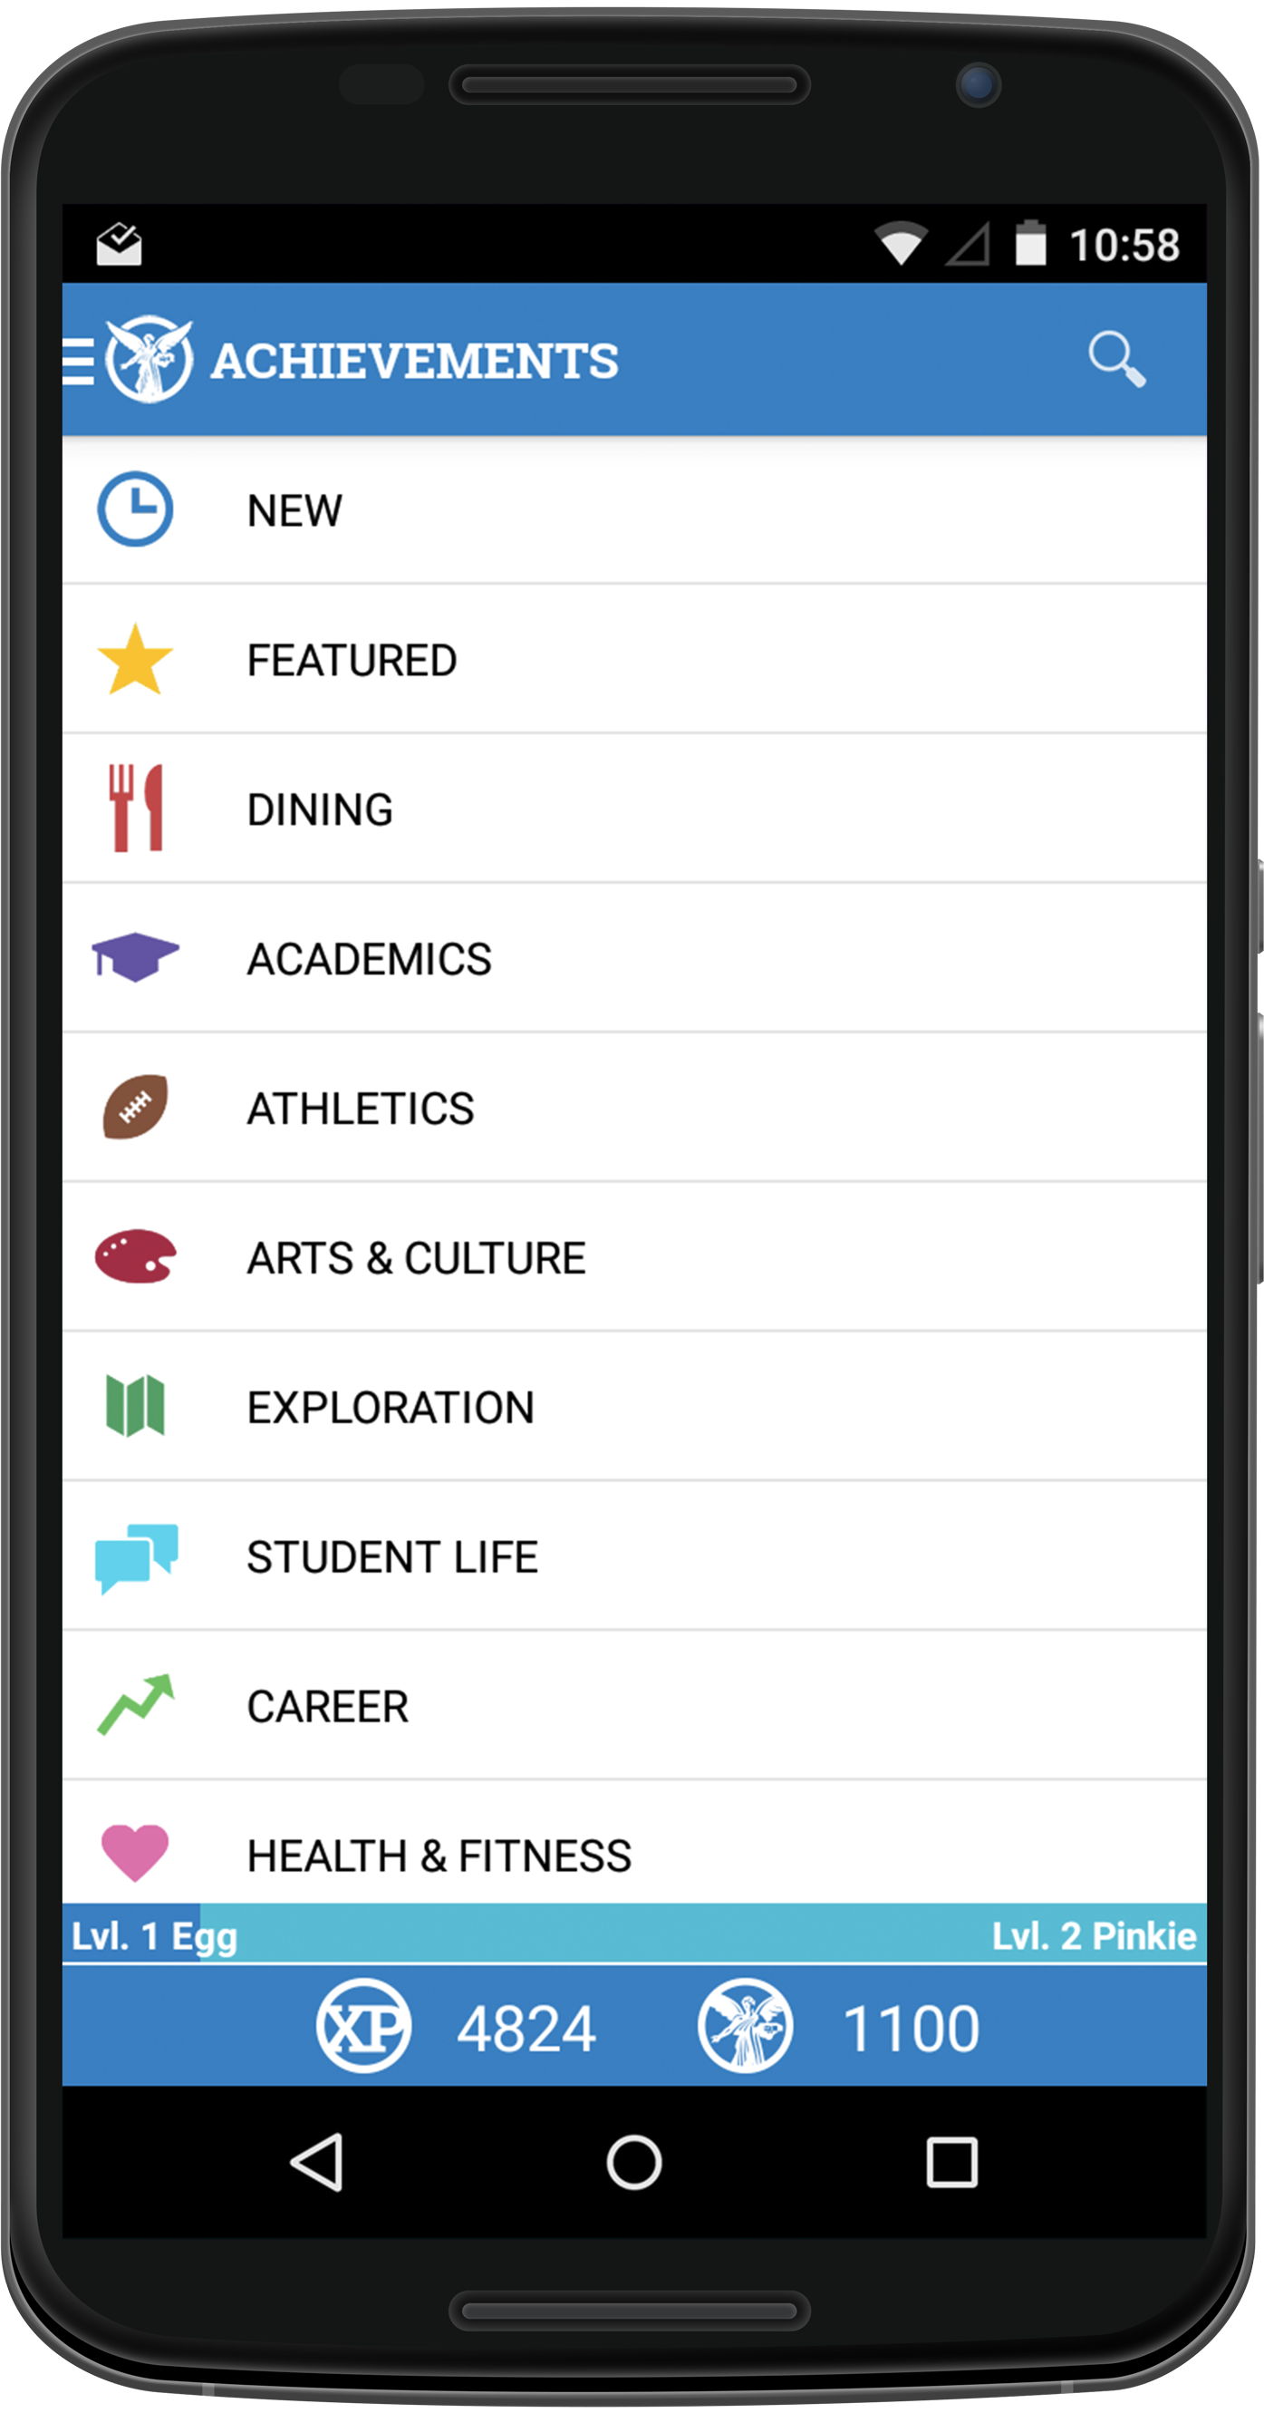
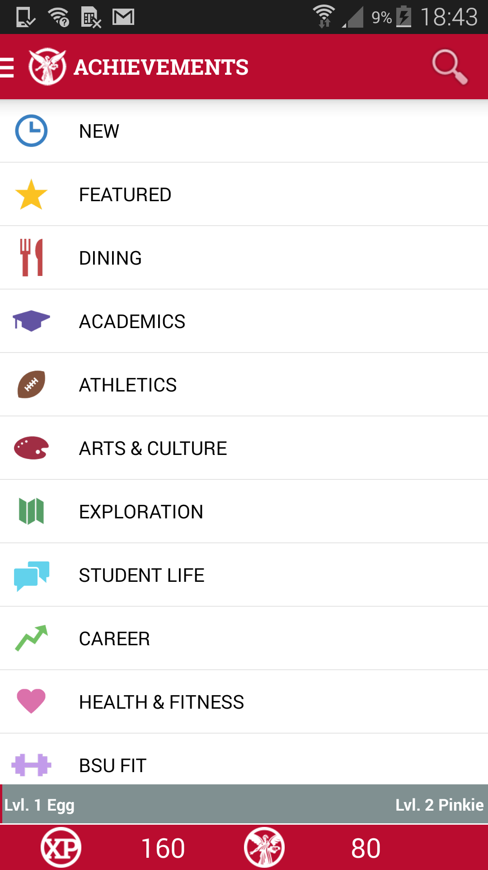
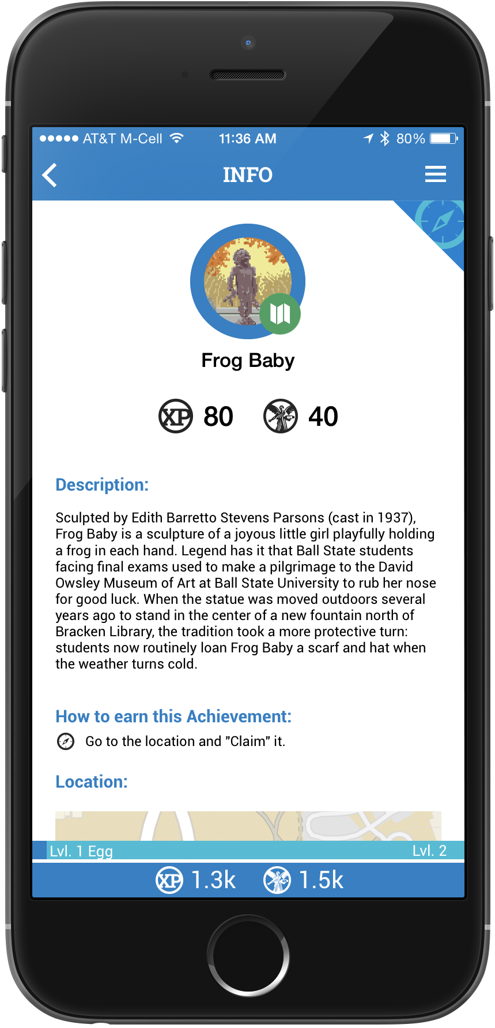
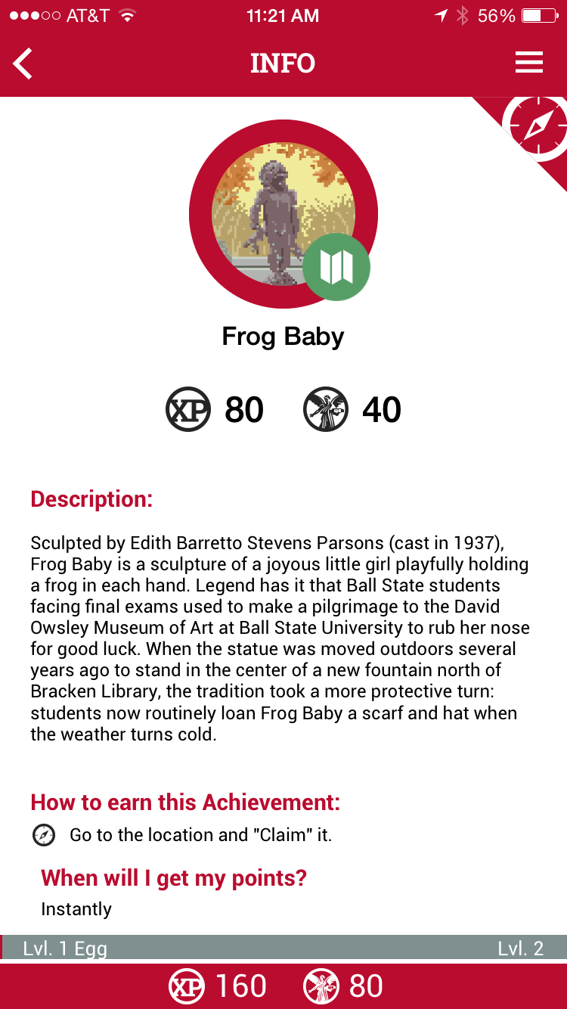
Ball State Achievements

Slide 12
Games vs. Gamification
Games
Gamification
Usually have narratives
Intended for recreation
Are voluntary
Provide interaction
Have goals and endings for the player
Guide users through content
Reinforce or alter behavior
Are often ongoing
Align with the creators goals for their product or service

Slide 13
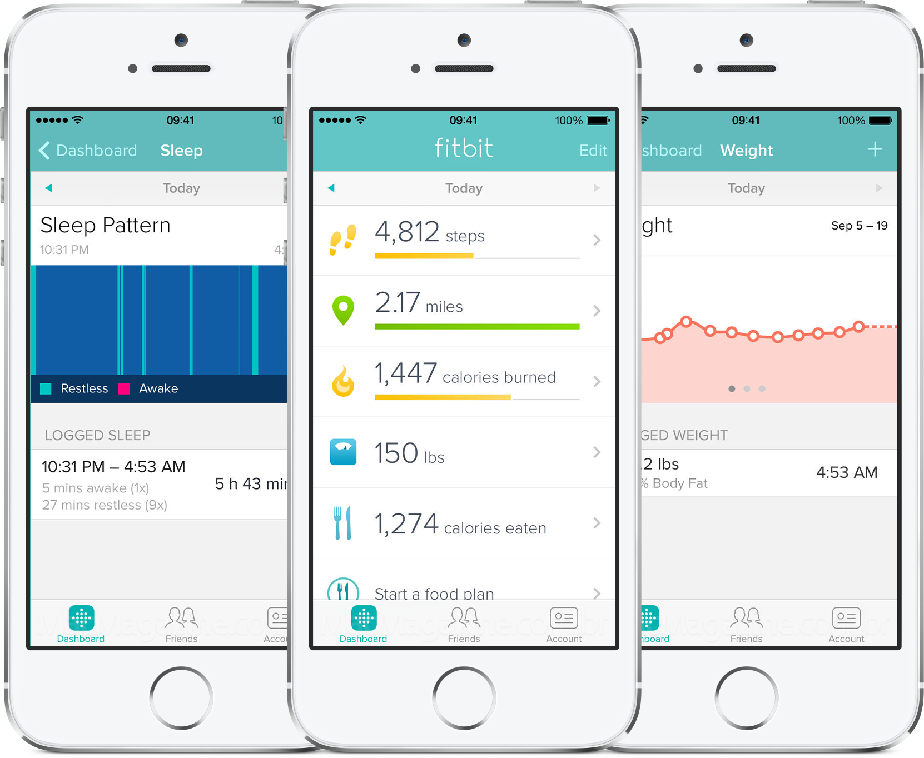
fitbit

Slide 14
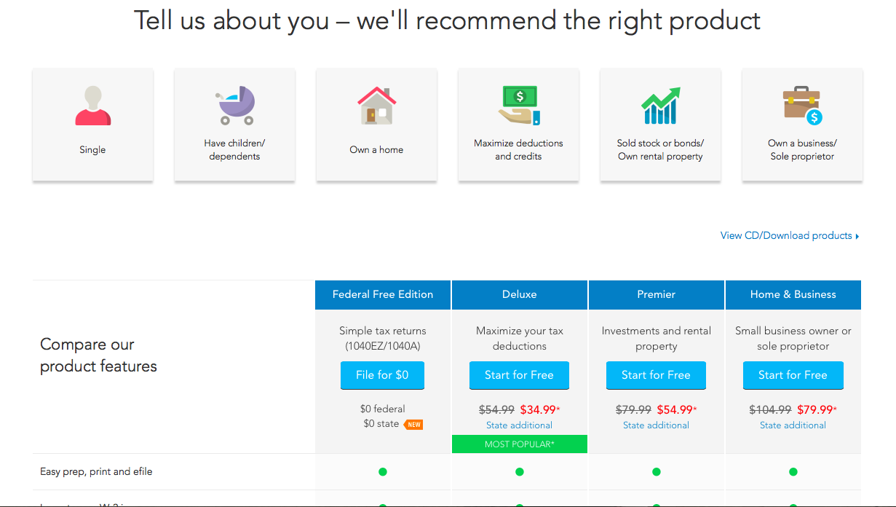
Turbo Tax

Slide 15
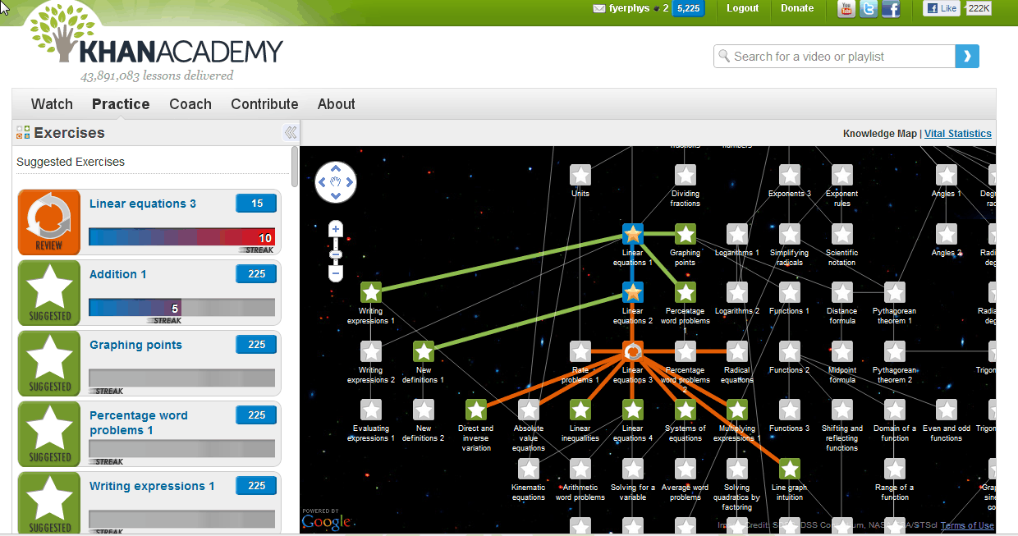
Khan Academy

Slide 16
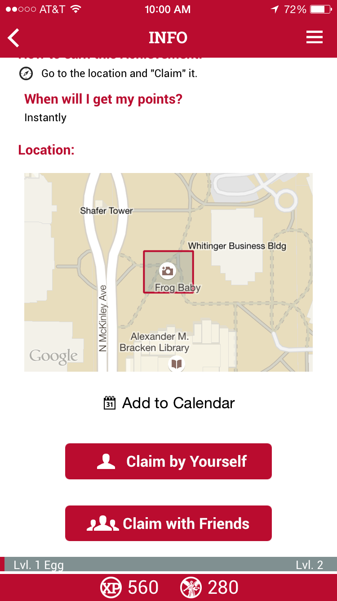

Slide 17
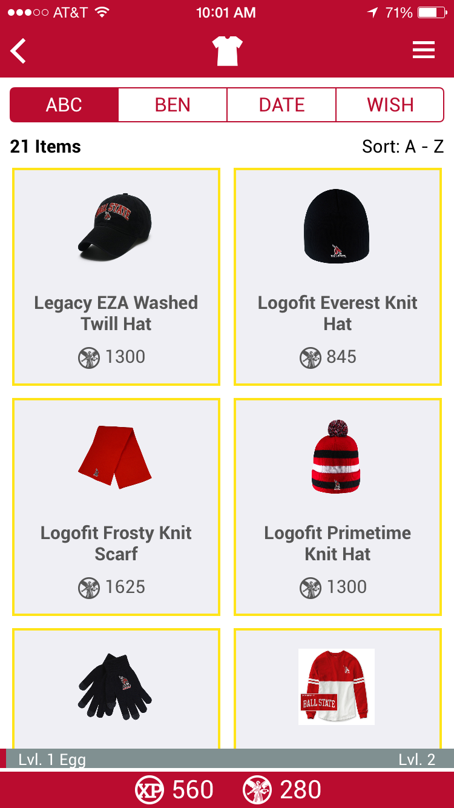
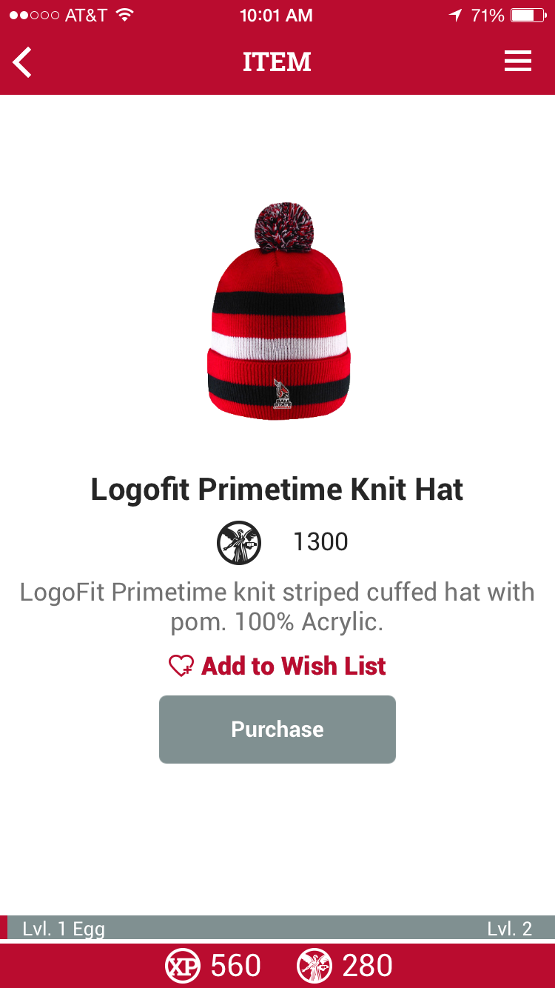

Slide 18
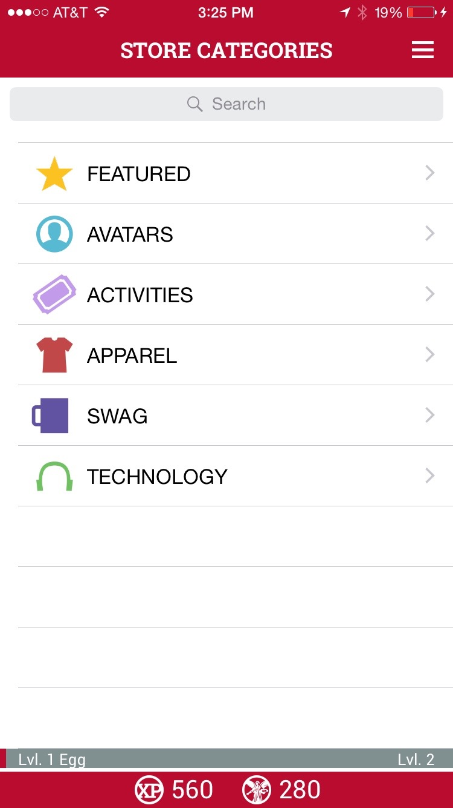
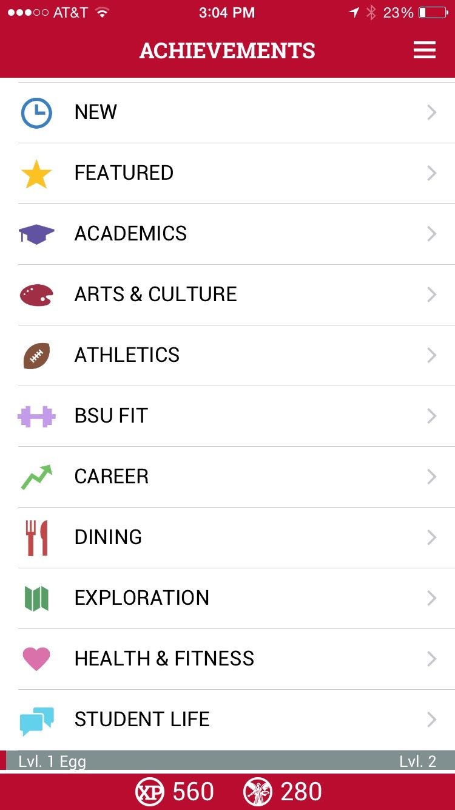

Slide 19
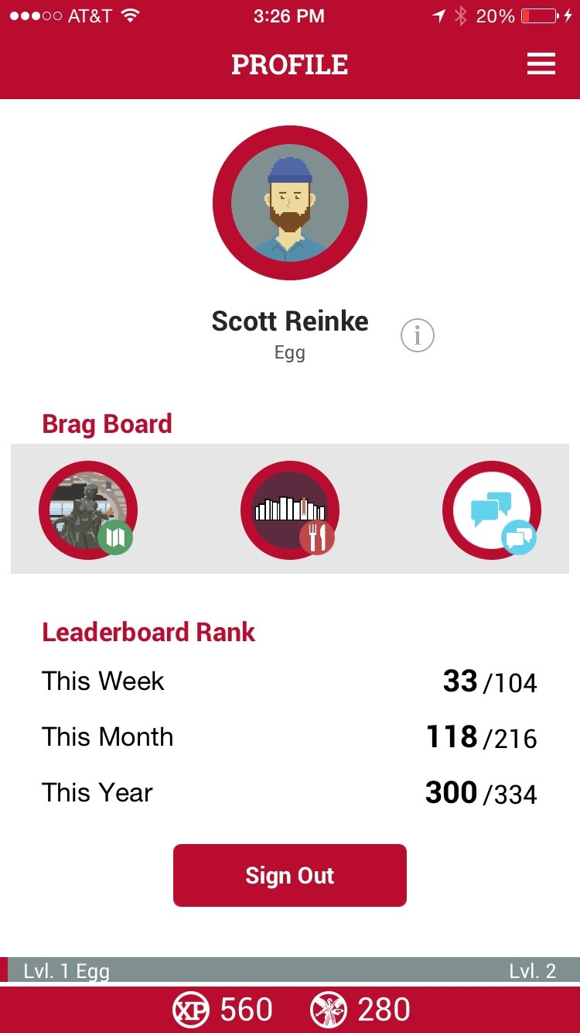
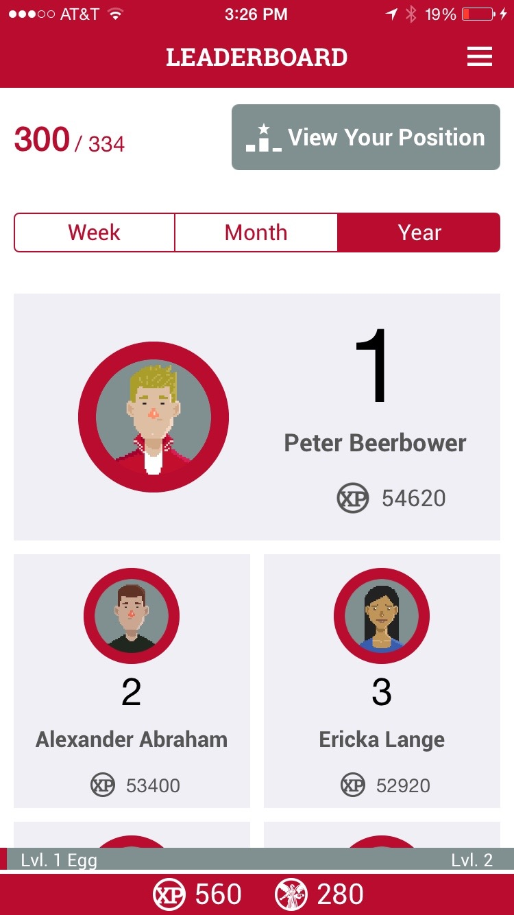

Slide 20
Questions?

Slide 21
Thank you!

