Slide 1
Welcome!
(Caution: This presentation contains pictures of clowns)
Is this a Joke? Adding humor to your communication strategy
“This presentation leaves copyright of the content to the presenter. Unless otherwise noted in the materials, uploaded content carries the Creative Commons Attribution-NonCommercial-ShareAlike license, which grants usage to the general public with the stipulated criteria.”
Notes:
Encourage people to sit at tables where they don’t know some of the people.
Keep slide up until everyone is seated.

Slide 2
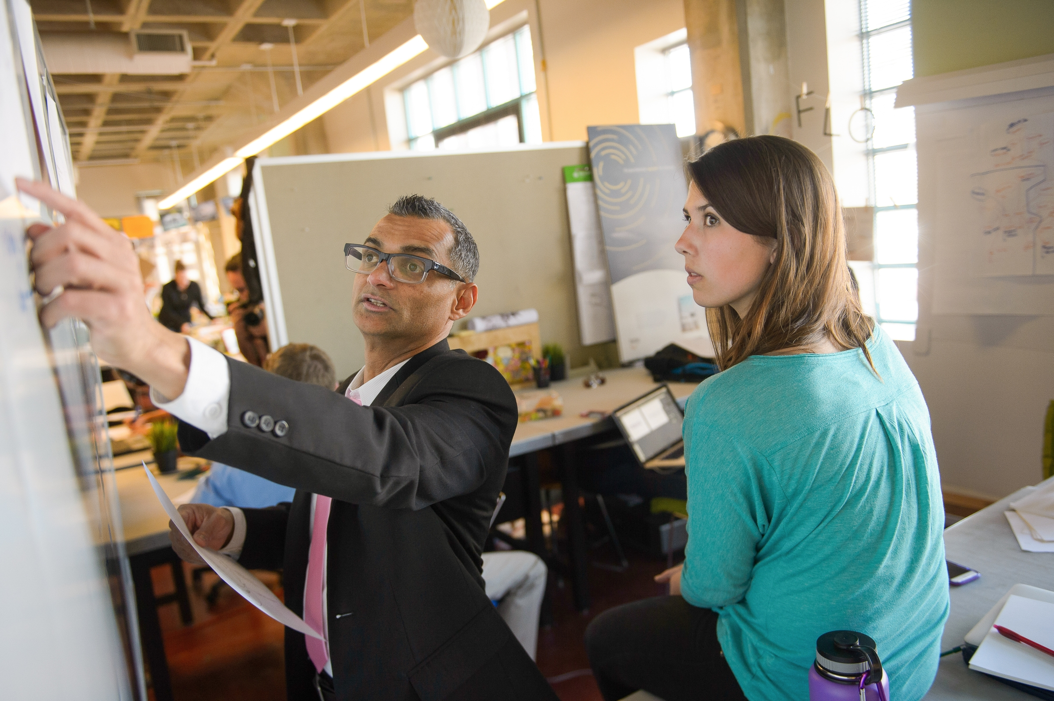
Why are we here?
To build a plan
To add Humor
to your communication!
Notes:
My Name is Paul Stoll. I have worked for Arizona State University for 10 years, managing a training group for the university technology office. During that time, we have starting using humor in some of our communications to our users, and have benefitted from it!
Today, we will share our story with you and give you space to develop your own plan for adding humor to our communications. Maybe this will work for you, maybe not, but you will have time today to decide! And you have very talented people around your table to help!
At the end of the workshop, those of you who wish to share their zany ideas will be able to do that with the larger group.
Ok – let’s get started!

Slide 3
Activity 1
Introduce yourselves!
Tell your favorite joke.
Got a joke?
1 volunteer from 2 tables
Notes:
Let’s go through what is on the table!
In front of you is a packet of pages, let’s look at them.
The first page is the activity page. In a few moments we will get to know each other by doing activity 1.
On the back side of that is activity 2, which is later in the workshop.
Next is a joke page (front and back). More about that in a minute.
Thumbing through the next two pages are a sample of the type of communication we are talking about – there is a humorous and a serious version of the same communication. When things get boring, take a look at what we mean by humor..
Finally there is the Plan – this is where you can write your own plan for adding humor to your communication strategy and we will be using this page for the majority of the workshop.
But now – let’s get to know each other! Please flip back to the beginning of the package and find activity one. As you read through these instructions, we want you to introduce your selves, and tell your favorite joke! If you don’t have one, we have your back.. There is a Joke page – feel free to look at those websites or choose a joke off that page to tell!
Once everyone has had a chance to introduce themselves, you can nominate someone from your table to tell their joke to the larger group. We may have time for one or two, but not enough for every table….
Go! (This is a great time to share business cards!)

Slide 4
Brief History
2006
Notes:
Here’s a VERY brief history of how we started using humor at ASU in some of our technical communications.
In 2006, (click) we went from a text based Student Information system to a mouse-driven one (PeopleSoft)
Our CIO at the time was of the mind that these large, enterprise wide ERP conversions were always painful, and that taking a shorter time, rather than a longer time was the more humane course. SO in the period of about 18 months, ASU replaced the text-based system of record that had housed our student and HR data for that last 20 years with a completely new system. It was a very interesting time to be alive! Talk about change management!
(Click) Through this process, we communicated in many ways with staff and faculty, one of the primary ones being email.
(click) Toward the end of the project, we started to throw some humor into the email communications. Mostly because we were tired, and we wanted to find as many way to strengthen the relationships with the departments as we could. So we started adding humor to our email updates.
In your packet is an example of a communication from last year.. One page is the humorous verison, one is the serious version - -If I start to bore you, feel free to look those pages over. ..

Slide 5
Benefits
Listening..
Dialogue..
Same team..
Hearts and minds..
Project ideas initiated from departments..
Notes:
So… what happened when we started putting humor in our communication? They stopped blowing us off! A few started to read our information.
They started listening, and some
(click) even started to talk back to us - - (as opposed to yell at us). When the technology department is the faceless organization that is inflicting unwanted change on you, it’s easy to get mad. When that same department has made you laugh, it’s harder to get angry (at least right away!)
(click) We tried (and succeeded to a certain extent) to craft our communications so that we were all in the same boat. This change was happening to all of us… here’s how we can all make this easier… etc.
(click) – we won a few hearts and minds (ok this is a photo of ASU students) (go devils!) There is, in areas, less of a need to establish rapport before we talk about change, we can just get right to the point.
(click) and some departments are now very interested in starting their own projects and asking for our help… (this is really a photo at our EMERGE conference this year – melding technology and art. - - couldn’t pass up the picture and didn’t have one about starting a project..

Slide 6
Feedback
LOL!! I know I’ve told you before, but THANK YOU for the continued laughs and entertainment from your updates. I truly do want to read your emails because I know I’m learning a lot— in addition to getting a good chuckle every time. THANK YOU!!
Thank YOU for these entertaining emails. They are always informative and make me smile.
I’m sure you will be inundated with thanks, but . . . thanks to you and the UTO team for all of the hard work, excellent communication and sense of humor that definitely lightens the load!
One BIG thank you to you, for giving us something to enjoy and talk about here in the office this morning!
Notes:
Here are a couple of quotes from employees about the use of humor in our communications.
Click
Click
Click
Click

Slide 7
The plan
Find the page titled “The plan”!
Benefit from our “lessons learned” –
Time will be given to update your plan and share at the table.
Notes:
Ok – So now you may be bought in to thinking about adding humor to communication.. The rest of our time together will be spent work on your plan! If you will leaf through your papers and find “the plan” and dig out a pen or pencil…

Slide 8
5 Lessons
Know your audience
Opt in
Be gently positive
Be responsive
Carry on
Notes:
As we used humor in our communication, we learned 5 lessons.
For each lesson, I will talk briefly about that, and then give you time to update your plan. As you update, please share with your table, ask questions of each other, give advice, take advice.. Etc.
The five lessons are: (read list)

Slide 9
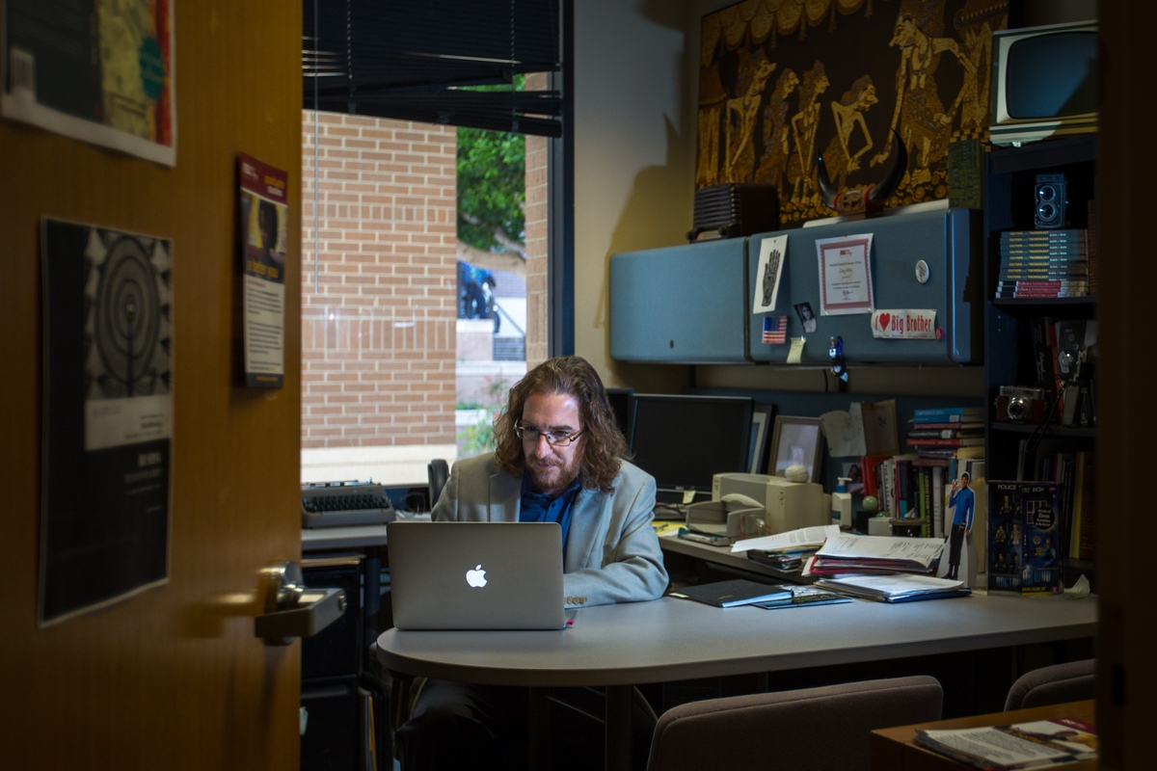
Lesson 1: Know your audience!
Notes:
Lesson one: Know your audience…
This picture is one of our faculty, who teaches about social media. (notice the spock on his desk.. How cool!)
He represents the 2000 staff and faculty at ASU who have access to student data. These people advisors, faculty and department admins who are in direct contact with the students every day. They mostly communicate through email, are older and pretty much hate change (like we all do)
That description changes each year, with the population getting younger with more and more relying on social media. We will have to monitor to see if our strategy should change in the near future.
So – on your plan, describe who you want to communicate to. And – what topics do you want to talk about? Fill in section one and share what you wish with your group.

Slide 10
Lesson 2: Opt-In
Notes:
Not Everyone wants humor.
Several years into our use of humor, it was pointed out that not everyone liked the update.
So we set up a way for people to opt-in to the humor.
Our update is an email that we send out using outlook. We pull the list of everyone that has access to student data, and delete from that list the people that have subscribed to the humorous version. (we use outlook for that as well)
The resulting people get the serious version and the subscribers get the humorous version. We put links on both to allow people to identify which side of the “funny fence” they want to be on!
Right now – We have about 2300 people total and about 500 subscribes. (A tiny bit more than 1/5th of the population)
So – how will YOU make it possible for people to optin? What system? Who will manage it? How will it work, or who do you need to talk to in order to figure it out?
Add to your Plan and share at your table

Slide 11
Lesson 3: Be gently positive!
Update your Plan,
and try Activity 2!
Notes:
One of the huge deals here is that adding humor is NOT about telling jokes. Its about gently poking fun at the common situation that you and your audience have together. I often make fun of the Arizona heat, or the rate of change, or how hard it is to navigate through the 80,000 sutdents on campus during the first week of classes.
This is NOT the place for “Blonde” jokes. Have a test audience is a really, really clever idea!
Since this one is so important, we have a few things for you.. If you haven’t already, find the two sample papers. It’s the same update, one humorous and one serious. Read the serious one first, then the humorous one. With that as a reference point, find the page that says “activity 2”. Try your hand at adding humor to one of the three options listed on the page. If none of those make sense to you, use the back of your plan to write a bit of humor for your next communication. When people feel like they have written enough, you can ask for volunteers at the table to share their prose. .

Slide 12
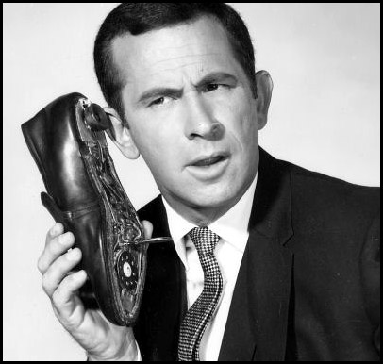
Lesson 4: Be Responsive!
Notes:
I send the update from my email address. And I do that intentionally, because it is part of developing that relationship.
Because this is only one way that people have access to our technology office, I am not bombarded with communication after an update. But I do get four or five comments about the update, and few more subscribers and a few people who have a technology question that has been bugging them that they need someone to ask about. I am that guy!
Throwing humor over the wall is NOT as effective as humor given from a real peson…
So – think about how people will be able to respond to your messages. Who will do the work, what system will use (email? Smoke signals? )
Add to your Plan and share at your table

Slide 13
Lesson 5: Carry On
Notes:
Finally, we’ve found that – even though we have 450 people in our technology office working as hard as they can, some months, there isn’t much to say… So we backfill with tips about how to do things in MS office or one of the Adobe products. We publicize other upcoming events on campus, just generally try to be helpful.
Just as in social media, you Publish or Perish” so think about how you continue this effort for the near term, the medium term and the long term. We publish monthly, and there have been some gaps, which has caused a decline in our numbers.. SO be consistent!
Add to your Plan and share at your table

Slide 14
Wrap-up
Anyone want to share their plan?
Notes:
Ok! How this instructor ever did this, I will never know!
Does anyone want to comment on their plan? We have (nn) minutes left..
As always – I’m available for questions and comments. Find me afterward. My email and phone are on the Plan page of your packet.
Feel free to keep what you want, leave the rest so that we can recycle it!

