Slide 1
Developing and Nurturing IT/Faculty Relationships
Barbara J. Draude
Assistant Vice President for Academic and Instructional Technologies
Co-Director, Teaching, Learning and Innovative Technologies Center
Assistant Professor, School of Nursing
Middle Tennessee State University

Slide 2
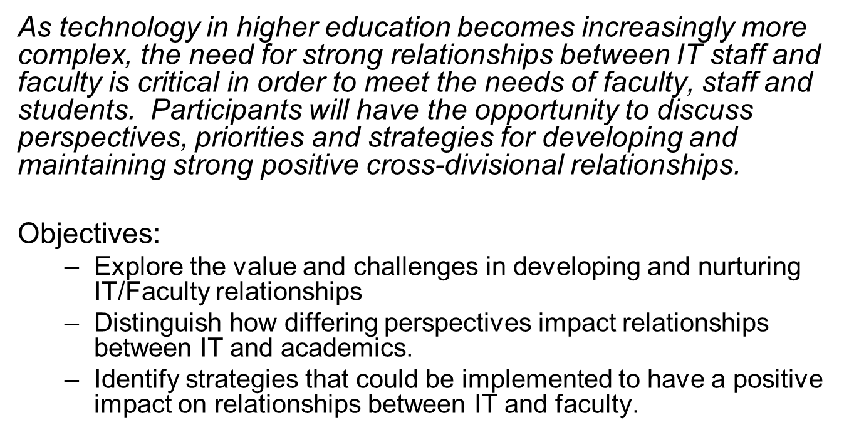
Abstract

Slide 3
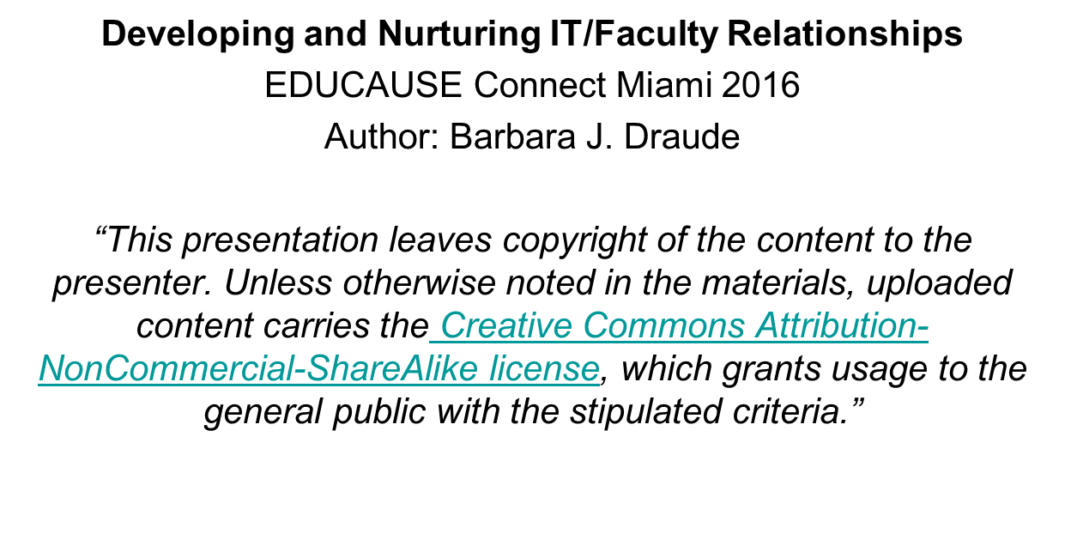

Slide 4
Introductions
Meet those at your table
Identify your primary work “focus” – faculty/academic OR technical

Slide 5
Activity 1
Individually - identify what do you feel is your highest priority “technology–oriented” issue / concern”

Slide 6
Share-Out 1 : Highest priority technology–oriented issue / concerns
Faculty/Academic:
Going online with courses
Research
Training
Resources
LMS
Learning Spaces
Accessibility
Continuity
Academic Freedom
Copyright
IT
Security
Wireless capacity
IT Communications
Research Storage
Training
Resources
Maintaining day-to-day functionality (i.e. LMS, Servers)
Funding
Continuity

Slide 7
What is needed for Good Faculty / IT Relationships
Are there challenges with working with or establishing relationships ?
Are there barriers that may be impeding those relationships?
Share out:
Unions
Communication
Unwillingness to meet in the middle
Not involved enough
Working hours
Fear of change
Perception versus reality
Lack of planning
Sense of entitlement
Peer Pressure

Slide 8
What is needed for Good Faculty / IT Relationships
Trust
Mutual respect
Mindfulness
Welcoming of diversity
Open communication

Slide 9
Strategies for developing and nurturing relationships

Slide 10
Activity 2
discuss strategies for the tables' highest priority issue/concern that you feel would be successful at their institutions.

Slide 11
Share-Out 2: Successful Strategies
“Walk arounds” – going to offices
IT “tries” it out first
Focus groups
Targeted training
Faculty meetings
Partnerships
SoTL incentives
Communication opportunities

Slide 12
How to build Good Faculty / IT Relationships
Develop people skills (collaboration, communication, conflict resolution, etc.)
Schedule time to build relationships
Appreciate others and their contributions
Be positive
Listen actively
Manage expectations / boundaries

Slide 13
Activity 3
Choose a strategy that you feel would be successful in your environment – and begin a plan for implementation (use your table colleagues as consultants for your ideas)
Action Plan: Create a calendar event (in 3 months) to revisit the plan to evaluate implementation.

Slide 14
Wrap-up
Review objectives:
Explore the value and challenges in developing and nurturing IT/Faculty relationships.
Distinguish how differing perspectives impact relationships between IT and academics.
Identify strategies that could be implemented to have a positive impact on relationships between It and faculty.
Thank you !
barbara.draude@mtsu.edu

