Slide 1
Lightning Round: iPad Apps for Active and Engaged Learning
Jennifer Sparrow
Virginia Tech
February 14, 2011

Slide 2
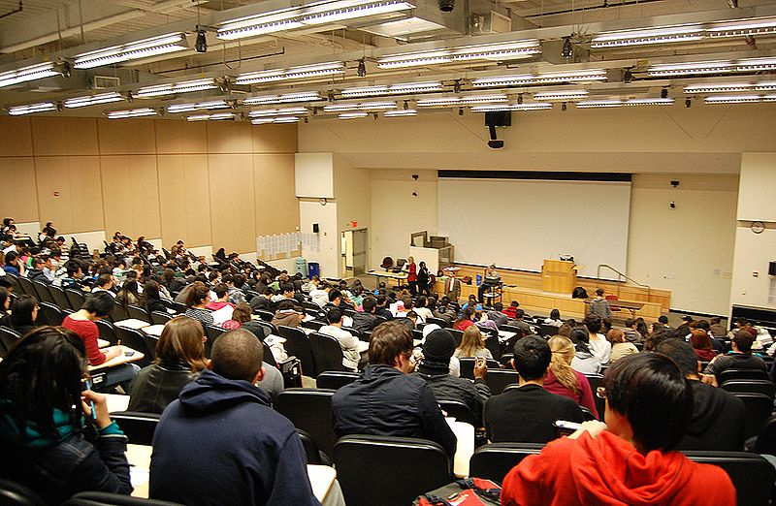
http://commons.wikimedia.org/wiki/File:5th_Floor_Lecture_Hall.jpg
By Xbxg32000 (Own work by uploader; the watermark is my own.) [CC-BY-SA-3.0 (www.creativecommons.org/licenses/by-sa/3.0)

Slide 3
http://farm5.static.flickr.com/4103/5058462402_198dd6dedc_o.jpg
By Mike Mcilveen Creative Commons Licensed

Slide 4
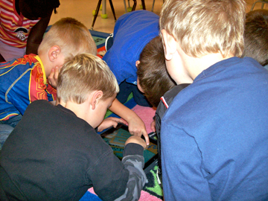
Kathy Cassidy Creative Commons Licensed
http://www.flickr.com/photos/57634636@N00/

Slide 5
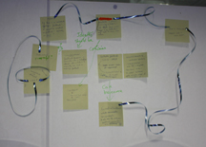
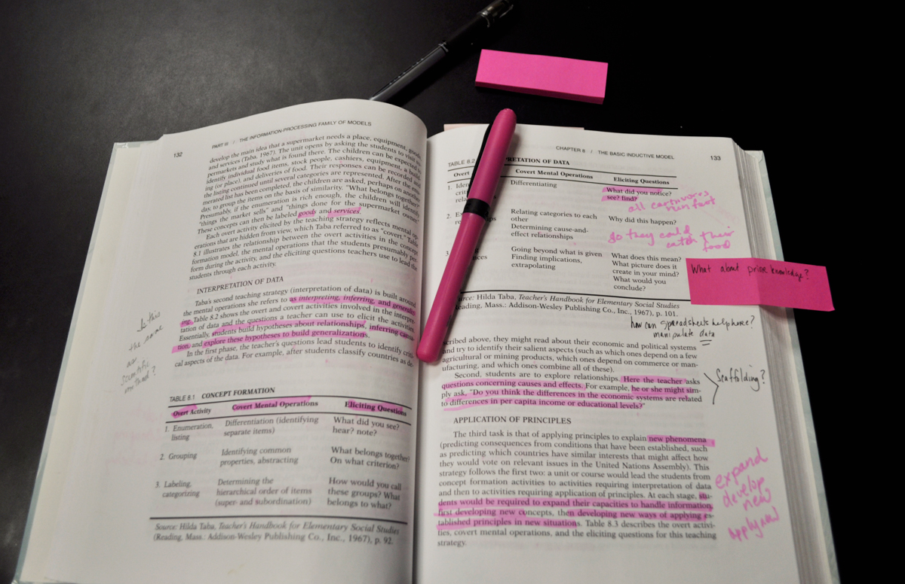
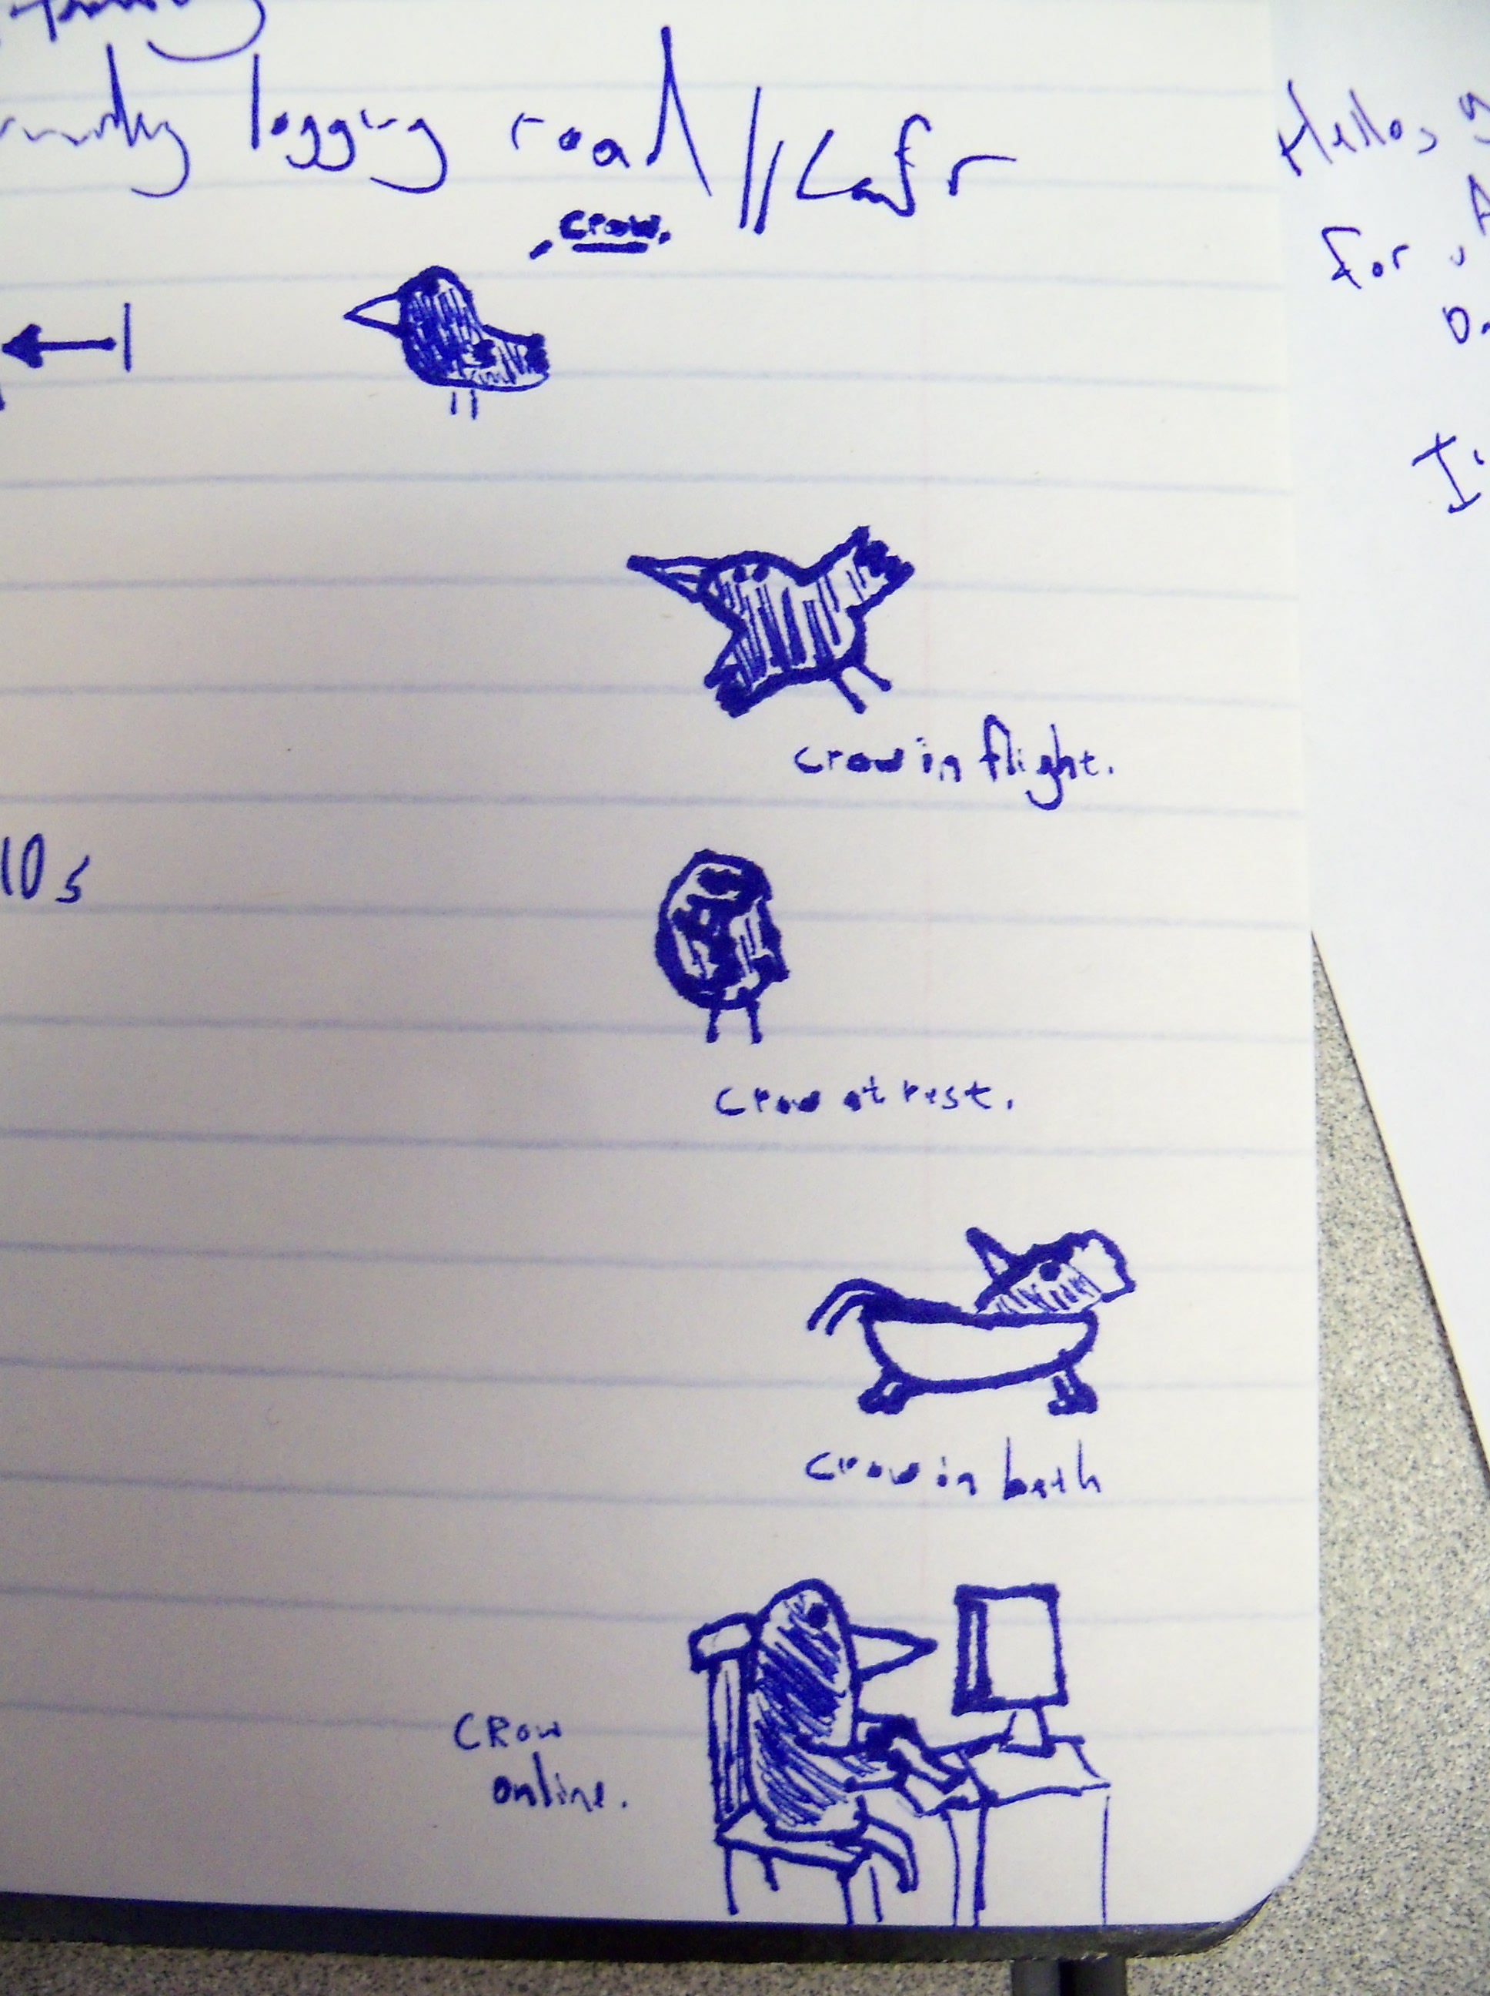
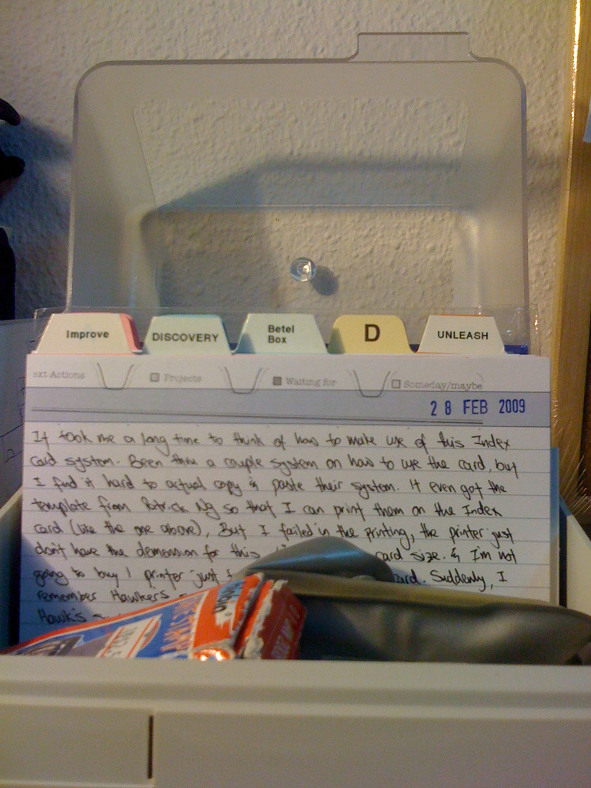
Active and Engaged Learning
Notes:
Critical Reading
Concept Mapping
Compiling & Organizing Data
Critical & Engaged

Slide 6
iAnnotate PDF
Notes:
Critical Reading

Slide 7
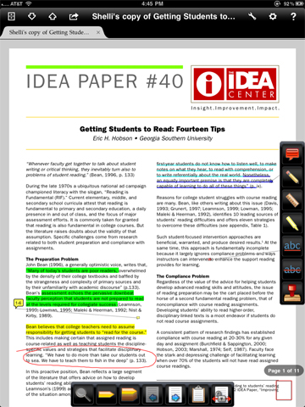

Slide 8
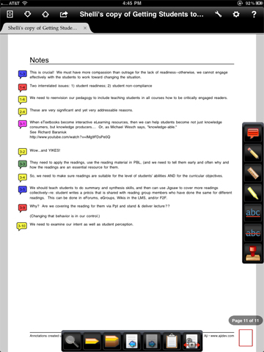

Slide 9
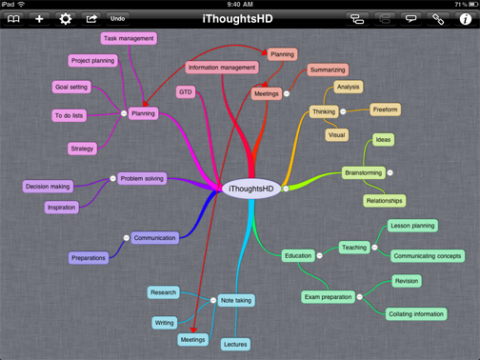
IThoughtsHD
iThoughts HD basic

Slide 10
IThoughtsHD
iThoughts HD basic

Slide 11
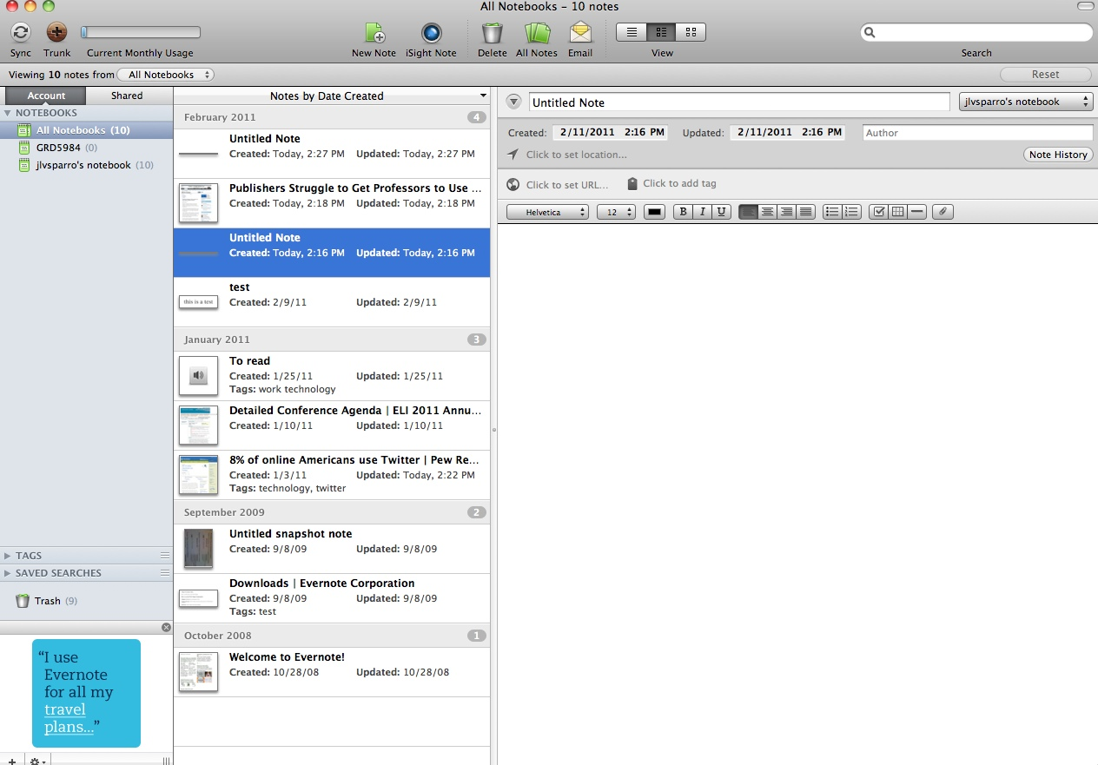

Slide 12
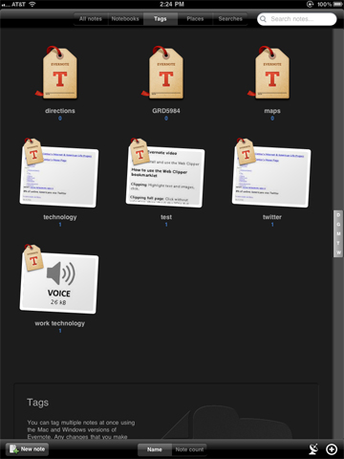
Evernote

Slide 13
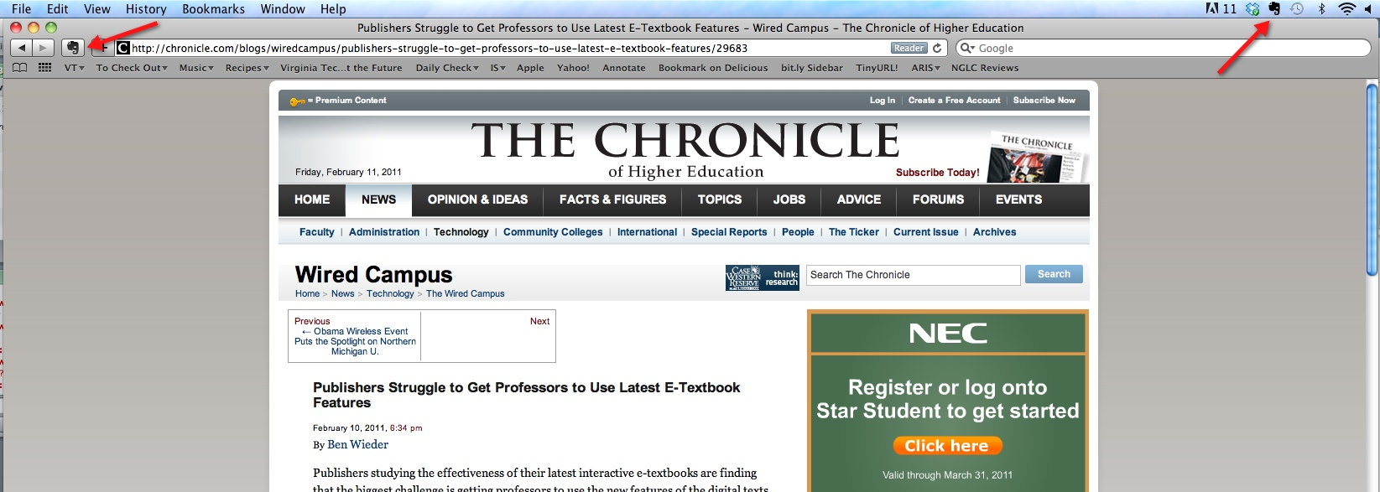
Evernote

Slide 14
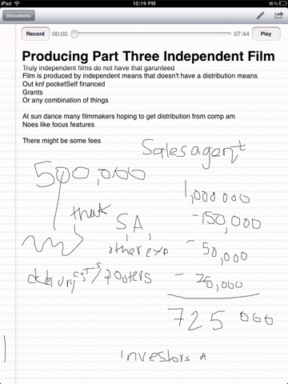
Soundnote

Slide 15
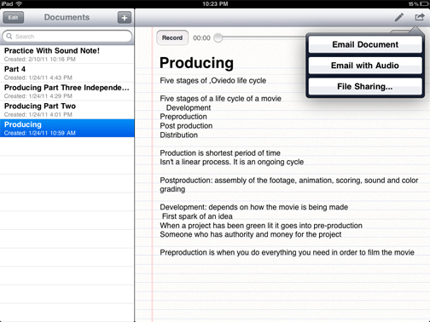

Slide 16
It is our responsibility to TEACH our 21st-century students how to be active and critically engaged learners, and “knowledge-able.”
http://www.youtube.com/user/mwesch#p/u/0/-_XNG3Mndww

Slide 17
THANK YOU
Contact Info:
Jennifer Sparrow
sparrow@vt.edu
540-231-5377

