Slide 1
A Story of Openness: The Transition From Blackboard Vista to Moodle
J. Garvey Pyke, Ed.D.
Nicole Harris
Center for Teaching and Learning,
University of North Carolina at Charlotte

Slide 2
Timeline
Spr.
2007
Spr.
2008
Fall
2008
Spr.
2009
Sum.
2009
Fall
2009
Spr.
2011
Transition from WebCT to Blackboard Vista
Campus discussion on alternative LMS. Evaluation committee formed.
Limited pilot.
12 faculty, 23 courses,
850 students
Expanded pilot.
40 faculty,
90 courses,
3000 students
Moodle adopted.
Opened to campus.
Migration 97% complete.
18 Months: Evaluation
24 Months:
Migration

Slide 3
Blackboard Vista
Campus in Crisis
Anecdotal unhappiness
System outages
Closed process for picking WebCT Vista
Blackboard purchased WebCT
Cost increased
Customer service decreased
New director, new CIO

Slide 4
LMS Evaluation
Philosophy:
Unlike usual IT processes, it was
Collaborative
Open
Inclusive
Faculty Led
Data Driven

Slide 5
Openness Strategies
LMS Evaluation Committee
Faculty
Instructional staff
IT staff (central and distributed)
Students
Chaired by two respected faculty leaders
Appointed by the Provost
Public LMS Evaluation Website
Minutes
Data
Rubrics
Discussion
Documentation

Slide 6
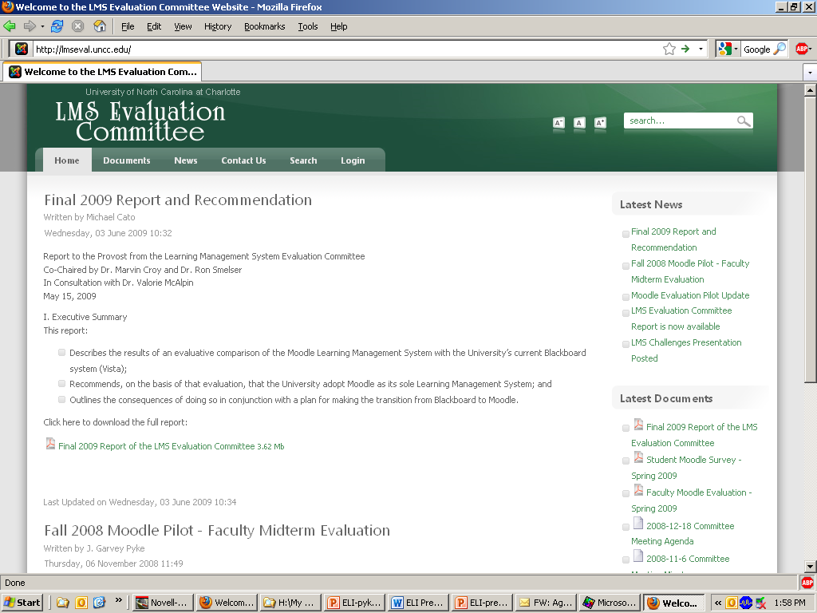

Slide 7
Openness Strategies, Cont.
Communications Plan
LMS website
CTL website
University listservs
Campus News
Faculty Council briefings
Deans Council meetings
College, departmental meetings
Distributed responsibility

Slide 8
Data Collection Strategies
Faculty Survey
Satisfaction with BB [58%]
Willingness to Change LMS [65%]
Tools & Practices*
Student Survey
Satisfaction with BB [44%]
Cited access issues, value of BB
Evaluation Rubric*
Categories
Weighted
Instructional and technical

Slide 9
Data Collection, Cont.
Total Cost of Ownership Comparisons
BB external hosting, licensing, plus internal staff
Other LMS scenarios [internal/external hosting, et al.] plus internal staff
Demo/Test LMS
Moodle
Sakai
Blackboard
Angel
D2L
Timeline reminder:
6 months to get to a pilot recommendation; next 12 months spent on pilot

Slide 10
Pilot Process
Two Stage Pilot
Fall: 12 Faculty, 23 courses, 850 students
Spring: 40 faculty, 93 courses, 3000 students
Data Collection – Rubric Based
Surveys: faculty, students
Ease of use, training needs, reliability, usefulness
80+% preferred Moodle in both groups
Focus groups: faculty, students
Communications Plan Continued
Final Report & Recommendation

Slide 11
Two-Year Migration
Dual LMS Support
Training Strategies
Online and F2F
Moodle Success Was Immediate
1st semester adoption exceeded BB: 650 faculty, 800 courses, 18000 students
Fall 2010: 1000 faculty, 1900 courses, 22000 students
Moodle Enhancement Process
Continued openness
Enhancement request forum
Faculty Moodle Enhancement Committee
Communications/marketing plan

Slide 12
Final Considerations
Culture & Context
Large core of active faculty who take shared governance seriously
Central IT involvement
Desire for openness
Take Your Time
Collect Data
Continue the Collaborative Process Post-Implementation
“Greater Openness Leads to Greater Adoption”

Slide 13
More Info
http://lmseval.uncc.edu
http://teaching.uncc.edu

