Slide 1
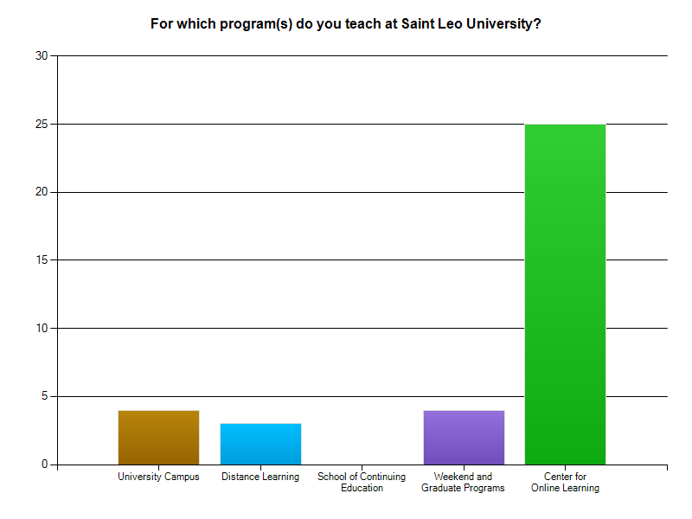
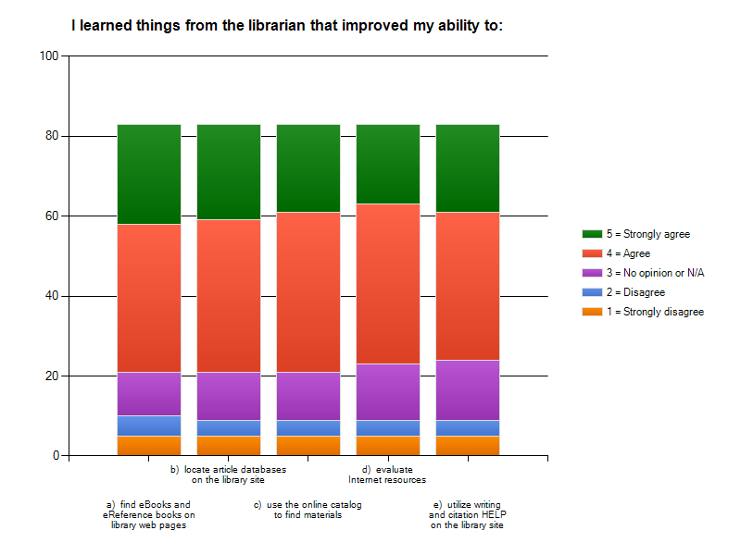
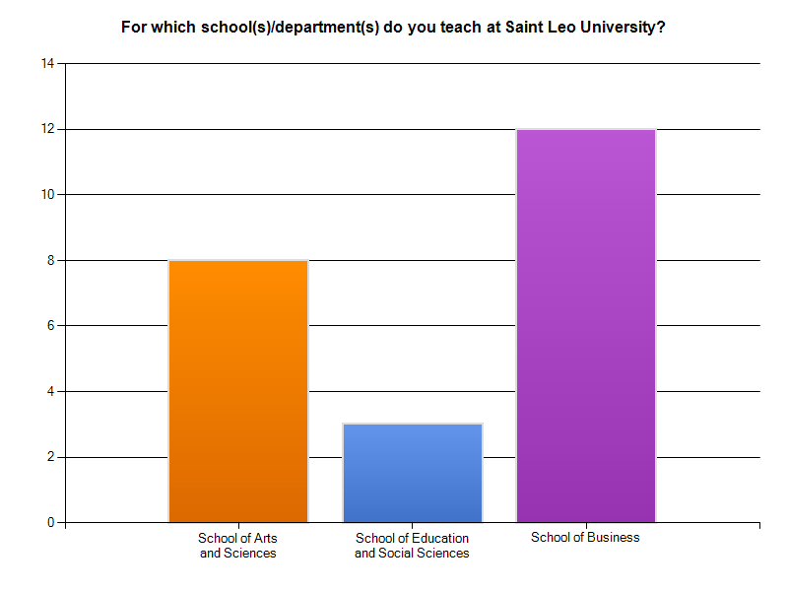
There will be a fold here
There will be a fold here
Who Let the Librarians In? Strategies for Expanding Online Library Services in a Course Management System
Sandra Lee Hawes, Digital Resources Librarian, Saint Leo University, Florida
OPTIONAL LOGO HERE
OPTIONAL LOGO HERE
Playing to Win: Embedding in a CMS
2. In the Dugout—Developing the Proposal
4. The Sweet Spot—Agreeing on a Pilot Project
6. Back in the Locker Room—Post Game Analysis
The poster presents one academic librarian’s experience as an embedded librarian in multiple online courses over a five-year period. Instructional services were provided in an eCollege course management system (CMS) by chat, email, and electronic bulletin board.
In SY2009-2010, an ElluminateLive! virtual training room was added, in which 113 sessions were delivered to 180 classes.
Faculty surveys and student evaluations were developed and delivered using SurveyMonkey.
Develop relationships with administrators and faculty for whom your project is intended; understand their students’ needs
Bring up ideas informally at lunch, during graduation ceremonies, or in faculty meetings with members of your audience or colleagues who influence their opinions
Mention your ideas in your promotion and tenure portfolios so that both administrators and faculty will think about them positively
Describe your readiness to use new technology and skills for the project in your professional development narrative and annual report
Look for a win-win outcome that meets stakeholder needs
Agree on a time period to implement the new service
Agree on a timeframe to run the pilot project, perhaps six months
Agree on the type and number of courses to receive the service during the pilot phase
Establish how you will update stakeholders on your project (email, formal report, meeting) and keep them updated
Establish a general outline of what the new services will provide
Develop assessment tools and begin using them with students
Analyze any data you have collected from faculty or students
Prepare a follow-up report to administrative stakeholders
Continue reading the professional literature to compare with your outcomes; adjust course accordingly
Figure out where you want to go next with the project
Ask for another meeting; return to step 1 and renegotiate
Gather and Represent Data to Support the Pilot Project,
Such as Information about Best Days of the Week
and Times of Day to Pilot New Services
Assessment Data from Student Survey of Embedded Librarian Services in eCollege Classroom Using ElluminateLive! for Training Activities
and Librarian QnA Bulletin Board
Example Statistical Summary Indicating Center for Online Learning as Optimum Program for Pilot Project
Sample of Faculty Survey Data
Used to Select Content Courses for the Pilot Project
5. Rounding the Bases—Review and Expand the Pilot
Look for a win-win outcome during the review period; negotiate, compromise, be honest about what is working and what needs to be improved, added, deleted, or changed
Bring statistical summaries and sample work product to the review meeting; anticipate administrative concerns
Know how you want to proceed with the project
Be prepared with an executive summary
Discuss how the project has impacted your other obligations
Determine if the results of the pilot project warrant a re-evaluation of your duties and reallocation of time on other projects
Know what tasks you will need to stop doing in order to continue expanding the new project
Acknowledgements
Special Thanks to Saint Leo University:
Brent Short, Director of Library Services, Cannon Memorial Library
Diane Johnson, Assistant Director of Center for Online Learning Faculty
Claudia Ruiz, Assistant Director of Instructional Technology
Susan Nelson, Instructional Analyst, Center for Online Learning
And ACRL Distance Learning Section, Conference Planning Committee Members, for Contributing to the Annotated Bibliography:
Alice Daughtery, Information Literacy Librarian, Louisiana State University, Baton Rouge, LA
Johanna Tuñón, Director of Distance and Instructional Library Services, Nova Southeastern University, Fort Lauderdale, FL
3. At Bat—Pitching the Proposal
Present the research base behind your proposal
Provide evidence of your ability to perform the new service
Know what you can realistically provide
Work out in advance how you will reorganize your time to be able to provide the service
Research what the cost will be of any technology you need
Have alternate options for the proposed technology
Find out what funds might be available to cover it, such as strategic initiatives
1. Batting Practice—Preparing for the Game
Read the professional literature
Save articles that describe the proposed service
Attend professional conferences
Gather information from sessions and meetings about the proposed service and technology to implement it
Take online webinars to develop knowledge of how to use the intended technology
Contact Information
Sandra Lee Hawes, MA(LIS), MEd Digital Resources Librarian, Associate Professor Saint Leo University
Cannon Memorial Library MC2128, POB 6665 St. Leo, FL 33574-6665 | T: 352.588.8262 F: 352.588.8484 E: sandra.hawes@saintleo.edu
There will be a fold here
There will be a fold here

