Slide 1
Openness to Integrating Technology: Assessing Faculty and Student Perceptions and Attitudes
Valerie J. Robnolt, Suzanne Mazzeo, Britt Watwood,
Ibironke Lawal, Alma Hassell
Virginia Commonwealth University
Justin Lincoln
Whitman College
ELI 2011 Annual Conference February 16, 2011

Slide 2
Introduction
The current research investigates
faculty and students’ perceptions
of and openness to the skills
necessary for literacy and
learning in the 21st century.
Content
Social
Media
Digital
Skills
21 C Teaching and Learning

Slide 3
Review of the Literature
Several authors have described a “digital disconnect” between faculty and students at the undergraduate level (Levin & Arafeh, 2002; Reardon et al., under review).
Previous work in this area has examined faculty and students’ use of digital media, and preferences regarding the integration of digital technology into undergraduate coursework (e.g., Reardon et al., under review).

Slide 4
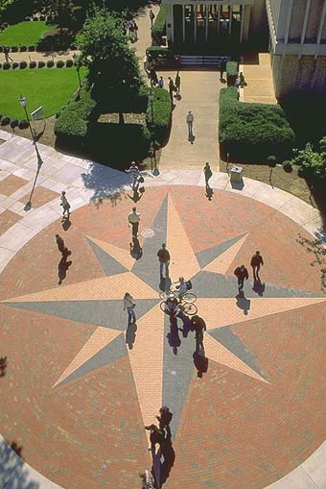
Methodology - Participants
Faculty from the College of Humanities and Sciences and School of Education (n=83)
Arts and Humanities (n=25)
Social Sciences (n=17)
Natural Sciences (n=14)
Education (n=10)
Other (n=2)
Not Answered (n=15)
Students enrolled in PSYC 101 and EDUS/PSYC 301 (n=677)

Slide 5
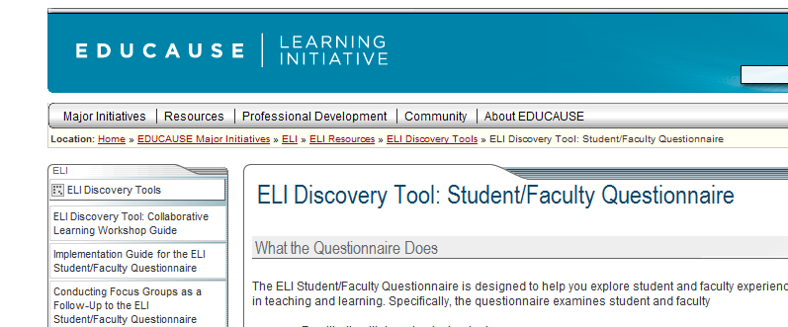
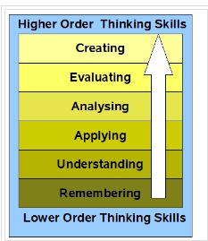
Survey Development

Slide 6
Participant Recruitment
Faculty were recruited via an invitation email and their survey was administered through Inquisite.
Students were recruited from undergraduate Psychology and Education courses and completed the survey through SONA, an online survey program, as an extra-credit option.

Slide 7
Research Questions
What are faculty and students’ use of digital media for personal and educational work?
What are faculty and students’ expectations of digital media for educational use?
What are faculty and students’ perceptions of the importance of various digital skills to 21st century literacy?

Slide 8
Key Findings
When asked about text messaging, 52.1% of the students reported text messaging several times a day while only 15.1% of the faculty reported text messaging several times a day.

Slide 9
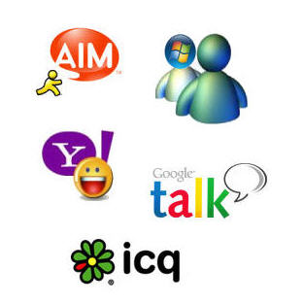
Key Findings
66.27% of the faculty reported never using instant messaging while 27.9% of the students never use it.

Slide 10
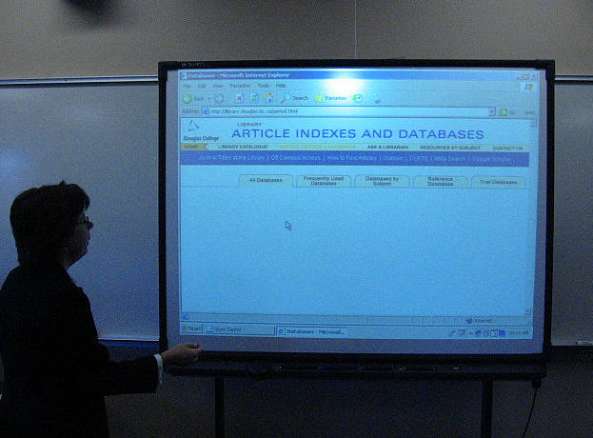
Key Findings
Nearly one third (30.1%) of faculty thought students definitely expected them to use the Internet in class; however, 19.2% of the students reported that they definitely expected faculty to use it.

Slide 11
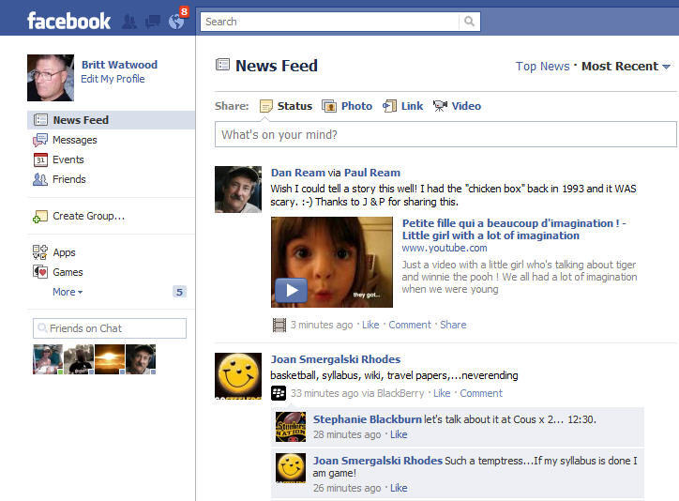
Social Networking
On the survey, 72.1% of students don’t expect faculty to use social networking sites and 78.1% of faculty say their students don’t expect them to use those sites.
When students were asked an open-ended question about what technology they didn’t want used in class, social networks, such as Facebook, were the most frequently cited answer.
Faculty overwhelmingly shared that they didn’t think students wanted them to use Facebook.

Slide 12
PowerPoint
STUDENTS
FACULTY
In the open-ended response, only 3 students mentioned PowerPoint as a technology they don’t want to see used; on the other hand, more faculty seem to think that students don’t want PowerPoint used.

Slide 13
Searching for Information on Web
Students
Faculty
When asked what are the most important skills to learning in today’s environment, overwhelmingly faculty said that searching for information (e.g., Googling) was a necessary skill.
One faculty said that students should, “[Search] journal databases like Medline and NOT using Google as a substitute.”

Slide 14
Validating Information on the Web
Students
Faculty
When asked what are the most important skills to learning in today’s environment, faculty overwhelmingly said that validating authenticity of information on the Web was a necessary skill.

Slide 15
Point of Discussion…
One faculty member said, “They (the students) are driven by technology – I’m sure they would prefer me to make my lectures like a video game.”

Slide 16
Questions Raised by Research…
What is the role of PowerPoint?
Is there a role for social networking in instruction?
Whose job is it to teach online searching strategies and how to validate authenticity of information on websites?

Slide 17
THANK YOU
vjrobnolt@vcu.edu
semazzeo@vcu.edu
bwatwood@vcu.edu
ahassell@vcu.edu
ilawal@vcu.edu

