Slide 1
Teaching & Learning Design Lenses for the
Sakai Open Academic Environment
David Goodrum
Lynn Ward

Slide 2
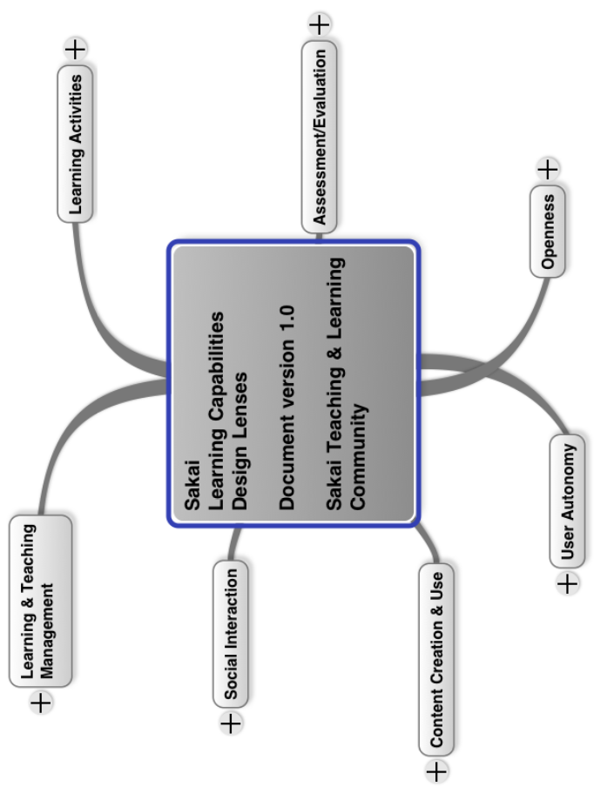


Sakai Teaching & Learning Community
30+ people @ 25+ institutions
3 active working groups:

Slide 3
Learning Capabilities Design lenses
Project Background
Initial activity focused on defining simple learning capabilities
  Diverse effort generated 160+ rows in Google
  Decided that categorizing these was next step
Notes:
Handout here

Slide 4
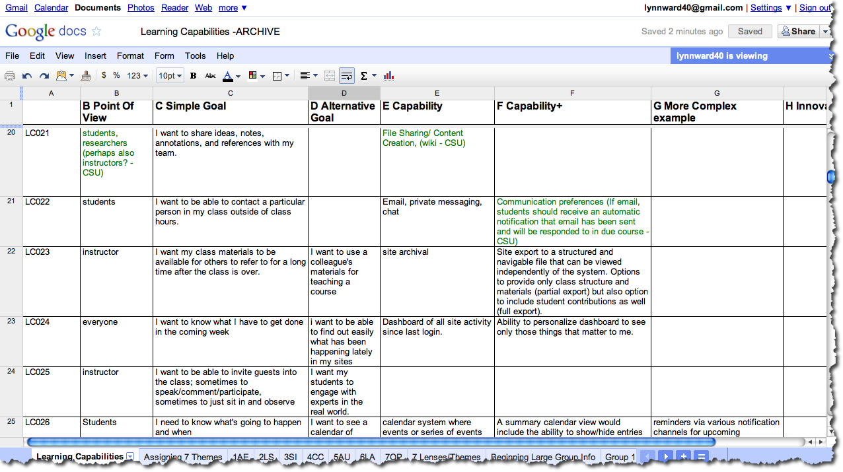
The raw data

Slide 5
Example of LC spreadsheet item
Reference #
LC015
Point of View
instructor
Simple Goal
I want to have a class discussion about a particular topic.
Alternative Expression of Goal
I want students to lead a discussion on a particular topic.
Basic Capability Needed
Threaded discussion

Slide 6
Example of LC spreadsheet item
Advanced Capabilities
Ability to move posts or threads to a new or different discussion.
Ability to privately respond to a post. Ability to grade/rate a post.
Ability to see all posts by an individual across multiple discussion topics.
Ability to search for keywords to pull up related posts.
Ability to have students see the contributions of others after they make their own.
Ability to tag posts to particular topics…
More Complex example
Google Wave-like capability mix of discussion, messaging, instant messaging, etc.
Innovations
Text contributions could also be listened to. Spoken contributions could be also seen as text.

Slide 7
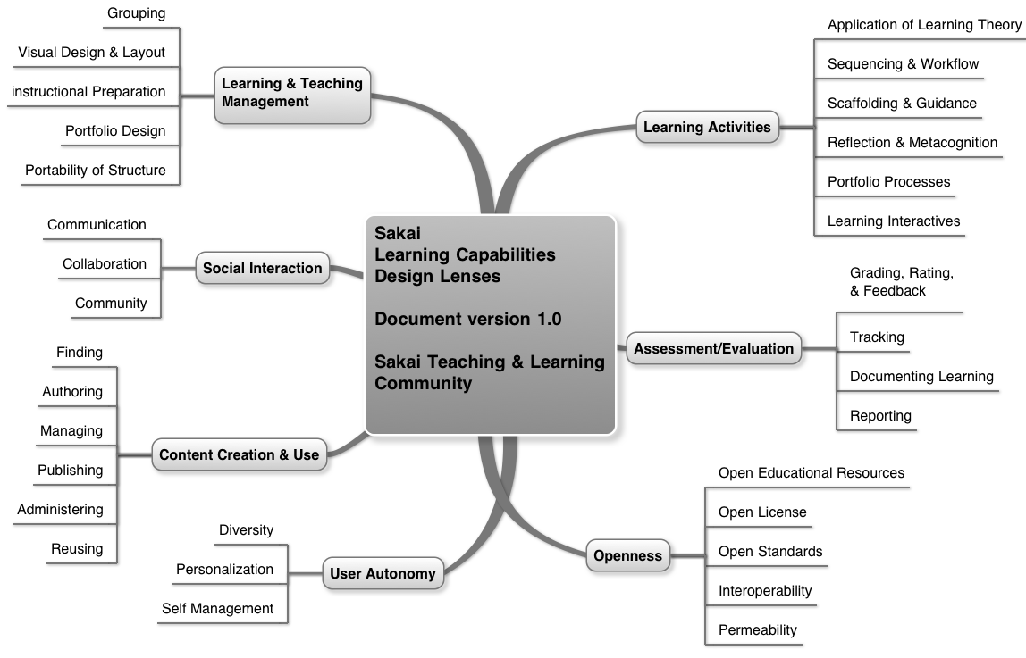
Lenses and FACETS

Slide 8
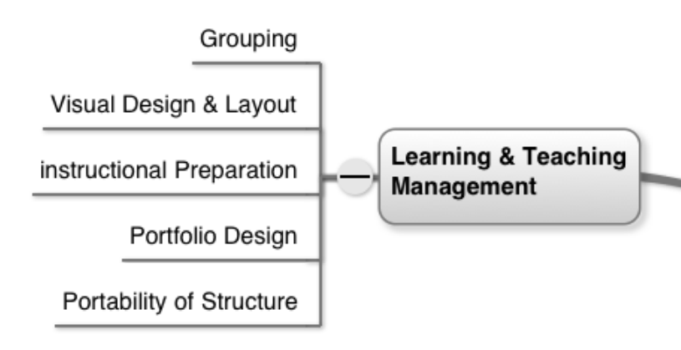
Learning & Teaching Management
The logistical and configuration work required to design and manage a teaching and learning environment as means to set the stage for Learning Activities and to match learning spaces to underlying pedagogical models.

Slide 9
Simple Goal Examples
Preparation | Delivery
I want to organize my course materials and activities in a way that reflects the organizational structure of my course | I want to learn my student's names, and be able to match them to faces.
I want to choose the tools I want, and have the flexibility to turn them off and save data later on. | I need to be able to coordinate a large course with many instructors and sub-sections, and a very large number of students.
I want a one-stop-shop for coordinating groups, group behavior, group work | I want to be able to remove users from tools if they have been rude or defamatory
I want to easily be able to take all of my teaching materials with me when I go to another institution using Sakai. | I want to know what I have to get done in the coming week

Slide 10
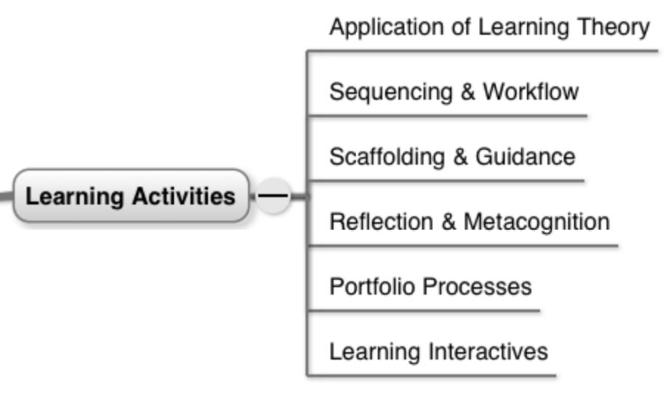
Learning Activities
The assembly and synthesis of content, guidance, interaction, and assessment tasks into cohesive learning experiences, for individuals or groups of learners, as means to meet specific learning outcomes. Ideally, this work is based on established learning theory and/or design methodology.

Slide 11
Simple Goal Examples
I want my students to be thinking and doing, not just listening to me talk or reading what I write. | After responding with some feedback, I want to ask that an improved draft of the work be submitted again.
I want to encourage and at times require students to reflect on the task I have them doing. | I want to stage the release of new tasks, conditional on completion of other tasks
I want to my students to see and understand the linkages between the learning objectives, learning activities, and learning assessments in my course | I want my students to do some peer teaching.
I want my students to create a graphic representation of concepts. | I want to have a class discussion about a particular topic

Slide 12
The lenses Revealed
Early examples in Sakai OAE

Slide 13
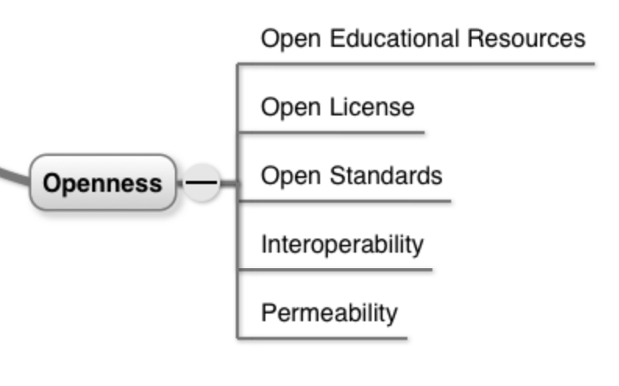
Openness
A philosophy (with supporting practices, licensing models, and technology standards) that embraces the free use and distribution of creative works, data, information, and software without legal, technological or social restriction.
Adapted from the
Open Knowledge Foundation.

Slide 14
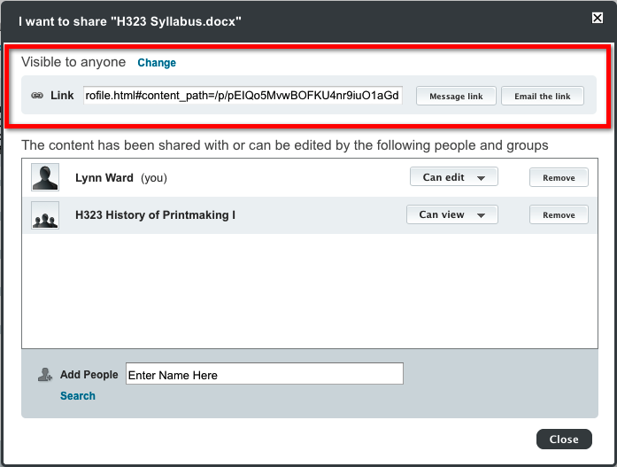
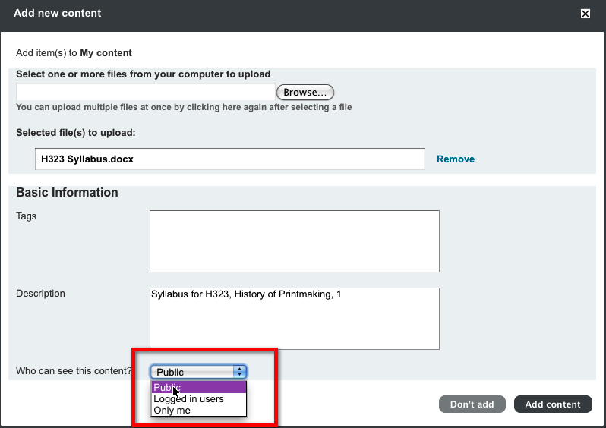
Open Publishing

Slide 15
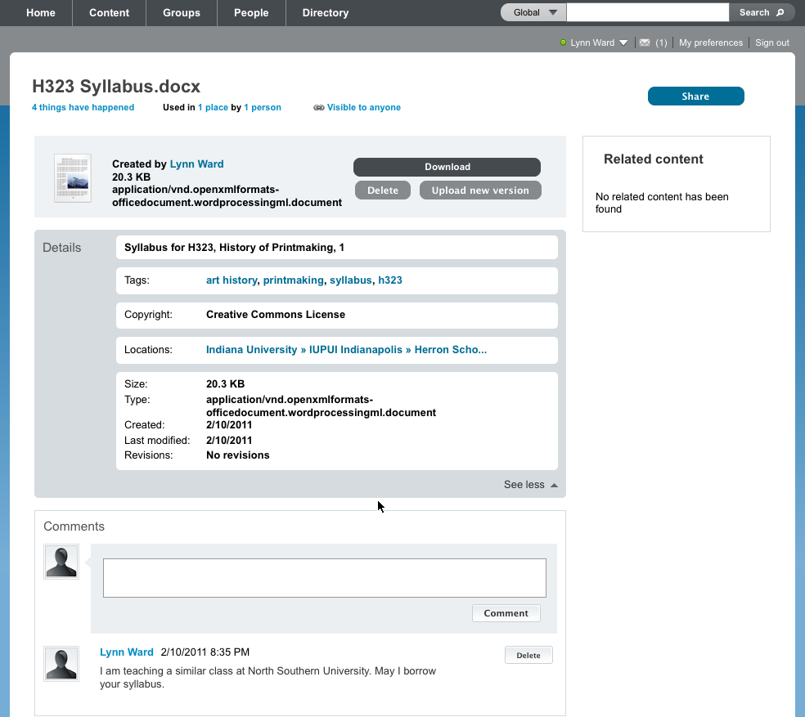
assessment and evaluation: tracking
openness:
open educational resources
content creation and use: managing
content creation and use: managing
Content creation and use: publishing
openness:
open licensing
content creation and use: managing
social interaction:
communication

Slide 16
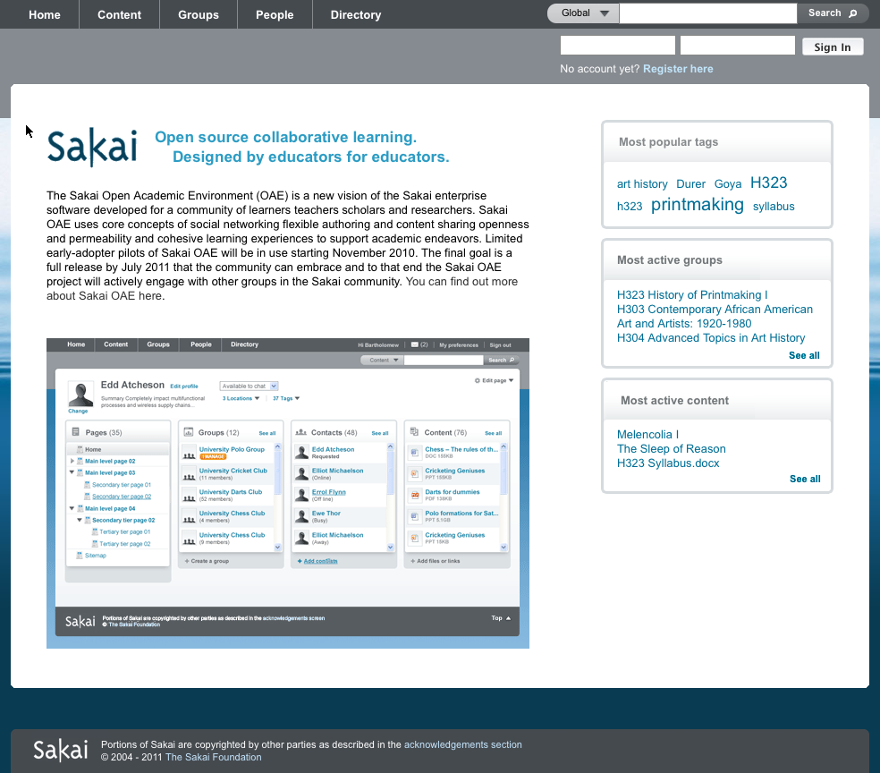
Robust Public Experience
Multiple methods of searching and browsing
Multiple methods of searching and browsing
Home page widgets highlight interesting content and groups

Slide 17

Browsable Public directory

Slide 18
Goal: support Open Standards
Basic Learning Tool Interoperability (LTI)
IMS Common Cartridge (CC)
IMS Learning Information Services (LIS)
OpenSocial
SCORM
Etc.

Slide 19
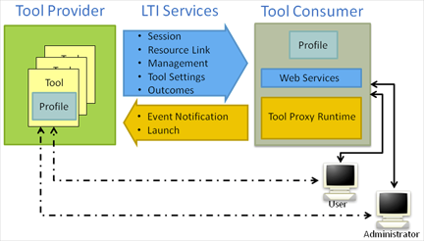
Basic LTI
Seamless integration of external tools
Supports teaching & learning innovation
Foundation of migration
strategy for Sakai 2.x
institutions
Sakai 2/OAE hybrid mode
IMS Global Learning Consortium
Learning Tools Interoperability v1.0 Project Group

Slide 20
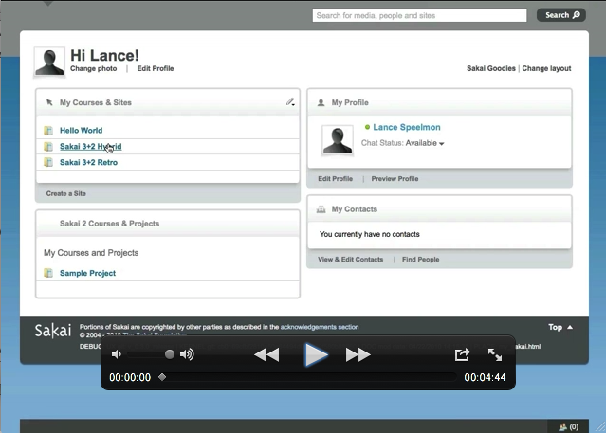
Basic LTI Demo
http://vimeo.com/12618381

Slide 21
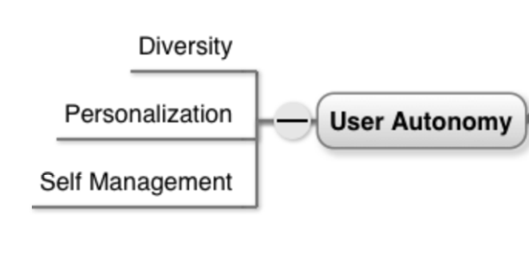
User Autonomy
Autonomy encourages diverse users to own their virtual identity by ensuring their ability to set preferences, make choices, determine how their data is used, and direct their own learning.

Slide 22
User Autonomy: Early Examples
Every user can:
  Manage personal profile
  Create and share personal pages
  Create and manage collaborative group spaces and pages
  Create and customize personal and group dashboards
  Create and share a personal portfolio

Slide 23
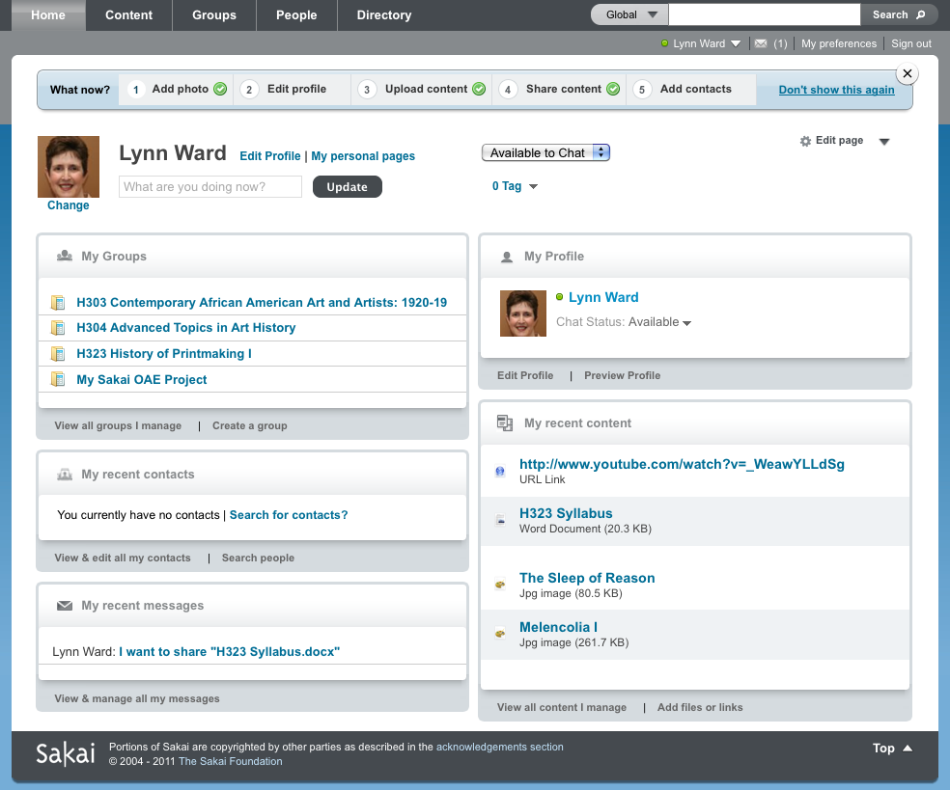
Live Demo

Slide 24
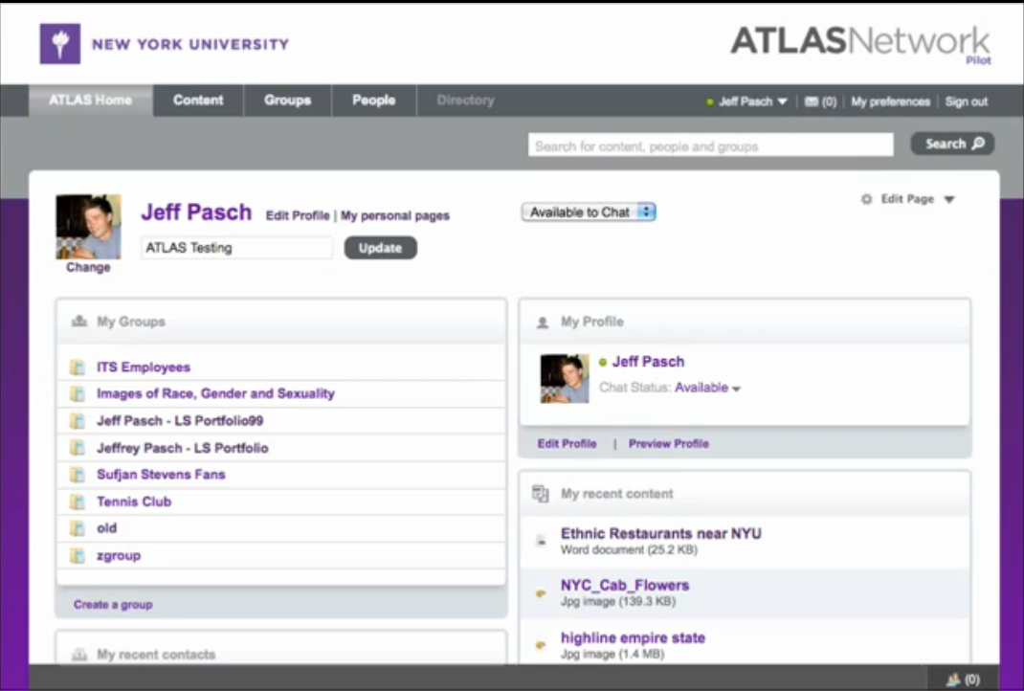
NYU Portfolio Demo
http://www.youtube.com/watch?v=_WeawYLLdSg

Slide 25
Sakai Open Academic Environment Project Timeline
June 2010:
  Steering Group established
  Sakai 3 Roadmap
  Managed project (Cambridge, Georgia Tech, NYU, Indiana University, Charles Sturt, Berkeley, Sakai Foundation staff)
November 2010:
  Version 0.1 released
  Code name “Sakai OAE” adopted
  June 2011:
    Version 1.0

Slide 26
Questions
David Goodrum, goodrum@indiana.edu
Lynn Ward, leward@iupui.edu

Slide 27
Sakai
Open Academic Environment
More Information

Slide 28
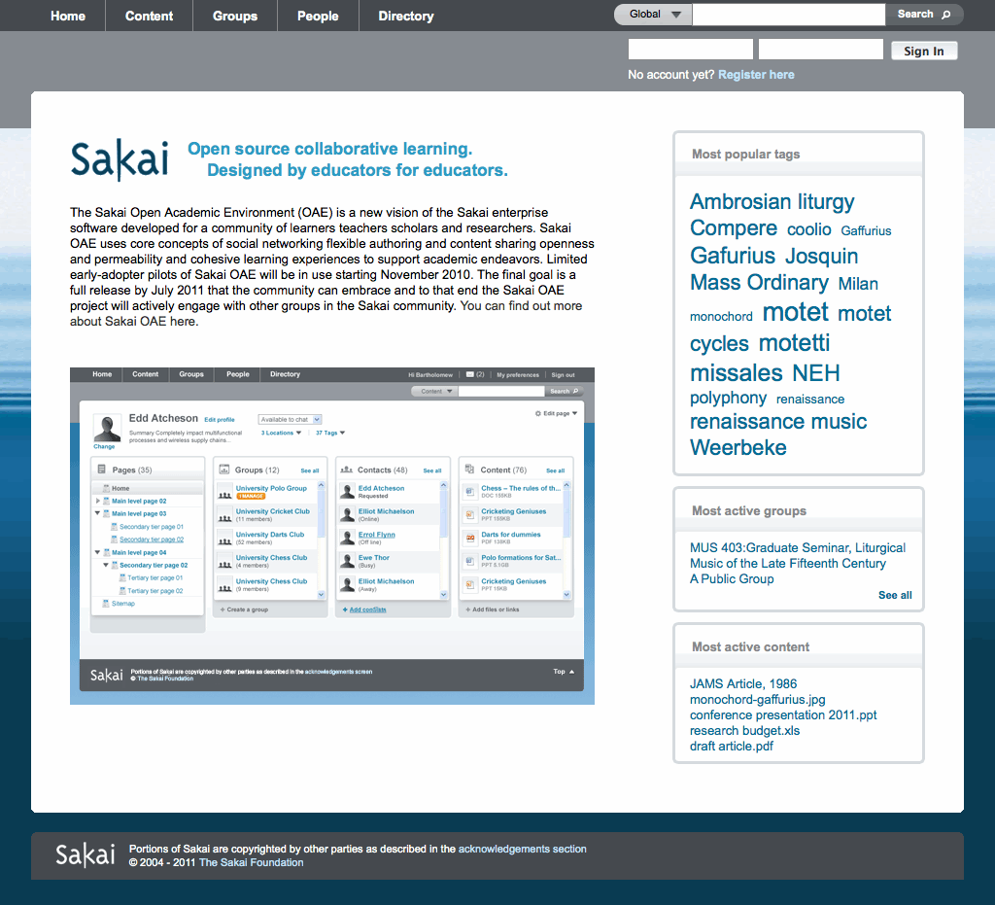
WHAT IS SAKAI OAE?

Slide 29
Permeable access to the world of learning and research
PERMEABLE
Collect and curate resources from within and outside Sakai
Connect experts within and outside the institution
Pushes Sakai out to other platforms, and brings other platforms into Sakai
Supports open teaching practices
http://sakaiproject.org/oae-permeable

Slide 30
knowledge connections for academic growth
SOCIAL
Creates a network of people able to answer questions and provide feedback
Leverages networking while maintaining full privacy and security
Connects shared interests with scholarly pursuits
Fosters connections between groups of students, teachers, and researchers
http://sakaiproject.org/oae-social

Slide 31
Personal control of your academic Environment
PERSONAL
Add comments to everything, everywhere
Grade everything, everywhere
Create your own environment and vantage point with customizable dashboards and feeds
Make your own connections and collections
Share anything with anyone or everyone
http://sakaiproject.org/oae-personal

Slide 32
Remixable content and connections on an open canvas
REMIXABLE
Author your own learning experiences
Create pages from a blank canvas or from tailor pre-made templates
Store, re-use, revise, and share your work
Create mash-ups of functionality, content, connections, and media from within Sakai and on the web
http://sakaiproject.org/oae-remixable

