Slide 1
Into the Light Using Data Mining to Reveal Online Programs
Thomas Cavanagh, Ph.D. -- Assistant Vice President, Distributed Learning
Andre Watts – IT Manager, Center for Distributed Learning (contributing author)
University of Central Florida

Slide 2
About UCF
University of Central Florida
Orlando, FL
Metropolitan university
56,100 students
2nd largest university in U.S.
216 degree programs across 12 colleges
11 Regional Campuses
Carnegie: “Very High Research Activity”
Notes:
All

Slide 3
Online@UCF
50% of all students take at least one online course each year (Web-based/Blended)
Web/Blended: 19% SCH
With Video lecture capture: 26.6% SCH
GEP online for most majors
Strategic part of UCF’s growth plan
Notes:
Tom

Slide 4
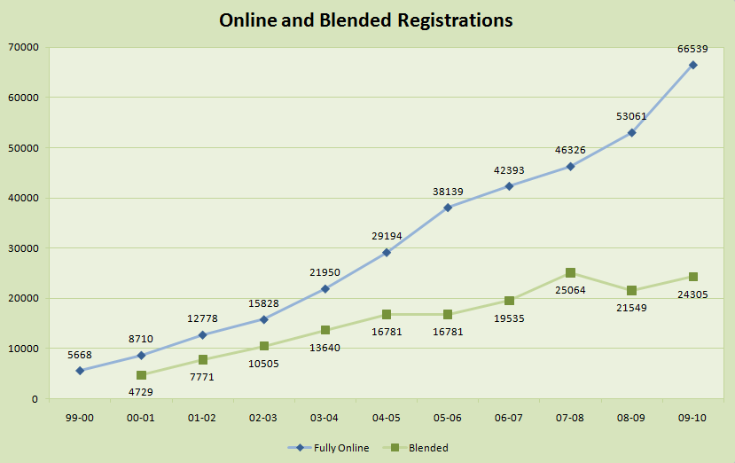
University of Central Florida
Combined (W & M) = 19% of SCH
Notes:
Tom

Slide 7
Total UCF Fall 2008 Headcount
“Live” Main Campus Students
43,466
“Live” Rosen Campus Students
2,446
1,301
2.6%
865
1.7%
137
0.3%
111
0.2%
33,087
65.8%
Web Students
11,514
7,127
14.2%
2,847
5.7%
363
0.7%
923
1.8%
1,436
2.9%
2,046
4.1%
“Live” Regional Students
4,800

Slide 8
Total UCF Fall 2009 Headcount
“Live” Main Campus Students
45,988
“Live” Rosen Campus Students
2,531
827
1.6%
782
1.5%
697
1.3%
204
0.4%
33,988
63.5%
Web Students
14,543
8,593
16.1%
3,637
6.8%
375
0.7%
1,030
1.9%
1,497
2.8%
“Live” Regional Students
4,809
1,886
3.6%

Slide 9
Total UCF Fall 2010 Headcount
“Live” Main Campus Students
47,926
“Live” Rosen Campus Students
2,472
758
1.4%
695
1.2%
764
1.4%
234
0.4%
34,059
60.6%
Web Students
17,172
10,363
18.4%
4,113
7.3%
478
0.9%
1,213
2.1%
1,490
2.7%
“Live” Regional Students
5,251
2,049
3.6%

Slide 10
Built for Scale
Centralized support, required faculty development
Decentralized delivery
Policy, Planning, Standards, Credentialing, Reporting
Faculty Development
Course Design
Course Production
Assessment
Technical Support

Slide 11
Accreditation Requirements
Southern Association of Colleges and Schools
Faculty support services are appropriate and specifically related to distance education.
Faculty who teach in distance education programs and courses receive appropriate training.
Notes:
Tom

Slide 12
Required Faculty Development
Web Essentials | IDV Essentials | ADL5000 | IDL6543
Required to teach “Web-enhanced” Face-to-face | Required to teach lecture-capture/ video streaming course | Required to teach existing online/blended course | Required to design and teach original online/blended course
Technology Focus | Design and Delivery Focus | Pedagogy, Logistics, Technology Focus | Deeper Design, Delivery, and Teaching Focus
5 hrs | 8 hrs | 35 hrs | 80 hrs
Ad hoc training, open labs, JIT Resources, and advanced topics sessions

Slide 13
Accreditation Requirements
Southern Association of Colleges and Schools
Substantive Change requirements
25%-49% online: letter of notification
>50% online: written notification 6 months in advance and approval of a prospectus
Notes:
Tom

Slide 14
Florida Board of Governors
Annual reporting:
Programs offered completely online
Programs where majority of courses are online

Slide 15
Online@UCF
Web-based
4 undergraduate degree completion programs
12 graduate degree programs
15 Web-based graduate certificate programs
Video-based (lecture capture)
9 Video-based Engineering graduate degree programs
10 Video-based graduate certificate programs
50 Total “official” programs
Notes:
Tom

Slide 16
“Shadow” Programs
Programs completely (or mostly) online but not declared as “official” in online program guide
Result of centralized faculty training/support and decentralized delivery
Examples
Political Science (2 tracks)
Engineering

Slide 17
Reporting Challenge
Both SACS and BOG relied on departmental self-reporting
Needed a programmatic solution
Improved responsiveness
Increased data reliability
Leverage existing toolsets

Slide 18
EIS Overview
Executive Information System
Faculty development scheduling
Historical faculty teaching records
Course schedule data
Productivity data
By college
By campus
By modality
Student demographics

Slide 19
Executive Information System (EIS) – What is it?
A small scale (300 MB) data silo used to track and report on UCF’s distance learning initiatives and support other internal CDL business processes.
Web based system driven by PHP w/ MySQL database backend
Spans data from 1996 – Present
1st version rolled out early 2003
Custom built – started as a skunk-works project
Constantly evolving

Slide 20
EIS – Who Uses It?
Direct Access
Upper level stakeholders (In/Out of Unit)
CDL Unit Staff
College contacts for faculty development
Indirect Access
Students (online course search) http://learn.ucf.edu/
Public charts and graphs http://dl.ucf.edu

Slide 21
EIS – Why Was It Built?
Provide Upper Level Management close to real time metrics on distance learning
No University data warehouse at the time
Speed up the processing of University and State reporting requirements
Better track faculty development
Cause us to ask more questions and dig for more answers

Slide 22
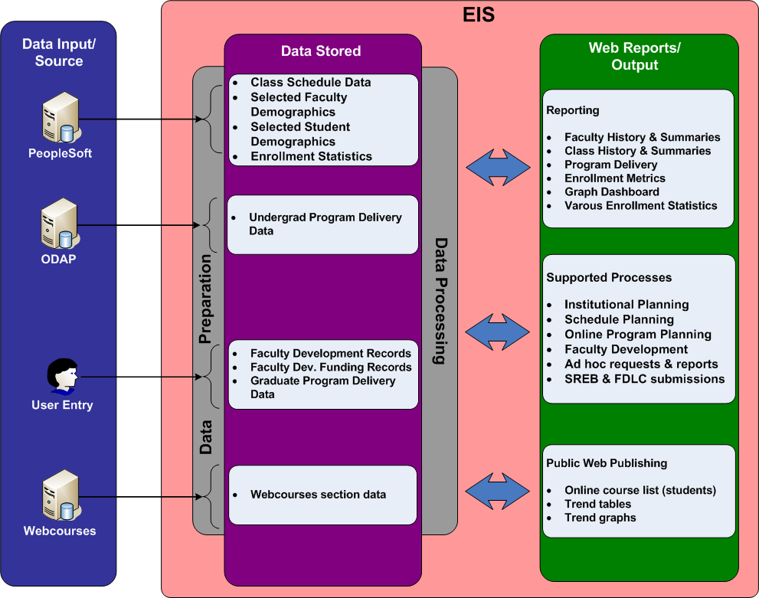
EIS – Data Flow

Slide 23
Program Sequencing Project
Goals:
Identify programs’ percentages online
Not simply an aggregate total
Not “Total Online Credits / Total Program Credits”
Key was to identify a “critical path” through a degree program
Use existing data
Online Degree Approval Process (ODAP)
Database for paperless catalog

Slide 24
Program Sequencing Project
Focus on courses in the major
Exclude thesis, dissertation, internship
Reports:
GEP
Core
Restricted Electives
Unrestricted Electives

Slide 25
Demonstration
Demo of EIS data

Slide 26
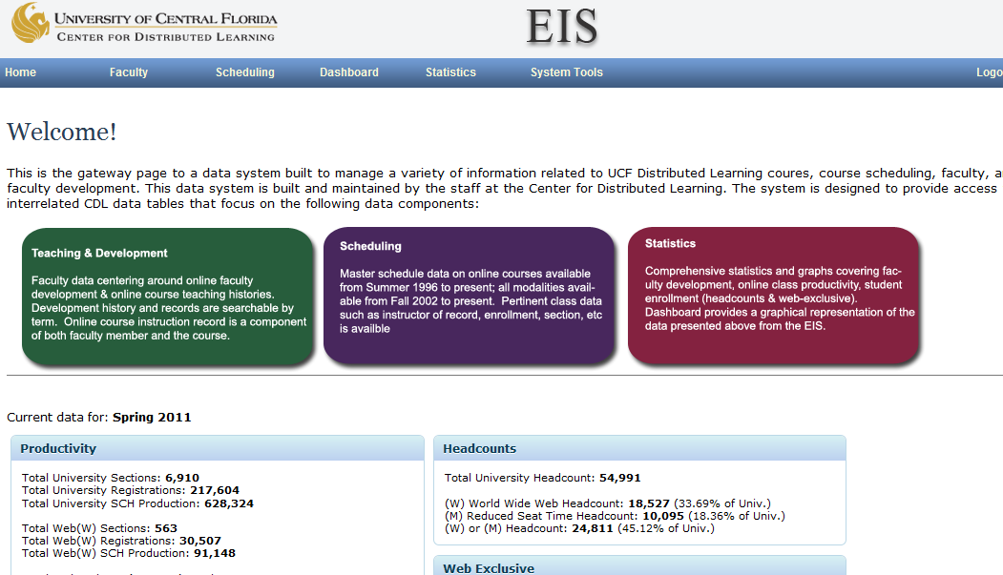

Slide 27
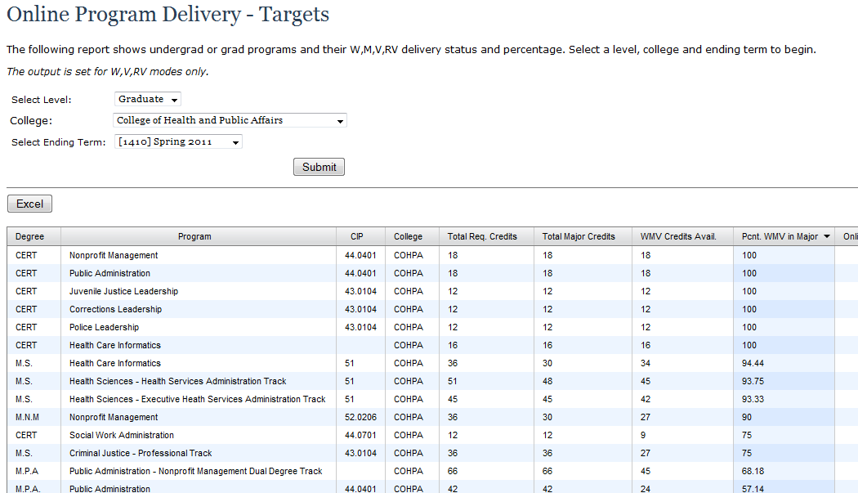

Slide 28
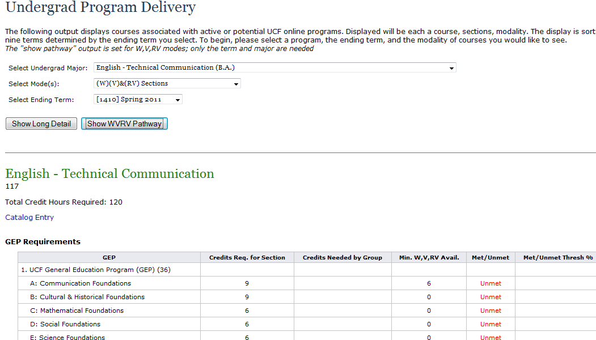

Slide 29
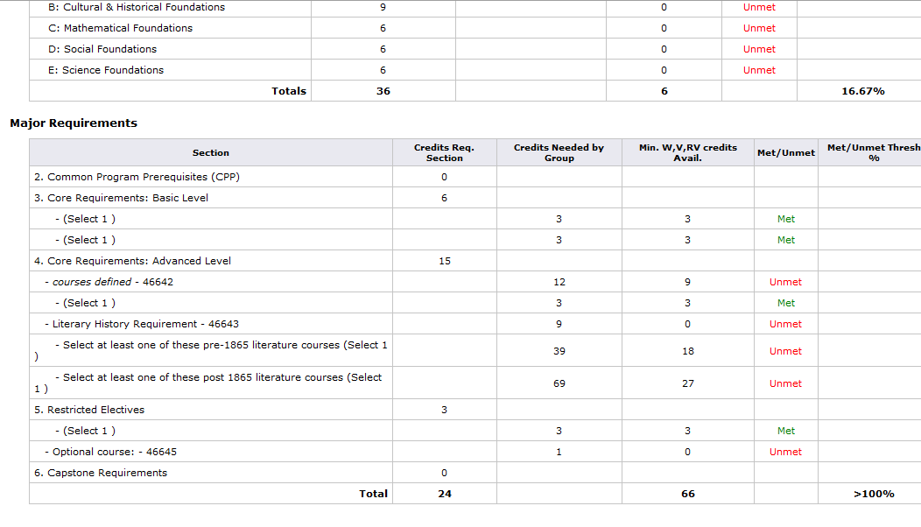

Slide 30
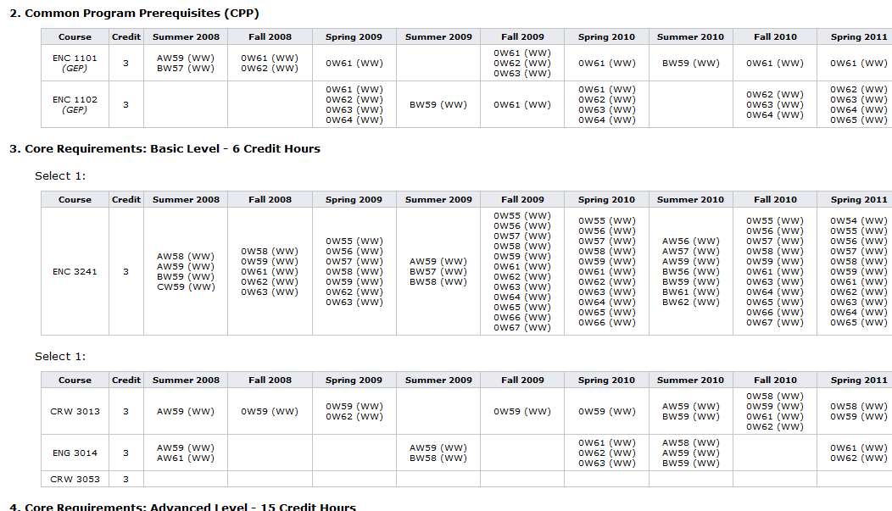

Slide 31
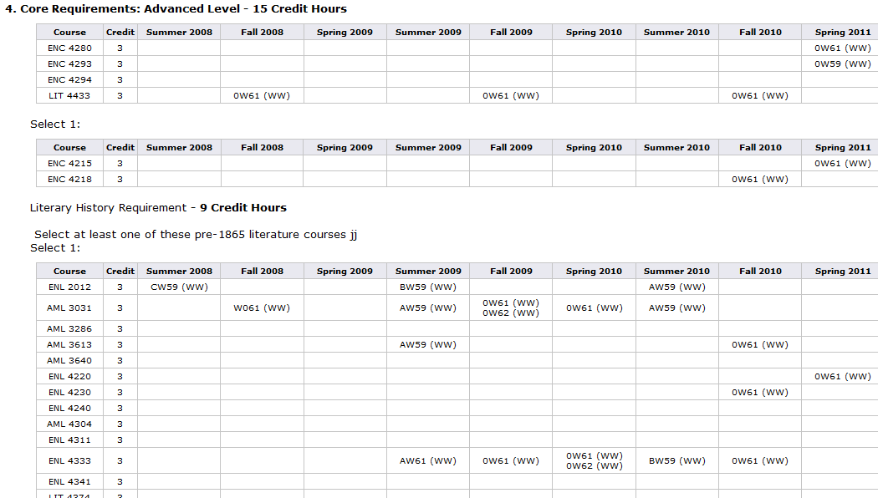

Slide 32
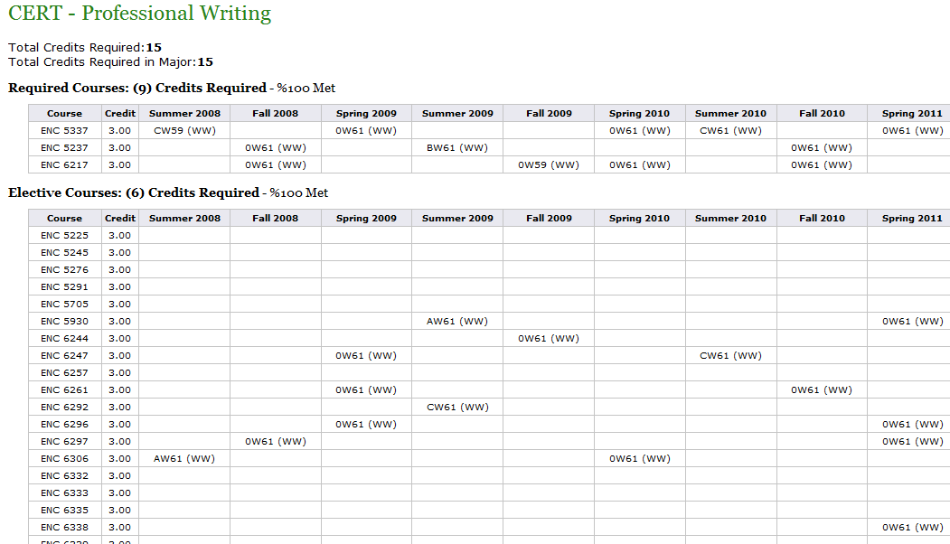

Slide 33
Results: Engineering
9 Graduate Degrees
9 Graduate Certificates

Slide 34
Results: Political Science
Two tracks in the major are online
RC Partnership

Slide 35
Example Reports
Internal Assessment
College of Health and Public Affairs
College of Engineering and Computer Science
College of Nursing
BOG

Slide 36
Ongoing Challenges
Incomplete UG data definitions (History)
Difficulty of Choose 2 from A, 3 from B
And/Or choices
Inclusion of GEP
Minors not included
Graduate programs still manual process (degrees/certificates)

Slide 37
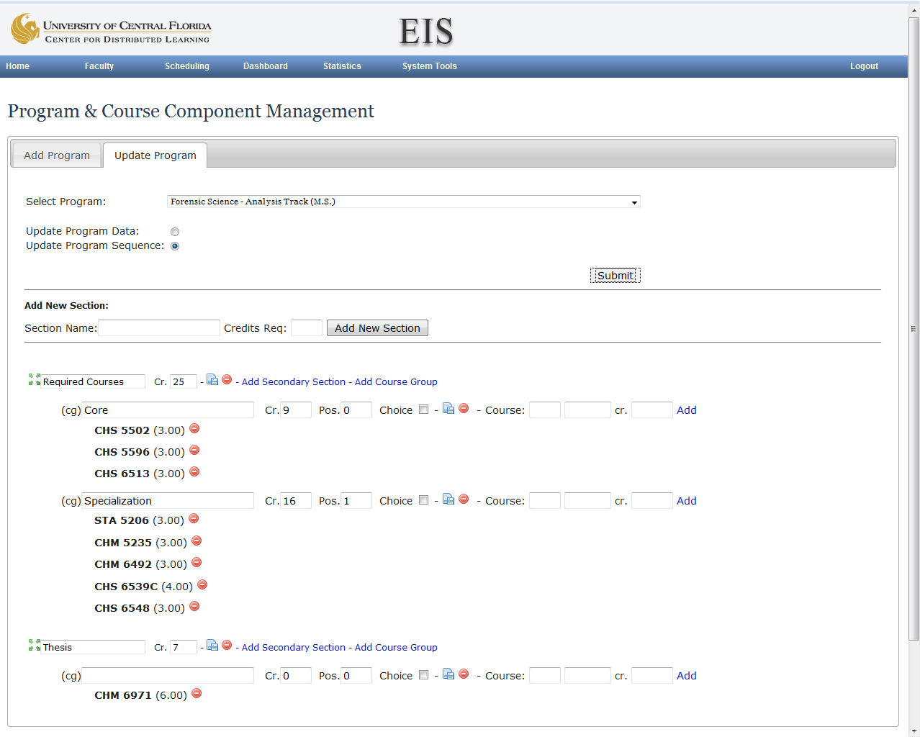

Slide 38
EIS – Lessons Learned
Upper level management buy-in = MUST HAVE
Knowing what you want to answer is critical
Integration with other systems can take time
Planning and patience
Integrate current reports you have first (easier)
Not every report request needs to have a home in the system
Some reports can stay ad-hoc

Slide 39
Other EIS Features
Demo of EIS data
Notes:
Tom

Slide 40
Questions / Comments / Feedback
Thomas Cavanagh, Ph.D., Asst. VP, Distributed Learning cavanagh@mail.ucf.edu
Notes:
All

