Slide 1
Copyright Mary Mawn and Ken Charuk 2011. This work is the intellectual property of the authors. Permission is granted for this material to be shared for non-commercial, educational purposes, provided that this copyright statement appears on the reproduced materials and notice is given that the copying is by permission of the authors. To disseminate otherwise or to republish requires written permission from the authors.

Slide 2
Hands-On and Online:
Scientific Experimentation at a Distance
Mary Mawn and Ken Charuk
February 16, 2011
Notes:
Mary

Slide 3
SUNY Empire State College
Founded as a cutting-edge, comprehensive college in 1971
60,000 alumni
11 academic centers of learning, > 30 locations throughout the state
> 19,000 students enrolled per year
  including every county in New York state
  including every state in the United States
  50 countries around the world
2,000 faculty and staff serving primarily adult learners
Mission
  To be innovative and creative, and to offer people throughout the state of New York and beyond the opportunity to study, to learn, and to earn a degree while still being able to work, raise a family and be engaged in their communities.
Notes:
Mary

Slide 4
Science Courses
Science courses often emphasize a large number of concepts, with less emphasis on science processes.
  However, individuals need both an understanding of scientific concepts and the ability to analyze and problem-solve when making informed decisions on public policy and health choices.
Learning outcomes need to not only be content specific, but be socially relevant and reflect the skills that a student needs to become life-long learners.
  As a result, learning objectives related to science literacy and scientific inquiry should be an integral part of course design.
  Hobson, 2001; Lynd-Balta 2006.
4
Notes:
Mary

Slide 5
Laboratory Science
Laboratory experiences are often considered the defining characteristic of science courses.
They provide students with:
  opportunities to extend their learning of scientific concepts;
  develop an understanding of the nature and methods of science;
  stimulate the development of analytical and critical thinking skills; and
  foster an interest in science.
    Hofstein & Mamlok-Naaman, 2007; Ma & Nickerson, 2006; Ottander & Grelsson, 2006; Hofstein & Lunetta, 2004.
Notes:
Mary

Slide 6
Science Online
6
As the number of courses offered through distance learning increase, trends indicate that there is a growing need to:
  develop online science courses that integrate science content and process;
  determine best practices related to the incorporation of labs in online science courses; and,
  assess the impact of such approaches on student learning.
Notes:
Mary

Slide 7
Science and Mathematics Project (SMP)
7
Through grant-funding from the Charitable Leadership Foundation, ESC developed fifteen online science and math courses geared for general education students.
These online courses were specifically designed to:
  address relevant science and math topics in a rigorous way;
  provide students with authentic and relevant learning activities;
  be interactive and media-rich learning environments;
  incorporate the methods and tools of science and math; and,
  promote science and math literacy in adult learners.
Notes:
Ken

Slide 8
SMP Course List
Mathematics | Science | Biology
Math for the Inquiring Mind | Invention by Design | Marine Biology
Math Modeling | The Future of Being Human | Evolution: One Long Argument
Discovering Math Across Generations | Energy: The Issues and the Science | Populations and Diseases
Statistics: An Activity-Based Approach | Global Climate Change | Ethnobotany
Visualizing Math | Contemporary Environmental Issues
 | GPS and the New Geography
8
Notes:
Ken

Slide 9
Different Approaches to Labs
Software purchased or downloaded
  Commercial programs – Disney Roller Coaster
  Free downloads - GIMP
Simulations
  University of Colorado at Boulder – Electrical circuits
  Second Life – NASA CoLab
Lab kit based
  Bookstore supplied - Solar cells, meter and generator
Field Activities
  Community – Cemetery demographics
  Backyard – Minimum viable population
9
Notes:
Ken

Slide 10
Energy: The Issues and the Science
Power Consumption
  Calculate/compare home energy use over time.
Virtual Circuit Construction
  Experiment with the Univ. of Colorado’s Circuit Construction Kit.
Using a Multimeter
  Measure voltage and current using a battery and virtual circuit.
Generating Electricity
  Measure voltage and current; compare parallel & series circuits.
Measuring Current and Resistance
  Measure the current and resistance of a series circuit.
Battery Charger
  Design, test, and optimize a solar battery charger.
10
Notes:
ken

Slide 11
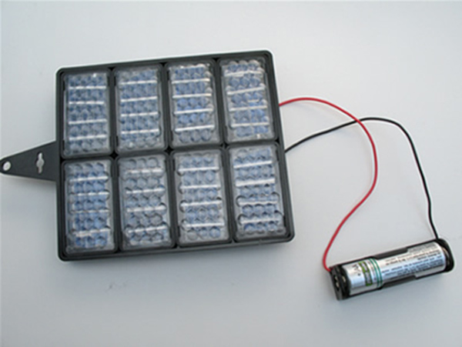
Battery Charger
Students design, test, and optimize a solar battery charger
using photovoltaic cells and a rechargeable battery.
Notes:
Ken

Slide 12
Contemporary Environmental Issues
Designing a Nature Preserve
  Collect data and make predictions about organisms in an area.
Analyzing Winter Bird Data
  Collect and compare data from Project Feederwatch.
Global Renewable Energy Consumption
  Collect and compare data for global energy consumption.
Light Bulb Choices
  Compare incandescent bulbs with compact fluorescent bulbs.
Analyzing Human Population Growth
  Plot U.S. Census data identify potential environmental issues.
Cemetery Demography
  Collect data & link survivorship to environmental variables.
12
Notes:
Ken

Slide 13
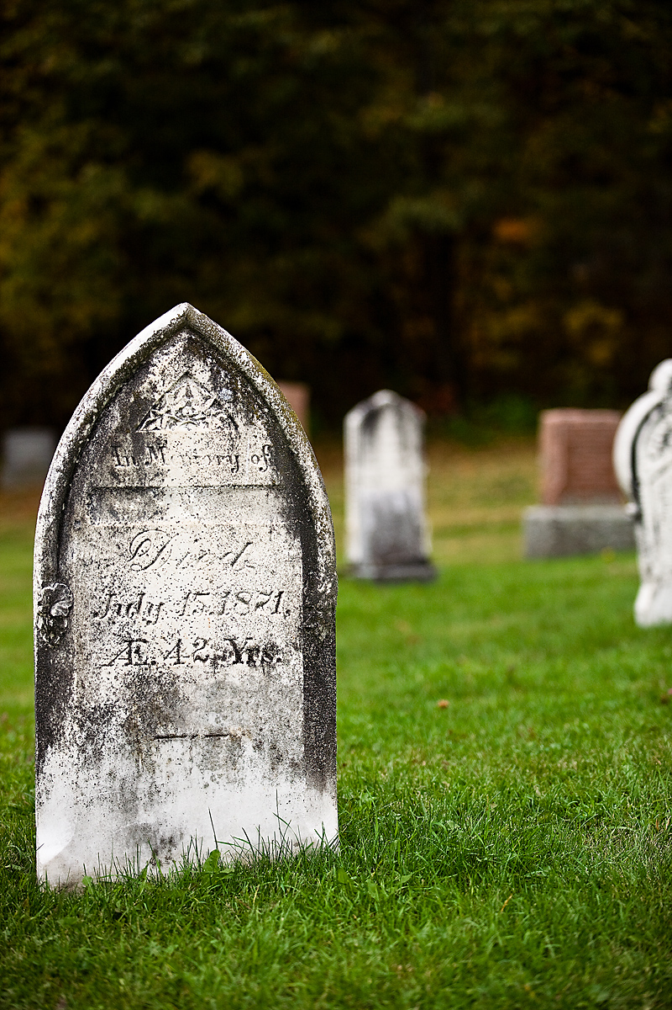
Cemetery Demographics
Students plot data collected from their local cemetery
and make predictions about how survivorship may be linked
to environmental variables.
Notes:
Ken

Slide 14
Invention by Design
Testing Paper Clips
  Predict the number of pages that paperclips can hold.
Lego Racer
  Design a racer that will travel the same distance.
Design a Roller Coaster-Phase 1
  Design a roller coaster model as a base line for comparison.
Design a Roller Coaster-Phase 2
  Test roller coaster designs and model expected ridership.
Roller Coaster-Final
  Model performance and safety under various conditions.
14
Notes:
ken

Slide 15
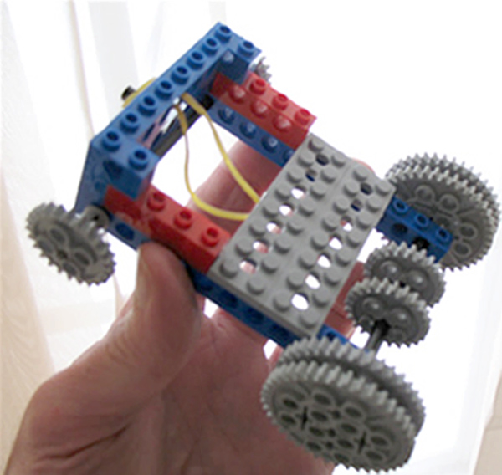
Lego Racer
Students design and build a racer that will travel
the same distance in a series of repeated trials.
Notes:
Ken

Slide 16
Study Question
16
Three labs under study:
  Battery Charger
    Design, test, and optimize a solar battery charger.
  Cemetery Demography
    Collect data and link survivorship to environmental variables.
  Lego Racer
    Design a racer that will travel the same distance.
As students participate in online labs, to what extent do they engage in the processes of science?
Notes:
Mary

Slide 17
Essential Features of Classroom Inquiry
Learner engages in scientifically orientated questions.
Learner gives priority to evidence in responding to questions.
Learner formulates explanations from evidence.
Learner connects explanations to scientific knowledge.
Learner communicates and justifies explanations.
Source: National Research Council. 2002. Inquiry and the National Science Education Standards: A Guide for Teaching and Learning. Washington, D.C.: National Academy Press.
17
Notes:
Mary

Slide 18
Elements of Scientific Inquiry
Engage in an investigation. | Identify variables.
Investigate a testable question. | Formulate explanations.
Make predictions. | Formulate a testable hypothesis.
Make observations. | Extend the investigation.
Collect data. | Communicate with others.
Analyze data. | Make connections to prior learning.
Use qualitative methods. | Make connections to scientific knowledge.
Use quantitative methods. | Demonstrate conceptual understanding.
Notes:
Mary

Slide 19
Study Design
3 online courses between Fall 2007/Spring 2009
64 representative student submissions
Assignment instructions/student work analyzed
  Sixteen key Elements of Scientific Inquiry
Independent coding of instructions/submissions
Presence of inquiry elements noted
  Always observed
  Frequently observed
  Not observed
19
Notes:
Ken

Slide 20
Student Demographics
N = 107
  75% non-science majors
    49% general education requirement
  32% required for major or minor
  45% first or second year
  70% prior online experience
  36 year old average age
Notes:
Mary

Slide 21
21
Notes:
Mary

Slide 22
Findings: What students did…
22
Students engaged in scientifically-orientated questions and conducted investigations.
  They investigated questions posed by the instructor and conducted experiments from their own locations.
  “…the fastest charging time was achieved with a solar panel that connected using entirely series connections. With the series connections, the charging time of the battery was half of the next closest configuration. Therefore, I have concluded that when recharging a battery, the most desirable configuration to use is one comprised of solely series connections.”
Notes:
Ken

Slide 23
Findings: What students did…
23
Students made observations.
  They made and recorded observations as they conducted experiments.
    “One thing I noticed while walking through the cemetery was I could not read a lot of the headstones of people who died before 1890. This influenced my data; since I was unsure of the dates on some headstones I skipped those and moved on to another headstone that I could read better.”
Notes:
Ken

Slide 24
Findings: What students did…
24
Students identified variables and variations that influence outcomes.
  They identified factors that could lead to variation and/or could be modified when conducting experiments.
  “The unexpected variable is the number of times the wheels spin without traction before the car gains speed. If I would be able to attend this problem I am more likely to gain a better standard deviation and larger speed/distance.”
Notes:
Ken

Slide 25
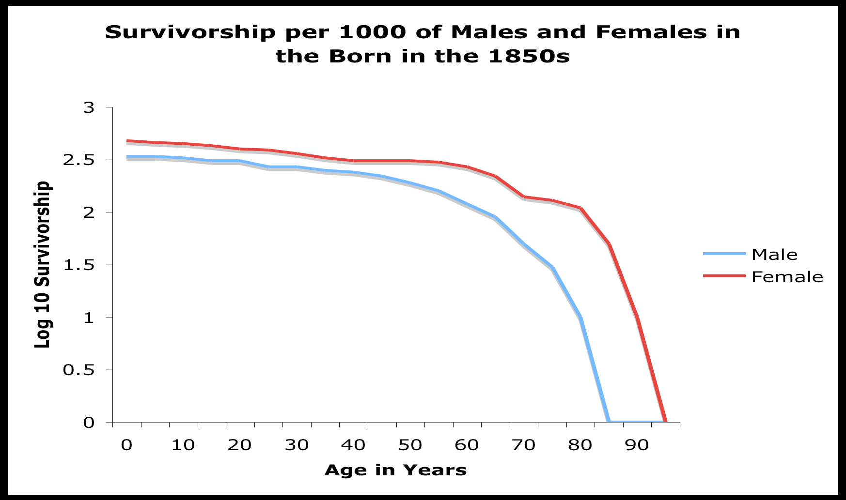
Findings: What students did…
Students used quantitative approaches.
  Quantitative approaches ranged from basic (simple calculations) to more involved (functions and graphs).
25
Notes:
Ken

Slide 26
Findings: What students did…
26
Students collected and analyzed data.
  They used equipment, software, and other approaches to collect and analyze data.
    “…using a standard construction tape measure…”
    “The battery was checked using the multi-meter…”
Students communicated their findings.
  They communicated their findings mainly in the form of written reports.
    Write up the activity as a brief report….
Notes:
Ken

Slide 27
Elements of Scientific Inquiry
Engage in an investigation. | Identify variables.
Investigate a testable question. | Formulate explanations.
Make predictions. | Formulate a testable hypothesis.
Make observations. | Extend the investigation.
Collect data. | Communicate with others.
Analyze data. | Make connections to prior learning.
Use qualitative methods. | Make connections to scientific knowledge.
Use quantitative methods. | Demonstrate conceptual understanding.
Notes:
Mary

Slide 28
Elements of Scientific Inquiry
Engage in an investigation. | Identify variables.
Investigate a testable question. | Formulate explanations.
Make predictions. | Formulate a testable hypothesis.
Make observations. | Extend the investigation.
Collect data. | Communicate with others.
Analyze data. | Make connections to prior learning.
Use qualitative methods. | Make connections to scientific knowledge.
Use quantitative methods. | Demonstrate conceptual understanding.
Notes:
Mary

Slide 29
Elements of Scientific Inquiry
Engage in an investigation. | Identify variables.
Investigate a testable question. | Formulate explanations.
Make predictions. | Formulate a testable hypothesis.
Make observations. | Extend the investigation.
Collect data. | Communicate with others.
Analyze data. | Make connections to prior learning.
Use qualitative methods. | Make connections to scientific knowledge.
Use quantitative methods. | Demonstrate conceptual understanding.
Notes:
Mary

Slide 30
Elements of Scientific Inquiry
Engage in an investigation. | Identify variables.
Investigate a testable question. | Formulate explanations.
Make predictions. | Formulate a testable hypothesis.
Make observations. | Extend the investigation.
Collect data. | Communicate with others.
Analyze data. | Make connections to prior learning.
Use qualitative methods. | Make connections to scientific knowledge.
Use quantitative methods. | Demonstrate conceptual understanding.

Slide 31
Findings: What students did NOT do…
31
Students generally did not make predictions prior to conducting experiments.
Students often did not refer back to their data when summarizing their findings.
Students were generally not asked to form a testable hypothesis. These experiments were mainly observation-based.
Notes:
Mary

Slide 32
Findings: What students did NOT do…
32
Students were not encouraged to make connections to external knowledge.
Students completed experiments as directed, and did not explore further.
Students were not provided discussion forums related to the laboratory.
Notes:
Mary

Slide 33
Findings: What students did NOT do…
33
Students often did not make explicit connections to previous learning.
Students generally did not include references to real-world experiences.
Student understanding of more generalized concepts was difficult to assess.
Notes:
Mary

Slide 34
What We Have Learned
34
The learning objectives for each lab need to be clear, with a clear progression from one lab to the next.
The experiments need to be more open-ended, which might then foster exploration.
Class discussions are needed to promote conceptual understanding and link observations with theory.
More reflection is needed so that students can become more aware of what they have learned.
Notes:
Ken

Slide 35
Implications
35
Hands-on and field-based experiments can be used in online courses
Students can increase science content knowledge
Students can develop scientific process skills
Notes:
mary

Slide 36
Questions?
36

Slide 37
References
Hobson, A. (2001). Teaching Relevant Science for Scientific Literacy. Journal of College Science Teaching, 30:238-243.
Lynd-Balta, E. (2006), Using Literature and Innovative Assessments to Ignite Interest and Cultivate Critical Thinking Skills in an Undergraduate Neuroscience Course. CBE-Life Sciences Education, 5:167-174.
Hofstein, A., Lunetta, V.N. (2004). The Laboratory in Science Education: Foundations for the Twenty-First Century. Science Education, 88:28-54.
Hofstein, A., Mamlok-Naaman, R. (2007). The Laboratory in Science Education: The State of the Art. Chemistry Education Research and Practice, 8(2):105-107.
Ma, J., Nickerson, J.V. (2006). Hands-On, Simulated, and Remote Laboratories: A Comparative Literature Review. ACM Computing Surveys, 38(3), Article 7:1-24.
National Research Council (2000). Inquiry and the National Science Education Standards: A Guide for Teaching and Learning. Table 2-6. p 29.
Ottander, C., Grelsson, G. (2006). Laboratory Work: The Teachers' Perspective. Journal of Biological Education, 40(3):113-118.
37

