Slide 1
Launching Evidence of Impact Projects
………………
Susan Grajek, Vice President for Data, Research & Analytics, EDUCAUSE

Slide 2
Using Research to Seek Evidence of Impact
Susan Grajek
Vice President for Data, Research & Analytics
EDUCAUSE
sgrajek@educause.edu

Slide 3
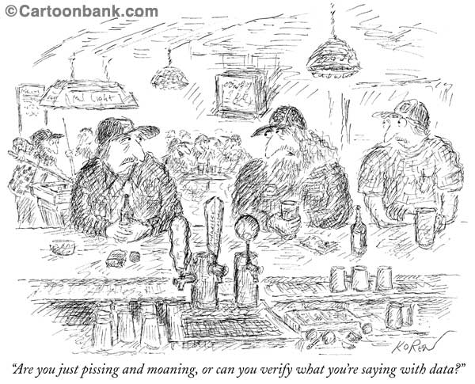
Source: The New Yorker

Slide 4
Why use research?
Research can help establish whether technologies, practices or programs make a measurable difference

Slide 5
Why use research?
To help understand what works
To isolate the particular elements of success
To help understand why something works
What are the right conditions or circumstances?
To what extent is the impact due to extraneous factors like the student, the instructor, the excitement of something new?
Can the innovation’s effect be replicated?

Slide 6
Why use research?
Without research, we’re left to guess-work, anecdote and common sense
“common sense is not so common”
We can’t afford to guess…and be wrong
The bar is rising: funders and stakeholders are demanding more than enthusiasm and plausibility

Slide 7
Types of research
Qualitative
Descriptive
Correlational
Experimental
Evaluation
When numbers aren’t enough or possible
Counts
Associations
Effects
Assessment

Slide 8
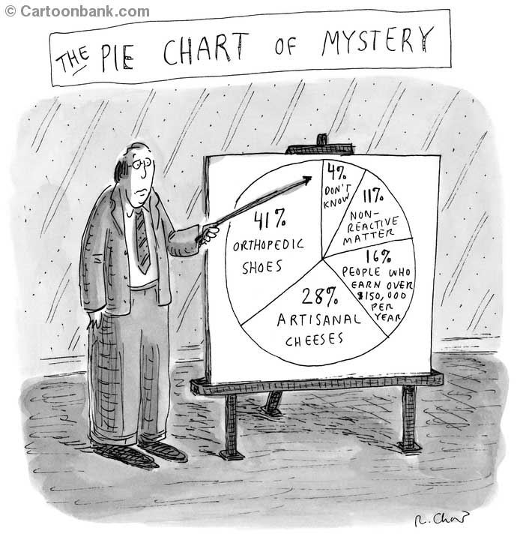
There’s research…and there’s research: How to evaluate research
Source: The New Yorker

Slide 9
The Subjects
How were they chosen?
How well do they represent other people to whom you will try to apply the findings?
Demographics
Institutional type
How many subjects and are they evenly distributed across the characteristics that matter?
Was a control group used?

Slide 10
Timing
The timing
How old is the research?
Where the data collected at sensible times?

Slide 11
The Content
The topics/questions
Are the questions unambiguous?
Do they assess a single factor?
Can your respondents understand them?
Are your rating scales realistic? (offer a mid-point, provide sufficient anchor tags, provide anchor tags at all?)

Slide 12
Sources of Bias
Phrasing of questions
Language and cultural differences
Do the subjects (students, instructors) know what you’re assessing?
Everybody wants to please and to look good
…answer questions even if they don’t have any knowledge or an opinion
…agree
…say they’ll use or buy something
How badly do you want positive results?

Slide 13
Measure twice, cut once: Pilot your research
You’re too close to the topic and the research
Piloting can identify
Poorly-worded questions
Unrealistic expectations
Small problems that are easy to correct if caught, but that can invalidate your research if not caught
Make sure your pilot is realistic and thorough
You may need to do several pilots
To get it right
If your research has several points in time or dimensions

Slide 14
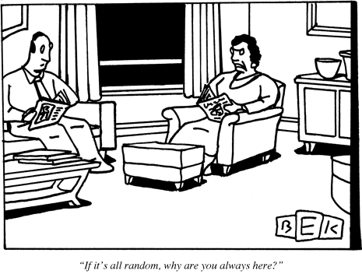
The Analyses
Source: The New Yorker

Slide 15
The Analyses
Are you eyeballing the numbers for what looks good?
Are you doing the right analyses for your data?
The right statistics for the way your data are distributed
The right analyses to answer the interesting questions

Slide 16
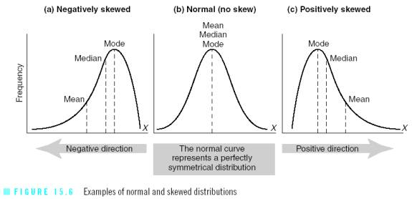
Do you know the shape of your data?

Slide 17
Analysis as a fishing expedition l (At the p<.05 level 1 of 20 tests will be significant)

Slide 18
Analysis as a fishing expedition l (At the p<.05 level 1 of 20 tests will be significant)

Slide 19
Outliers

Slide 20
The Conclusions
Distinguish clearly between evidence and interpretation
Do you have evidence for your interpretations? Or are they simply speculation, informed or otherwise?
Are you over-generalizing the results?
Remember the difference between correlations and causes

Slide 21
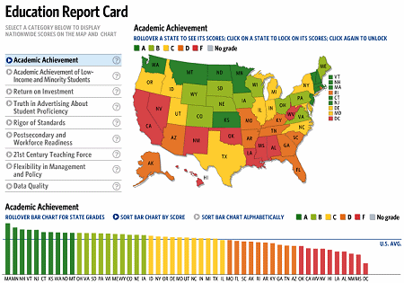
Outcomes: Impact on What?
What are the outcomes we should be measuring?
What are the outcomes we can measure?

