Slide 1
Evaluating Next Generation Learning Challenges: Blended Learning in a Scaled-up Environment
Thomas Cavanagh
Chuck Dziuban
Patsy Moskal
University of Central Florida
Copyright T. Cavanagh, C. Dziuban, P. Moskal (2012). This work is the intellectual property of the authors. Permission is granted for this
material to be shared for non-commercial, educational purposes, provided that this copyright statement appears on the reproduced materials
and notice is given that the copying is by permission of the author. To disseminate otherwise or to republish requires written permission
from the author."

Slide 2


Project Overview
Scale the proven UCF Blended Learning model via the national AASCU network of more than 420 institutions and systems
Starting with 20 targeted schools selected for their alignment with NGLC objectives (under 26, low income)

Slide 3
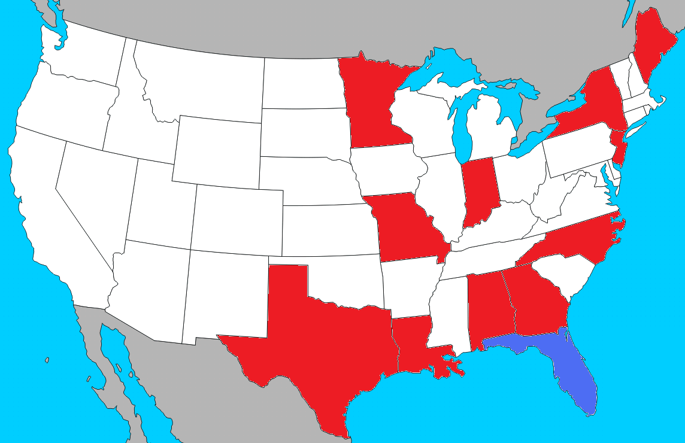
Scale UCF Model of Blended Learning
Across 20 AASCU institutions and 11 states

Slide 4
Partners
Individual Institutions | State Coordinating Institutions | State Participating Institutions
Columbus State University | Missouri | Harris-Stowe State University
Fayetteville State University | Southeast Missouri State University | Lincoln University of Missouri
Grambling State University |  | Missouri Southern State University
Northwestern State University (LA) |  | Missouri State University
Indiana University Kokomo |  | University of Missouri-St. Louis
Texas A&M University-Corpus Christi | Alabama | University of North Alabama
The College at Brockport, State University of New York | Troy University | University of South Alabama
Thomas Edison State College | Minnesota | St. Cloud State University
University of Maine at Fort Kent | Winona State University

Slide 5
Partners- Individual Institutions
Individual Institutions
Columbus State University
Fayetteville State University
University of Maine at Fort Kent
Northwestern State University (LA)
Indiana University Kokomo
Texas A&M University-Corpus Christi
The College at Brockport, State University of New York
Thomas Edison State College
Grambling State University

Slide 6
Partners- State Coordinating Institutions
State Coordinating Institutions | State Participating Institutions
Missouri | Harris-Stowe State University
Southeast Missouri State University | Lincoln University of Missouri
 | Missouri Southern State University
 | Missouri State University
 | University of Missouri-St. Louis
Alabama | University of North Alabama
Troy University | University of South Alabama
Minnesota | St. Cloud State University
Winona State University

Slide 7

Project Overview
An open educational resource (OER) Blended Learning Toolkit containing:
  Best practices, strategies, models, and course design principles.
  Two OER prototype courses in Composition and Algebra.
  Directions for applying the toolkit to create original blended courses.
  Train-the-trainer materials.
  Assessment and data collection protocols, including survey instruments and standards.

Slide 8
Project Overview
Virtual and in-person workshops for participating institutions and others within the AASCU membership.
Institutional support through existing AASCU meetings and conferences, which will align ongoing activities in technology and educational transformation with NGLC’s goals.
Clear access points for additional institution-funded blended courses, ensuring the toolkit materials are openly available.

Slide 9
Project Overview (key measures)
217 funded blended course sections across twenty project institutions: target delivery of at least 85% of those sections (185).
Targeted low-income students under age 26 (with the total population across the participating institutions being 187,500).

Slide 10
Composition
Coordinators: Elizabeth Wardle & Debbie Weaver
  English Composition I: Expository writing with emphasis on effective communication/critical thinking. Emphasizes the writing process.
  “Flexible Template” model
    Prix Fixe or A la carte
  6-week online course for participating faculty to understand the blended format applied to the WAW curriculum.
  Monthly webinars starting in Fall.

Slide 11
Algebra
Coordinator: Tammy Muhs
  College Algebra: Algebra skills: Inequalities, high degree polynomials, graphs, rational, logarithmic, and exponential functions, and systems of equations.
  “Flexible Template” will allow for individualized customization.
  One or more webinar sessions for participating faculty to understand the blended format applied to the modified emporium model of the Algebra curriculum.
  Monthly webinars starting in Fall.

Slide 12

Blended Learning Toolkit
Now available: www.blendedlearningtoolkit.org

Slide 13
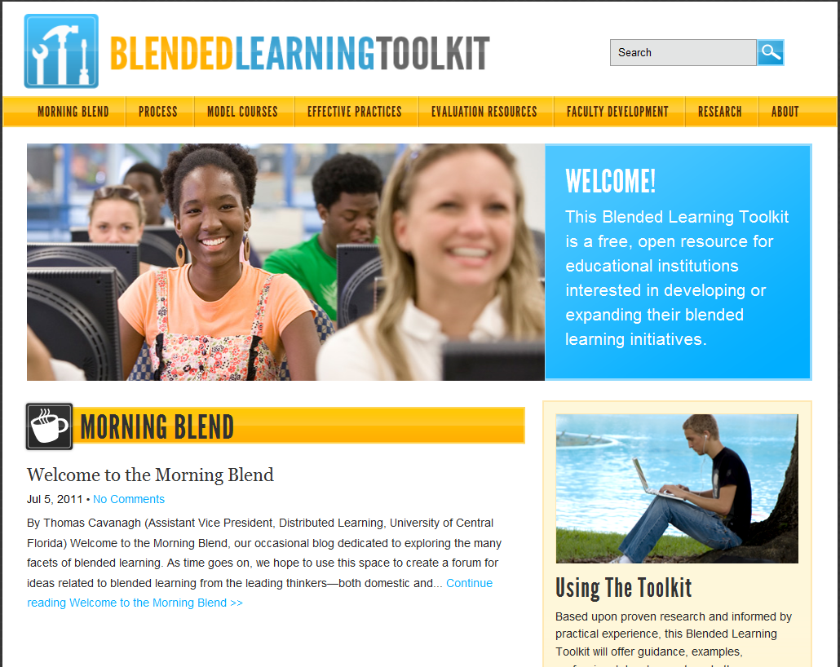

Slide 14
BlendKit2011
Designed and facilitated by Kelvin Thompson
Generic instruction on blended course design and delivery
5 week Quasi-MOOC (facilitated for grant)
Began 7/11/11
“Home Base”: http://bit.ly/blendkit2011
  Also accessible via the Blended Learning Toolkit under Faculty Development

Slide 15
BlendKit Course Self-Study Components
Instructional modules
BlendKit Reader
Do-It-Yourself design tasks
Recordings of interdisciplinary faculty interviews
Recordings of online webinar discussions with faculty group
http://bit.ly/blendkit

Slide 16
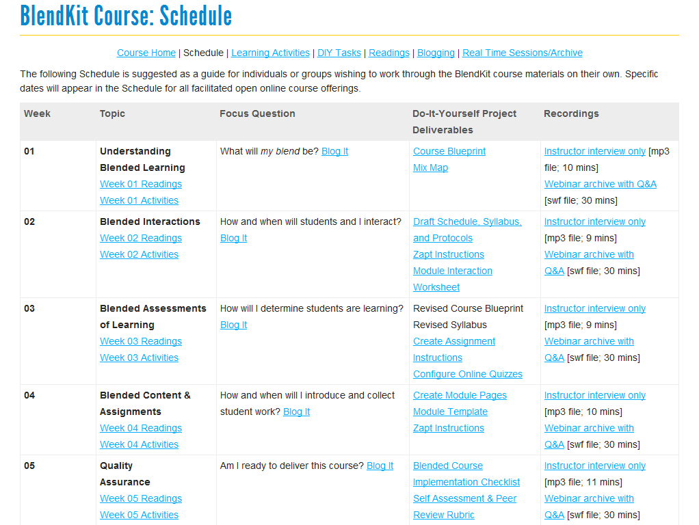

Slide 17
Next Generation Learning Challenges: Assessment

Slide 18
Distributed Learning Impact Evaluation
Students
Faculty
Online and blended
programs
Success
Satisfaction
Writing project model
Retention
Demographic
profiles
Higher order
evaluation models
Reactive behavior
patterns
Strategies for
success
Theater
Student evaluation of
instruction
Generational
comparisons
Information
fluency
Large online classes

Slide 19
Impact Evaluation as a Matter of Scale
Beyond
Institution
Opportunity Cost
A lot
Institution
College
Department
There is added value at every level
Program
A little
Individual
Few
Many
Level

Slide 20
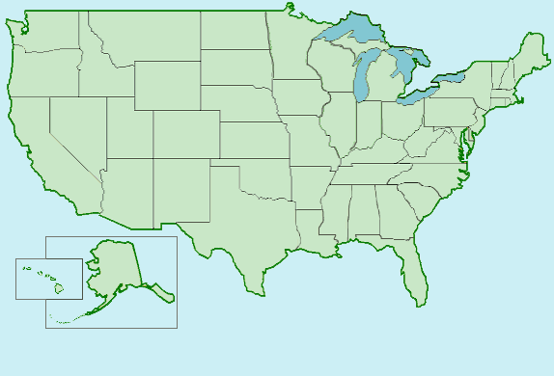
= NGLC Institution
= Non-NGLC Institution

Slide 21
Assessment
Coordinator: Patsy Moskal
IRB consultation
Assessment / Data Collection
  Planned centralized online forms
    Student perception
    Student success
    Course retention/withdrawal

Slide 22
UCF-AASCU Blended Learning Program
Organizational Environment
Training Environment
Learning Environment
Teaching Environment
Participant Feedback
Staff Feedback
Withdrawal
Scalability
Success
Analytics
Consortia Arrangements
Faculty Feedback
Student Feedback
Training for Blended Learning
Faculty Feedback
Low SES
Possibilities

Slide 23
NGLC Outcomes: Scale
Fall 2011
  95 course sections
  2,600 students
  12 schools
  55 teachers
  50% low income
Spring 2012
  62 course sections
  1,445 students
  12 schools
  36 teachers

Slide 24
NGLC Outcomes: The Student Experience
Students in Fall sections surveyed
521 responses
84% freshmen
47% white/Caucasian
86% had never taken a blended course
66% had never taken a course using any web components

Slide 25
How satisfied were you with this blended course?
(n=520)
Percent
Very Dissatisfied
Somewhat Dissatisfied
Somewhat Satisfied
Very Satisfied
Neither

Slide 26
What did you like most about this blended course?
(n=515)
Percent
Ease of access
Easy to get help
Dual-learning
Convenient
Instructor

Slide 27
What did you like least about this blended course?
(n=515)
Percent
Technology issues
Less
teaching time
Lack
of help
Time consuming
Poor time management

Slide 28
What advice would you give to a student new to blended courses?
(n=515)
Percent
Use tutoring
Review on own time
Attend
Class
Better time management
Stay on task

Slide 29
NGLC Outcomes: Student success
Place holder for a success slide???

Slide 30
NGLC Outcomes: The Faculty Experience
Faculty in Fall sections surveyed
28 responses
54% math, 32% English, 14% other
75% white/Caucasian
48% had taught a blended course
45% had taught a course using any web components

Slide 31
In the future, if you had a choice, would you consider teaching a course in the blended format?
(n=28)
Percent

Slide 32
What are the positive aspects of teaching a blended course?
(n=29)
Percent
Best of
both worlds
Individualized
Better use of F2F time
Reduced contact hours
Interaction

Slide 33
What are the negative aspects of teaching a blended course?
(n=29)
Percent
Less F2F time
Online
assignments
Lack of preparation
Undisciplined students
Technology Issues

Slide 34
How has teaching this blended course changed your F2F teaching?
(n=29)
Percent
Enrich technology
Differentiate between modes
Slow down F2F teaching
Plan better

Slide 35
NGLC Evaluation Issues
Kindness of strangers for responses
Different contexts
Local buy-in unknown
Granularity of evaluation
No budget for site visits
Cross organization evaluation UCF-AASCU
Unable to assess learning outcomes
Diseconomy of scale

Slide 36
NGLC Evaluation Issues
Excessive resources for start up
Technology issues
Very short grant period
Blended learning – a boundary object
Difficult to remove obstacle long distance
Grant participation negotiated by provosts

Slide 37
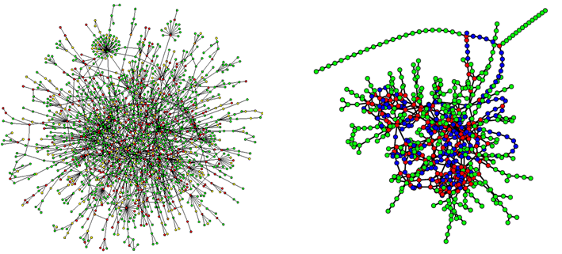
The Autocatalytic Network

Slide 38



Slide 39
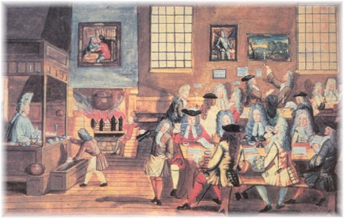
The Coffeehouse

Slide 40
For more information:
  Dr. Tom Cavanagh
  (407) 823-4910
  Cavanagh@ucf.edu
  Dr. Chuck Dziuban
  (407) 823-5478
  Charles.Dziuban@ucf.edu
  Dr. Patsy Moskal
  (407) 823-0283
  Patsy.Moskal@ucf.edu
  http://rite.ucf.edu
  http://www.if.ucf.edu/

