Slide 1
USING SOCIAL MEDIA TO LEVERAGE YOUR PROFESSIONAL NETWORKS
Tanya Joosten and Shannon Ritter | October 18, 2011

Slide 2
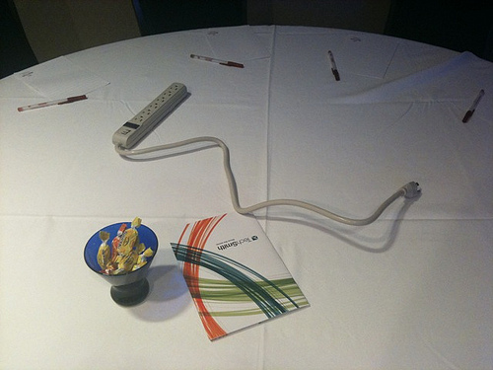
Why Use Social Media for Professional Networking?
Connections = Resources
$$
Community
Best Practices
Collaborations
Shared experiences

Slide 3
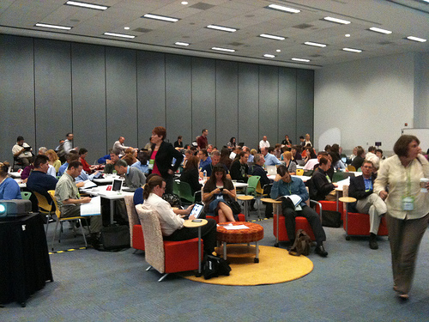
Most Popular Ways to Connect:
Twitter (#edusocmedia, #highered, #sachat)
Facebook Groups
YouTube/Vimeo
LinkedIn
Google+
Hangouts
Threaded Discussions

Slide 4
Twitter:
Connect with others with similar interests (Higher Education, Technology, Academic Advising, Faculty, etc.)
Use hashtags to join larger conversations (#edusocmedia, #highered, #eli2012 (!!) etc.)
Create twitter “lists” and follow lists others have made
Thanks for the photo,
@ericstoller!

Slide 5
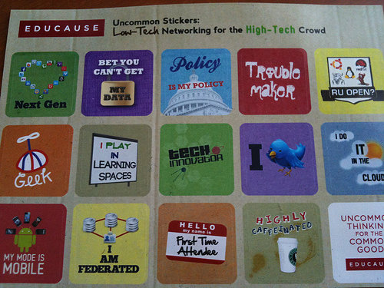
Facebook:
Extend connections
Search for groups to join or create a group yourself
LinkedIn:
Keep up to date
Join Groups
Connect with others
YouTube/Vimeo:
Post videos or video responses
Use as resource

Slide 6
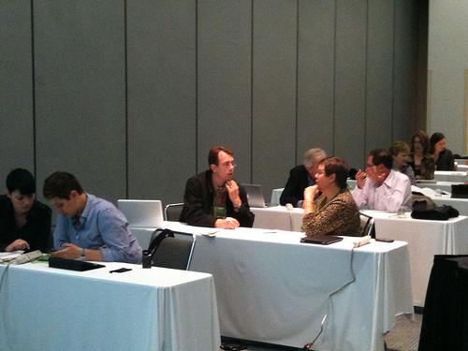
Google+:
Hangouts
Threaded discussions
Organize people into “circles” to facilitate better sharing/listening to conversations
Longer posts and discussions than twitter
Follow “circles” that
others have created

Slide 7
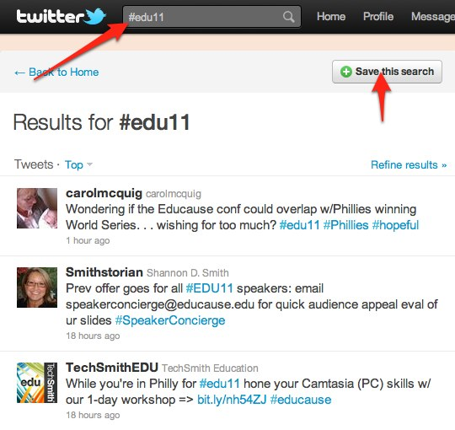
How To Get Started!
Create a twitter account at twitter.com
Follow @tjoosten and @micala, and do a “search” for #eli2012
Tweet about conference sessions you’re participating in, follow along with the larger conversation about the conference!

Slide 8
THANK YOU!!
Tanya Joosten
@tjoosten
Shannon Ritter
@micala

