Slide 1

Open Academic Analytics Initiative (OAAI)
Next Generation Learning Challenges (NGLC)
Wave 1

Slide 2

Higher Education is in crisis…
…but technology can play a role in in meeting this challenge…

Slide 3
National 4-year
Graduation Rate (2009)…
Notes:
At a time when a college degree is more important than ever before…

Slide 4
32%
5-year graduation rate: 43%
6-year graduation rate: 47%
Notes:
The national 4-year graduation rate is only 32%...

Slide 5
National 4-year
Graduation Rate (2009) for Historically Black Colleges and Universities (HBCUs)…
Notes:
As shocking as that number was…the rate for HBCUs…

Slide 6
14%
5-year graduation rate: 25%
6-year graduation rate: 30%
Notes:
(pause for a few seconds to let this sink in)

Slide 7
Notes:
Of class of 20 at an HBCU, only 3 will graduate within 4-years

Slide 8
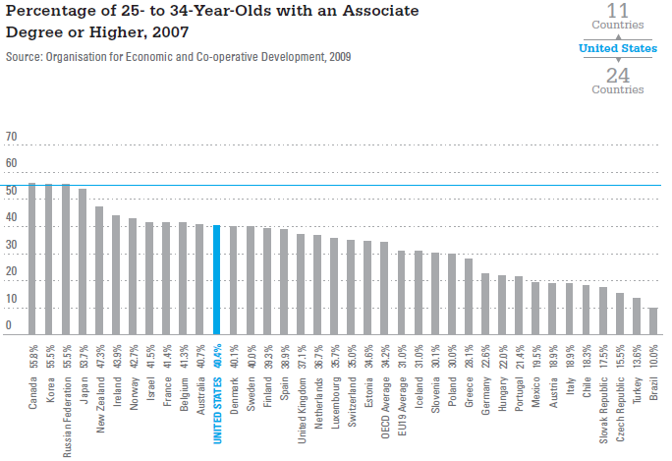
Notes:
As a result, the United States is now ranked 12th internationally in terms of the percentage of 25-34 year-olds with an Associates Degree or higher.

Slide 9
Presentation Outline
Open Academic Analytics Initiative (OAAI)
Online Academic Support Environment (OASE)
  Conceptual Overview
  Design Framework
  Demonstration
OAAI Predictive Model and “Portability”
  Research strategy
  Initial Findings
Next steps and looking beyond the grant

Slide 10

open academic analytics initiative
Using analytical software to find patterns in “big data” sets as means to predict student success
OAAI is using two primary data sources:
  Student Information System (SIS)
    Demographics, Aptitude (SATs, GPA)
  Learning Management System (LMS)
    Event logs, Gradebook
Goal is to create open-source “early alert” system
  Predict “at risk” students in first 2-3 weeks of a course
  Deploy intervention to ensure student succeeds
Notes:
(Josh presents…) I’m going to introduce you to the Open Academic Analytics Initiative…
OAAI is using two primary data sources…

Slide 11
How does this actually work
Static data
Student Attitude Data (SATs, current GPA, etc.)
Student Demographic Data (Age, gender, etc.)
Identified Students “at risk” to not complete course
Predictive Model
Scoring
Dynamic Data
Sakai Event Log Data
Sakai Gradebook Data
Intervention
(Online Academic Support Environment)

Slide 12

Evidence of Prior success
Purdue University’s Course Signals Project
  Built on dissertation research by Dr. John Campbell
  Now a SunGard product the integrates with Blackboard
  Students in courses using Course Signals*…
    scored up to 26% more A or B grades
    up to 12% fewer C's; up to 17% fewer D's and F‘s
  6-10% increase in semester-to-semester persistence
Interventions that utilize “support groups”*
  Improved 1st and 2nd semester GPAs
  Increase semester persistence rates (79% vs. 39%)
* - see reference on final slide
Notes:
In terms of evidence of prior success, probably the most well known is the work out of Purdue University’s Course Signals project…
They were able to show an increase in A and B letter grades and a decrease in C’s, D’s and F’s as well as an increase in semester-to-semester persistence…
Similarly, there is early evidence the intervention strategies that utilize “support groups”…which we are also deploying…can have a similar impact on GPAs and persistence….

Slide 13



OAAI: Building on prior success
Building “open ecosystem” for academic analytics
  Sakai Collaboration and Learning Environment
    Sakai API to automate secure data capture
    Will also facilitate use of Course Signals & IBM SPSS
  Pentaho Business Intelligence Suite
    OS data mining, integration, analysis and reporting tools
  OAAI Predictive Model released under OS license
    Predictive Modeling Markup Language (PMML)
Researching critical analytics scaling factors
  How “portable” are predictive models?
  What intervention strategies are most effective?
Notes:
OAAI is building on this prior success through two primary “thrusts”…the first is the creation of an “open ecosystem” for academic analytics…this ecosystem contains the Sakai…
We will also be open sourcing our predictive model and releasing it using a standard mark-up language which will allow…
The other major “trust” is researching critical scaling factors…so we are looking at this issue of “portability”…how can you effective take a model developed for one academic context (e.g. liberal arts school) and “port” it to another context (e.g. community college).
We are also looking at what are the most effective intervention strategies, particularly those which use…

Slide 14




OAAI’s Outcomes
Released the Sakai Academic Alert System (beta)
  Will be included as part of Sakai CLE release
Conducted real world pilots with:
  36 courses at community colleges
  36 courses at HBCUs
Research finding related to…
  Strategies for effectively “porting” predictive models
  The use of online communities and OER to impact on course completion, persistence and content mastery.
Notes:
At the conclusion of our project…we will have released what we are now calling the….and piloted it at community colleges and HBCUs….
We will also be releasing research findings related to the “portability” issue as well as the degree to which the use of…impacts on…

Slide 15
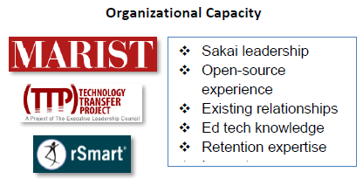
Open Academic Analytics Initiative
Wave I EDUCAUSE
Next Generation Learning
Challenges (NGLC) grant
Funded by Bill and Melinda
Gates and Hewlett Foundations
$250,000 over a 15 month period
Began May 1, 2011, ends January 2013 (extended)

Slide 16

How many people have deployed LMS-based learner analytics solutions?

Slide 17
How many people are considering doing so in
next 1-2 years?

Slide 18
Online Academic Support Environment (OASE)

Slide 19
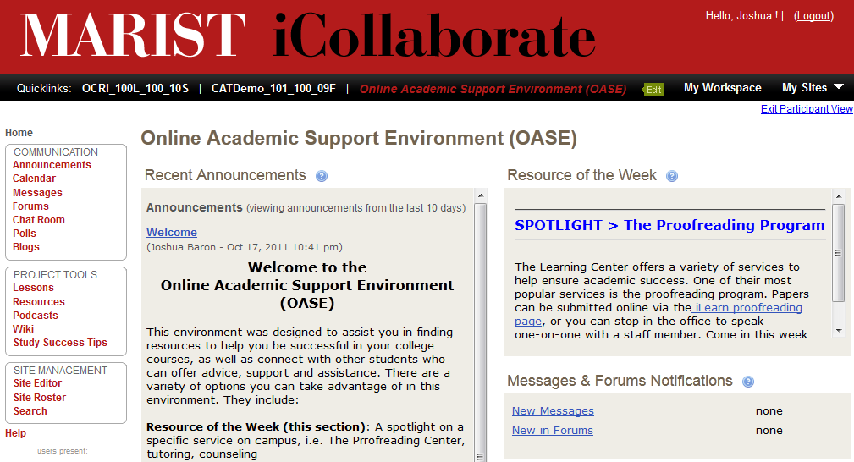
Online academic support environment (OASE)

Slide 20
OASE Design Framework
Guiding design principals that allow for localization
  Will be releasing under a CC license
Follows online course design concepts
  Learner – Content Interactions
  Learner – Facilitator Interactions
  Learner – Mentor Interactions
Leverages Open Educational Resources
Notes:
The approach we have taken is to create a “design framework” for the OASE

Slide 21
Design Frame #1
Learner-Content Interactions
Self-Assessment Instruments
  Assist students in identify areas of weakness related to subject matter and learning skill
OER Content for Remediation
  Focus on core subjects (math, writing)
  Organized to prevent information overload
    “Top rated math resources”
OER Content for Improving Learning Skills
  Focus on skills and strategies for learner success
    Time management, test taking strategies, etc.
Notes:
Include some screenshots of examples from Khan, etc.

Slide 22
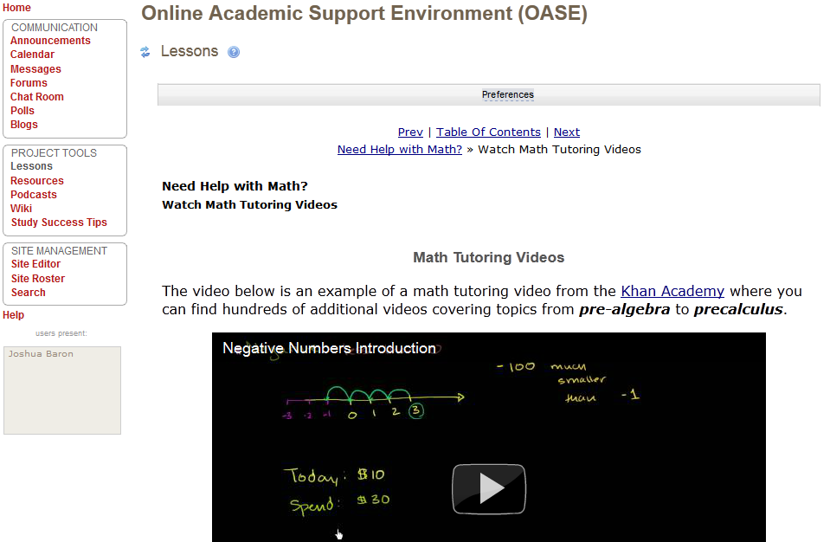
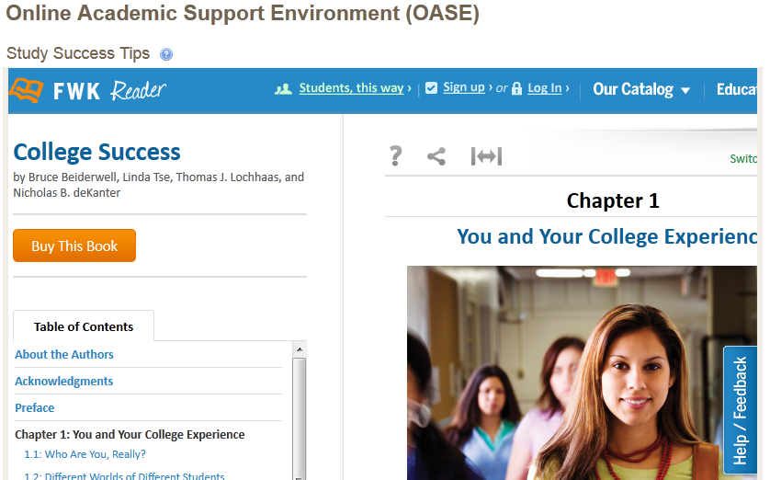
OER Content for remediation and study skills

Slide 23
Design Frame #2
Learner - Facilitator Interactions
Academic Learning Specialist role would
  Connecting learners to people and services
  Promoting services and special events
  Moderates discussions on pertinent topics
    Example: “Your first semester at college”
Guest motivational speakers
  Occasional webinars with upperclassman, alumni, etc.
  Allows learners to hear from those who “made it”
Notes:
Note that the goal is not to replace tutoring services or answer a lot of subject matter questions online.

Slide 24
Design Frame #3
Learner - Mentor Interactions
Online interactions facilitated by student “mentor”
  Facilitates weekly “student perspective” discussions
    Example: “Your first semester of college – the real story”
Online “student lounge” for informal interactions
  Let others know about study groups, etc.
  Help build a sense of community
Blogs for students to reflect on experiences
  Could be public, private or private to a group
Notes:
Note that the goal is not to replace tutoring services or answer a lot of subject matter questions online.

Slide 25
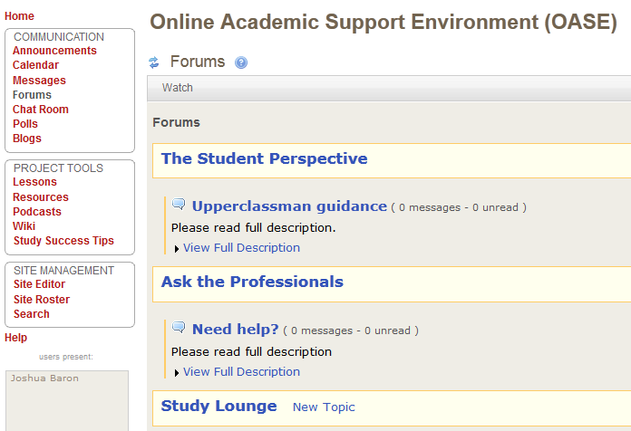
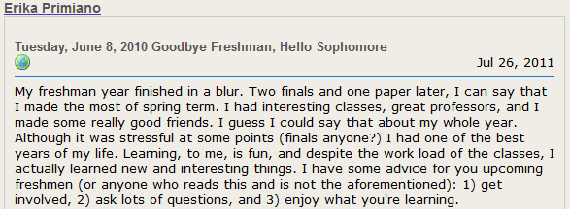
Engaging student in online interactions

Slide 26
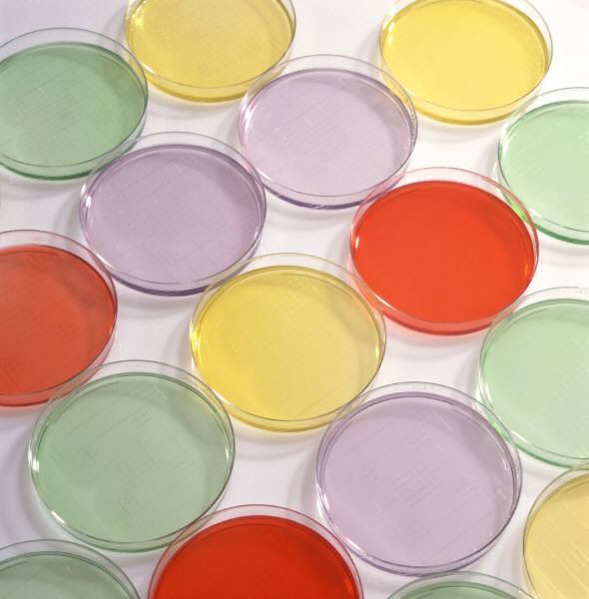
Researching effectiveness of OASE

Slide 27
Exploratory study Design
Control Section
No Intervention (instructor not informed)
Identified Students “at risk” to not complete course
“Awareness” Section
Instructor sends “identified students” message encouraging them to seek help
“OASE” Section
Instructor sends “identified students” message encouraging them to join OASE

Slide 28
OASE research Overview
Instructor sends “identified students” message encouraging them to join OASE
Online Academic Support Environment (OASE)
Make student aware that they may be struggling
Provide students access to a support community and remediation resources
May increase students likelihood of seeking help
May increase students feelings of engagement with faculty and institution
May increase basic skill remediation and study skills

Slide 29
OAAI Predictive Model and “Portability”

Slide 30
Two phased research approach
Phase 1: Replicate Purdue’s research at Marist
  Building on Dr. John Campbell’s dissertation research
    Analyzed large data sets related to:
      LMS “events” (reading content, submitting assignments, etc.)
      Student demographic and aptitude data (SATs, GPA)
    Identified correlations to student success in courses
Two primary research questions:
  Do the same correlations exist at other institutions?
  If so, are the “strengths” of these correlations the same?

Slide 31
How Marist and Purdue compare
Some similarities between institutions
  Pell Grants (Marist 11%, Purdue 14%),
  Minority students (Marist 11%, Purdue 11%)
  ACT composite 25th/75th percentile (Marist 23/27, Purdue 23/29)
Some differences between institutions
  Institution type (liberal arts vs. land-grant research)
  Size (6000 FTE vs. 40,000 FTE) [impacts class size]
  LMS (Sakai vs. WebCT/BlackBoard)

Slide 32
Phase one: same student data
Feature | Description
High School Rank | The high school rank as expressed as a percentile.
SAT Verbal Score | The numeric SAT verbal score.
SAT Math Score | The numeric SAT mathematics score.
SAT Composite score | Defined as the sum of the SAT verbal and SAT math scores.
ACT Composite Score | The ACT composite score.
Aptitude score | Defined as the SAT composite score or the converted ACT to SAT score. In the cases in which students have both SAT and ACT scores, the SAT score will remain
Birth Date | The birth date of the student
Age | Converted from the birth date, expressed in years.
Race | The race of the student (self-reported)
Gender | The gender of the student (self-reported).
Full-time or Part-time Status | Code for full-time or part-time student based on the number of credit hours currently enrolled.
Class Code | The current academic standing of the student as expressed by the number of semesters of completed coursework. Ranges from one to eight for undergraduate students. One (1) indicates a first semester freshman. Four (4) would indicate a second semester sophomore.
Cumulative GPA | Cumulative university grade point average (four point scale).
Semester GPA | Semester university grade point average (four point scale).
University Standing | Current university standing such as probation, dean’s list, or semester honors.

Slide 33
Phase one: same Course Data
Feature | Description
Subject | The Dept from which the course is offered.
Course | The course identification
Course size | The number of students in the course/ section
Course length | The length of the course, measured in weeks
Course Grade | The final course grade of the student. Entries are A,A-, B+,B,B- ,C+C,C- D+D,F, row is discarded.
At Risk | Defined as students completing the course within the normal timeframe and receiving a grade below C

Slide 34
Phase one: same LMS Event Log Data
Feature | Description
Qty Content viewed | The total number of times the student views content
Qty Lessons Accessed | The total number of times a section in the Lessons tool is accessed
Qty Discussion Postings | The total number of discussion postings by student
Qty Discussion Postings read | The total number of discussion postings opened by student
Qty Assessments completed | The number of assessments completed by the student
Qty Assessments opened | The total number of assessments opened by the student
Qty Assignments completed | The number of assignments completed by the student
Qty Assignments opened | The total number of assignments opened by the student

Slide 35
Phase One results
We found very similar correlations with LMS data
  Content “Reads” – Resources and Lesson (Melete)
  Assignment Submissions
  Site Visits
We found similar correlations “strengths”
  LMS elements are somewhat predictive
  Student attitude and demographics are much stronger
“Missing data” was a challenge

Slide 36
Phase 2: enhance model and deploy
Enhance the initial Marist predictive model
  New analytical techniques
  Additional data sets
Pilot in very different academic contexts
  Community colleges and HBCUs
Question: How well does the predictive model perform?

Slide 37
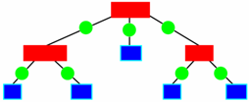
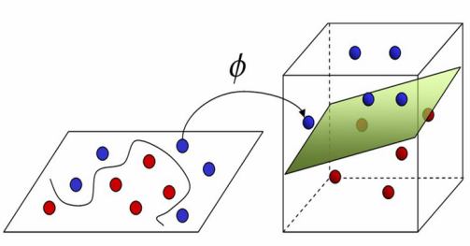
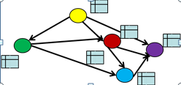
Advanced Analysis
Moved from “absolute” to “relative” measures within a course.
C4.5/C5.0 Boosted Decision Tree
Random Forests
Support Vector machines
Bayesian Networks

Slide 38
Additional Data Set: Gradebook
Feature | Description
Gradable Event | A test, assignment, project, etc
Max points | The maximum number of points a student can receive in that gradable event
Actual Points | The actual number of points a student received in that gradable event
Score | Actual points / Max Points
Weight | The contribution of the gradable object to the overall grade

Slide 39
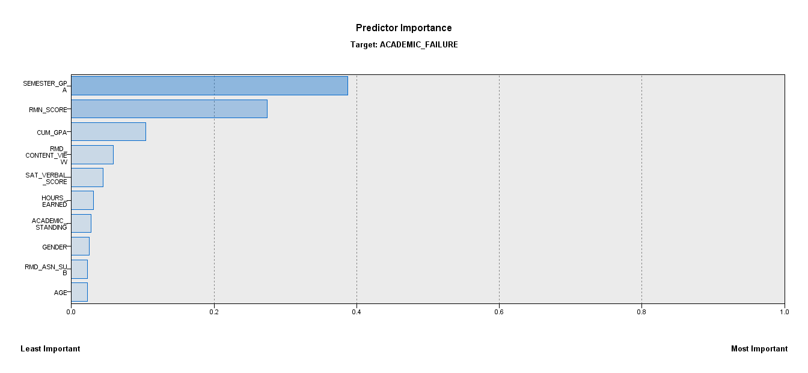
Phase Two model predictors

Slide 40
Phase two: next steps
Looking at “data snapshots” over semester
  Help determine how early predications are valid
  May allow us to improve model
Run pilots and collect data from control groups
  Results will indicate “portability” of our model
Analyze full semester data from partners
  Allow us to build customize models and compare results

Slide 41
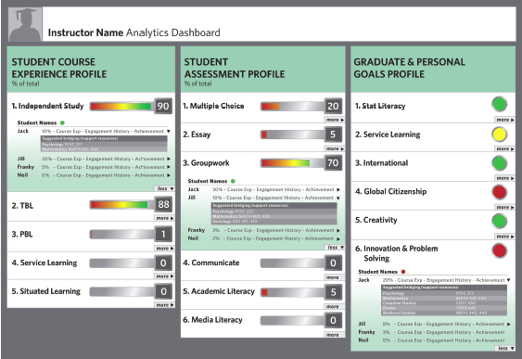

OAAI Scaling Plans and Interests
Expand Sakai Academic Alert System
  Develop “Academic Alert” Dashboard
  Develop a configurable API
Enhance OAAI Predictive Model
  Data mining of extracurricular activities &
  ePortfolios data sets
  Sakai Open Academic Environment (OAE)
  Marist NSF Enterprise Computing Research Lab
Leverage outcomes from other NGLC projects
to enhance intervention strategies
Notes:
Looking over the horizon a bit, we would like to develop….
We also want to enhance our predictive models through additional data mining of new data sets and also take advantage of a new NSF funded EC research lab at Marist.
Finally, we’d love to leverage the outcomes…

Slide 43
Contact information
Josh Baron,
Senior Academic Technology Officer, Marist College
Josh.Baron@marist.edu
Ramon Harris
Director, Technology Transfer Project
Ramon@

Slide 44
References
Arnold, Kimberly E. “Signals: Applying Academic Analytics”, EDUCAUSE Quarterly, Volume 33, Number 1, 2010
Campbell, J. P. (2011, February). Opening the Door to New Possibilities Through the Use of Analytics.
Presented at the EDUCAUSE Learning Initiative 2011 Annual Meeting, Washington, DC.
Cuseo, J. (n.d.) Academic Advisement and Student Retention: Empirical Connections & Systemic Interventions. (Marymount College) Retrieve February 13, 2011 from https://apps.uwc.edu/administration/academicaffairs/esfy/CuseoCollection/Academic%20Advisement% 0and%20Student%20Retention.doc
Folger W., Carter, J. A., Chase, P. B. (2004) "Supporting first generation college freshmen with small group intervention". College Student Journal. FindArticles.com. 22 Feb, 2011. http://findarticles.com/p/articles/mi_m0FCR/is_3_38/ai_n6249233/

