Slide 1
Creating a Culture of Innovation
Jennifer Sparrow
Virginia Tech
October 2, 2012
Notes:
Required – Title Slide

Slide 2
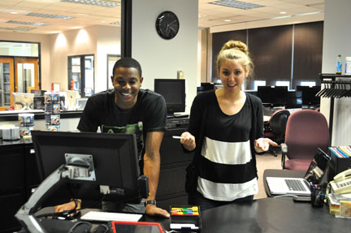
Overview
The “Right” Stuff
The Physical Space
The Culture of Yes
The Two R’s and a P
Relationships
Rapid Response
Pedagogy
Notes:
Poll question 1:
Remember to look at answers…and address them

Slide 3
The “Right” Way to Culture
People
Time
Place
Tools
Notes:
Required - Main Body Slide

Slide 4
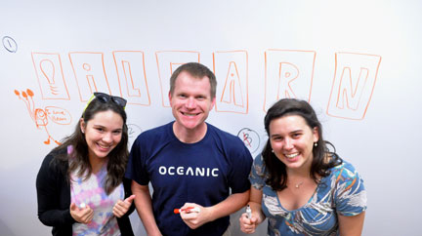
The Right People

Slide 5
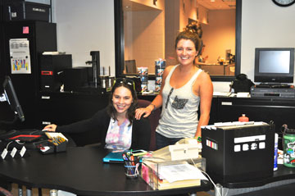
The Right Time
Notes:
Poll

Slide 6
The Right Space (InnovationSpace)

Slide 7
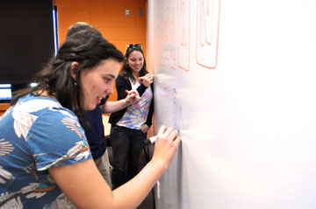
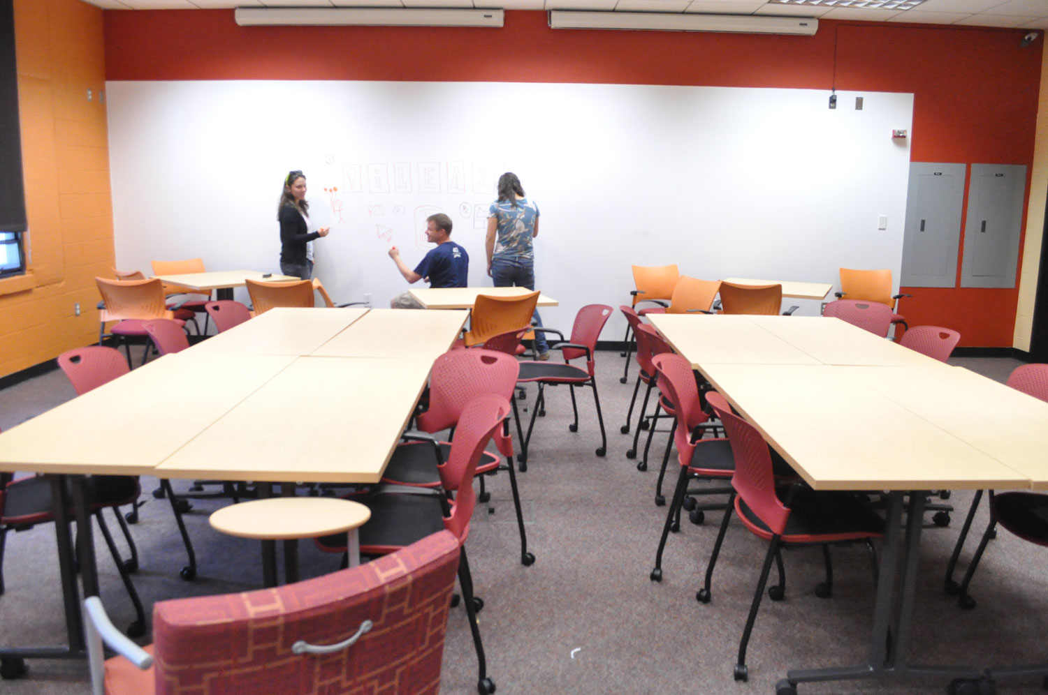
The Space

Slide 8
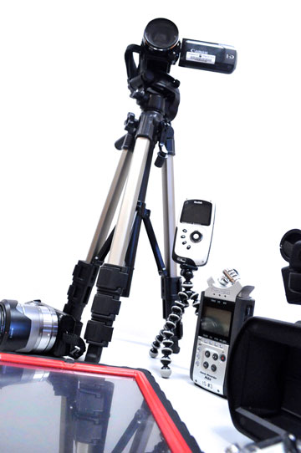
The Right Tools

Slide 9
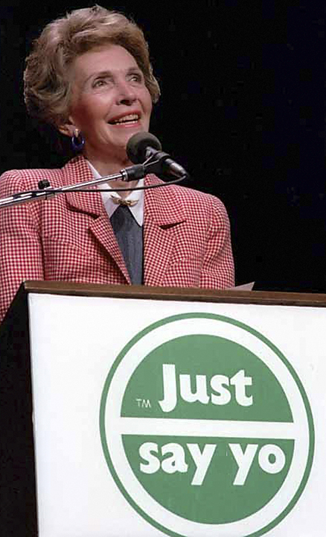
“Yes”
Notes:
Optional – Quote Template

Slide 10
Three R’s & a P
elationships
apid Response
edagogy

Slide 11
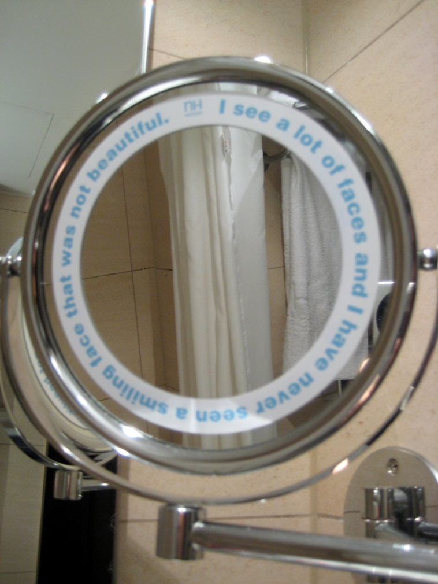
What does a culture of innovation look like?

Slide 12
References
http://blogs.hbr.org/schwartz/2010/08/six-secrets-to-creating-a-cult.html
http://www.cbsnews.com/8301-505125_162-57351693/how-to-create-a-culture-of-innovation/
http://www.inc.com/articles/201106/josh-linkner-7-steps-to-a-culture-of-innovation.html
Books:
In The Plex by Steven Levy
Imagine: How Creativity Works by Jonah Lehrer
Images Licensed Under Creative Commons
Right Arrow on Tree: http://www.flickr.com/photos/pascal-blachier/2284372750/
Nancy Reagan http://www.flickr.com/photos/swanksalot/3774844897/sizes/o/in/photostream/
R #1 http://www.flickr.com/photos/chrisinplymouth/4083274576/
R#2 http://www.flickr.com/photos/chrisinplymouth/3515631233/lightbox/
P http://www.flickr.com/photos/chrisinplymouth/3934438598/sizes/z/in/photostream/
Jennifer Sparrow
jennifers@vt.edu
540-231-5377
Notes:
Required – End Slide

