Slide 1
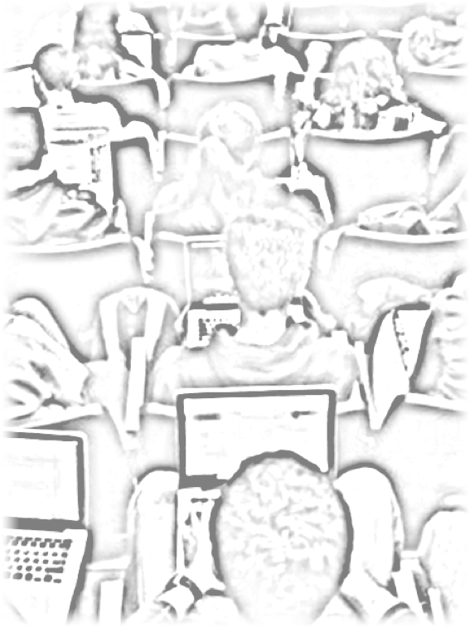
Edupreneurship: Engaging Students in Mobile Learning
Perry Samson
University of Michigan
October 2, 2012
Notes:
Required – Title Slide

Slide 2
In times of rapid change, experience could be your worst enemy.
J. Paul Getty
Notes:
Optional – Quote Template

Slide 3
Motivation
Who is better qualified to envision and design mobile tools for learning than those who use mobile tools for living?
Notes:
Optional – Agenda Slide – Option 2
Instead of using the agenda template on the previous slide, you also have the option to use this section break template to place sub titles or section breaks within your presentation.

Slide 4
Edupreneurship: Motivation
Learning is a Contact Sport
Notes:
Required - Main Body Slide

Slide 5
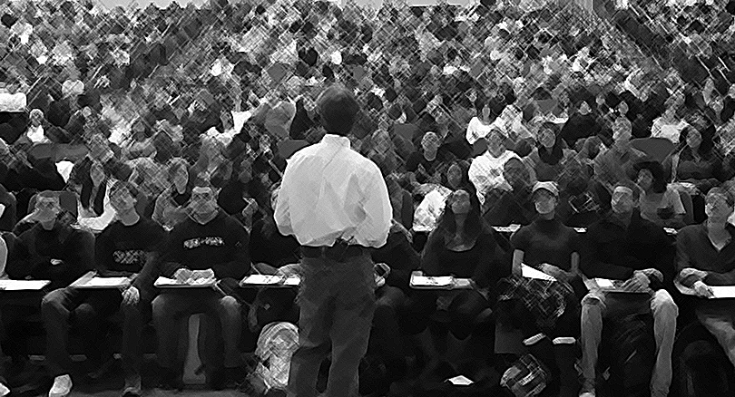
Learning is a Contact Sport
Edupreneurship: Motivation
Notes:
Required - Main Body Slide

Slide 6
Edupreneurship: Motivation
Instructor
Questions
Answers
Answers
Confusion
Questions
Students Notes
Feedback
Notes:
Required - Main Body Slide

Slide 7
EDUpreneurship
Challenges to Innovation
NEED
RESEARCH
ASSESSMENT
SUSTAINABILITY
TRADITIONAL NIH/NSF SUPPORT
SBIR/Angel

Slide 8
Play Along
Go to http://my.lecturetools.com
Log in with username “demo284” (no password required)
NOTE: If you’re using an iPad, first download the LectureTools iPad app from iPad store.

Slide 9
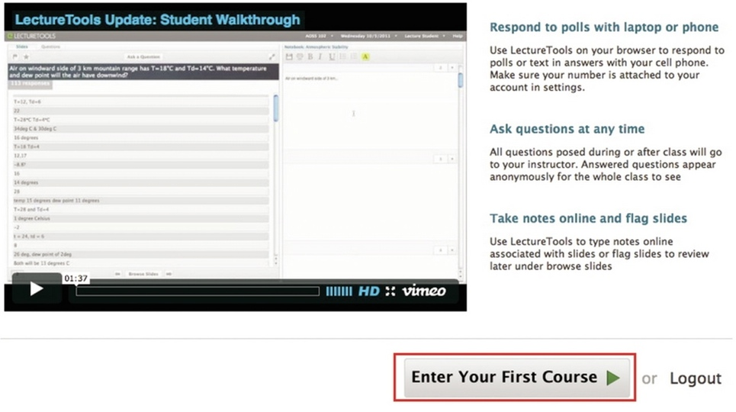
Play Along

Slide 10
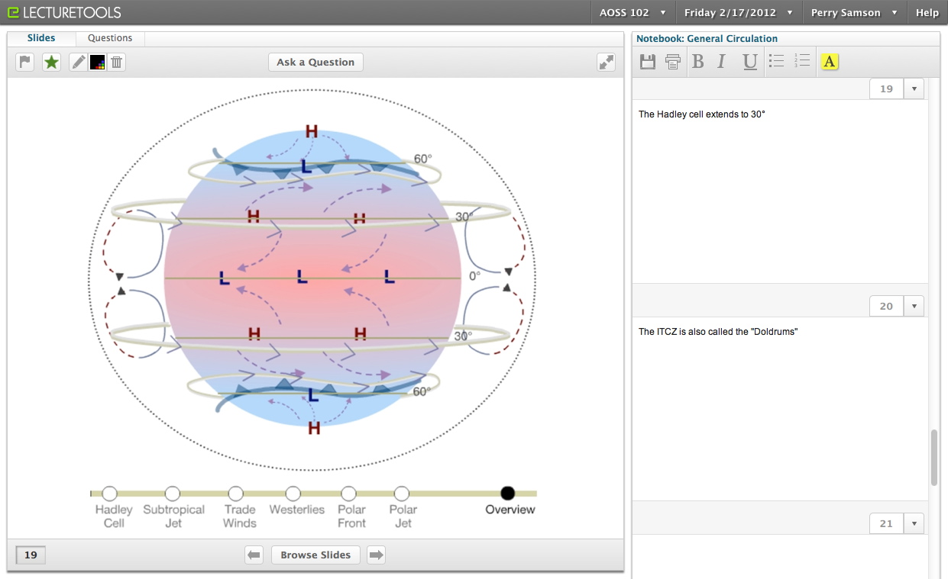
LectureTools
I’m confused!
Draw on slides
Ask questions
Get feedback
Bookmark slides
Take notes
Browse slides
Notes:
Required - Main Body Slide

Slide 11
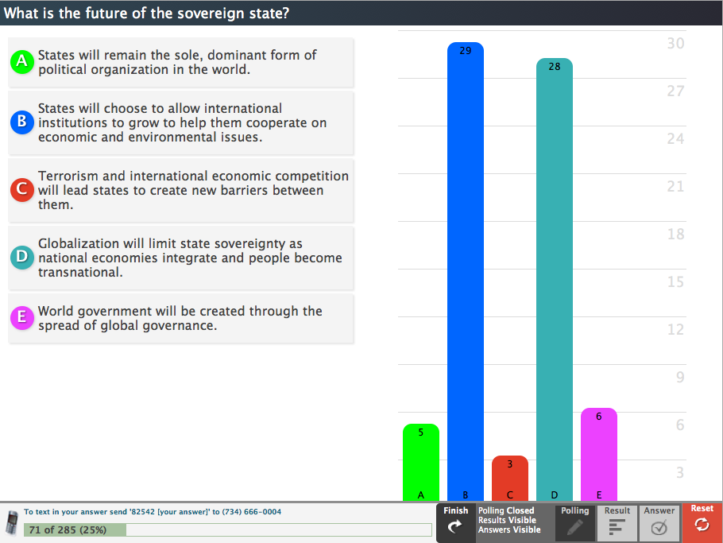
Edupreneurship: Building from Research
Multiple Choice
Notes:
Required - Main Body Slide

Slide 12
Edupreneurship: LectureTools
Free Response
Notes:
Required - Main Body Slide

Slide 13
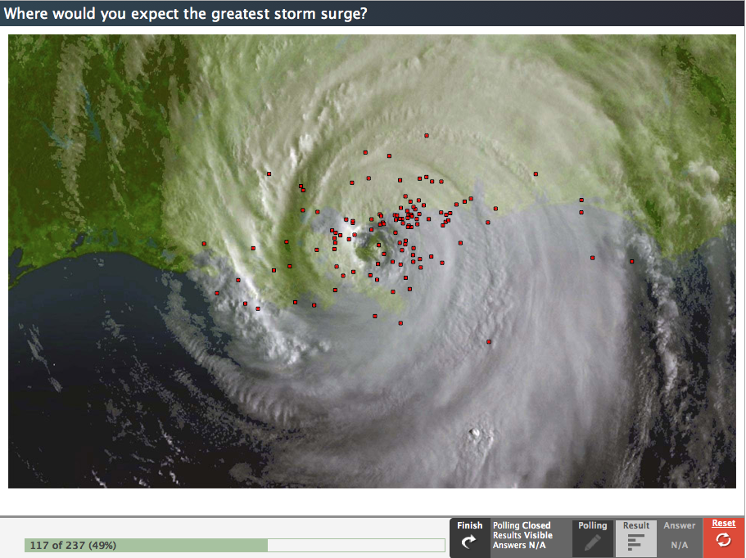
Edupreneurship: Building from Research
Image-Based
Notes:
Required - Main Body Slide

Slide 14
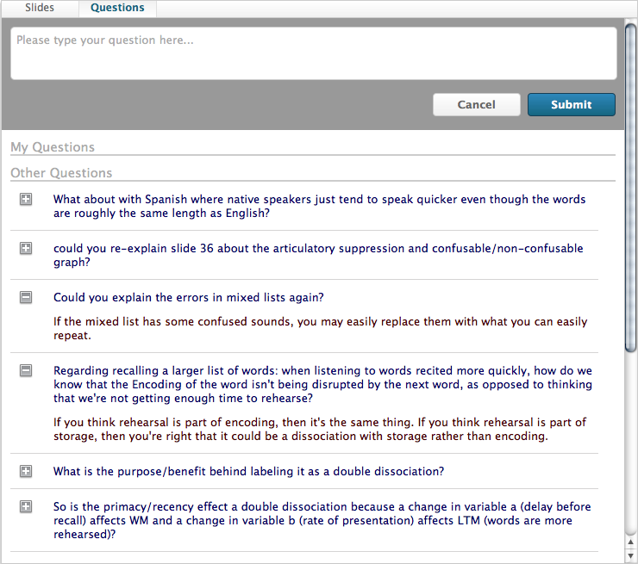
Edupreneurship: Building from Research
Student Questions
Notes:
Required - Main Body Slide

Slide 15
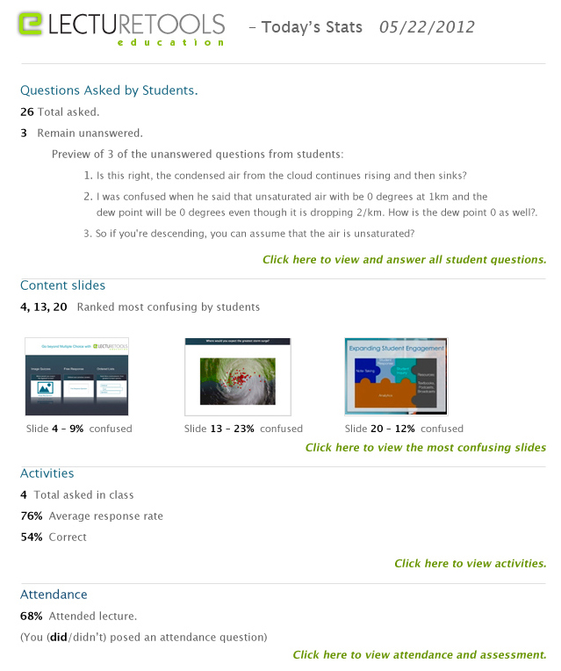
Edupreneurship: Building from Research
Instructor Feedback
Notes:
Required - Main Body Slide

Slide 16
Edupreneurship: Building from Research
21%
13%
Source: Use of Laptops in the Classroom: Research and Best Practices,
University of Michigan CRLT, 2010
Notes:
Required - Main Body Slide

Slide 17
Edupreneurship: Building from Research
+.5
“Overall the instructor was an excellent teacher.”
Scores above 4.5:
2/9 in 2010
7/9 in 2011
Source: Use of Laptops in the Classroom: Research and Best Practices,
University of Michigan CRLT, 2010
Notes:
Required - Main Body Slide

Slide 18
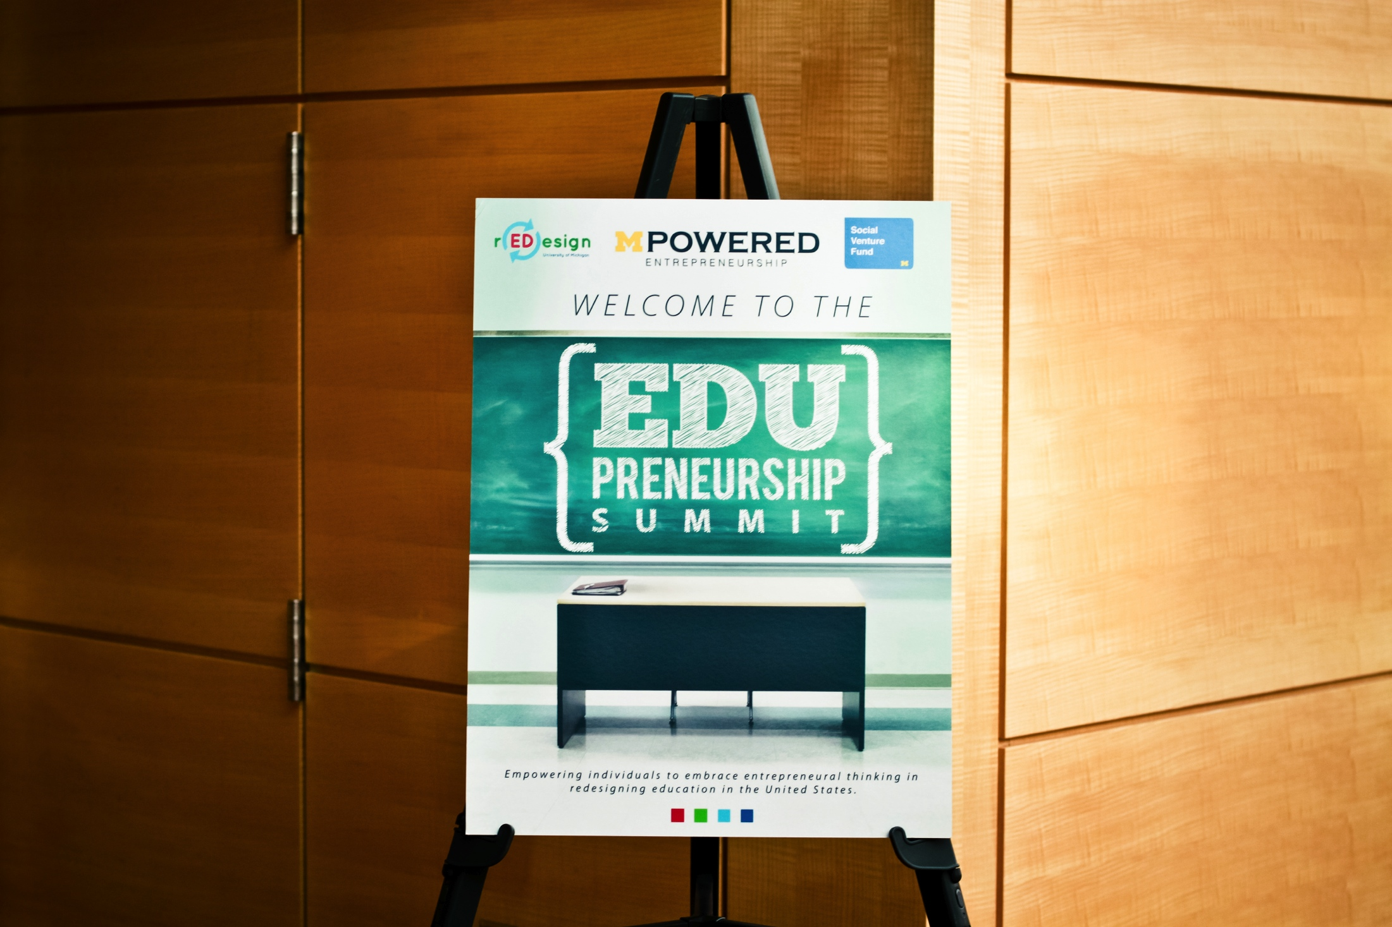
Edupreneurship: Building from Research
Notes:
Required - Main Body Slide

Slide 19
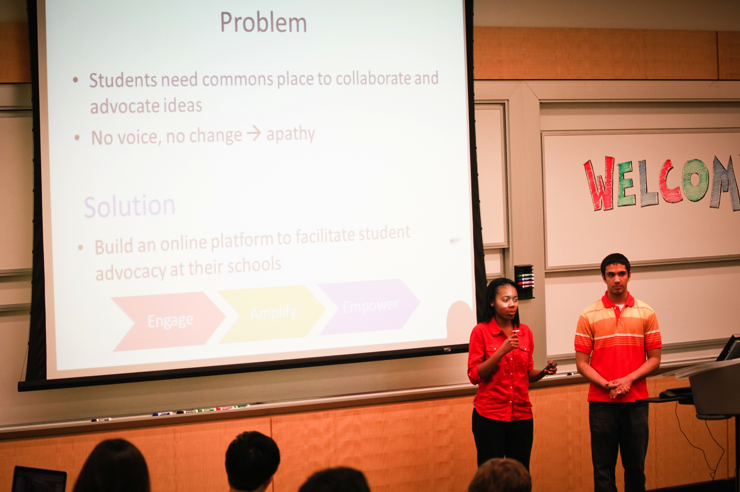
Edupreneurship: Building from Research
Notes:
Required - Main Body Slide

Slide 20
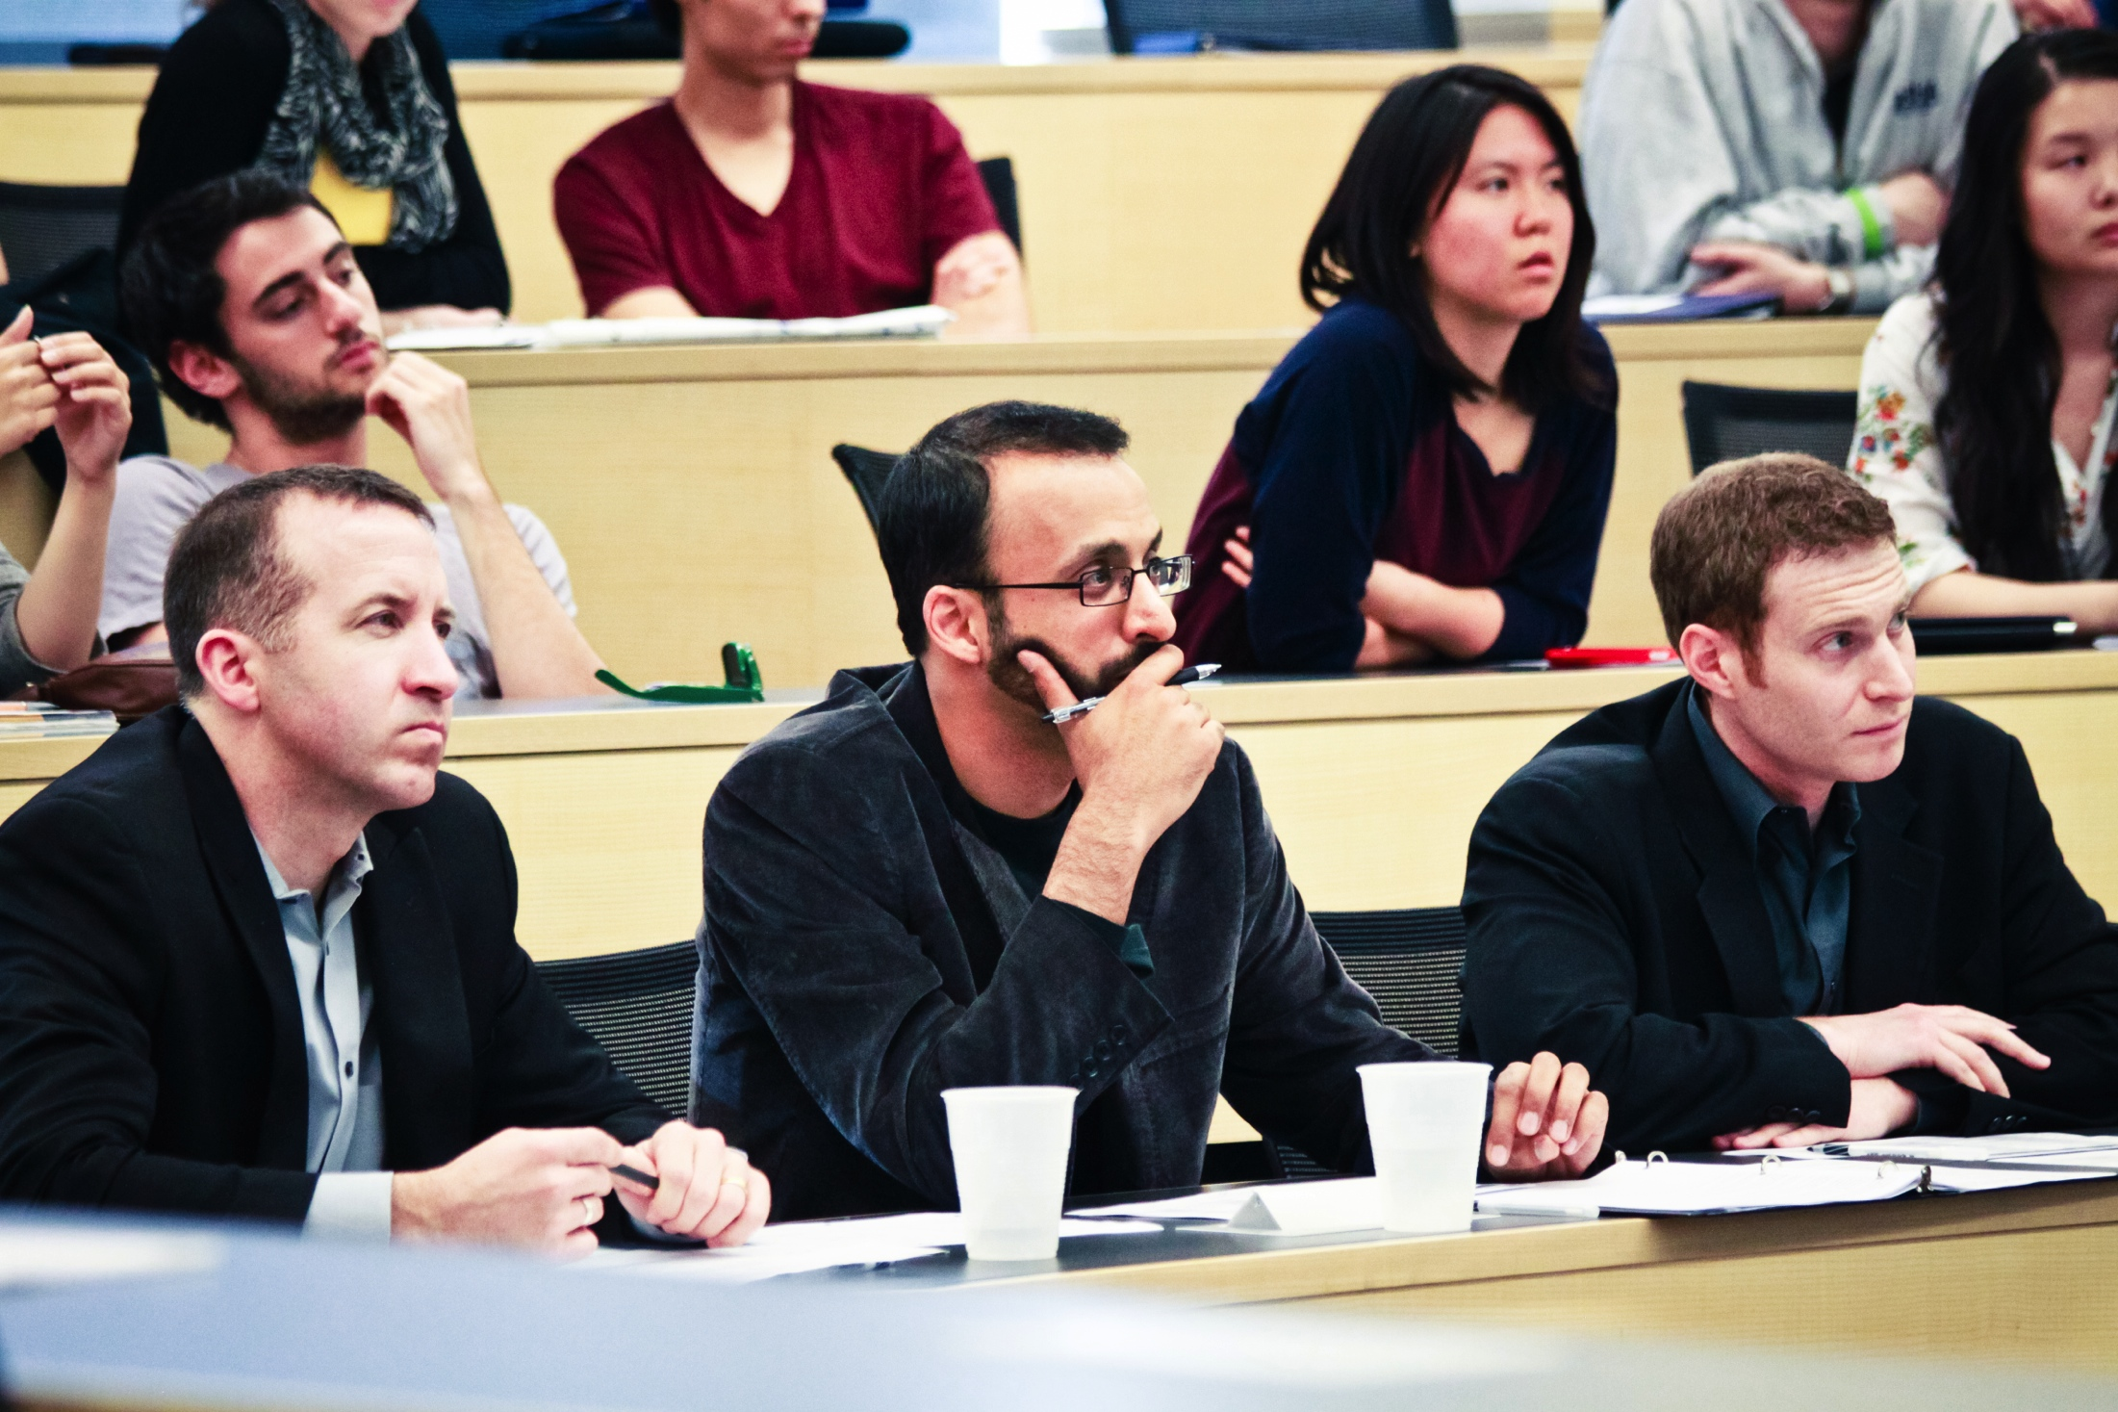
Edupreneurship: Building from Research
Notes:
Required - Main Body Slide

Slide 21
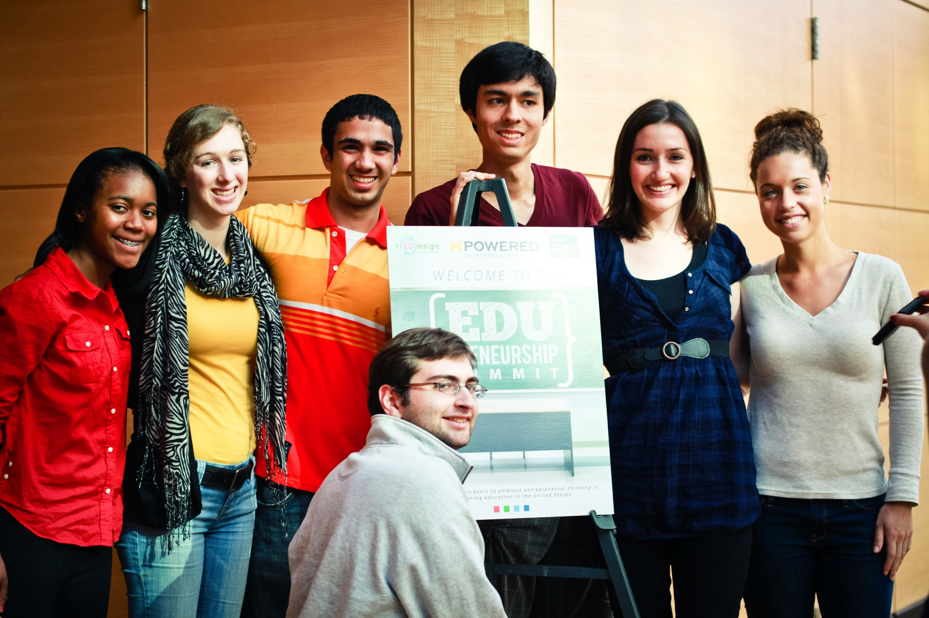
Edupreneurship: Building from Research
Notes:
Required - Main Body Slide

Slide 22
http://www.sageonstage.com http://www.lecturetools.com
Perry Samson
University of Michigan
samson@umich.edu
Notes:
Required – End Slide

