Slide 1
What's Next for Emerging Technologies that Support Teaching and Learning?
Anastasia (Stacy) Morrone, Dean, Information Technology; Associate Vice President, Learning Technologies, Indiana University‐Purdue University Indianapolis
October 3, 2012
Notes:
Required – Title Slide

Slide 2
Indiana University recently launched a two‐year pilot program to assess multiple learning technologies.
In this session, we will describe our process for conducting and evaluating the pilots over the next two years.

Slide 3
Poll #1
Replace this slide with poll #1

Slide 4
Next.iu.edu
Notes:
Optional – Agenda Slide – Option 2
Instead of using the agenda template on the previous slide, you also have the option to use this section break template to place sub titles or section breaks within your presentation.

Slide 5
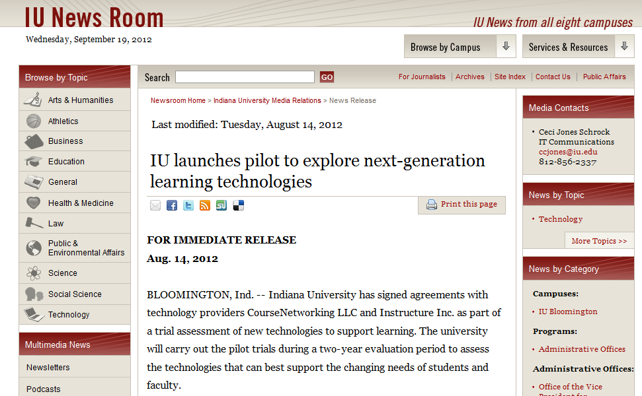
IU launches pilot to explore next-generation learning technologies
Notes:
Optional – Plain White
For full screen images and charts.

Slide 6
Fall 2012 Pilots
Notes:
Optional – Agenda Slide – Option 2
Instead of using the agenda template on the previous slide, you also have the option to use this section break template to place sub titles or section breaks within your presentation.

Slide 7
What needed to happen next?
Determine the types of learning technologies that will be considered
Develop a process for technical review of piloted tools and systems
Develop a process for functional review of piloted tools and systems
Develop an evaluation plan

Slide 8
Determine the types of pilots
Notes:
Optional – Agenda Slide – Option 2
Instead of using the agenda template on the previous slide, you also have the option to use this section break template to place sub titles or section breaks within your presentation.

Slide 9
IU's Next Learning Technologies
Learning & Teaching Activity Management
Content Creation, Sharing, and Reuse
Assessment, Portfolio, and Analytics
Communication, Collaboration and Social Networking
eTexts, Open Content, and Repositories
Notes:
Optional – Plain White
For full screen images and charts.

Slide 10
Poll #2
Replace this slide with poll #2

Slide 11
Develop a process for technical review
Technical reviews will assess the state, risk and technical viability of the application by reviewing the technology stack, standards, development methodologies and platforms for reliable, serviceable and highly available applications.
Notes:
Optional – Agenda Slide – Option 2
Instead of using the agenda template on the previous slide, you also have the option to use this section break template to place sub titles or section breaks within your presentation.

Slide 12
Technical review criteria
Virtualized
Interoperable
Integral
Standards
Tooling
Scale
Availability
Usability
Licensing
Accessibility

Slide 13
Develop a process for functional review
An informal/triage review will be conducted for any product being seriously considered for the pilot. A formal review will commence as soon as the pilot has been approved. A template for conducting the functional review will be used.
Notes:
Optional – Agenda Slide – Option 2
Instead of using the agenda template on the previous slide, you also have the option to use this section break template to place sub titles or section breaks within your presentation.

Slide 14
Functional reviews will include:
an executive summary offering highlights of the review and a narrative assessment of the overall suitability of the tool/system for its intended purpose(s )
a matrix indicating the degree to which the primary business requirements and specific user needs for the system/tool are met
descriptions of the tool/system’s major features, as well as significant strengths and weakness

Slide 15
Develop an evaluation plan
The Center for Evaluation and Education Policy (CEEP) at Indiana University is conducting the formal evaluation of the pilots. The research will include faculty and student surveys, student focus groups, and faculty interviews.
Notes:
Optional – Agenda Slide – Option 2
Instead of using the agenda template on the previous slide, you also have the option to use this section break template to place sub titles or section breaks within your presentation.

Slide 16
Evaluation plan deliverables and timeline
 | Aug | Sept | Oct | Nov | Dec | Jan
Refinement of Evaluation Plan
Development of instruments and protocol
Administration of online student surveys
Student focus groups
Faculty interviews
Administration of online faculty surveys
Data analyses
Final Report; Discussion of Possible Future Steps/Studies

Slide 17
“Assessment of these technologies and others will enable our students and faculty to evaluate what combinations of institutional, cloud, open source and commercial tools can best serve IU's future," said Brad Wheeler, vice president of IT and CIO at Indiana University.

Slide 19
What's Next for Emerging Technologies that Support Teaching and Learning?
Anastasia (Stacy) Morrone
amorrone@iu.edu
Notes:
Required – End Slide

