Slide 1
WHY INTERVENTION AND IMPACT EVALUATION IS CRITICAL FOR IMPROVING STUDENT LEARNING
Raymond Fleming
University of Wisconsin – Milwaukee
J.D. Walker
University of Minnesota
February 4, 2013
3:45 pm

Slide 2
PLAN FOR THE SESSION: TWO ELI CASE STUDIES
Research on:
Tech-enhanced learning spaces (Minnesota)
U-Pace instruction (Wisconsin-Milwaukee)
Lessons learned:
Improving research itself
Affecting institutional practice

Slide 3
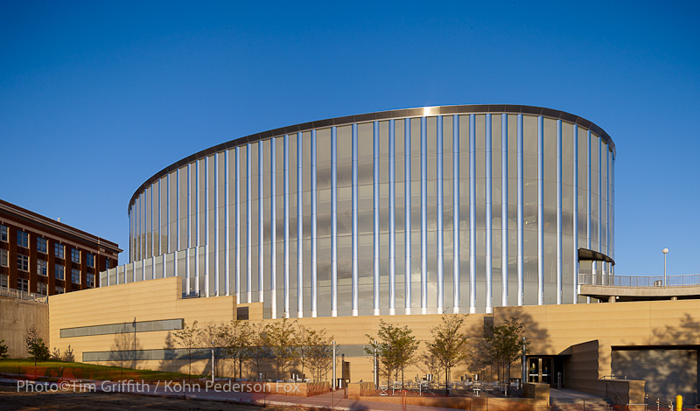
CASE STUDY – ACTIVE LEARNING CLASSROOMS AT THE UNIVERSITY OF MINNESOTA

Slide 4
ALC RESEARCH: PILOT PHASE
Strong student engagement
Changed student-student, student-teacher relationships
Good effects of new physical layout

Slide 5
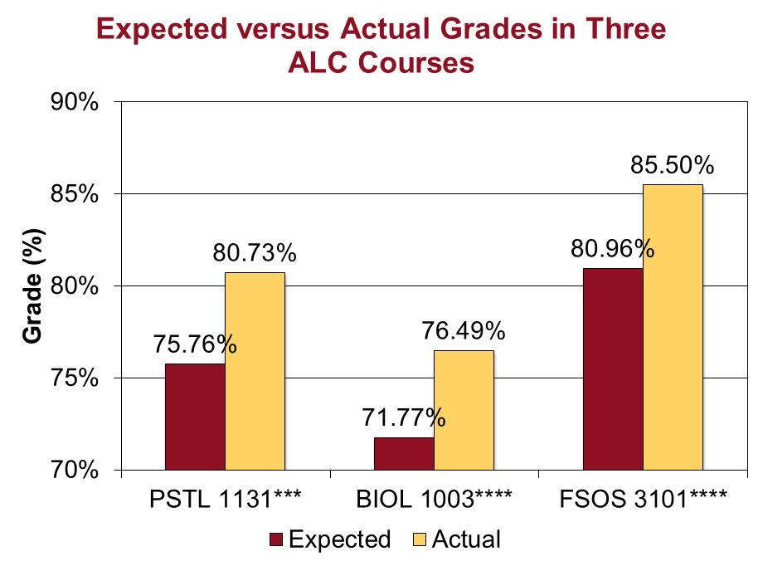
ALC RESEARCH: COMPARISON PHASE

Slide 6
ALC RESEARCH: EXTENSION-REPLICATION PHASE
Broadening data set – external validity

Slide 7
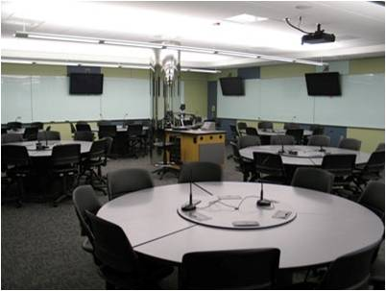
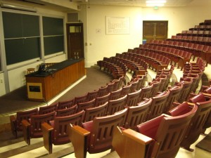
ALC RESEARCH: EXTENSION-REPLICATION PHASE
Hybridizing large Chemistry course

Slide 8
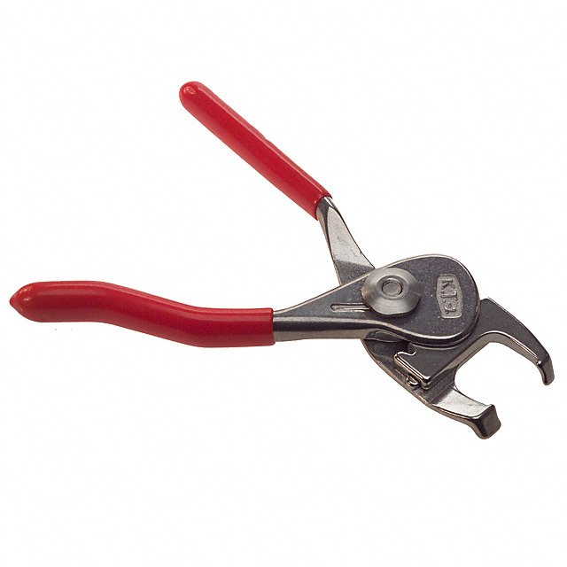
ALC RESEARCH: LESSONS LEARNED
Specialize – focus your investigations
Learn from others’ work

Slide 9
ALC RESEARCH: LESSONS LEARNED
Compare things!
2.59/4.00

Slide 10
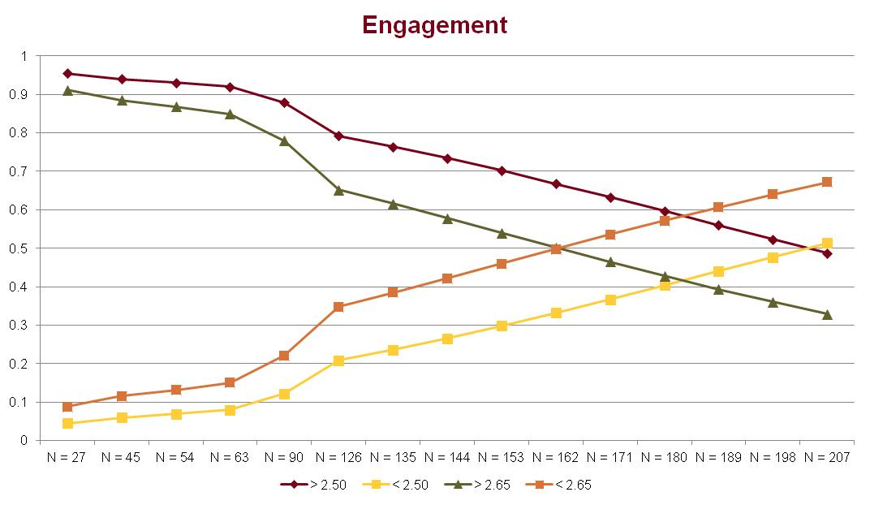
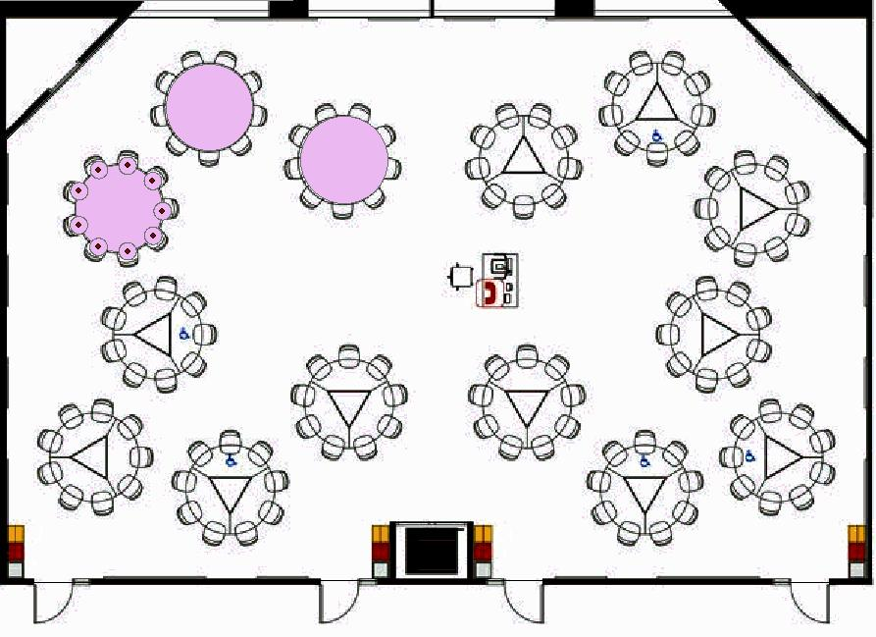
ALC RESEARCH: LESSONS LEARNED
Understand mechanisms: educational alliances, room size, instructor behavior.

Slide 11
ALC RESEARCH: QUESTIONS

Slide 12
IMPORTANCE OF SEEKING EVIDENCE OF IMPACT
Intervention Outcomes

Slide 13
WHAT ARE THE INTERVENTION’S ACTIVE INGREDIENTS?
Intervention Outcomes
U-Pace Instruction
*Mastery-based
*Amplified Assistance

Slide 14
DOES THE INTERVENTION LEAD TO THE EXPECTED MEASURABLE OUTCOMES?
Intervention Outcomes
U-Pace Instruction
*Mastery-based
*Amplified Assistance
*Academic Success
*Deeper Learning

Slide 15
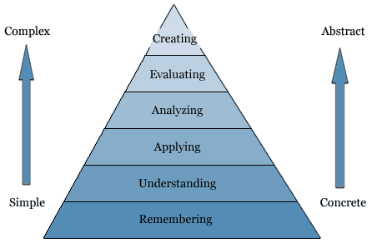
MEASUREMENT OF STUDENT OUTCOMES
All final grades were objectively determined
The assessments of student learning were developed with Bloom’s Revised Taxonomy as a framework
Students who earned a final grade of A or B understood the concepts at a deep level
Notes:
Questions were developed to tap conceptual knowledge
Rather than factual knowledge
And to require higher-level thinking.

Slide 16
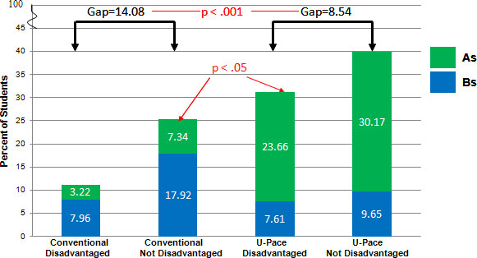
PERCENT OF U-PACE AND CONVENTIONALLY TAUGHT STUDENTS EARNING AS AND BS BY DISADVANTAGED STATUS
Journal of Asynchronous Learning Networks (in press).
Notes:
Disadvantaged status was defined by:
Being eligible for Federal Pell Grants
Being a member of an ethnic or racial group at risk for college noncompletion

Slide 17
IMPACT OF U-PACE INSTRUCTION ON STUDENT LEARNING: PERFORMANCE ON TWO CUMULATIVE EXAMS
EDUCAUSE Quarterly, 34(4): www.educause.edu/library/EQM1140
Notes:
Randomly selected students from U-Pace and F2F sections of Psych 101 took a cumulative exam in a proctored classroom.

Slide 18
WHY DOES THE INTERVENTION WORK?
It is critical to know both that technology-enabled interventions work, and why they work.
In other words,
what are the mediators of the effects of
U-Pace instruction?

Slide 19
WHY DOES THE INTERVENTION WORK?
Intervention Outcomes
U-Pace Instruction
*Mastery-based
*Amplified Assistance
*Academic Success
*Deeper Learning
Mediators
*Engagement
*Sense of Control

Slide 20
DID THE INTERVENTION IMPACT
STUDENT ENGAGEMENT?

Slide 21
DOES THE INTERVENTION IMPACT
PERCEIVED CONTROL OVER LEARNING?

Slide 22
WHY DOES THE INTERVENTION WORK?
Intervention Outcomes
U-Pace Instruction
*Mastery-based
*Amplified Assistance
*Academic Success
*Deeper Learning
Mediators
*Engagement
*Sense of Control

Slide 23
EVIDENCE-BASED OUTCOMES
INFORM CHANGE IN TEACHING AND LEARNING
Change
*Students
*Faculty
*University
Intervention Outcomes
U-Pace Instruction
*Mastery-based
*Amplified Assistance
*Academic Success
*Deeper Learning
Mediators
*Engagement
*Sense of Control

Slide 24
WHAT CHANGES HAVE RESULTED FROM
THE EVIDENCE SUPPORTING U-PACE INSTRUCTION?
Stimulated the development of more U-Pace Courses
Improved quality of Face-to-Face instruction and
measurement of student outcomes
Influenced the self-paced, competency-based nature
of UWM’s new Flex Degree program and
program evaluation strategies
Shaped student advising toward more high quality,
proactive communication
Notes:
Soc, political science, english, environmental science, math
Focusing on both WHAT we are doing and how we can improve has led to 2.
3.
4. U-Pace has cultivated a climate that focuses on evidence-based outcomes and quality

Slide 25
THE INQUIRY CYCLE CAN RESULT IN POSITIVE CHANGE IN TEACHING AND LEARNING
Change
*Students
*Faculty
*Administration
Intervention Outcomes
U-Pace Instruction
*Mastery-based
*Amplified Assistance
*Academic Success
*Deeper Learning
Mediators
*Engagement
*Sense of Control

Slide 26
U-PACE: Questions

Slide 27
ACKNOWLEDGMENTS
U of Minnesota Learning Spaces Research was supported by partners from OIT, OIR, OCM, OMS, and CTL at the University of Minnesota.
U-Pace research was supported by grants from:
EDUCAUSE Next Generation Learning Challenges and the
U.S. Department of Education's Institute of Education Sciences

Slide 28
RESOURCES
U of Minnesota Learning Spaces Research: http://z.umn.edu/lsr
U-Pace website:
www.u-pace.uwm.edu

