Slide 1
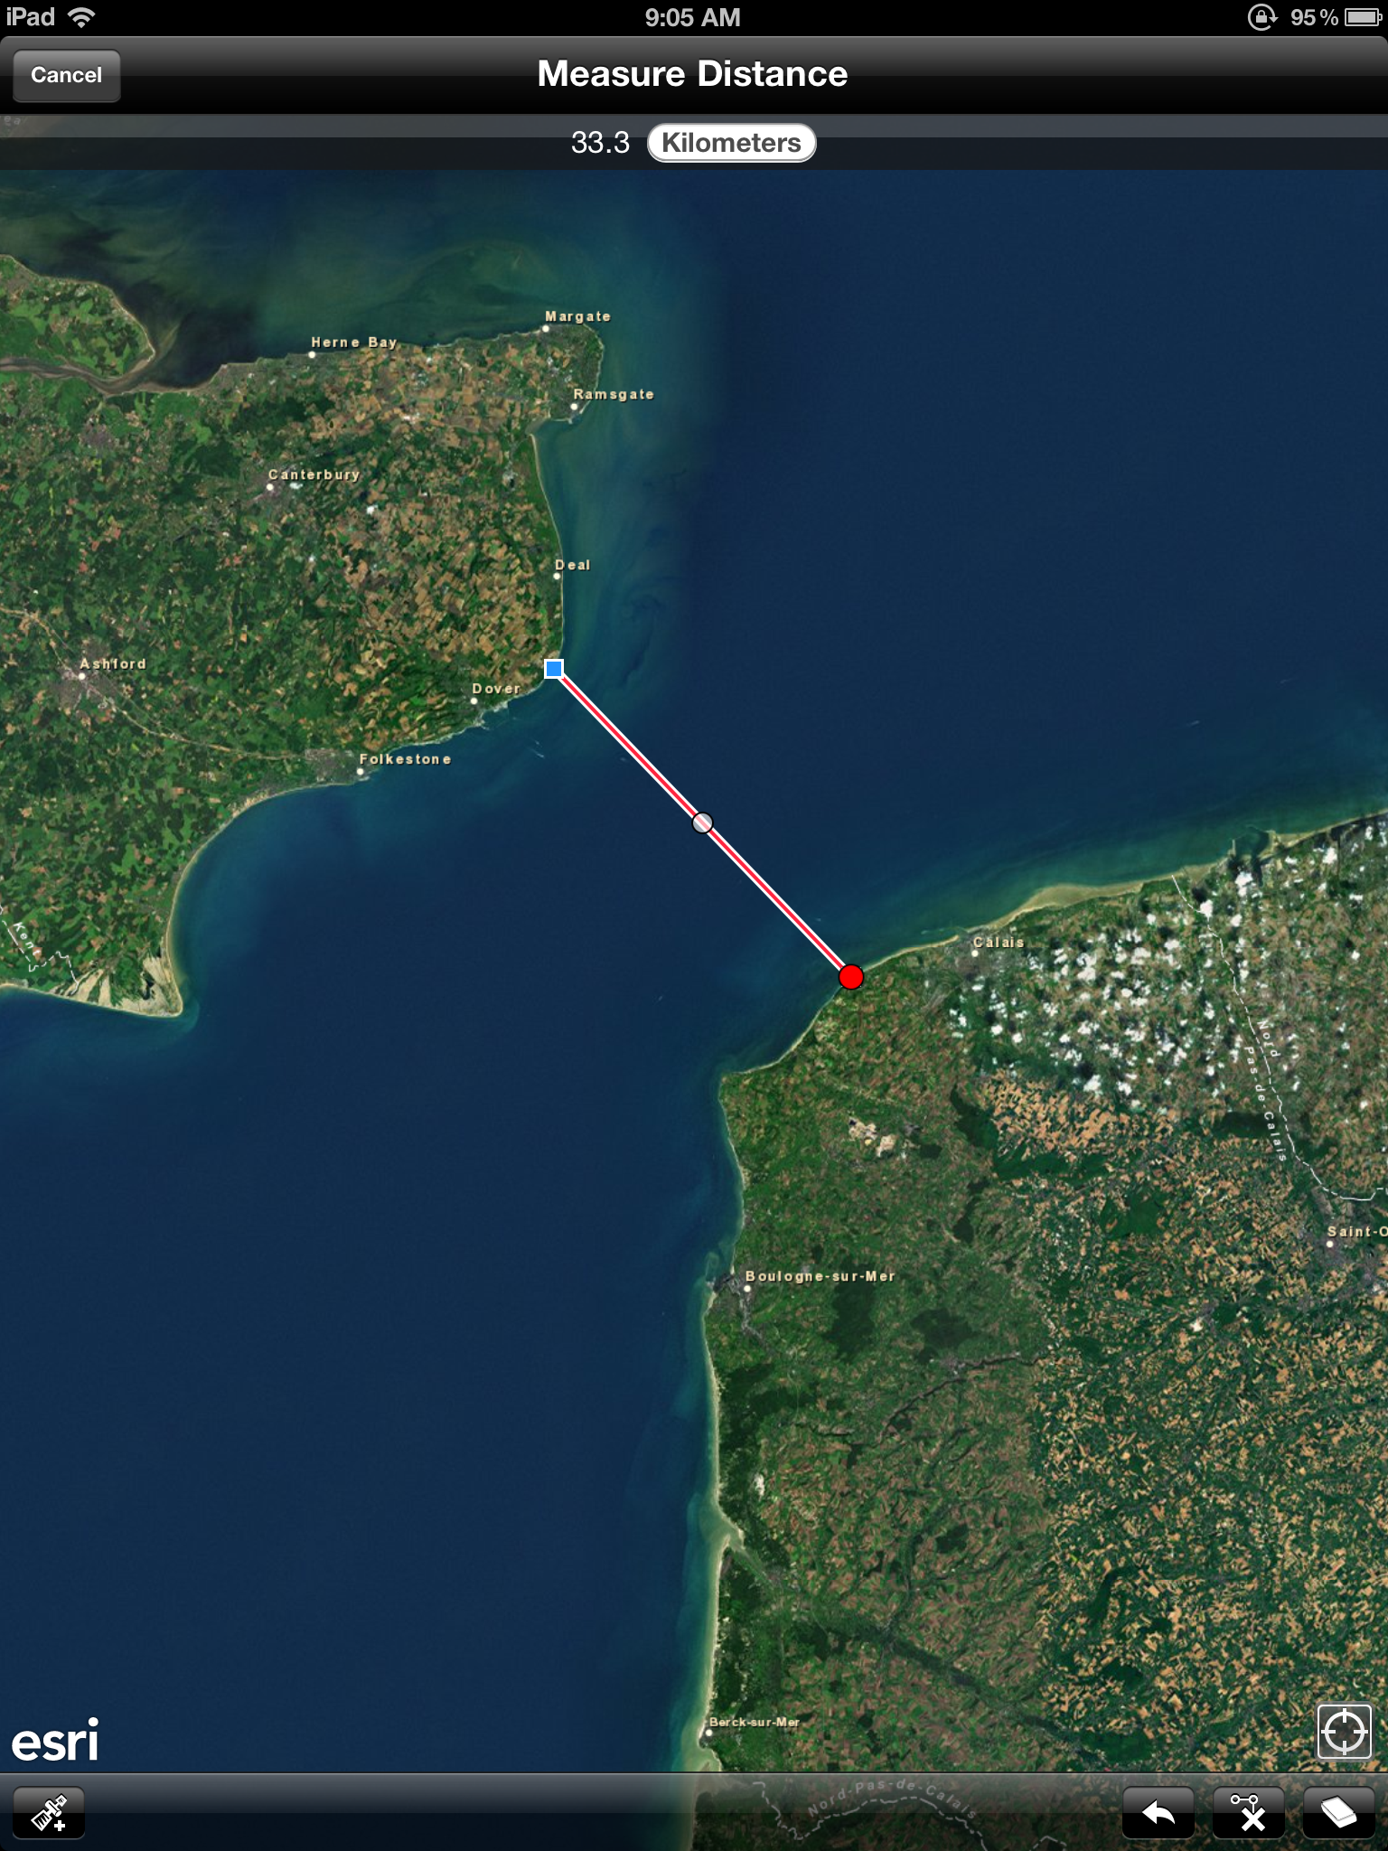
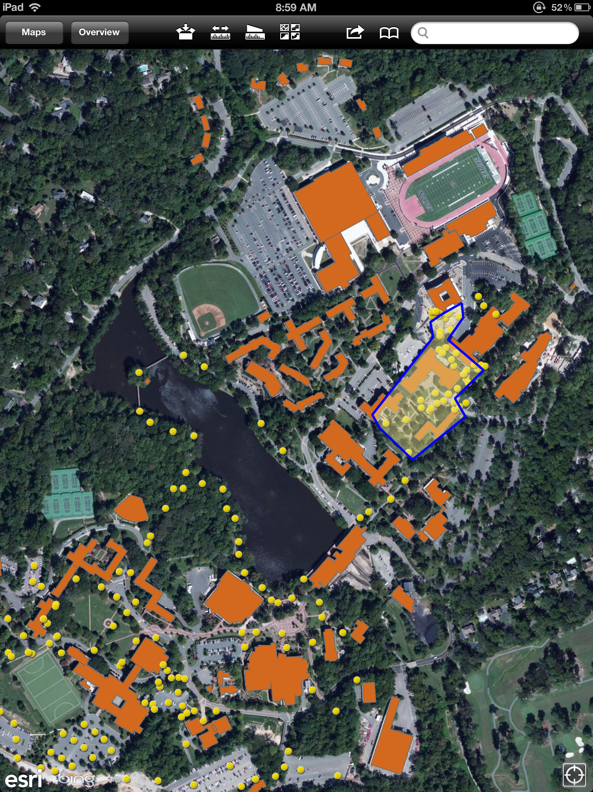
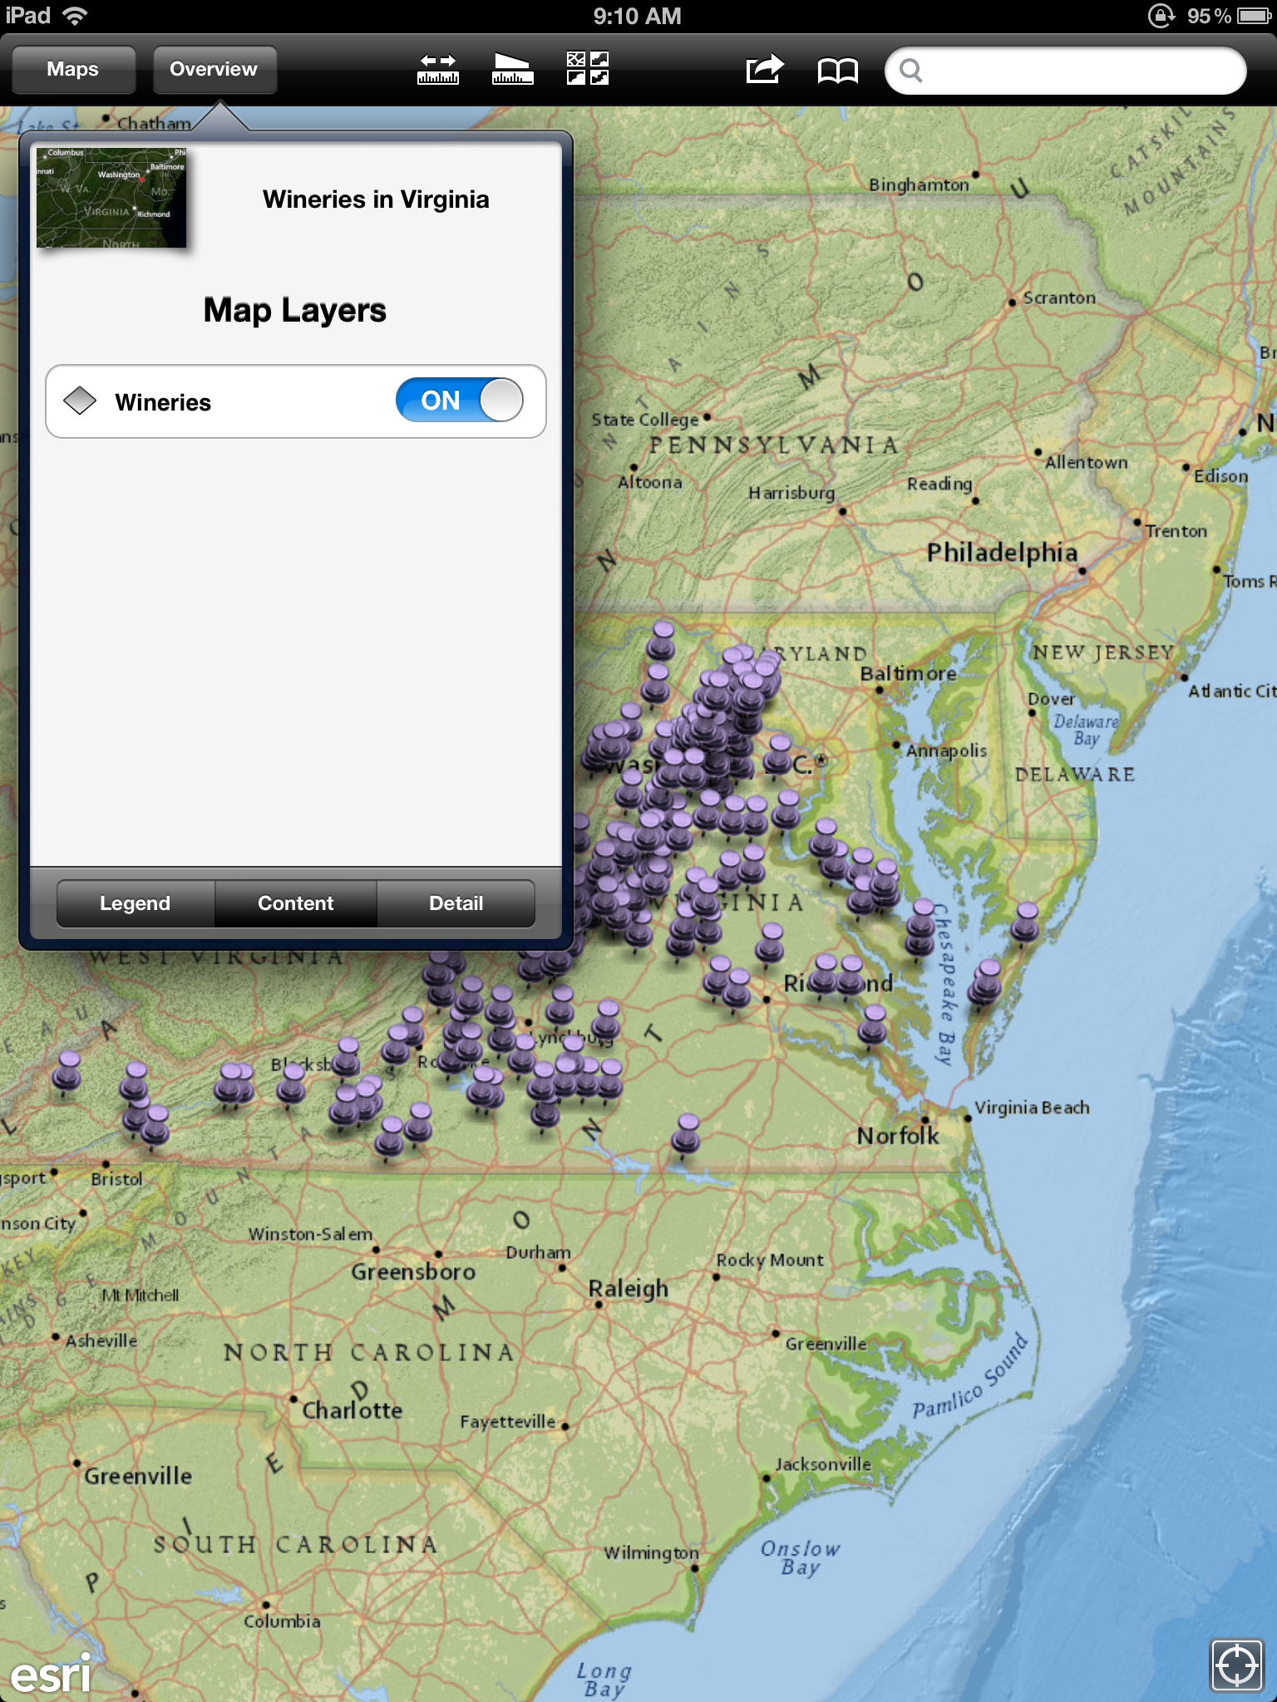
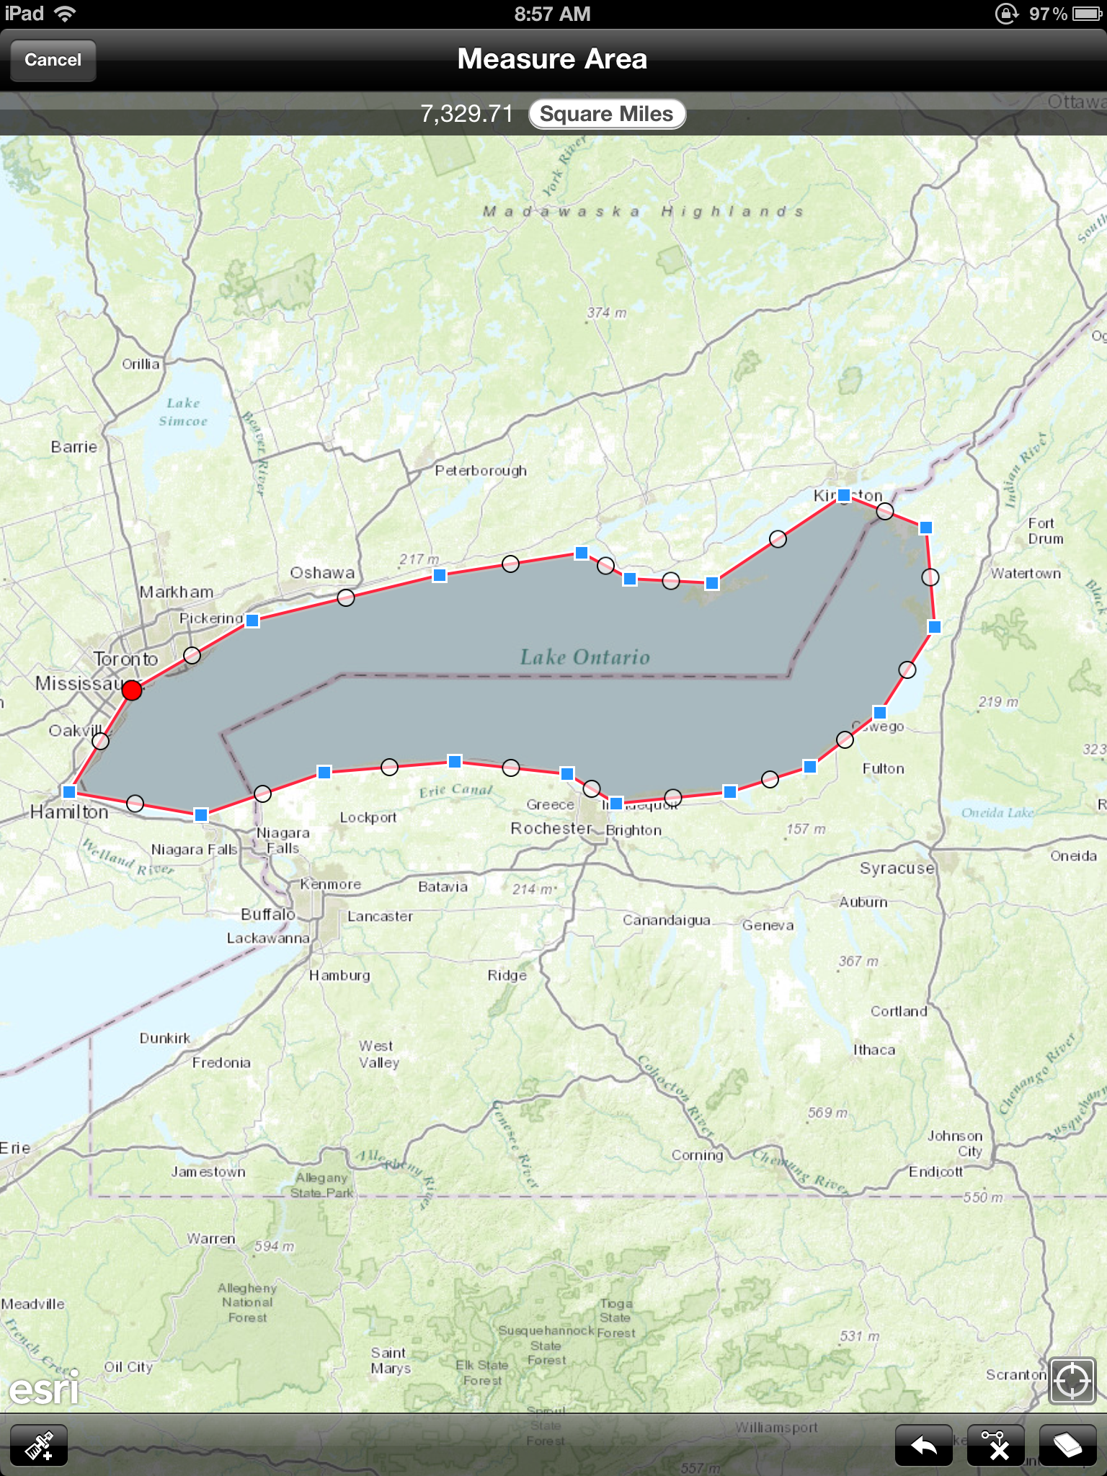
ArcGIS Online: Easily Accessible Content for Your Mobile Device
Nick Cammarano
Center for Teaching, Learning and Technology, University of Richmond, VA 23173
CTLT
Visualization & Collaboration Tool
Working With Layers
Measuring Distance & Area
Although the ArcGIS app is an excellent visualization tool, it also allows users to add data with an iOS device using the GPS
Layers work in much the same way as the desktop version of ArcGIS. Layers can be added and edited via the iOS app. Layers can be turned on and off easily within the app’s interface.
capabilities of the device. Data can be added by multiple users on the same map. In this way, collaborators can create dynamic maps quickly and easily. In addition to using the iOS app, map data can also be added via the ArcGIS website. Maps can even be created within the full ArcGIS software and ported to the cloud or accessed from your own ArcGIS server and vice versa.
The map to the left is an example of using the “Measure Distance” tool using the shortest distance across the English Channel (Dover Strait). Visually picking out features can result in fairly close approximations. The known distance across the Dover Strait is 34 km.
The map to the right is an example of the “Measure Area” tool using Lake Ontario as an example. Again a visual approximation was used to place points around the lake with a fairly accurate approximation. The known area of Lake Ontario is 7,340 sq mi.
The map above details the University of Richmond campus with a buildings layer (orange spaces), and a lights layer (yellow dots) indicating where buildings and street lights are located.
The map above shows a “Wineries” layer on a map of Virginia with the “National Geographic” background. All layers are listed in the “Overview” tab. The Overview tab also has a section dedicated to the legend as well as any notes added to the map.

