Slide 1
Turning Big Data Analytics into Personal Student Data
Michael L. Mathews, Lone Star College, University Park
Shah Ardalan, President, Lone Star College, University Park
Sandra DeCastro, IMS Global Learning Consortium
February 5, 2013
Notes:
Required – Title Slide

Slide 2
Big Data solves big problems
The mystery … connecting big data to personal life.
Taking Big Data into a personal level
Examples of personal data simplified
Conclusion
Q & A
Notes:
Optional - Agenda Slide – Option 1
This slide is designed for you show participants where you are throughout the presentation. To use this, start off by typing your full agenda. Then, duplicate the slide by the number of agenda items that you have. Move each duplicate to the section breaks in your presentation. In each duplicate copy, pick up the blue bar and place it over the appropriate agenda item and change the text over the bar to white, leaving the rest of the agenda in grey. This allows participants to see what’s coming up next, how close it is to the end.

Slide 3
Big Data … Can solve big problems
Notes:
Optional – Agenda Slide – Option 2
Instead of using the agenda template on the previous slide, you also have the option to use this section break template to place sub titles or section breaks within your presentation.

Slide 4
Notes:
Required - Main Body Slide

Slide 5
Quantum Computing
Notes:
Optional – Main Body Slide Option B
No header background image.

Slide 6
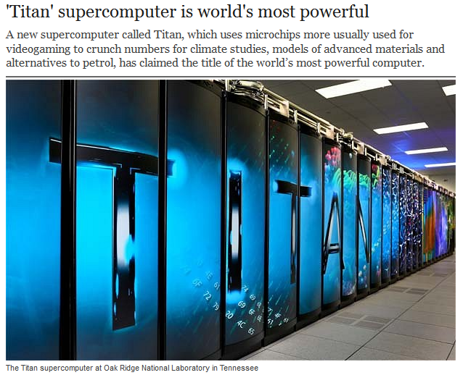

Slide 7
Education
Harvard and MIT combining forces to make all online courses free - MOOC
MOOC – Massive Open Online Courses
Notes:
Optional – Plain White
For full screen images and charts.

Slide 8
The Mystery
Why is education getting worse as technology becomes faster and bigger?
Why is the U.S. GDP still hanging around 2.0?
Why is the unemployment rate not reduced to an acceptable level?
Why are there 2.5 million unfilled jobs in the U.S.?
Notes:
Required – End Slide

Slide 9
The Mystery
We enjoying talking about …
Cloud Computing
Software as a Service (SaaS
Big Data
BYOD

Slide 10
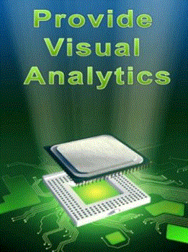
However
Few know how to personalize BIG DATA

Slide 11
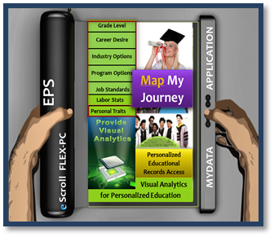
Lone Star College System – Educational and Career Positioning System

Slide 14
Personal Data
Labor Data
School Data

Slide 15
Individual Ownership
Require that eighty million students have hope that they can access and analyze their personal data against the national data, on a daily basis.

Slide 16
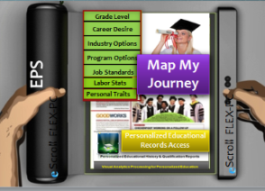
Individual Ownership
It’s time for every student to simulate, navigate, and visualize their part in the future of a successful U.S. Economy

Slide 17
Personal education and career ownership via visual navigation
Has Potential to Produce
An increase in annual U.S. GDP
An increase in annual employment
An increase in annual global markets
An increase in workforce satisfaction
A proven economic growth model for all major metropolitan areas

Slide 18
Samples of Personalizing Big Data

Slide 19
MyData Button Initiative

Slide 21
Conclusion
Big and Personal Problems can be solved
With alignment of education to workforce
Big Data is turned into personal analytics
BYOD is turned into BYOA
GDP can be increased, unemployment
reduced, and good jobs filled

Slide 22
Economic Value – Educational Alignment
In 2011 the U.S. created 1.6 million jobs, during which time GDP grew at 2.0 percent.
Annual GDP needs to grow at 3.5 percent to stimulate significant job growth. This would require an additional 800k jobs in the same time period.
Sources: Econedlink, World Economic Forum report; 2012 Deloitte

Slide 23
Economic – Educational Misalignment
There were 2.0 million U.S. jobs unfilled (skills gap) due to lack of alignment.
If educational navigation and alignment had been in place between 2009 – 2011,
Potentially filling 1.0 million additional jobs.
Potentially increasing U.S.GDP to 3.7% in 2012.

Slide 24
Contacts
Mydatabutton.com
Eps4.me
Michael.mathews@LoneStar.edu
Shah.Ardalan@LoneStar.edu
sdecastro@imsglobal.org

