Slide 1
“Sometimes when you innovate, you make mistakes. It is best to admit them quickly, and get on with improving your other innovations.”
― Steve Jobs

Slide 2
“Innovation is not the product of logical thought, although the result is tied to logical structure.”
―Albert Einstein

Slide 3
“Take chances, make mistakes, get messy!”
― Ms. Frizzle, The Magic School Bus

Slide 4
“I am interested in seeing your results! I like the scavenger hunt idea for a conference poster.”
― Scavenger Hunt Participant

Slide 5
“Innovation! One cannot be forever innovating. I want to create classics.”
―Coco Chanel

Slide 6
“It's easy to come up with new ideas; the hard part is letting go of what worked for you two years ago, but will soon be out of date.”
―Roger von Oech

Slide 7
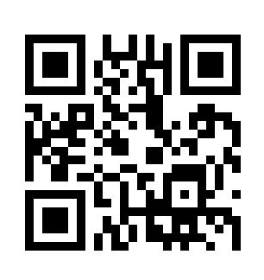
Follow this link to a crossword puzzle about innovation. (Be prepared to use the built-in hints! ☺)

Slide 8
“The essential part of creativity is not being afraid to fail.”
―Edwin H. Land

Slide 9
“Innovation―any new idea―by definition will not be accepted at first. It takes repeated attempts, endless demonstrations, monotonous rehearsals before innovation can be accepted and internalized by an organization. This requires courageous patience.”
―Warren Bennis

Slide 10
“If you’re in control, you’re not going fast enough.”
―Parnelli Jones

Slide 11
“Innovation distinguishes between a leader and a follower.”
―Steve Jobs

Slide 12
“I loved doing this - please keep me on your list. This was awesome and now I want to research more and get into innovative processes.”
― Scavenger Hunt Participant

Slide 13
“An inventor is simply a person who doesn't take his education too seriously. You see, from the time a person is six years old until he graduates from college he has to take three or four examinations a year. If he flunks once, he is out. But an inventor is almost always failing. He tries and fails maybe a thousand times. If he succeeds once then he's in. These two things are diametrically opposite. We often say that the biggest job we have is to teach a newly hired employee how to fail intelligently. We have to train him to experiment over and over and to keep on trying and failing until he learns what will work.”
―Charles Kettering

Slide 14
“Innovation is the process of turning ideas into manufacturable and marketable form.”
―Watts Humprey

Slide 15
“If I had asked people what they wanted, they would have said faster horses.”
―Attributed to Henry Ford (But see http://blogs.hbr.org/cs/2011/08/henry_ford_never_said_the_fast.html.)

Slide 16
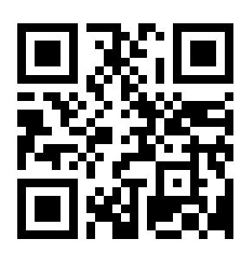
It’s not too late to play the scavenger hunt! We’ll update the results page with additional entries. (But it is too late to win a prize!)

Slide 17
“For a successful technology, reality must take precedence over public relations, for Nature cannot be fooled.”
―Richard P. Feynman

Slide 18
“This is a great idea. What fun!”
― Scavenger Hunt Participant

Slide 19
“Maintaining a consistent platform also helps improve product support―a significant problem in the software industry.”
―Bill Gates

Slide 20
“You win some, you lose some, you wreck some.”
―Dale Ernhardt , Sr.

Slide 21
“The winner is the chef who takes the same ingredients as everyone else and produces the best results.”
―Edward de Bono

Slide 22
“The real source of wealth and capital in this new era is not material things… it is the human mind, the human spirit, the human imagination, and our faith in the future.”
―Steve Forbes

Slide 23
“If I have a thousand ideas and only one turns out to be good, I'm satisfied.”
―Alfred Nobel

Slide 24
“Remember, computers and software do not innovate. People innovate.”
―http://bit.ly/UQWSSd

Slide 25
“Would love to see the results and this is a continuing issue at every institution I’ve been at….”
― Scavenger Hunt Participant

Slide 26
“Imagination is more important than knowledge.”
―Albert Einstein

